Slide 1
Schedule Management
Made by Henrique Fernandes, José Sousa e Leandro Martins

Slide 2
 | Table of contents
01 | 02 | 03
Introduction | Overview | Listing
04 | 05 | 06
Requests | Problems | Conclusion

Slide 3
Introduction

Slide 4



Overview of the structure

Slide 5
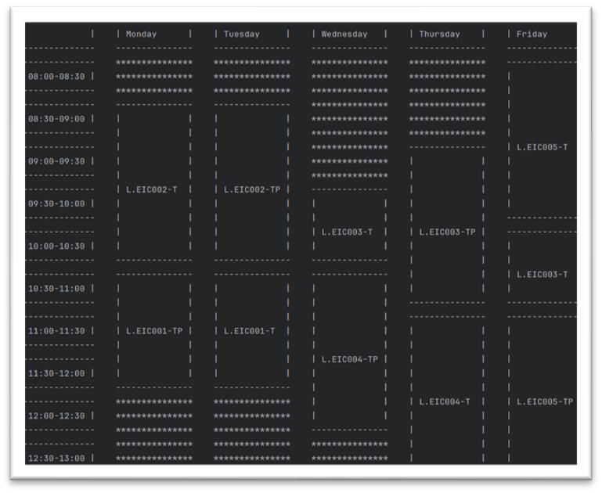
Listings
-See Schedules
-See Number of Students in n Ucs
-See Students
-See all UCs

Slide 6
Data Structures used
-Vector ex: LessonVector
-List ex: StudentGroupList
-Set ex: StudentSet

Slide 7
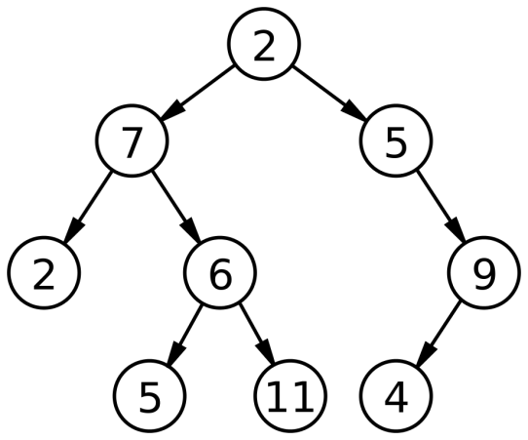
Why set?
-No duplicates
-Mantains order
-Fast Insertion and Search

Slide 8
Why vector?
-Random Acess
-Dynamic Size

Slide 9
Why lists?
-Fast Insertions and deletions

Slide 10
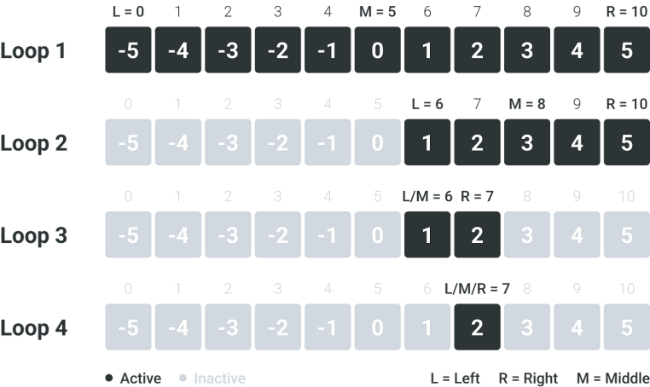
Algorithms used
-Linear Search
-Binary Search

Slide 11

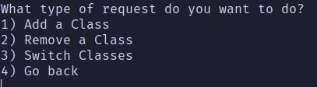
Requests
-Create requests
-Store requests
-Validate requests
-Process requests

Slide 12
Data Structures used
-Queue
ex: RequestsToProcess
-Stack
ex: ProcessedRequests

Slide 13
Why queue?
-Uses FIFO
-Enqueue and dequeue are fast

Slide 14
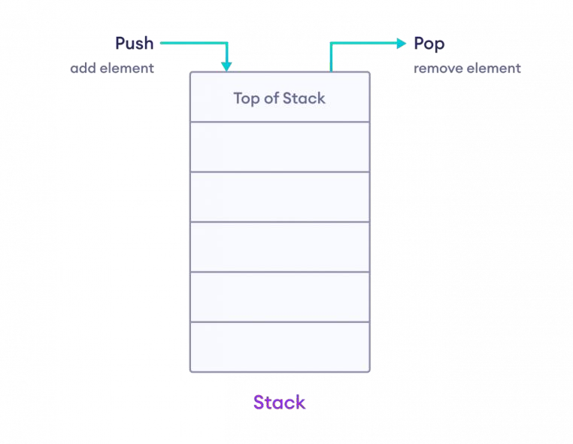
Why stack?
-Uses LIFO
-Undo/Redo Functionality

Slide 15
Algorithms used
-Linear Search
-Binary Search

Slide 16
Problems we faced
-Defining the structure
-Parsing data
-Displaying the Schedule
-Naming

Slide 17
Conclusion!

