Slide 1
ObserverNet
A Topological Prior Framework on Sea State Recognition
Presenter: Henry Shen, PIN 184A
Stevens Institute of Technology
Dept. of Civil, Environmental, and Ocean Engineering
Stevens Institute of Artificial Intelligence

Slide 2

Application motivation
The MU-SSiD is a dataset with clips from videos that evaluate CV models’ performance on classifying sea states.
Oceanographically, such classification is completed by separating and analyzing the main wave.
CV models for recognition help USV operations to deploy suitable countermeasures to unfavorable conditions.

Slide 3
Theoretical Motivation
Neural networks tend to overfit, especially with millions of parameters trained on dataset containing elements far smaller than its expressivity capacity.
Reducing the generalization gap (test performance – train performance) is crucial for industry applications to ensure the stability of the model.

Slide 4
Current Solutions
GoogLENet (~81%, >15% generalization gap)
MUSeNet (published with MU-SSiD) reaching 88.7, no statistical or overfitting report.
Remark: current models have millions of parameters; they are bound to overparameterize. They merely reach their accuracy bu pushing this test accuracy very high.

Slide 5
Research Gap Addressed
Can topological prior using reaction-diffusion equation mitigate gap?
Can a smaller model that can be better deployed to edge devices reach similar capacity?

Slide 6
Methodology
Establish baseline with conventional CNN
Establish calculation backbone for a topological prior (statistical voting as pooling)
Establish full framework with corresponding noise injection mechanism.
Ablation

Slide 7
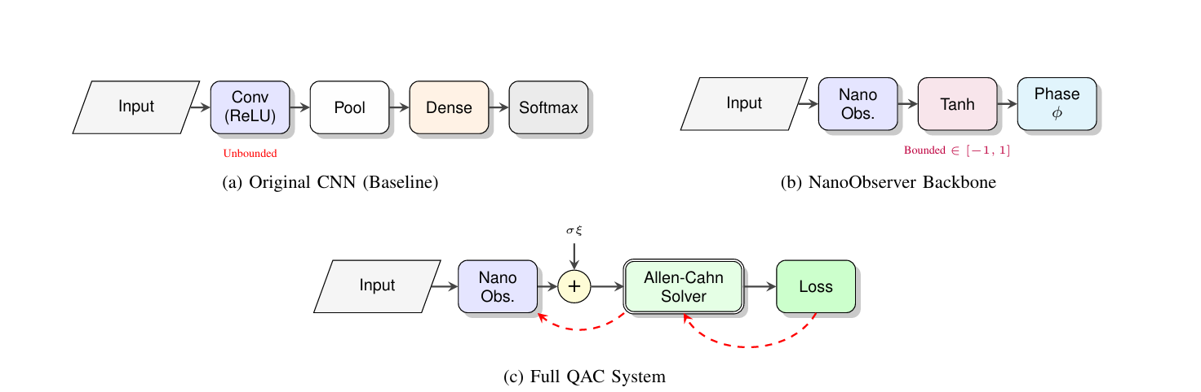
Architecture

Slide 8
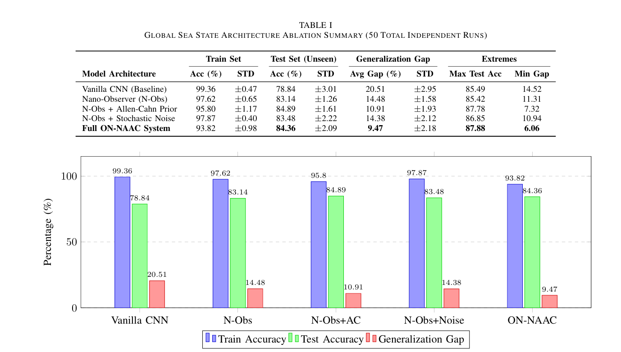
Training Results

Slide 9
Training Results Implications
The topological prior DOES improve generalization gap.
The injected noise itself cannot help regulatization without the PDE, which makes sense as it is designed to remove topological collapse.
The attractor voting itself is a very strong mechanism that greatly boosts the performance.

Slide 10
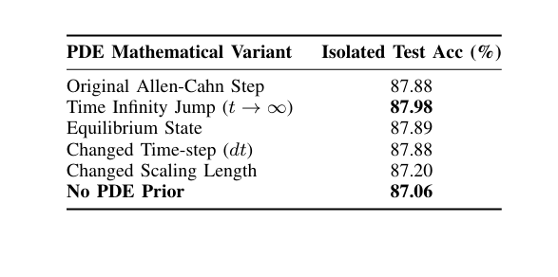
Artifact Results and Implications
The Allen Cahn prior has been imprinted, and the weights are essentially conditionally robust against changes to numerical integration.
The indicates accuracy preservation in quantization for deployment.

Slide 11
Contribution and Conclusion
We provided the ObserverNet framework, which uses topological prior to achieve near-SOTA performance with 80x less parameters.
We proved that under certain conditions, topological priors and statistical pooling for gradient cutoff are extremely beneficial for reduction of overfitting.
We provide a hardware-deployable artifact for naval operations for this specific CV task.

Slide 12
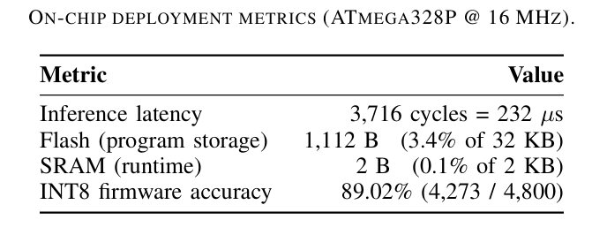
Further explorations by my team
Hardware deployment simulation showed very promising results.
ObserverNet generalizable across many tasks, such as RetinaMNIST.
PDE priors are the ONLY known viable method for ELMs to learn complex env.

Slide 13
Thank you!
Questions?

