Slide 1
STA130 Presentation
Women are credited less in science than men
The purpose of our presentation is to explain you about the study, and we hope to leave you with a better understanding of the topic and its importance.
Xuanqi Henry Wei, Riyad Veliyev, Shujun Chloe Yang, Nicolas Dias Martins

Slide 2
Presentation
Overview
Introduction
Background
Authors Interest
Study Significance
Methods
Study Design
Participation
Statistical Test

Slide 3
Results
From Administrative Data
From Qualitative Data
From the Survey
Conclusion
Most important message
Limitations
Future Directions
Q & A
Contribution

Slide 4
Introduction
Background
Gender differences in observed scientific output are well-documented: women both publish and patent less than men.
The possibility that women receive less recognition for their scientific contributions is not hypothetical. Example: Franklin (contribution in structure of DNA initially went unrecognized)
Some recent work has suggested that women are not less productive but rather that their work is undervalued.

Slide 5
Introduction
Author’s Interest (Purpose)
The gap might be a result of productivity differences; or might be owing to women’s contributions not being acknowledged, showing the causes of these differences are not well understood.
The analysis in this article uses new data on research teams to suggest that women are accorded less credit than men: they are systematically less likely to be named as authors on articles and patents.

Slide 6
Introduction
Significance
This well-documented gap between the observed number of works produced by women and by men in science, with clear consequences for the retention and promotion of women, which affect’s a person’s future and their prestige.

Slide 7
Methods
Data Construction and Variable Operationalization used in the analysis of Administrative Data：
1. Participants: employee in a laboratory between 2013 and 2016 from which an article or patent was published between 2014 and 2016.
2. Type of Study Design: observation study.
3. Three variables:
1) “Ever-author rate”: the proportion of individuals who have ever been identified as authors in a scientific publication
2) “Attribution rate”: the proportion at which people are credited as authors on a certain scientific article created by their team
3) “High-Impact attribution rate”: the proportion with which people are mentioned in any particular high-impact document
4. Statistical test: Two_side t-test to determine the result is reliable or not.

Slide 8
Methods
Analysing of Administrative Data：
1. Participants: 17,929,271 (around 18 million) potential article authorships.
3,203,831 (around 3 million) potential patent inventorships.
2. Type of Study Design: observation study.
3. Aim: To analysis whether women are much less likely to be named in articles.
4. Statistical test: Two side t-test to determine the result is reliable or not.

Slide 9
Methods
Construction of the Survey Data:
1. Participants: authors who appeared on at least one article in the Web of Science21 after 2014 and who had a published and available e-mail address.
2. Type of Study Design: observation study.
3. Aim: To find whether if Women are more likely to be underestimated or that there was discrimination which leads to women need making more contributions than men on authored papers in order to become a author.
4. Statistical test: Two side t-test to determine the result is reliable or not.

Slide 10
Methods
Qualitative Responses and Interviews
1. Participants: 887 Voluntary open-ended, written responses from scientist with 338 respondents volunteered to be interviewed.
2. Type of Study Design: observation study.
3. Aim: To listen scientists experience and opinions about discrimination and power imbalances.
4. Statistical test: None

Slide 11
Results from the Administrative Data
A total of 118 campuses from 36 universities are participating.
The earliest data dates to 2000, while the most recent data is from 2019.
Data = Payments of wages from individual grants during each pay period + each employee's job title.
Three measures for attribution:
'Ever-author' Rate
'Attribution' Rate
'High-Impact' Rate
Men's 'ever-author' rate is 21.17% while that of women's is 12.15% (due to women's junior positions in the teams)
'Ever-author' rate is not as comprehensive: "Franklin could have been named as an author on some articles or patents other than the DNA paper with Crick and Watson" (Ross et al., 2022)

Slide 12
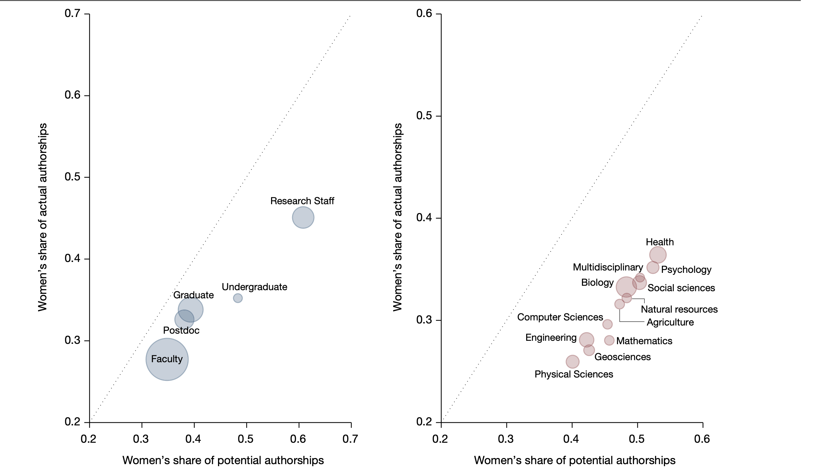
Results from the Administrative Data
'Attribution' Rate = "The possibility that a
woman receives credit for the scientific work
produced by specifically her own research
team."
A.R. =
On average,
1. Overall A.R. = 3.2%
2. Men’s A.R. = 4.23%
3. Women's A.R. = 2.11%
(P = 0.0000; two-sided t-test; test value = 19.5823, effect size = 2.11%)
Main factor: “The proportion of women in each position declines as the seniority of the position increases.” (Ross et al., 2022)
Actual Authorships
Potential Authorships

Slide 13
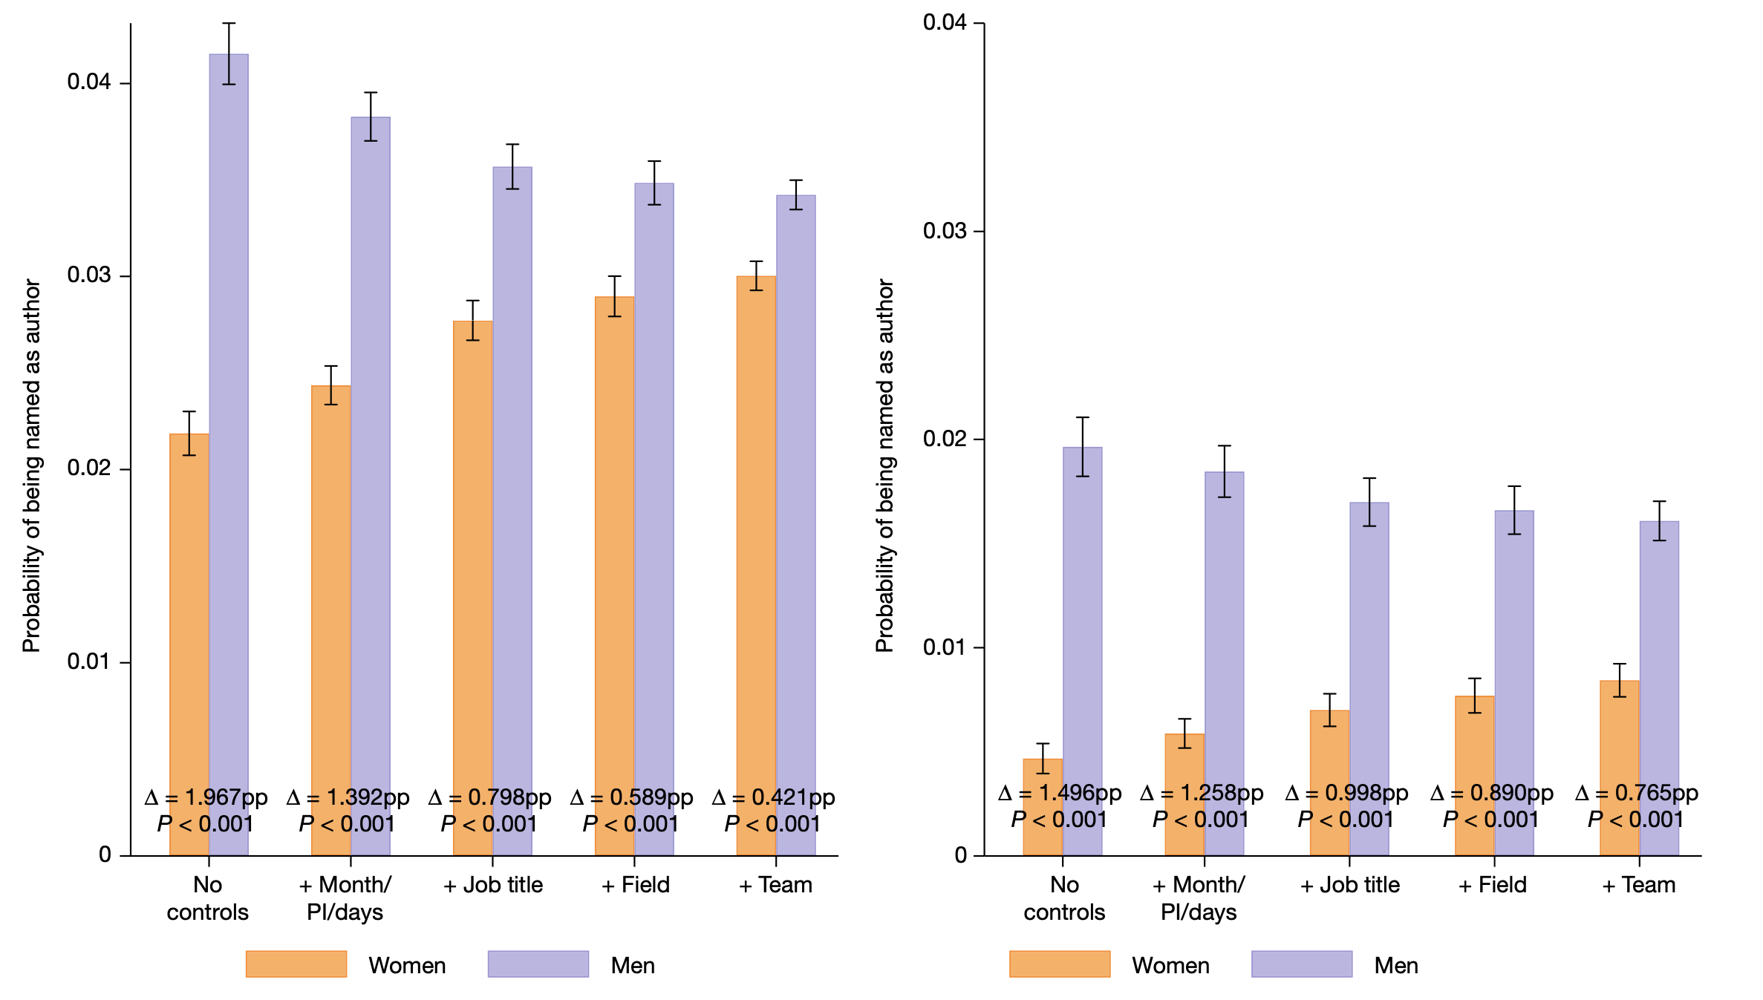
Results from the Administrative Data
Figure 2 presents the results of regression
models measuring gender differences. They
involve multiple controls: Months/PI/days of
work + Job title + Field + Team.
Even in the model involving all controls,
women are
1. 13.24% (P < 0.0001) less likely to be
named on articles.
2. 58.40% (P < 0.0001) less likely to be
named on patents.
There is no significant difference between the likelihood of a woman being named relative to a man on an article with zero citations (P = 0.1725). However, for more highly cited articles women are less likely than men to be named.

Slide 14
Results
From the Survey
2.
1.
3.
“Why do you believe you were not credited?”: out of 871 responses, the most common answer was that their scientific contributions were underestimated. This was the case for 48.97% of women and 39.13% of men, which is a significant difference. A two-sided t-test was executed, with a small p-value of 0.0036. Moreover, discrimination was twice as likely to be an answer for women (15.46%) than for men (7.67%). Again, a two-sided t-test was executed, with a very small p-value of 0.0003. These estimates (along with some other ones) suggest that a portion of the gender gap is due to either discrimination or underestimated contributions;
“Have you ever been excluded from a paper to which you had contributed?”: out of 2660 responses, it is clear that there is a gender difference - 42.95% of women and 37.81% of men have been excluded as an author of a paper. A two-sided t-test was executed, with a small p-value of 0.0151;
“What did you do to gain authorship on one of your most recent publications?”: on average, women have to do more than men in order to gain authorship on their publications. Out of 2297 responses (1371 men and 926 women), women reported a total 6.34 contributions on average compared with 6.11 contributions on average for men. A two-sided test was executed, with a small p-value of 0.0907.

Slide 15
Conclusion
Most Important Message
The key finding of this work, which is supported by all its sources, is that women in research teams are significantly less likely to be credited with authorship.

Slide 16
Conclusion
There are some limitations to this work:
01
02
03
Administrative
Data
Survey
Data
Different
Dimensions
The administrative data was gathered from research-intensive universities. Therefore, it may not be representative of research experiences for all teams and of all women;
There are many things that could have been done to unpack the results in different dimensions.
The sample for the survey data does not capture the experiences of researchers who were never mentioned as an author;

Slide 17
COnclusion
Future Directions
The researchers responsible for this work encourage other researchers to work with the data. Moreover, the data infrastructure highlighted throughout the work can be expanded by the addition of new universities and links to many data sources. In addition, the work can also be used to allow more investigation about how science is organized and to investigate the effect of policies instituted by research institutions on the retention and productivity of scientists, student placements, career trajectories and business startups. Finally, the data infrastructure can be replicated by other countries.

Slide 18
Member Contributions
Xuanqi Wei(Henry): Slides Making & Introduction (Background, Author Interest & Significance)
Shujun Yang(Chloe): Methods (Study Design, Participants & Statistical Test)
Riyad Veliyev: Results (Administrative Data & Qualitative Data) & the Supporting Facts
Nicolas Dias Martin: Results (Survey) & Conclusion (Findings, Limitation & Future Directions)

Slide 19
Thank you so much for listening!

