Slide 1
EPSON T3 SCARA Robot Analysis
Presentation

Slide 2
Introduction
Project Overview • Analysis of EPSON T3 SCARA Robot CAD model • Inspection of SolidWorks assembly • Identification of components and joints • DOF estimation • MATLAB/Simulink motion analysis • Workspace and applications Objective: Understand how a CAD assembly is interpreted as a practical robotic system.

Slide 3
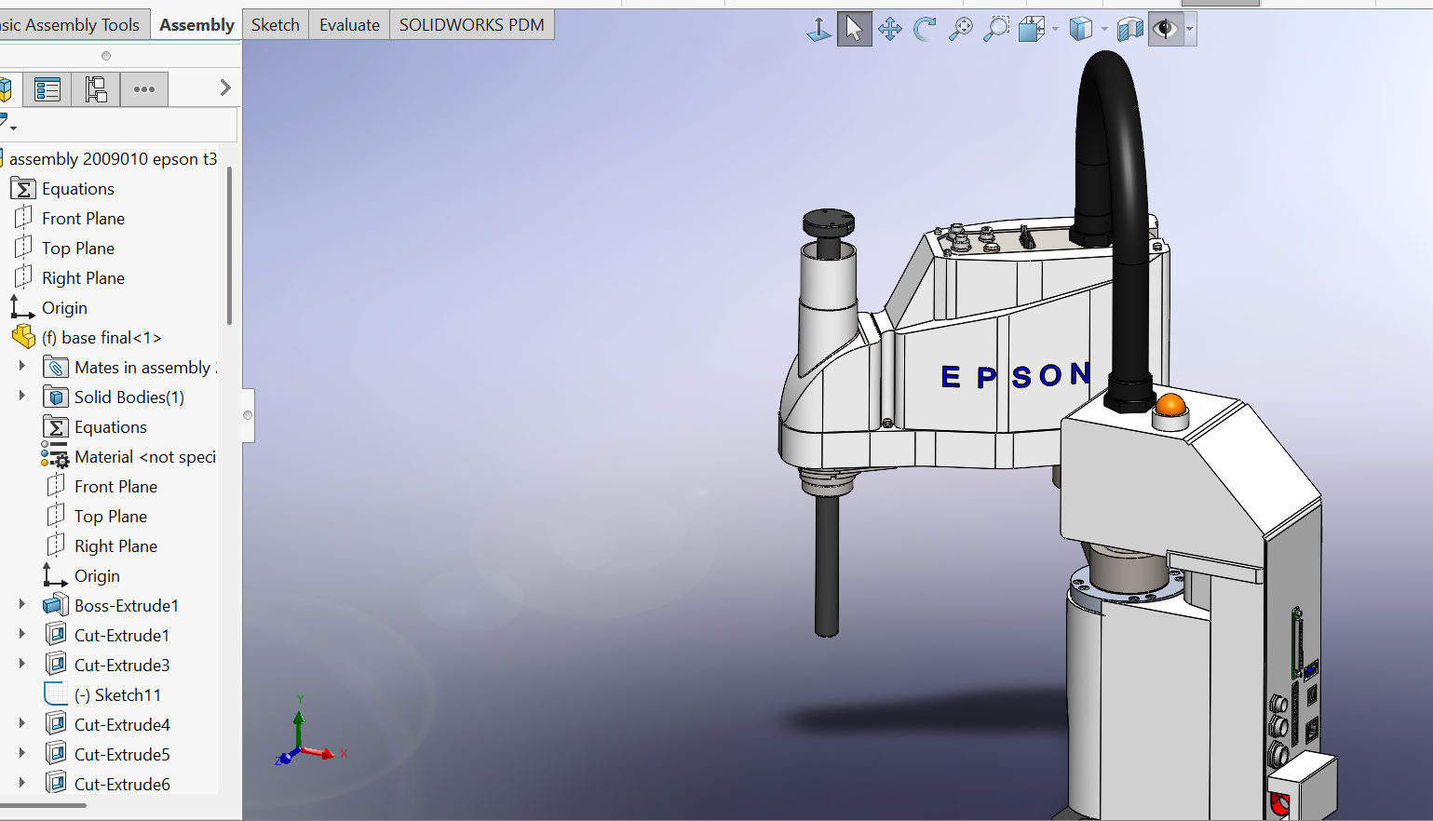
Robot Assembly Overview
Robot: EPSON T3 SCARA CAD: SolidWorks Simulation: MATLAB/Simulink/Simscape Main Parts: Base, Connecting Arm, Main Arm, Shaft, Stopper, Cable, End-Effector

Slide 4
CAD Assembly Inspection
Base – Supports robot Connecting Arm – Transfers motion Main Arm – Carries end-effector Shaft – Vertical motion Cable – Electrical connection Stopper – Motion limitation

Slide 5
Robot Type & DOF
Type: SCARA
DOF: 4
Joints:
Revolute, Revolute, Prismatic, Revolute Applications
: Pick & Place, Electronics, Packaging, PCB

Slide 6
Link and Joint Identification
J1: Base→Link1 Rotation J2: Link1→Link2 Rotation J3: Link2→Z-axis Vertical J4: Z-axis→End-effector Rotation

Slide 7
Motion Reference Points
Home → Object → Pick → Place → Return Home Objective: Move object in ~2 seconds.

Slide 8
Robot Motion Description
0.0s Home 0.5s Rotate 1.0s Lower 1.5s Move 2.0s Release Steps: Rotate J1, Rotate J2, Lower, Grip, Lift, Rotate, Release, Return

Slide 9
MATLAB / Simulink Preparation
Export SolidWorks to Simscape Multibody Import XML Detect bodies Detect joints Connect World Frame Test movement

Slide 10
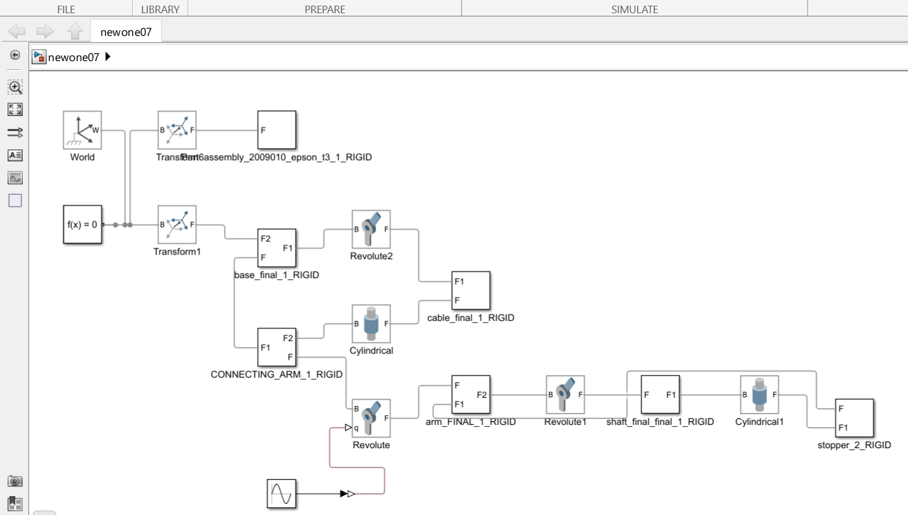

Slide 11
Workspace Analysis
Reachable area: Semi-circular High precision Fast horizontal motion Limitations: Payload, Vertical reach, Fixed installation

Slide 12
Applications & Limitations
Applications: Electronics PCB Packaging Pharma CNC Loading Material Handling Limitations: Limited payload/workspace Calibration required

Slide 13
Conclusion
EPSON T3 SCARA enables fast, accurate automation. CAD model supports identification of links, joints and motion. MATLAB/Simulink enables simulation and analysis. CAD models can be converted into practical robotic systems.

