Slide 1
CIS 6270 · PROJECT 1 DEFENSE · GROUP 2
BDG: Batch-Dispersion Guidance for Property-Band Generation
A feedback-servoed deviation gain for property-gradient guidance, studied on QM9 3D molecules and on DeepFlyBrain DNA enhancers on the probability simplex
University of Pennsylvania
30 September 2026
Bobo Li · Henry Huang · Idea Idehpour

Slide 2
1a
PART 1 · SET UP THE STUDY
Frame the study
Problem. Steer a frozen generator so a sample's property lands in a band y ± δ. We score band coverage: the share of samples inside the band.
MODALITY 1
QM9 3D molecules [1]
Coordinates in ℝᴺˣ³ plus atom types, N ≤ 29. A Euclidean space with a symmetry group: translation, rotation, permutation [2].
The catch. Gradient guidance has one knob, the strength w. Turning it up pulls the batch toward y and squeezes the batch together. Spread is never set — it is a side effect.
MODALITY 2
Question. Can we ask for a spread — give the sampler a setpoint τ for how wide the batch should be — and steer coverage with it, instead of only turning w up?
DeepFlyBrain DNA [4]
500-bp enhancers as points of (Δ³)⁵⁰⁰: one probability simplex per position. No rotation group; every step must land back on the simplex.
Hypothesis. Setting dispersion separately from centring raises band coverage at comparable sample quality, with one rule in both state spaces.
CIS 6270 · Group 2 · 1 / 29
[1] Ramakrishnan et al. 2014 (QM9) · [2] Hoogeboom et al. 2022 (EDM) · [4] Stark et al. 2024 (Dirichlet FM; DeepFlyBrain data)

Slide 3
1b
PART 1 · SET UP THE STUDY · DATA 1 OF 2
Datasets, splits and leakage
MODALITY 1 · QM9 [1]
MODALITY 2 · DEEPFLYBRAIN [4]
133,885 molecules, explicit hydrogens
Drosophila enhancers, 500 bp
MoleculeNet release, pinned by SHA-256. We keep the 3,054 molecules that EDM's preprocessing drops [2].
One-hot A, C, G, T; four ambiguous training sequences removed.
Split | Used for | n
train | generator | 83,722
val | checkpoint selection | 10,505
test | held out | 10,434
Split | Used for | n
train_a | generator and guide f_A | 51,527
train_b | evaluator f_B only | 51,527
val | checkpoint selection; molecule sizes | 17,748
test | held out | 13,083
No learned evaluator. GC and CpG are counted exactly on the decoded sequence, so there is nothing for guidance to exploit and nothing to leak.
No leakage. f_B, which scores every sample, never saw a molecule that trained the generator or the guide. Normalisation uses train_a alone.
Cell-type labels are not given to the generator. A random split says nothing about unseen sequence families.
Preprocessing. QM9: coordinates centred per molecule (Å), padded to 29 atoms with a mask; targets are dipole moment μ, polarizability α and HOMO–LUMO gap. DNA: one-hot on the simplex, decoded by per-position argmax.
CIS 6270 · Group 2 · 3 / 29
[1] Ramakrishnan et al. 2014 (QM9) · [2] Hoogeboom et al. 2022 (EDM) · [4] Stark et al. 2024 (Dirichlet FM; DeepFlyBrain data)

Slide 4
1b
PART 1 · SET UP THE STUDY · DATA 2 OF 2
Representations, conditioning, and what we measure
 | QM9 molecules | DeepFlyBrain DNA
Representation | Per atom: 3D coordinates + a one-hot type over {H, C, N, O, F}, relaxed to continuous values while sampling, read back by argmax. | Per position: a probability vector over {A, C, G, T}; a sequence is a point of (Δ³)⁵⁰⁰ [4, 5], read back by argmax.
Conditioning | None, in both. No property, no class label reaches either generator — the only extra input is QM9's atom mask. The property enters only at sampling time, through guidance, which is exactly where BDG acts.
Staying feasible | Noise projected to zero centre of mass; an E(3)-equivariant EGNN [9] (12/12 equivariance checks pass). | After each step, clamp at zero and renormalise per position, so every position stays on the simplex.
What we measure · QM9
What we measure · DNA
Band coverage (in-band). the share of decoded molecules with |f_B(x̂) − y| ≤ δ. This is the control score.
GC content. the fraction of bases that are C or G. CpG: how often a C is immediately followed by a G.
Molecule stability. every atom's valence satisfied, EDM's rule [2]. Validity: RDKit parses and sanitises it.
Band coverage (in-band). counted exactly on the decoded sequence — no learned evaluator, so nothing to exploit.
Diversity. uniqueness among valid molecules; distinct-valid yield per attempt.
3-mer JSD. Jensen–Shannon divergence between the 3-mer histogram of generated and of training sequences. Lower = more realistic composition.
Spread R. s.d. of the property over the batch ÷ the unguided s.d. R < 1 is a tighter batch.
Diversity. mean normalised Hamming distance between decoded sequences.
Both modalities are scored by the same code. Coverage is never compared across modalities: the two bands are set by different rules (1e, 3a).
CIS 6270 · Group 2 · 4 / 29
[2] Hoogeboom et al. 2022 (EDM) · [4] Stark et al. 2024 (Dirichlet FM) · [5] Davis et al. 2024 (Fisher Flow) · [9] Satorras et al. 2021 (EGNN)

Slide 5
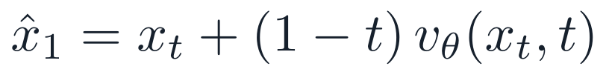
1c
PART 1 · SET UP THE STUDY · FLOW MATCHING 1 OF 2
Flow-matching baseline: the formulation
Flow matching learns a velocity field vθ that carries noise x₀ to data x₁ along a straight line [6, 7, 8]. Time t runs from 0 (noise) to 1 (data).
Path and target
The target is conditioned on the pair (x₀, x₁), not on any property: vθ has no condition input.
Noise source
Coordinate noise is projected to zero centre of mass (dimension 3(N − 1)); type noise is a masked Gaussian.
Loss
M is the atom mask. Coordinate (c) and type (f) errors are averaged separately and weighted equally, so padding never dilutes the loss.
Endpoint estimate
A one-step estimate of the final sample at any t. Guidance differentiates it (2b).
CIS 6270 · Group 2 · 5 / 29
[6] Lipman et al. 2022 (Flow Matching) · [7] Liu et al. 2022 (Rectified Flow) · [8] Albergo et al. 2025 (Stochastic Interpolants)

Slide 6
1c
PART 1 · SET UP THE STUDY · FLOW MATCHING 2 OF 2
Flow matching: training, selection, sampling
Architecture [9]
Training
E(3)-equivariant graph network (EGNN): width 256, 8 layers, SiLU, 3,753,229 parameters. Time enters through the input embedding; no attention.
train_a only. Adam, learning rate 2 × 10⁻⁴ with cosine decay to 5%, batch 256, gradient clip 5, EMA 0.9999, 1,500 epochs (303k steps), seed 20260918.
Model selection
Sampling [6]
The trainer keeps the best validation atom stability (loss as tie-break) on one 512-sample draw every 25 epochs. We evaluate the recorded final-epoch EMA weights — epoch 1,500, MD5 e19ccc06 — and say so wherever the number appears.
Probability-flow ODE, explicit Euler, 100 uniform steps: NFE 100, one network evaluation per step. Unguided, that is 0.051 s per molecule (2a).
CIS 6270 · Group 2 · 6 / 29
[6] Lipman et al. 2022 (Flow Matching) · [9] Satorras et al. 2021 (EGNN)

Slide 7

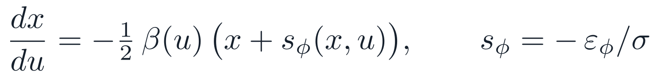
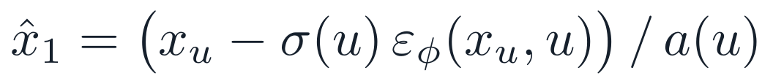
1d
PART 1 · SET UP THE STUDY · DIFFUSION 1 OF 2
Diffusion baseline: the formulation
Variance-preserving (VP) diffusion in continuous time [2, 10, 11]. Noising time u runs from 0 (data) to 1 (noise); the network εφ predicts the added noise.
Noise schedule
Forward process
Loss
The same masked norm as flow matching; ε projected to zero centre of mass; u ~ U(10⁻³, 1) keeps σ away from zero.
Sampler
Integrated from u = 1 to 0 on a decreasing 100-step grid, then one denoising step to x̂₁: NFE 101.
Endpoint estimate
Tweedie's posterior mean: the diffusion counterpart of x_t + (1 − t)vθ, and what guidance differentiates.
Checked: a² + σ² = 1 to 6 decimals, a(0) = 1, a(1) = 0.0066.
CIS 6270 · Group 2 · 7 / 29
[2] Hoogeboom et al. 2022 (EDM, molecules) · [10] Song et al. 2021 (Score SDE) · [11] Karras et al. 2022 (EDM design space)

Slide 8
1d
PART 1 · SET UP THE STUDY · DIFFUSION 2 OF 2
Diffusion: training, selection, sampling
Matched by design. Same representation, split (train_a), EGNN 256 × 8, optimiser, schedule, batch, EMA, clip, seed and 1,500-epoch budget as flow matching. Only the corruption process and the output head differ.
Architecture [9]
Model selection
Sampling [2, 11]
EGNN 256 × 8, 3,753,229 parameters, with a noise (ε) head in place of the velocity head.
Same rule, same code: best validation atom stability, loss as tie-break. It selected epoch 1,475 of 1,500 (EMA, MD5 8a3390a6); flow matching ships its final epoch (1c). We disclose both.
100-step decreasing grid plus the final denoising step: NFE 101 against flow matching's 100. We report the extra evaluation rather than hide it.
Benchmarked. 18 cells — unguided and plug-in × μ, α, gap × 3 seeds × 2,000 molecules at w = 1 — on the same protocol and the same property pair as flow matching. Results in 2a and 2b. These cells ran on a B200 MIG slice rather than the RTX A6000 used elsewhere, so their wall-clock is not hardware-matched (1e).
CIS 6270 · Group 2 · 8 / 29
[9] Satorras et al. 2021 (EGNN) · [2] Hoogeboom et al. 2022 (EDM) · [11] Karras et al. 2022 (EDM design space)

Slide 9
1e
PART 1 · SET UP THE STUDY · COMPARISON PLAN 1 OF 2
The evaluation protocol
One protocol governs every number in this talk — both base models, every guidance arm, both modalities. It was registered before the runs.
Fixed in advance
Target y | the property's training median (q50), fixed before any run, one per property
Band δ | 2 × f_B's calibration MAE on 3,000 held-out molecules: μ 0.1754 D, α 0.5062 Bohr³, gap 0.00748 Ha
Samples | 3 seeds × 2,000 = 6,000 per arm (seeds 20261001–03), drawn as 4 batches of 500
Sampling | 100 Euler steps; guidance applied for t ≥ 0.5 only; headline strength w = 1
Statistic | unpaired binomial z on the pooled 6,000, bar |z| ≥ 2.99 (18 contrasts, family level 0.05)
Resolution | that bar resolves about 0.8–1.9 points; smaller differences are reported as unresolved, never as equal
Hardware | RTX A6000 for the flow-matching, EquiFM and EDMsecond cells; B200 MIG for our VP cells — so timings are not hardware-matched across families
The two property networks
What in-band cannot tell us
Invariant EGNN on squared distances, 128 × 4, 429,825 parameters each, Adam 3 × 10⁻⁴ cosine, batch 128, 120 epochs, no EMA. f_A trains on train_a and its gradient steers; f_B trains on train_b and only scores — disjoint halves, so guidance cannot optimise its own judge.
It inherits f_B's error, and it counts invalid molecules — so it never appears without stability and validity (EDM's conventions [2]) beside it. On DNA there is no learned evaluator at all: GC and CpG are counted exactly.
CIS 6270 · Group 2 · 9 / 29
Registered protocol (this work); band calibration on 3,000 held-out molecules · [2] Hoogeboom et al. 2022 (EDM; stability and validity conventions)

Slide 10
1e
PART 1 · SET UP THE STUDY · COMPARISON PLAN 2 OF 2
Flow matching vs diffusion: a matched protocol
Both base models are ours, trained on the same half of QM9 with the same recipe. Everything except the corruption process is held fixed, so 2a compares two families, not two engineering efforts.
Factor | Identical by construction | Necessarily different
Data and split | train_a, 51,527 molecules; same representation | —
Backbone | EGNN 256 × 8, 3.75M parameters each [9] | velocity head vs noise (ε) head
Corruption | — | linear interpolant vs variance-preserving: the variable under test
Training recipe | Adam 2 × 10⁻⁴ cosine, batch 256, clip 5, EMA 0.9999, seed 20260918, 1,500 epochs | —
Checkpoint | same selection code | FM: final epoch 1,500 EMA; VP: validation-selected epoch 1,475 EMA
Sampling | probability-flow ODE, 100 steps | VP adds a denoising step: NFE 101 vs 100
Evaluation | same f_A, f_B, δ, masks, seeds, 3 × 2,000 per cell, metric code | VP cells ran on a different accelerator: time not comparable
Tested conservatively. The two models share noise, seeds and atom counts, so a paired test would be stronger — but the registered statistic is the unpaired binomial z of 1e-i. Where it cannot resolve a difference, we say so.
CIS 6270 · Group 2 · 10 / 29
Original protocol (this work) · [9] Satorras et al. 2021 (EGNN)

Slide 11

1f
PART 1 · SET UP THE STUDY
Study overview: one rule, two state spaces
1 · BASELINES
2 · DOES GUIDANCE WORK?
3 · THE INNOVATION
4 · EVIDENCE
MODALITY 1 · QM9 MOLECULES
Train two, matched
Frozen FM + frozen f_A
Ablations + comparison
Flow matching and VP diffusion, one recipe (1c–1e)
Unguided vs DPS-style plug-in, w = 1, t ≥ 0.5 (2b)
η = 0, gain, setpoint — 612 cells (2d)
FM carried forward (2a)
BDG
vs plug-in · TMPD · LGD-MC · TFG (2e)
Ask for a spread: setpoint τ, gain η → the deviation gain w_eff
Scored by held-out f_B
MODALITY 2 · DEEPFLYBRAIN DNA
Plug-in is exactly η = 0
Train one
Frozen CNN + analytic guide
The same rule and the same code in both modalities
Transfer comparison
Simplex flow matching, Dirichlet → one-hot (3a)
vs plug-in · TMPD · LGD-MC · TFG-MC (3b)
Exact GC or CpG steers; each step projected back (3a)
Scored by exact counts + 3-mer JSD
Everything inside the boxes is trained or run by us. Borrowed checkpoints — EquiFM and TFG's predictor pair — are a separate, parallel comparison and are never pooled with ours.
CIS 6270 · Group 2 · 11 / 29
Original figure (this work)

Slide 12
2a
PART 2 · BUILD THE EVIDENCE FOR MODALITY 1
Choose the base model
Every row is unconditional and unguided: no target, no property gradient. Guidance starts in 2b.
Model | Trained on | Atom ↑ | Molecule ↑ | Validity ↑ | Unique ↑ | NFE | s / sample
Flow matching (ours) | train_a (51,527) | 93.6 | 39.7 ± 0.6 | 75.6 ± 1.1 | 99.8 | 100 | 0.051
VP diffusion (ours) | train_a (51,527) | 90.7 | 28.8 ± 1.3 | 66.2 ± 0.7 | 100.0 | 101 | 0.048*
EquiFM [24], borrowed | full QM9 (100K) | 98.6 | 86.2 ± 0.3 | 93.8 ± 0.6 | 99.7 | 100 | 0.086
EDMsecond [15], borrowed | full QM9 (100K) | 96.4 | 67.2 ± 1.3 | 86.0 ± 1.3 | 99.8 | 101 | 0.087
Real QM9: the ceiling | — | 99.4 | 95.6 | 98.2 | — | — | —
Percent; mean ± seed s.d. over 3 seeds × 2,000. Euler probability-flow ODE; our evaluator, EDM's conventions [2]. *VP timing is on a B200 MIG slice, every other row on an RTX A6000 — not hardware-matched (1e).
Flow matching is carried forward
Reading the borrowed rows
At matched data, backbone, recipe and budget, our flow model beats our diffusion model on every quality axis: +10.9 molecule-stability points, +9.4 validity, +2.9 atom — with one fewer network call per sample (100 vs 101).
EquiFM and EDMsecond are external checkpoints trained on twice our data, and they bracket us from above. They set context, not a verdict: the family decision rests only on the two rows we trained ourselves.
It also hands guidance an explicit endpoint, m = xₜ + (1 − t)vθ, to differentiate (2b).
CIS 6270 · Group 2 · 12 / 29
[2] Hoogeboom et al. 2022 (EDM), Tables 1 and 10 · [24] Song et al. 2023 (EquiFM) · [15] Ye et al. 2024 (TFG; EDMsecond checkpoint) · all rows measured in this work

Slide 13
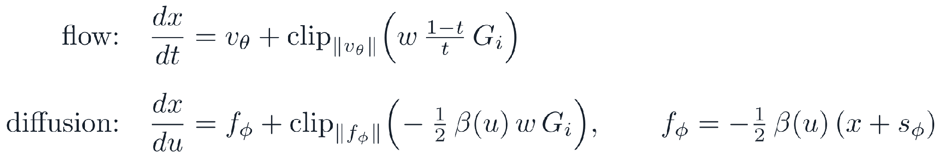
2b
PART 2 · EVIDENCE FOR MODALITY 1 · GUIDANCE 1 OF 2
Guidance strategy: the plug-in rule
The rule: DPS-style plug-in [12]
What is trained, and what is frozen
Generator: ours, frozen — no weight is updated at sampling time.
mᵢ is the model's one-step estimate of the finished sample: xₜ + (1 − t)vθ for flow matching, the Tweedie mean for diffusion (1c, 1d). y is the training median q50; s is the property's s.d. over the calibration pool.
Guide f_A: ours, trained on train_a, frozen; we differentiate it, we never update it.
Evaluator f_B: trained on train_b, never inside the sampler — it only scores afterwards.
How it enters each sampler
Nothing is retrained between arms, so any difference is the guidance rule alone.
This rule is the baseline BDG must beat. It is also the rule BDG reduces to when its gain is switched off (2c).
Same Gᵢ, same strength w = 1 [14], same window — guidance acts only in the second half of sampling (flow t ≥ 0.5, diffusion u ≤ 0.5) — and the same velocity-relative clip [13]: a correction is never allowed to exceed the model's own velocity. Identical for every arm in this talk, ours included.
CIS 6270 · Group 2 · 13 / 29
[12] Chung et al. 2023 (DPS) · [14] Ho & Salimans 2022 (CFG) · velocity-relative trust region: adopted practice [13]

Slide 14
2b
PART 2 · EVIDENCE FOR MODALITY 1 · GUIDANCE 2 OF 2
Guided vs unguided, on both base models
The setting, identical for all six rows. The guidance rule is DPS-style plug-in [12] (2b-i) on both families — the only thing changing down the table is which base model it steers. QM9, y = q50, w = 1, t ≥ 0.5; frozen f_A steers, held-out f_B scores decoded molecules. Each arm: 3 seeds × 2,000, sharing noise and atom counts; registered unpaired z, bar 2.99 (1e).
Property | Base model | In-band, decoded ↑ | Change (z) | Mol. stab. ↑ | Validity ↑
μ | Flow matching | 7.8 ± 0.1 → 10.6 ± 0.4 | +2.75 (z 5.22) | 39.7 → 35.6 | 75.6 → 72.5
μ | VP diffusion | 8.7 ± 0.8 → 10.8 ± 0.4 | +2.13 (z 3.94) | 28.8 → 26.2 | 66.2 → 61.8
α | Flow matching | 5.0 ± 0.3 → 6.1 ± 0.3 | +1.07 (z 2.56) | 39.7 → 37.2 | 75.6 → 73.7
α | VP diffusion | 5.2 ± 0.6 → 5.4 ± 0.4 | +0.15 (z 0.37) | 28.8 → 25.2 | 66.2 → 58.7
gap | Flow matching | 10.3 ± 1.0 → 12.6 ± 0.7 | +2.35 (z 4.04) | 39.7 → 33.6 | 75.6 → 69.9
gap | VP diffusion | 9.8 ± 0.6 → 12.4 ± 1.2 | +2.60 (z 4.55) | 28.8 → 23.2 | 66.2 → 57.3
Each cell: unguided → plug-in, percent (mean ± seed s.d.). Change: percentage points on decoded in-band, with the registered z. Uniqueness stays above 99.8 everywhere.
Guidance works, on both families
And it is bought, not free
Plug-in clears the bar on μ and gap for both models (z 2.6–5.2); both leave α unresolved. Same direction on both families, so this is not an artefact of one.
Every gain costs chemistry: stability falls 2.5–6.2 points on flow matching, 2.7–5.7 on diffusion. Flow matching pays from a far higher starting point (39.7 vs 28.8) — why 2a carries it forward.
CIS 6270 · Group 2 · 14 / 29
[12] Chung et al. 2023 (DPS) · cells: results/v3/{fm,vp}/v3/n2000 (this work)

Slide 15
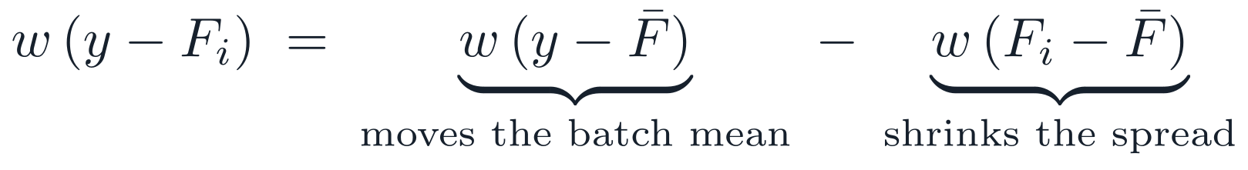
2c
PART 2 · EVIDENCE FOR MODALITY 1 · INNOVATION 1 OF 4
Motivating the innovation
The limitation
WHERE BDG SITS AMONG THE METHODS COMPARED IN 2E
Method | Statistic it uses | Acts on
DPS-style plug-in [12] | the residual y − Fᵢ | one sample
TMPD-inspired [22] | + the covariance of its own endpoint (a second moment) | one sample
LGD-MC [23] | Monte Carlo draws around the endpoint | one sample
TFG [15] | extra training-free steps on the endpoint | one sample
BDG (ours) | the batch variance of predicted properties, V_b vs τ² (a second moment) | the batch
In plug-in guidance [12] one strength w scales both terms, so moving the batch toward y also shrinks its spread.
BDG's idea, and the hypothesis
Keep the centring term; set the deviation coefficient by feedback on the batch variance V_b against a requested τ². Hypothesis: coverage rises at comparable quality.
Two different second moments. TMPD weighs one sample's uncertainty about its own endpoint; BDG reads the whole batch's spread in property space. No comparator here uses a batch statistic — though batch-level ideas exist elsewhere: joint potentials [20], moment targets [18], spread targets [19], the scale as a control gain [16, 17], negative-guidance widening [21]. We claim only the composition, from a bounded search.
CIS 6270 · Group 2 · 15 / 29
[12] Chung 2023 (DPS) · [15] Ye 2024 (TFG) · [16] Wang 2026 (CFG-Ctrl) · [17] Koulischer 2025 (Feedback Guidance) · [18] Lempereur 2026 (MGD) · [19] Azangulov 2026 (VTD) · [20] Corso 2024 (Particle Guidance) · [21] Ventura 2026 (negative guidance) · [22] Boys 2024 (TMPD) · [23] Song 2023 (LGD-MC)

Slide 16
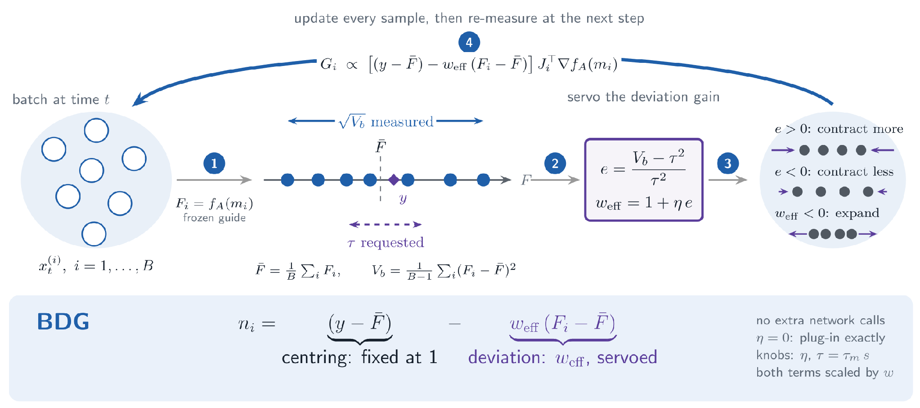
2c
PART 2 · EVIDENCE FOR MODALITY 1 · INNOVATION 2 OF 4
BDG: the mechanism
One coefficient changes
Same network calls
Two knobs
The centring term keeps coefficient 1; η = 0 gives plug-in [12] exactly.
Both terms share one gradient; BDG adds two batch reductions.
Gain η ≥ 0 and setpoint τ = τ_m·s — s is the calibration-pool s.d. from 2b, so τ_m is “how many s.d. wide should this batch be”.
CIS 6270 · Group 2 · 16 / 29
Original figure and formulation (this work) · plug-in base after [12] Chung et al. 2023 (DPS)

Slide 17
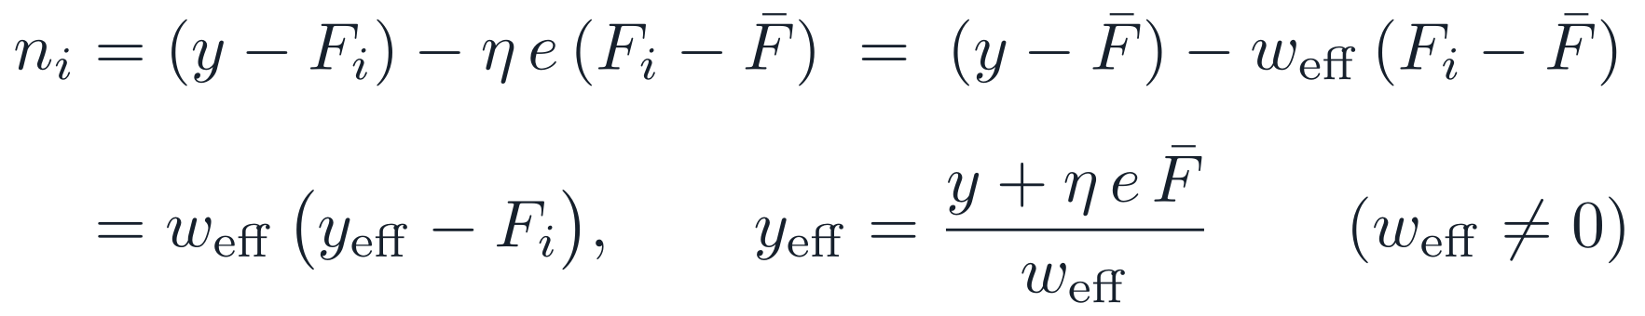
2c
PART 2 · EVIDENCE FOR MODALITY 1 · INNOVATION 3 OF 4
BDG: the reduction and its limits
Exact reduction
When it contracts, and when it expands
e > 0 strengthens contraction; e < 0 only weakens it. Net expansion needs a negative gain:
At any instant BDG is the plug-in direction with a batch-dependent gain w_eff and target y_eff. It adds no new direction — a reviewer will find this, so we say it first.
A bound for any batch
What it adds is that the gain is set by the batch, and reaches where no positive plug-in strength does (2d).
The gain can never run away below 1 − η, which is what lets BDG run two-sided with no clamp.
An idealised picture, not a guarantee
Assumes unit response, continuous time, no drift, cap or projection. The stationary variance sits below the setpoint and a 50-step window need not reach it. So we claim a monotone dial, not a regulated variance, and not independent control of mean and spread.
CIS 6270 · Group 2 · 17 / 29
Original formulation and proofs (this work); numerical checks in proj1/tests/test_bdg.py

Slide 18
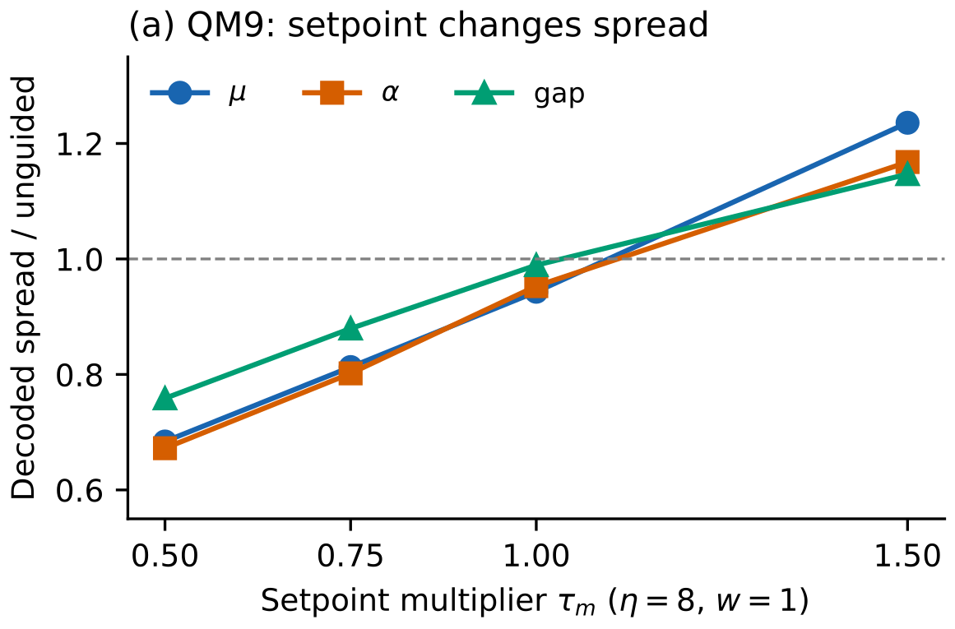
2c
PART 2 · EVIDENCE FOR MODALITY 1 · INNOVATION 4 OF 4
BDG at work: the setpoint moves the spread
The setpoint is a real dial
Ask for a tighter batch (τ_m = 0.5) and the spread drops to 0.67–0.76× unguided. Ask for a wider one (τ_m = 1.5) and it rises to 1.15–1.24×. Monotone across four setpoints, on all three properties, and again on EquiFM (up to 1.25×).
Strength alone cannot do this
Plug-in (η = 0) only ever narrows: 0.78–0.87× unguided at w = 1, and tighter still at w = 4 (0.65–0.79×). No tested positive strength reaches the wide side.
At plug-in's price
η = 0 reproduces plug-in bit for bit on our FM. The dial costs two scalar reductions per step — no extra network call. Algorithm 1: appendix A5.
Our FM, η = 8, w = 1; 3 × 2,000 per point. Dashed line: the unguided spread.
CIS 6270 · Group 2 · 18 / 29
Original experiment (this work); cells results/v3/{fm,equifm}/v3abl/n2000

Slide 19
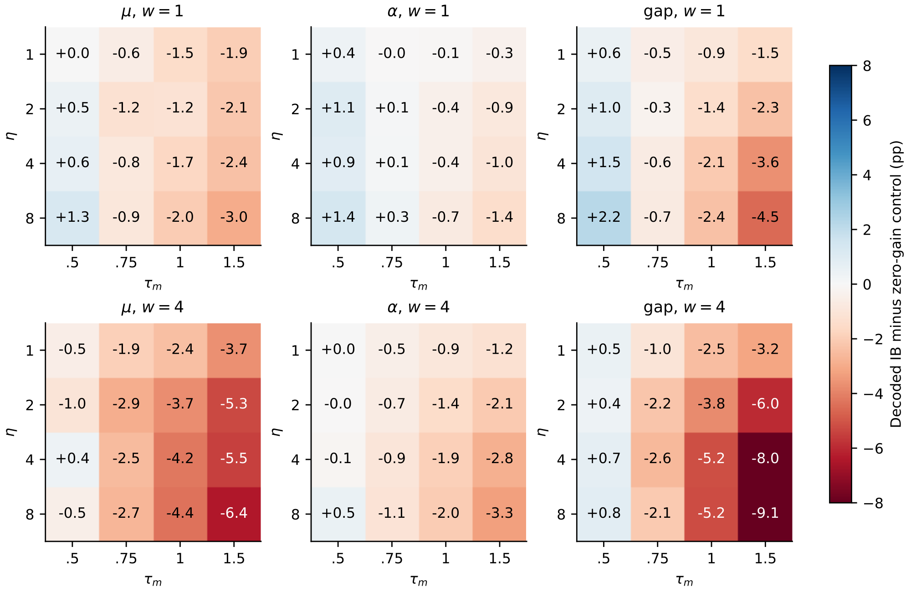
2d
PART 2 · EVIDENCE FOR MODALITY 1 · ABLATIONS 1 OF 2
Testing the innovation: the ablation grid
612 registered cells. η ∈ {1, 2, 4, 8} × τ_m ∈ {0.5, 0.75, 1, 1.5}, plus η = 0, at w = 1 and w = 4, on our FM and on EquiFM; 3 seeds × 2,000 each. Every cell is read against its own η = 0 control at the same strength, so w never moves inside a comparison.
Control · what changes | What it isolates, and what we saw
Switch the gain off η = 0 vs plug-in | The implementation. Bit-for-bit identical on our FM; EquiFM agrees within its rerun noise. BDG really does contain plug-in.
Turn the setpoint down η = 8, τ_m 0.5 at w = 1 | Can we ask for a tighter batch? Yes: spread 0.67–0.77× unguided, tighter than plug-in reaches at w = 1, and coverage rises in all six tasks.
Turn the setpoint up η = 8, τ_m 0.5 → 1.5 | Is it a dial, or one trick? A dial: the batch widens monotonically to 1.15–1.25×, past unguided in 6 of 6 tasks.
Turn up strength instead η = 0, w 1 → 4 | Does w do the same job? No — it only narrows further, 0.78–0.87× → 0.65–0.79×. The wide side is unreachable by strength.
Push the gain at a wide setpoint τ_m = 1.5, η 0 → 8 | The cost of widening. Coverage falls in all 12 grids: a wider batch fills a fixed band less well.
Our flow-matching model only — EquiFM has its own 306-cell grid, and it agrees. Decoded in-band minus the η = 0 control at the same w, in points.
CIS 6270 · Group 2 · 19 / 29
Original design (this work); cells results/v3/{fm,equifm}/v3abl/n2000, RTX A6000

Slide 20
2d
PART 2 · EVIDENCE FOR MODALITY 1 · ABLATIONS 2 OF 2
What the ablations establish
What the grid establishes
Coverage per point of chemistry
1 · The setpoint controls the spread. τ_m moves decoded spread monotonically from 0.67× to 1.25× unguided, over four setpoints, six tasks, two backbones.
In-band points gained per stability point lost, both measured from η = 0 at w = 1. Our FM: dispersion 0.52–0.81 vs strength 0.38–0.53. EquiFM: 0.06–0.39 vs 0.08–0.37. Descriptive ratios, not tests — but the dispersion dial is the better buy on five of six.
2 · It is the dispersion term doing it, not strength. Inside a fixed w, coverage tracks the measured gain w_eff with Spearman 0.92–0.99 in all 12 grids — and w itself only ever narrows.
3 · Tightening is the useful direction. At τ_m = 0.5 every one of the six tasks gains coverage over its own plug-in control, at a smaller chemistry cost per point than turning w up.
Where we stop short
Those six gains are all below the registered bar (+0.45 to +1.52 points, |z| ≤ 2.44), so we claim a controlled spread, not a coverage win, on QM9. And the loose setpoint τ_m = 1 loses on three of six. The bar is 2.99; we do not move it.
Why a wider batch need not mean more coverage: the band is fixed, so spreading the batch out fills it less; and heterogeneous gradients, the velocity clip and argmax decoding all sit between the algebra and the score.
CIS 6270 · Group 2 · 20 / 29
Original analysis (this work); exchange ratios and spread from results/v3 cells

Slide 21
2e
PART 2 · EVIDENCE FOR MODALITY 1 · RECENT WORK 1 OF 2
Position against recent work
Method | IB μ ↑ | IB α ↑ | IB gap ↑ | Mol. stab. μ/α/gap ↑ | DV μ ↑ | s/sample ↓ | Passes gen/guide ↓
Unguided | 7.8 | 5.0 | 10.3 | 39.7 / 39.7 / 39.7 | 75.5 | 0.051 | 400 / 0
DPS-style plug-in [12] | 10.6 | 6.1 | 12.6 | 35.6 / 37.2 / 33.6 | 72.4 | 0.119 | 1,000 / 400
TMPD-inspired [22] | 9.0 | 6.1 | 11.6 | 38.4 / 38.9 / 37.3 | 74.7 | 0.255 | 1,200 / 400
LGD-MC [23] | 9.6 | 5.2 | 10.8 | 39.9 / 39.2 / 39.5 | 75.4 | 0.229 | 1,200 / 2,000
TFG [15] | 28.8 | 10.5 | 27.5 | 24.5 / 26.8 / 14.4 | 62.7 | 0.122 | 800 / 2,000
BDG, τ_m = 0.5 (ours) | 11.2 | 7.0 | 14.2 | 35.1 / 36.4 / 30.0 | 71.2 | 0.119 | 1,000 / 400
BDG, τ_m = 1 (ours) | 8.9 | 5.6 | 10.6 | 40.5 / 37.9 / 37.6 | 76.3 | 0.119 | 1,000 / 400
Coverage (IB, decoded, %), quality (molecule stability, %), diversity (DV = distinct valid molecules per attempt, μ cells) and efficiency (RTX A6000 seconds per sample; network passes per 2,000-molecule cell). Our FM, QM9, q50, w = 1, t ≥ 0.5, 3 seeds × 2,000. Every row run by us on the same frozen checkpoint, guide and evaluator.
Why these four
BDG is the cheap one
All four are inference-time guidance rules from the last five years that steer a frozen generator with a frozen predictor — the same contract BDG works under. Running them on our checkpoint isolates the one thing we changed: the guidance rule.
It costs exactly plug-in's calls — 1,000 generator and 400 guide passes, 0.119 s per sample — because the dispersion term rides the same backward pass. LGD-MC and TFG need 5× the guide passes; TMPD and LGD-MC take about twice the time.
CIS 6270 · Group 2 · 21 / 29
[12] Chung et al. 2023 (DPS) · [22] Boys et al. 2024 (TMPD) · [23] Song et al. 2023 (LGD-MC) · [15] Ye et al. 2024 (TFG) · cells: results/v3/fm/v3/n2000

Slide 22
2e
PART 2 · EVIDENCE FOR MODALITY 1 · RECENT WORK 2 OF 2
Fair study, and fair discussion
Reproduced, not quoted
Where we are better
Every number in 2e is run by us — one frozen generator, one guide, one evaluator, one target, 3 seeds × 2,000 per cell. No published score is pooled with ours. EquiFM's arms use TFG's predictor pair and a different band, so they are reported separately and never ranked against our FM's.
Cost, and quality at equal cost. Plug-in's exact budget, a fifth of LGD-MC's and TFG's guide passes. At τ_m = 1 we hold the highest molecule stability of any guided arm (40.5 on μ, above unguided's 39.7) and the best DV (76.3).
Where we are competitive
Three port caveats we disclose
Coverage. τ_m = 0.5 is the best non-TFG arm on all three properties (11.2 / 7.0 / 14.2 vs plug-in's 10.6 / 6.1 / 12.6) — positive on all six tasks across both backbones, but +0.45 to +1.52 points, below the 2.99 bar. We report it as unresolved.
Plug-in is a DPS-style Gaussian-energy field; the original differentiates the residual L2 norm [12].
TMPD is the local-linear scalar limit — a related-work comparison, not a faithful nonlinear port [22].
TFG runs at its published QM9 hyperparameters but through our deterministic ODE sampler, on features scaled unlike its released checkpoint's. These rows must not be read against TFG's published table [15].
Where we are worse
TFG converges far harder — 28.8 on μ against our 11.2 — and it is above plug-in on 5 of 6 tasks. It pays 8–27 stability points for that; we do not match its coverage. And τ_m = 1 falls below plug-in on 3 of 6.
CIS 6270 · Group 2 · 22 / 29
[12] Chung et al. 2023 (DPS) · [22] Boys et al. 2024 (TMPD) · [15] Ye et al. 2024 (TFG) · contrasts over our FM and EquiFM, 3 × 2,000 per cell

Slide 23
3a
PART 3 · TEST TRANSFER AND CLOSE THE STORY
The transferred method
Unchanged: the rule itself. nᵢ, F̄, V_b, e, τ = τ_m·s, η and w_eff carry over as written — one scalar per sample multiplying the plug-in step. That is what makes the transfer a test and not a reimplementation.
What changes | Modality 1 · QM9 | Modality 2 · DeepFlyBrain
State space | ℝᴺˣ³ + a type simplex | (Δ³)⁵⁰⁰ — 500 coupled simplices
Generator | EGNN flow matching, 3.75M | dilated 1-D CNN, 128 × 10, ≈1.02M; Dirichlet(1,1,1,1) → one-hot linear path [4]
Guide | learned f_A (a network) | analytic soft GC or CpG — no predictor to train, none to exploit
Evaluator | learned f_B | exact GC or CpG count after argmax
Staying feasible | mask and re-centre | clamp at zero, renormalise each position
Training the simplex model
Sampling
One honest gap
83,722 sequences, 1,500 epochs (492k updates), batch 256, Adam 2 × 10⁻³ cosine to zero, no EMA. Validation selected epoch 1,450 (loss 0.0634); 539.7 min on an RTX A6000.
100-step Euler, clamp and renormalise after every step, argmax at the end. Guidance for t ≥ 0.5, batch 500, 3 seeds × 2,000 per cell, w ∈ {1, 4}, η = 4, τ_m ∈ {0.5, 1}.
The guide reads an extrapolated endpoint that can leave the simplex; the evaluator counts decoded bases. Soft and decoded scores can therefore disagree (3d).
CIS 6270 · Group 2 · 23 / 29
[4] Stark et al. 2024 (Dirichlet FM; DeepFlyBrain data) · GC and CpG defined in 1b

Slide 24
3b
PART 3 · TEST TRANSFER AND CLOSE THE STORY
Transfer results: DeepFlyBrain DNA
DeepFlyBrain, 500 bp. Coverage is the exact GC or CpG count inside the band; fidelity is 3-mer JSD against the training split; efficiency is seconds per sequence (definitions in 1b).
Method | GC w=1 ↑ | GC w=4 ↑ | CpG w=1 ↑ | CpG w=4 ↑ | JSD w=4 ↓ | s/seq ↓
Unguided | 14.0 ± 1.0 | 14.0 ± 1.0 | 50.2 ± 1.6 | 50.2 ± 1.6 | 4.53 | 0.021
DPS-style plug-in [12] | 14.0 ± 0.9 | 14.1 ± 1.0 | 50.5 ± 1.8 | 51.6 ± 1.4 | 4.63 | 0.096
TMPD / LGD-MC [22, 23] | 14.0 ± 0.9 | 14.1 ± 1.0 | 50.5 ± 1.8 | 51.6 ± 1.4 | 4.63 | 0.102
TFG-MC [15] | 14.1 ± 1.0 | 14.1 ± 1.0 | 50.4 ± 1.7 | 51.1 ± 1.7 | 4.58 | 0.084
BDG, τ_m = 0.5 (ours) | 14.5 ± 1.0 | 16.4 ± 1.2 | 55.3 ± 0.8 | 68.5 ± 1.2 | 7.73 | 0.076
BDG, τ_m = 1 (ours) | 14.0 ± 1.0 | 14.1 ± 1.0 | 50.2 ± 1.6 | 50.3 ± 1.5 | 4.52 | 0.076
Percent, mean ± seed s.d., 3 seeds × 2,000. JSD ×10⁻⁴ at w = 4 (CpG cells); unguided 4.53. BDG − plug-in: GC +0.42 (w=1), +2.32 (w=4); CpG +4.82 (w=1), +16.83 (w=4).
Fair study
Fair discussion
All rows share the generator, length, target, band, decoding, reference data and sample count. Late in sampling the endpoint uncertainty nearly vanishes, so plug-in, TMPD and LGD-MC collapse onto one effective comparator (agreeing to 4×10⁻⁶) — we say so rather than present three. TFG-MC is a restricted port; Dirichlet FM, Fisher Flow and MOG-DFM are not evaluated here [3, 4, 5].
The contracting setpoint is the only arm that moves anything: CpG +4.8 and +16.8 points, GC +2.3 at w = 4, where every comparator sits on top of unguided. It is also the only arm that pays — JSD 7.73 against 4.53, clipping 7.4–9.2% of steps. τ_m = 1 moves neither property: the dial behaving, not failing.
CIS 6270 · Group 2 · 24 / 29
[3] Chen et al. 2025 (MOG-DFM) · [4] Stark et al. 2024 (Dirichlet FM) · [5] Davis et al. 2024 (Fisher Flow) · guidance ports [12] [15] [22] [23] · cells results/m2

Slide 25
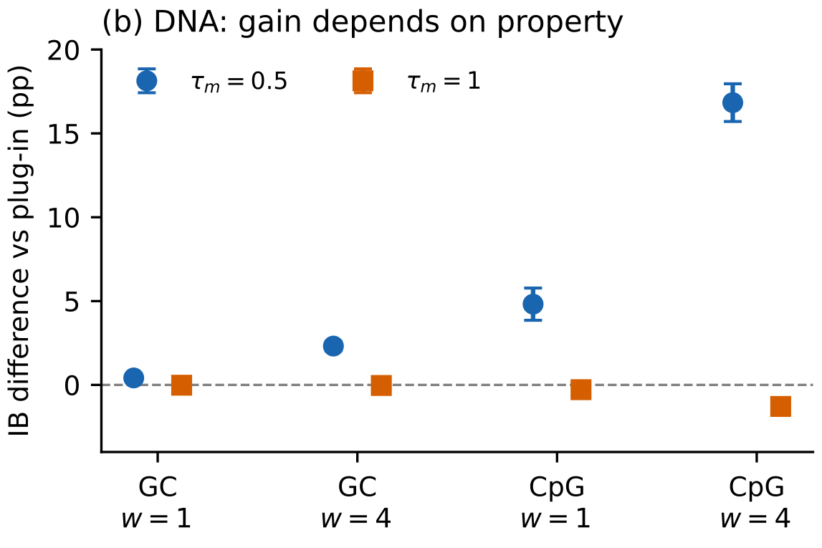
3c
PART 3 · TEST TRANSFER AND CLOSE THE STORY
Does the innovation transfer?
Criterion, fixed in advance. BDG transfers if its change from plug-in has the same sign in both modalities, in coverage and in how spread follows the setpoint, at a comparable fidelity cost. Each modality is judged against its own plug-in, never against the other.
Modality | Property | Coverage vs plug-in | Spread follows τ_m | Fidelity cost
QM9 | μ, α, gap | +0.5 to +1.5, unresolved | yes, 6 of 6 | −0.5 to −3.6 stab
DNA | GC | +0.4 (w=1) · +2.3 (w=4) | yes | JSD +0.4 to +1.4
DNA | CpG | +4.8 (w=1) · +16.8 (w=4) | yes | JSD +0.7 to +3.2
It transfers — and the magnitude is property-dependent
The sign is the same everywhere: tightening the setpoint raises coverage, loosening it does not, and the spread tracks τ_m in both state spaces. What changes is size. On QM9 the gain stays inside the noise; on DNA CpG clears the bar at both strengths and GC at w = 4.
η = 4, window t ≥ 0.5. Bars: s.d. of three paired seed differences.
The property that gains most is the quadratic one. GC is affine in the simplex coordinates, CpG is not — and a batch statistic has more to bite on when the property curves.
CIS 6270 · Group 2 · 25 / 29
Original analysis (this work); contrasts from results/m2 and results/v3 cells

Slide 26
3d
PART 3 · TEST TRANSFER AND CLOSE THE STORY
Limitations and failure modes
Four failure modes we measured rather than guessed, each with the number that exposes it.
1 · Equal strength is not equal force
2 · What is guided is not what is scored
BDG's winning DNA cells clip 7.4–9.2% of guided steps against plug-in's ≤ 0.21%, and apply about 10× the correction share. So at nominal w = 4 the two arms are not pushing equally hard: part of the CpG gain is force, not feedback. A matched-force rerun is the experiment that would separate them.
The guide reads a relaxed endpoint that can leave the simplex; the score decodes first. On GC at w = 1, opening the window to all t added 22.8 points before decoding against 4.2 in-window — a ~5.4× gap the decoded metric does not keep. We report decoded numbers only.
3 · The evaluator bounds the molecular claim
4 · The batch is the estimator, and the test ignores it
QM9 coverage inherits f_B's error, and guidance is an optimiser that can find its blind spots. Disjoint training halves reduce that risk without removing it. DNA sidesteps it entirely — exact counts — which is part of why the transfer is the cleaner evidence.
F̄ and V_b couple 500 samples, so the honest unit of uncertainty is the batch, not the molecule; our registered z is unpaired and assumes independence. EquiFM reruns move coverage by up to 0.7 points — the same size as its BDG-vs-plug differences.
Two things we did not run, and will not claim around: an open-loop replay of w_eff(t), which is what would show the feedback matters rather than the schedule it produces; and a joint in-band-and-stable yield, which needs sample-level records the aggregates do not carry.
CIS 6270 · Group 2 · 26 / 29
Original analysis (this work); diagnostics in results/v3 and results/m2 (M2_WINDOW_DOMINATES, M2_SHARE)

Slide 27
3e
PART 3 · TEST TRANSFER AND CLOSE THE STORY
Conclusion and future directions
Can we set dispersion separately from centring, and does it buy coverage?
What the evidence supports
A knob that did not exist. τ_m moves decoded spread from 0.67× to 1.25× unguided, monotonically, on two backbones — and no tested plug-in strength reaches the wide side at all. Inside a fixed w, coverage tracks the measured gain with Spearman 0.92–0.99.
Yes to the dial.
Yes on CpG.
It is the better buy per point of chemistry. 0.52–0.81 coverage points per stability point against strength's 0.38–0.53; at τ_m = 1 we hold the highest molecule stability and diversity of any guided arm.
The setpoint controls spread in both state spaces. On DNA CpG that converts into coverage well past the bar; on QM9 it points the right way but stays inside the noise.
It transfers, at plug-in's price. The same scalar rule, the same code, the same network calls — and on CpG, +4.8 and +16.8 points over plug-in.
Where we yield: TFG converges harder than we do on QM9 (28.8 vs 11.2 on μ) — but it spends 8–27 stability points to get there, and we do not.
The experiment that would settle it
Then, in order
Replay BDG's own w_eff(t) open-loop on fresh noise. If a fixed schedule reproduces the effect, the feedback is decoration and we say so; if it does not, the loop is the mechanism. Paired with a matched-force comparison, that also removes the clipping confound behind the CpG gain (3d).
1 · Batch-aware paired intervals and joint in-band-and-stable yield, from sample-level records.
2 · A CpG-side ablation on DeepFlyBrain: the gain is largest there, and we do not yet know how much of it is the curvature.
3 · External simplex generators (Dirichlet FM, Fisher Flow, MOG-DFM) as independent backbones.
CIS 6270 · Group 2 · 27 / 29
Original conclusions (this work)

Slide 28
REFERENCES · 1 OF 2
Bibliography
[1] R. Ramakrishnan, P. Dral, M. Rupp, O. von Lilienfeld. Quantum chemistry structures and properties of 134 kilo molecules. Scientific Data, 2014. (QM9)
[2] E. Hoogeboom, V. Satorras, C. Vignac, M. Welling. Equivariant Diffusion for Molecule Generation in 3D. ICML, 2022. (EDM; our stability and validity conventions)
[3] T. Chen, Y. Zhang, S. Tang, P. Chatterjee. Multi-Objective-Guided Discrete Flow Matching for Controllable Biological Sequence Design. arXiv:2505.07086, 2025. (MOG-DFM)
[4] H. Stark, B. Jing, C. Wang, G. Corso, B. Berger, R. Barzilay, T. Jaakkola. Dirichlet Flow Matching with Applications to DNA Sequence Design. ICML, 2024. (Dirichlet FM; DeepFlyBrain data)
[5] O. Davis, S. Kessler, M. Petrache, I. Ceylan, M. Bronstein, A. Bose. Fisher Flow Matching for Generative Modeling over Discrete Data. NeurIPS, 2024.
[6] Y. Lipman, R. Chen, H. Ben-Hamu, M. Nickel, M. Le. Flow Matching for Generative Modeling. arXiv:2210.02747, 2022.
[7] X. Liu, C. Gong, Q. Liu. Flow Straight and Fast: Learning to Generate and Transfer Data with Rectified Flow. arXiv:2209.03003, 2022.
[8] M. Albergo, N. Boffi, E. Vanden-Eijnden. Stochastic Interpolants: A Unifying Framework for Flows and Diffusions. JMLR, 2025.
[9] V. Satorras, E. Hoogeboom, M. Welling. E(n) Equivariant Graph Neural Networks. ICML, 2021. (our backbone)
[10] Y. Song, J. Sohl-Dickstein, D. Kingma, A. Kumar, S. Ermon, B. Poole. Score-Based Generative Modeling through Stochastic Differential Equations. ICLR, 2021.
[11] T. Karras, M. Aittala, T. Aila, S. Laine. Elucidating the Design Space of Diffusion-Based Generative Models. NeurIPS, 2022.
[12] H. Chung, J. Kim, M. McCann, M. Klasky, J. Ye. Diffusion Posterior Sampling for General Noisy Inverse Problems. ICLR, 2023. (DPS; our plug-in arm's ancestor)
[13] Velocity-relative trust region: adopted prior practice, described on slide 2b; not claimed as ours.
CIS 6270 · Group 2 · 28 / 29

Slide 29
REFERENCES · 2 OF 2
Bibliography
[14] J. Ho, T. Salimans. Classifier-Free Diffusion Guidance. arXiv:2207.12598, 2022.
[15] H. Ye, H. Lin, J. Han, M. Xu, S. Liu, Y. Liang, J. Ma, J. Zou, S. Ermon. TFG: Unified Training-Free Guidance for Diffusion Models. NeurIPS, 2024.
[16] H. Wang, Y. Liu, J. Chi, F. Liu, R. Xue, Y. Duan. CFG-Ctrl: Control-Based Classifier-Free Diffusion Guidance. arXiv:2603.03281, 2026.
[17] F. Koulischer, F. Handke, J. Deleu, T. Demeester, L. Ambrogioni. Feedback Guidance of Diffusion Models. NeurIPS, 2025. arXiv:2506.06085.
[18] E. Lempereur, N. Cuvelle-Magar, F. Coeurdoux, S. Mallat, E. Vanden-Eijnden. MGD: Moment Guided Diffusion for Maximum Entropy Generation. arXiv:2602.17211, 2026. (closest prior art)
[19] I. Azangulov, L. Zhang, K. Ashouritaklimi. Variance-Tilted Diffusion Models for Diverse Sampling. arXiv:2606.22239, 2026.
[20] G. Corso, Y. Xu, V. De Bortoli, R. Barzilay, T. Jaakkola. Particle Guidance: Non-I.I.D. Diverse Sampling with Diffusion Models. ICLR, 2024.
[21] E. Ventura, B. Achilli, L. Ambrogioni, C. Lucibello. Negative guidance reduces means and expands variances in diffusion models. arXiv:2602.00716, 2026.
[22] B. Boys, M. Girolami, J. Pidstrigach, S. Reich, A. Mosca, O. D. Akyildiz. Tweedie Moment Projected Diffusions for Inverse Problems. TMLR, 2024. (TMPD)
[23] J. Song, Q. Zhang, H. Yin, M. Mardani, M.-Y. Liu, J. Kautz, Y. Chen, A. Vahdat. Loss-Guided Diffusion Models for Plug-and-Play Controllable Generation. ICML, 2023. (LGD-MC)
[24] Y. Song, J. Gong, M. Xu, Z. Cao, Y. Lan, S. Ermon, H. Zhou, W.-Y. Ma. Equivariant Flow Matching with Hybrid Probability Transport for 3D Molecule Generation. NeurIPS, 2023. (EquiFM; appendix)
[25] F. Bao, M. Zhao, Z. Hao, P. Li, C. Li, J. Zhu. Equivariant Energy-Guided SDE for Inverse Molecular Design. ICLR, 2023. (EEGSDE; appendix)
CIS 6270 · Group 2 · 29 / 29

Slide 30
APPENDIX · NOT PART OF THE 15-MINUTE TALK
Q&A backup
Six topics, one or two slides each.
A1
A2
A3
EquiFM, the borrowed generator
Property predictors
The data split
Architecture, path, and how our arms run on it
Ours vs TFG's: architecture, training, accuracy
Who trains on which half, and why halves
A4
A5
A6
The guidance arms
Algorithm 1
Simplex FM architecture
Each arm's correction, what it changes, what it costs
One BDG-guided Euler step, line by line
The Modality 2 generator, layer by layer

Slide 31
A1
APPENDIX A1 · EQUIFM 1 OF 2
EquiFM: the borrowed generator
Released checkpoint
Paper | Song et al., NeurIPS 2023 [24]
Backbone | EDM-style equivariant GNN dynamics [2, 9], 256 × 9
Parameters | 5,339,920 (EMA)
State per atom | 3 coordinates (Å) + 5 one-hot ÷ 4 + charge ÷ 10; explicit H
Training data | the full 100K QM9 partition, unconditional
Hybrid probability path
Native time τ: 1 = noise, 0 = data.
Coordinates: almost linear — but the noise is rotated (Kabsch) and permuted (Hungarian) onto the molecule first, an equivariant optimal-transport coupling, plus an angle penalty.
Types and charge: variance-preserving, β from 0.1 to 20. Sampling: Euler, τ = 1 → 0.
Unguided, same protocol as ours
Why its chemistry beats ours
3 seeds × 2,000, 100 Euler steps: atom 98.6%, molecule 86.2 ± 0.3%, validity 93.8 ± 0.6%, uniqueness 99.7%; 0.086 s per sample on an RTX A6000.
Four candidates, none isolated by us: ~2× the training data, 5.34M vs 3.75M parameters, one-hot scaled by ¼ (our leading suspect in 2a), and the aligned coordinate path.
CIS 6270 · Group 2 · Appendix
[24] Song et al. 2023 (EquiFM) · [2] Hoogeboom et al. 2022 · [9] Satorras et al. 2021 · checkpoint SHA-256 47b40ae6…, audited in this work

Slide 32
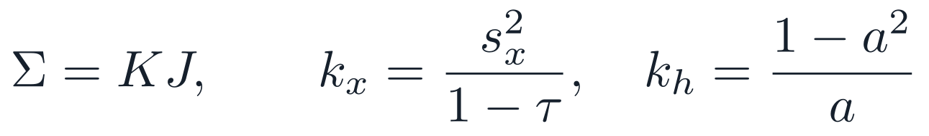
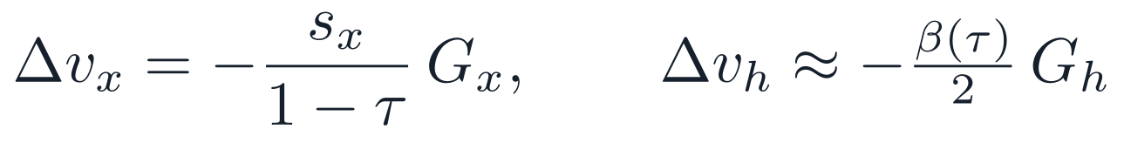
A1
APPENDIX A1 · EQUIFM 2 OF 2
Running our guidance arms on EquiFM
Why it is in the study: a second, external flow-matching generator asks whether the comparison survives on a model we did not train. Backend equifm, all seven arms [24].
Endpoint estimate m
Exact — algebra from its own regression targets.
Covariance Σ
TMPD and LGD-MC only
Exact for types, approximate for coordinates, whose aligned noise is not an independent Gaussian channel.
Guided velocity
The model's own velocity map at the guided mean m + K·G.
Property pair here
Disclosed limits
TFG's released guide (tf_predict at time 0) and oracle (evaluate) [15]. Its band is narrower than ours — δ 0.157 vs 0.175 (μ), 0.165 vs 0.506 (α), 0.0037 vs 0.0075 (gap) — so in-band never crosses backends.
Trained on the full 100K, so it saw both halves. Only TMPD and LGD-MC touch the Σ surrogate; plug-in, TFG and BDG do not. The charge channel is held fixed during guidance. Same-seed reruns move coverage by up to 0.7 points; about 1.8× our peak memory at batch 500.
CIS 6270 · Group 2 · Appendix
[24] Song et al. 2023 (EquiFM) · [15] Ye et al. 2024 (TFG) · adapter derivation and δ values: this work (v3 protocol, pair calibration)

Slide 33
A2
APPENDIX A2 · PROPERTY PREDICTORS 1 OF 2
Property predictors: our pair and TFG's
Ours score the fm and EDMsecond backends; TFG's score EquiFM. f_A's gradient steers sampling; f_B only scores.
 | Ours — f_A and f_B | TFG guide (tf_predict) | TFG oracle (evaluate)
Network | invariant EGNN on squared distances, mean-pool, linear head [9] | EDM dynamics EGNN with an energy head [2, 15] | EDM property-classifier EGNN [2]
Width × layers | 128 × 4 | 192 × 7 | 128 × 7
Edge attention | no — equal-weight sum | yes | yes
Parameters (μ) | 429,825 each | 1,671,566 | 743,944
Inputs | coordinates + unscaled one-hot | + one-hot ÷ 8; time fixed at 0 | + nuclear-charge powers
Training data | f_A: train_a · f_B: train_b (51,527 each) | QM9 second half (~50K) | QM9 first half (~50K)
Recipe | clean molecules, MSE on a standardised target; Adam 3e-4 cosine, batch 128, 120 epochs (~23 min); best validation MAE | clean molecules; EMA at epoch 2,000 | best-validation checkpoint
CIS 6270 · Group 2 · Appendix
[9] Satorras et al. 2021 (EGNN) · [2] Hoogeboom et al. 2022 (EDM) · [15] Ye et al. 2024 (TFG); TFG checkpoints inspected in this work

Slide 34
A2
APPENDIX A2 · PROPERTY PREDICTORS 2 OF 2
Theirs are better; ours are disjoint
MAE | μ (D) | α (Bohr³) | gap (Ha)
our f_A | 0.0872 | 0.2325 | 0.00402
our f_B | 0.0877 | 0.2531 | 0.00374
TFG guide | 0.0417 | 0.0925 | 0.00185
TFG oracle | 0.0784 | 0.0824 | 0.00187
Why theirs are more accurate
Capacity: 2–4× the parameters, 7 layers not 4.
Attention: a learned weight per neighbour; ours sums neighbours equally.
Training: the guide is an EMA at epoch 2,000 [15]; ours stop at 120.
Inputs: the oracle also reads nuclear-charge features.
Same 3,000 calibration molecules. Ours are scored only on the half each did not train on; TFG's on the whole pool, which overlaps their training halves and flatters them.
Why we keep ours on our FM
The honest gap on μ. On molecules neither TFG net trained on: guide 0.0659 D, oracle 0.0728 D, our f_B 0.0840 D. ~20% better, not 2×.
Ours is disjoint by construction; TFG's only by inference — its saved arguments are overwritten by its own training script, and the oracle's training IDs are unknown. The price is a wider band (ours / TFG δ: 1.12× μ, 3.07× α, 2.00× gap), which is exactly why in-band never crosses backends.
Disjointness test (μ, 3,000 molecules): guide wins by >2× on 30.9%, oracle on 40.9%, neither on 28.2% — against 37.4 / 37.4 / 25.3% predicted for disjoint halves. Replicated on α and gap.
CIS 6270 · Group 2 · Appendix
[15] Ye et al. 2024 (TFG) · accuracy and disjointness measurements: this work (pair calibration; predictor audit)

Slide 35
A3
APPENDIX A3 · DATA SPLIT
The data split, and why it has this shape
Split | Trains or supplies | n
train_a | generator (FM and VP) and guide f_A | 51,527
train_b | evaluator f_B only | 51,527
val | checkpoint selection; molecule sizes | 17,748
test | never trained or selected on | 13,083
1 · f_A and f_B never share data
Guidance is an optimiser aimed at f_A; pushed hard it finds inputs that fool it. The checker needs different blind spots, so the guide–evaluator gap stays a usable reward-hacking signal.
2 · The generator may share with f_A
It judges nothing. This keeps the claim to one sentence: f_B never saw a molecule the generator or the guide trained on.
δ calibration: 3,000 molecules from train_a + train_b; each of our nets is scored only on the half it did not train on.
3 · Halves, as the literature does
EDM's conditional protocol and TFG's EDMsecond train on one ~50K half; TFG shipped a full-data EDMfull and chose EDMsecond [2, 15]. Using both halves would set twice the data beside every number we compare to. 70/30 was rejected for the same reason.
QM9 [1], 133,885 molecules, pinned by SHA-256; split fixed by seed 20260917.
The cost we accept: half the data. A published half-data EDM loses only ~0.3 atom-stability points [2, 25] — so the split does not explain our gap in 2a.
CIS 6270 · Group 2 · Appendix
[1] Ramakrishnan et al. 2014 (QM9) · [2] Hoogeboom et al. 2022 (EDM) · [15] Ye et al. 2024 (TFG) · [25] Bao et al. 2023 (EEGSDE)

Slide 36
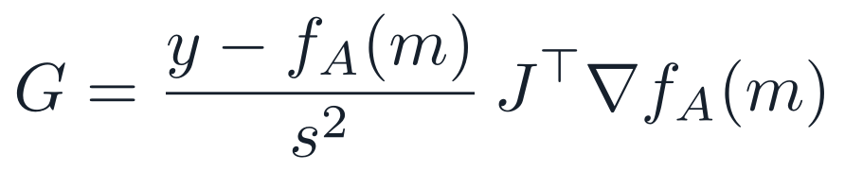
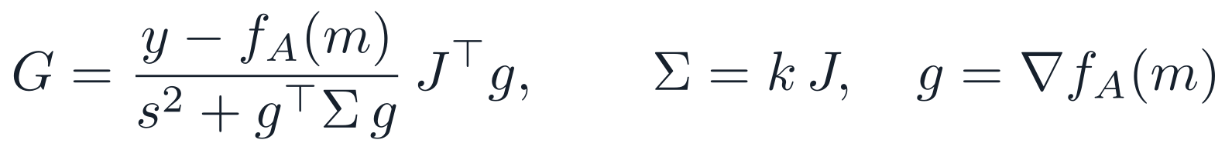
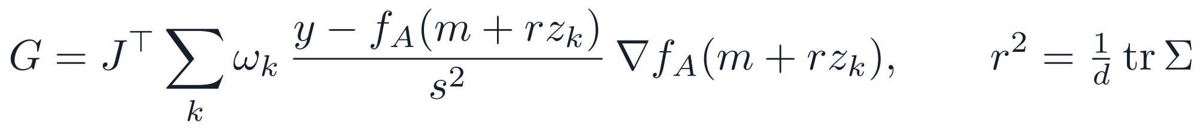
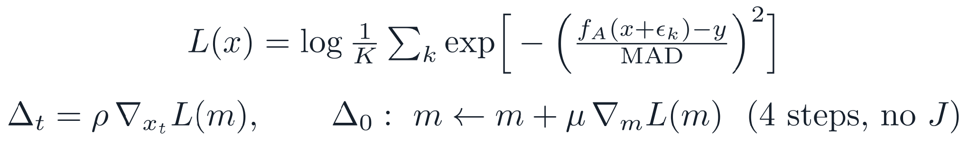
A4
APPENDIX A4 · GUIDANCE ARMS
The guidance arms, side by side
Shared frame. m = xₜ + (1 − t)vθ → frozen f_A → pull back through J = ∂m/∂xₜ → clip → add to the velocity (t ≥ 0.5, w = 1).
Arm
Correction
What it changes
Passes per cell (2e)
DPS-style plug-in [12]
the property at the endpoint; the baseline
1,000 / 400
TMPD-inspired [22]
shrinks the step where the endpoint is uncertain
1,200 / 400
LGD-MC [23]
averages the likelihood over K draws around m
1,200 / 2,000
TFG [15]
adds steps on the predicted molecule itself
800 / 2,000
BDG (ours)
plug-in with a servoed deviation gain
1,000 / 400
CIS 6270 · Group 2 · Appendix
[12] Chung et al. 2023 (DPS) · [22] Boys et al. 2024 (TMPD) · [23] Song et al. 2023 (LGD-MC) · [15] Ye et al. 2024 (TFG)

Slide 37
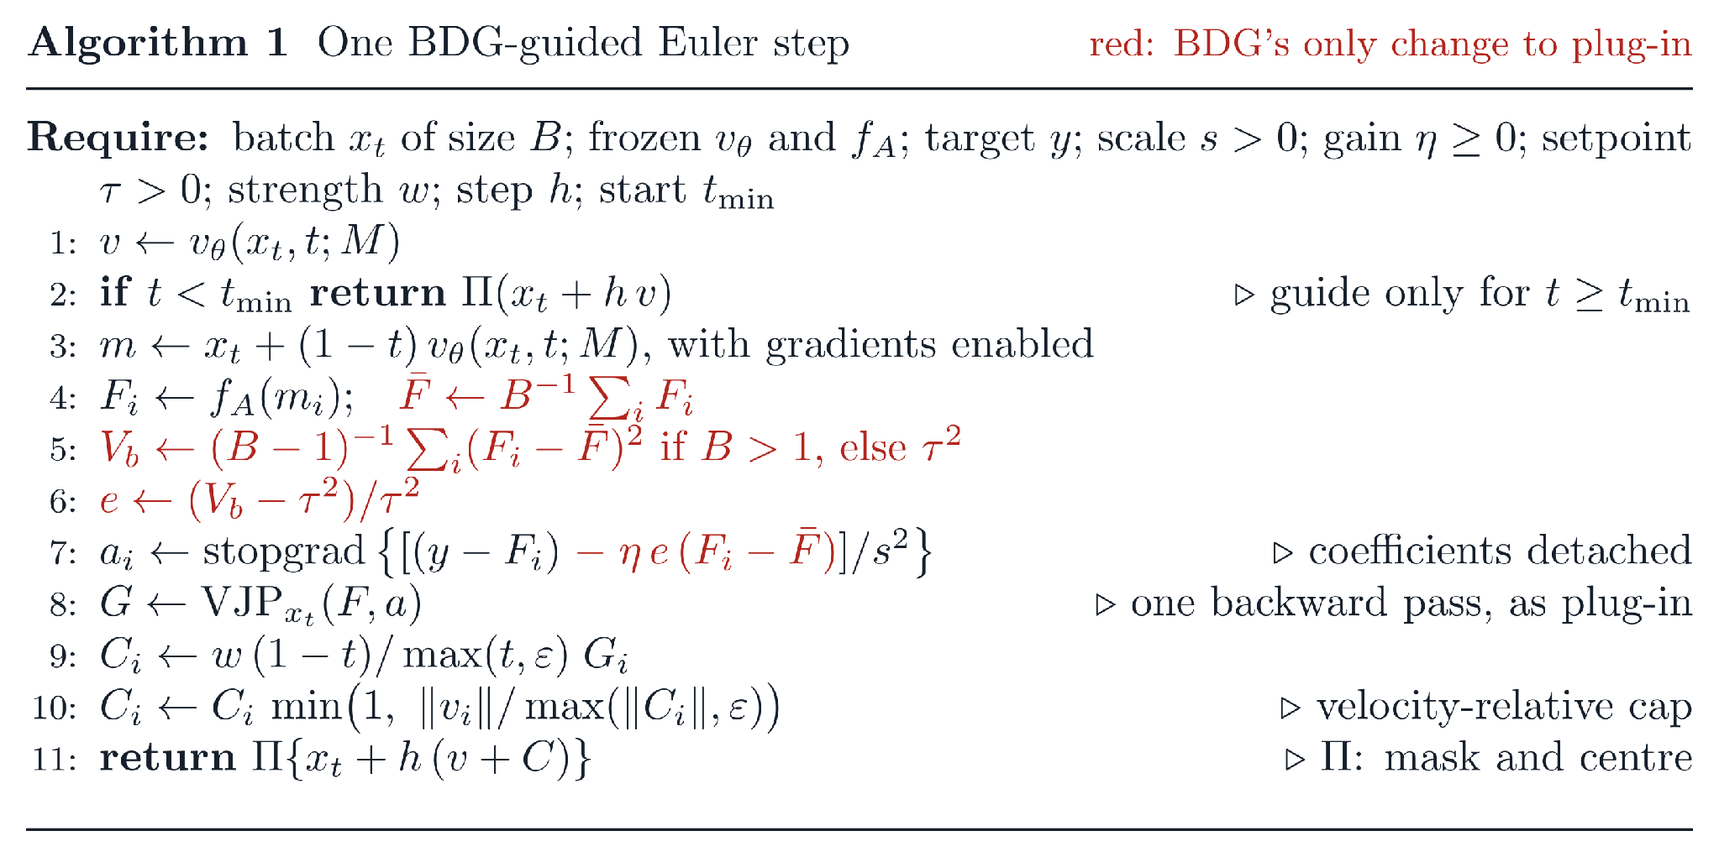
A5
APPENDIX A5 · THE ALGORITHM
BDG in the sampler: Algorithm 1
Checked in code
η = 0 gives plug-in's field bit for bit; the reduction and the bound hold numerically.
Cost
Plug-in's network calls; the red lines are scalar batch reductions.
The batch is the unit
B = 500, so each 2,000-sample cell runs four independent controllers.
On DNA only Π changes: clamp at zero and renormalise each position; decode by argmax at the end (3a).
CIS 6270 · Group 2 · Appendix
Original algorithm (this work), as in the paper's appendix; checks in proj1/tests/test_bdg.py

Slide 38
A6
APPENDIX A6 · MODALITY 2 ARCHITECTURE
The simplex flow-matching model
The Modality 2 generator: a dilated 1-D convolutional velocity field on the simplex. No equivariance is needed — a sequence has no rotation group — so the architecture is chosen for receptive field.
Stage
Input | one-hot / relaxed sequence, 500 × 4 channels (A, C, G, T)
Stem | Conv1d 4 → 128, kernel 5, padding 2
Body | 10 residual blocks. Each: Conv1d 128 → 128, kernel 5, dilation 1, 2, 4, 8 cycling → GroupNorm(8) → SiLU → Conv1d 128 → 128, kernel 1; added back to the input
Time | sinusoidal embedding → MLP → 128, added to the features inside every block
Head | Conv1d 128 → 4, kernel 1, zero-initialised so the field starts at zero
Size | ≈1.02M parameters
Receptive field | ≈100 bp — wide enough for the 3-mer structure the fidelity metric scores
Path and objective
Training
Why CpG is the interesting target
Linear path from a Dirichlet(1,1,1,1) source to the one-hot sequence, velocity MSE — the same objective as the molecular model, on a different state space [4].
83,722 sequences, 1,500 epochs = 492k updates, batch 256, Adam 2 × 10⁻³ cosine to zero, no EMA, seed 20260921. Validation selected epoch 1,450 (loss 0.0634); 539.7 min on an RTX A6000.
GC is affine in the relaxed sequence; CpG is quadratic, so its Hessian is non-zero and second-moment behaviour survives. CpG islands also mark regulatory DNA.
CIS 6270 · Group 2 · Appendix
Original architecture (this work): proj1/m2/simplex_fm.py · [4] Stark et al. 2024 (Dirichlet FM; DeepFlyBrain data)

