Slide 1
Brief Investigation into Infer.com
Qiqun.H
2013-08-13

Slide 2
Market Automation
Streamline sales and marketing organizations by replacing high-touch, repetitive manual processes with automated solutions
Cover almost all phases of the marketing process under full development as follows:
Demand generation
Lead management
Lead nurturing
Lead scoring (This is what infer.com focuses on)
Lead generation
Campaign analysis
Lead qualification
Sales effectiveness

Slide 3
Infer.com
General Introduction
spent 3 years of development before launching
aimed to help companies win more customers
focused on lead scoring in market automation process right now
Motif
launch a killer app that leverage data science but don't require you to be a data scientist to understand and run with
pick the biggest problem out there that affects the top line, that is, helping companies close more customers

Slide 4
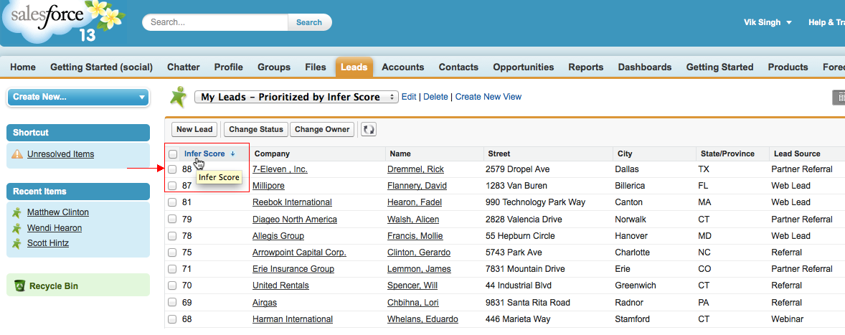
Infer.com (Product)
For sales

Slide 5
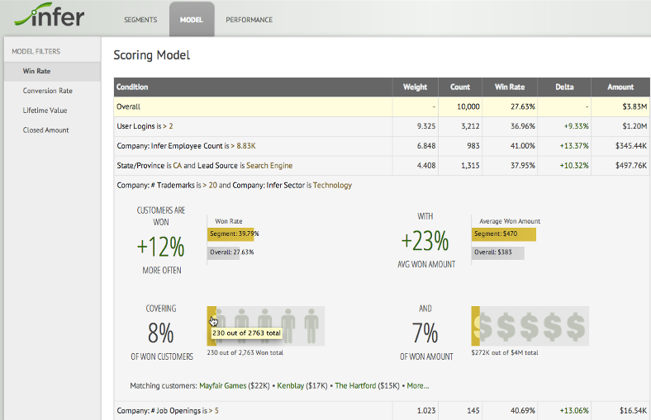
Infer.com (Product Continued)
For marketing

Slide 6
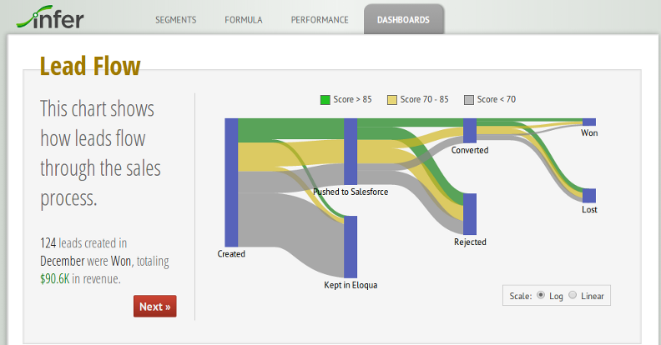
Infer.com (Product Continued)
For executives

Slide 7
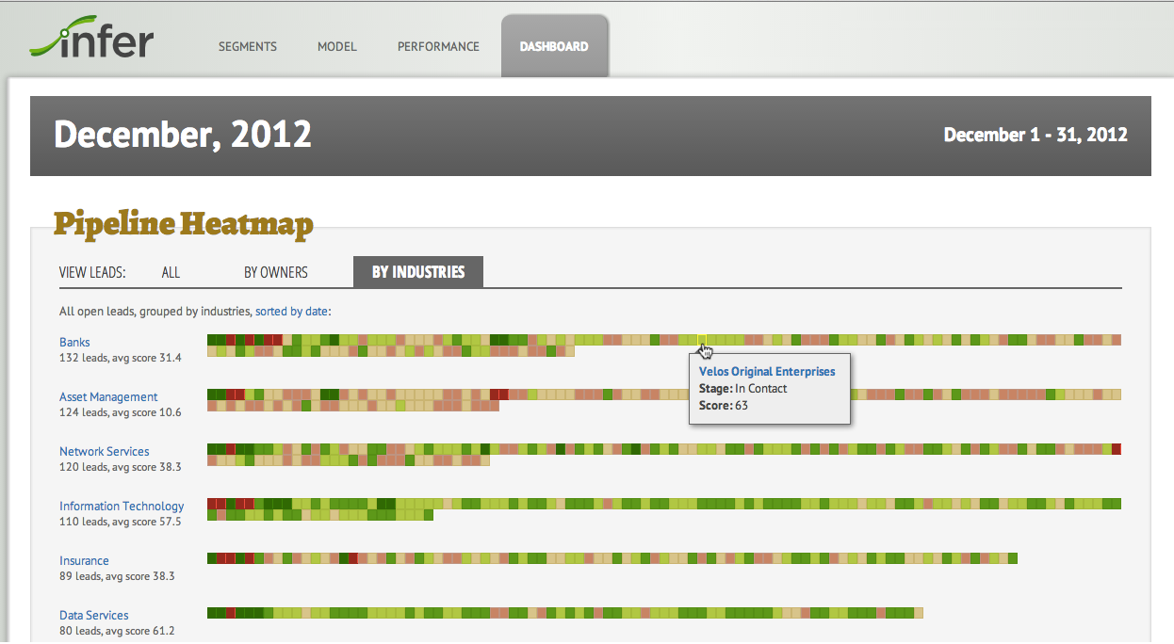
Infer.com (Product Continued)
For executives

Slide 8
Infer.com (Tech)
Tech: Predictive customer scoring
signals collection
internal data in automation system, e.g., Salesforce
external signals about customers from a variety of web sources
data cleansing
Name Entity Matching (IBM & International Business Machines)
data quality
sparsity issues (missing data)
Integration into any CRM system
Salesforce
Eloqua
Marketo

Slide 9
Infer.com (Customers & Competitors)
Customers
some Fortune 1000
Box, Jive, Tableau, Yammer, Zendesk
case study
How Infer Keeps Box on Top
Competitors (personal opinion)
SunGard: AvantGard Predictive Metrics
Kxen: Predictive Power
Neustar On-Demand Lead Scoring

Slide 10
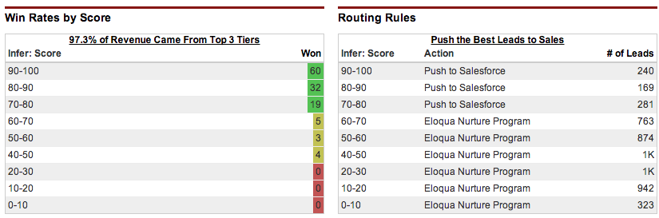
Infer.com (features)
Three ways Infer increase rep productivity
Send them your hottest leads

Slide 11
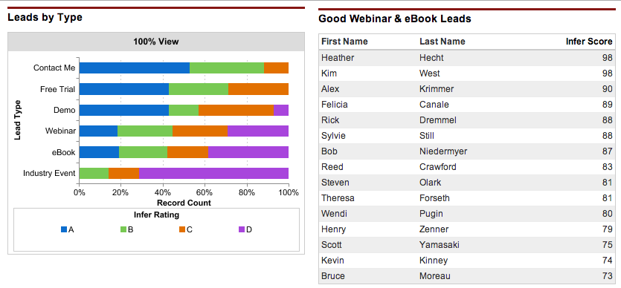
Infer.com (features Continued)
Three ways Infer increase rep productivity
Don’t miss out

Slide 12
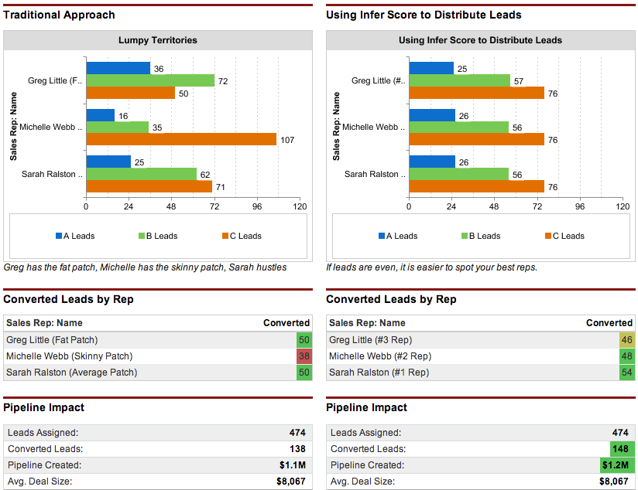
Infer.com (features Continued)
Three ways Infer increase rep productivity
Spot your best reps, and distribute leads accordingly

Slide 13
Extended Resource
Predictive Modeling
Three Trends in Predictive Modeling
how scoring and predictive models can help your business performing better
PredictiveMetrics for Consumer and Commercial Collections
Predictive Modeling and Scoring in ISO (a verisk analytics company)
Using Statistical Modeling to Get the Most Out of Your Customer Database
Predictive Analytics Applied: Marketing and Web
Customer Segmentation and Predictive Modeling
Developing a Predictive Model for Customer Trip Purpose to Be Integrated into Enterprise Strategy and Analytics

