Slide 1
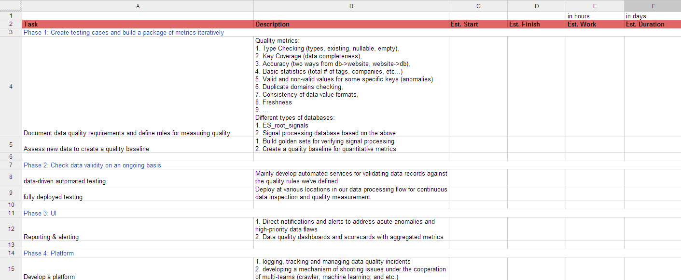
Blueprint of Data-driven Quality Assurance

Slide 2
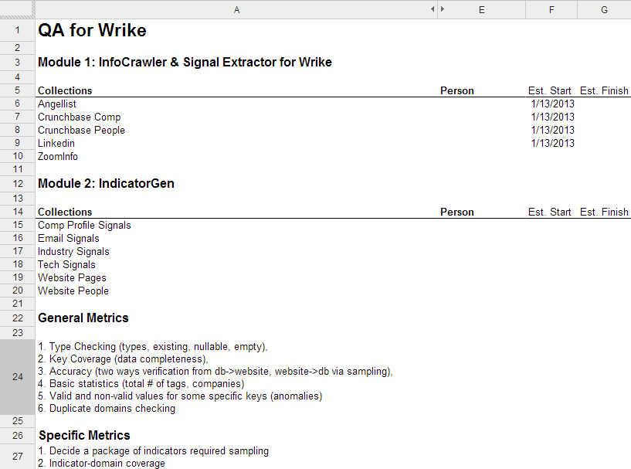
Details for phase 1

Slide 3
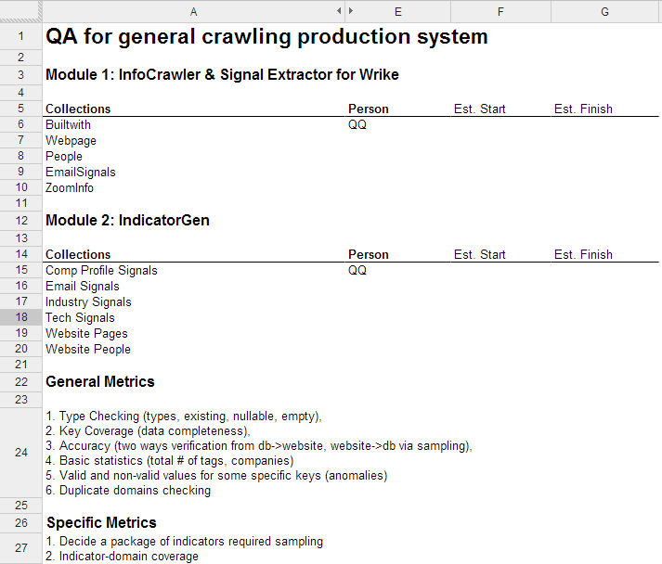
Details for phase 1 (continued)

Slide 4
Some QA outputs

Slide 5
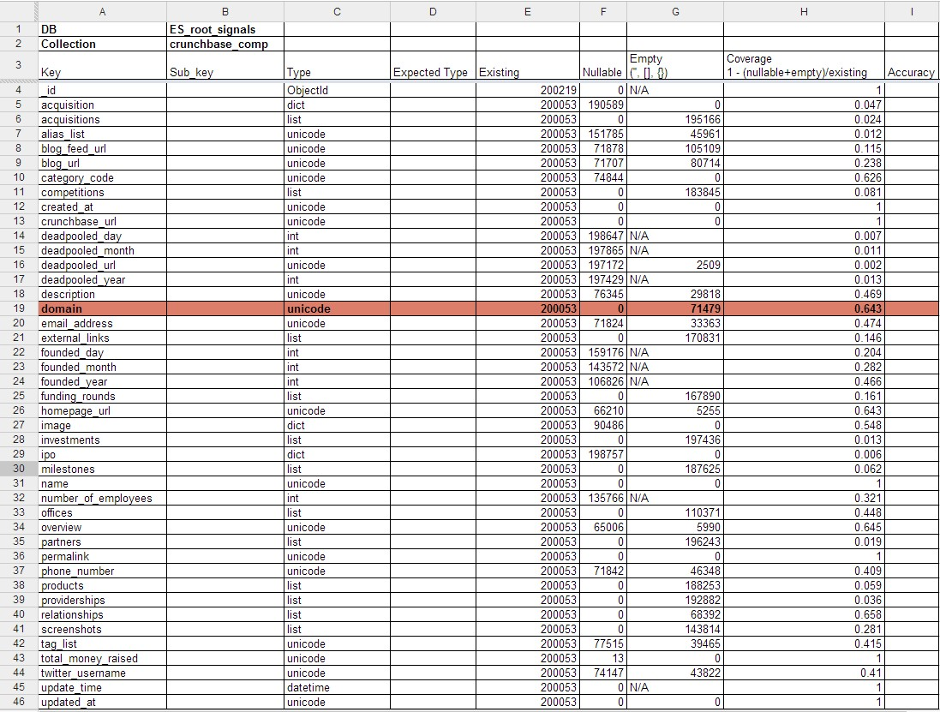

Slide 6
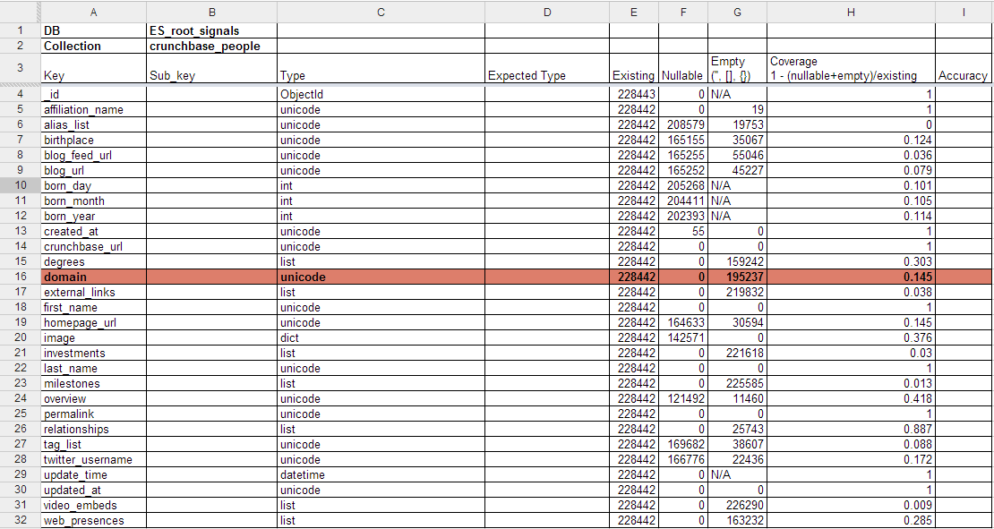

Slide 7
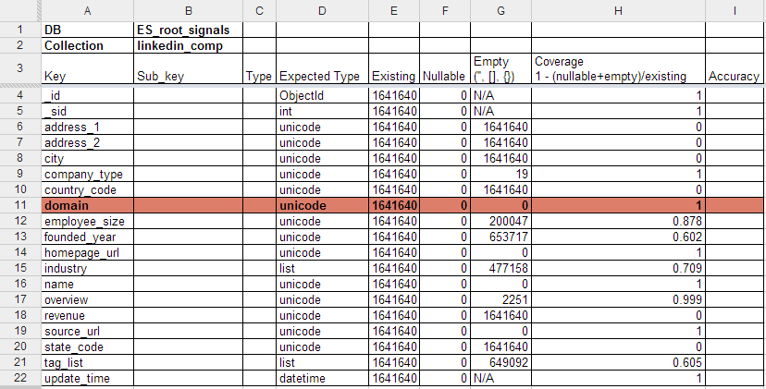

Slide 8
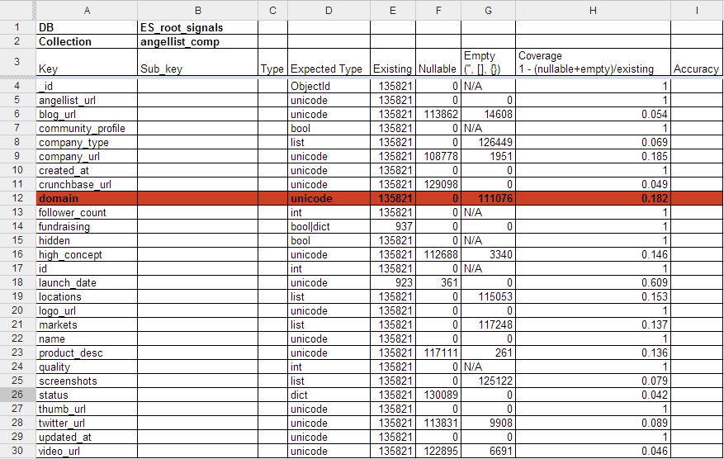

Slide 9
Some other concerns
Standalone test environment
Hope to spend more time to get familiar with how the data concerned is produced, and then how it is consumed in the whole data processing pipeline
Automated testing
Performance issues occured when dealing with DB-related requests
Limited resources

