Slide 1
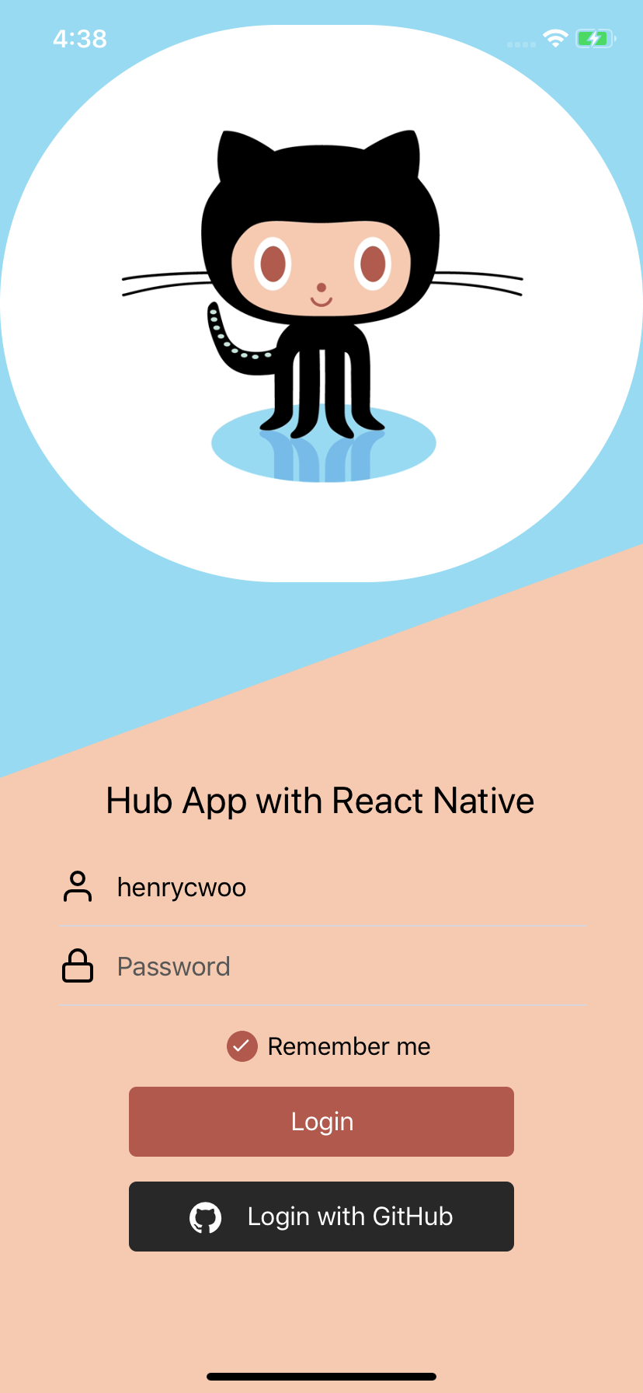
CS242 – Programming Studio
FA2018
Henry C Woo
hcwoo2
Assignment 3 Manual Test Plan
Users are greeted by Octocat. Here they can choose to input their credentials via BasicAuth or Auth2.0.
If they choose to “Remember Me” only their username will be stored for future accesses (password will still be required for entry).

Slide 2
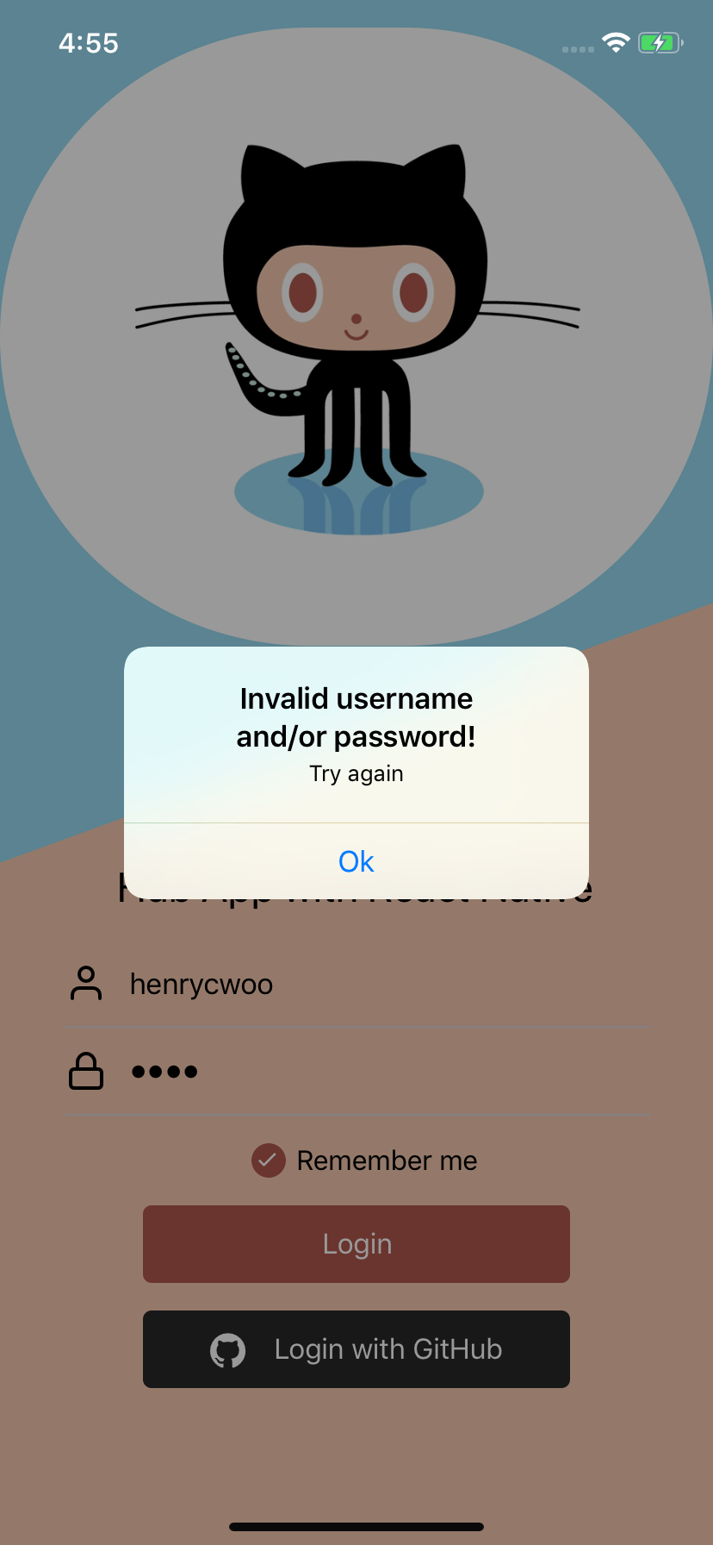
Invalid username and/or password entry will result in this alert.

Slide 3
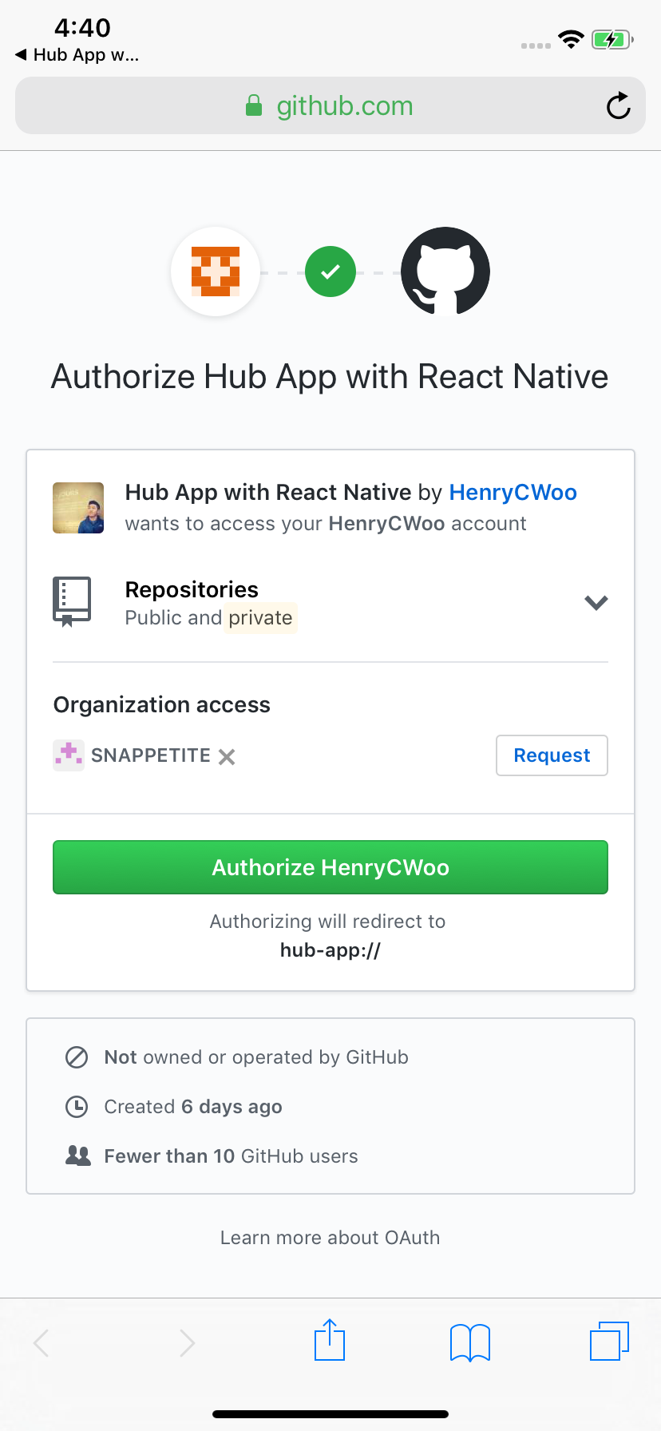
Choosing “Login with GitHub” will send them to https://www.github.com for permissions to access non-sensitive data about the user.

Slide 4
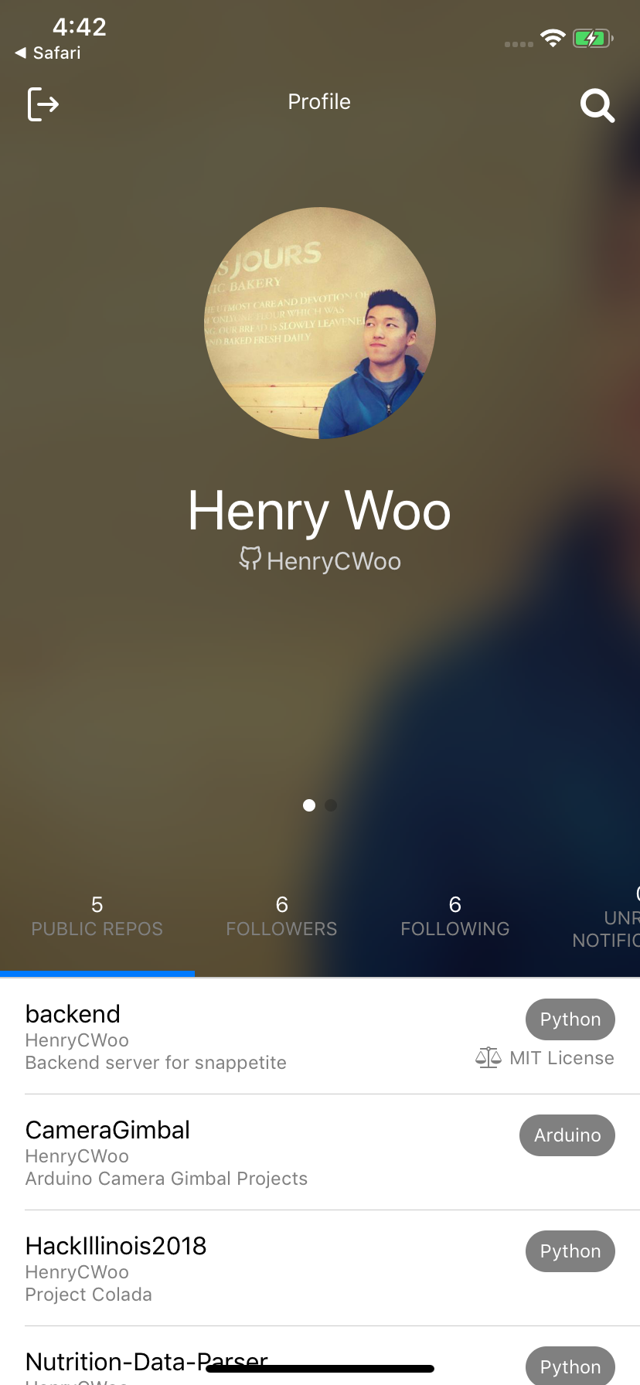
After login, they will see their avatar, the descriptions from their Github account, and 4 tabs for their public repos, following users, followers, and unread notifications.

Slide 5
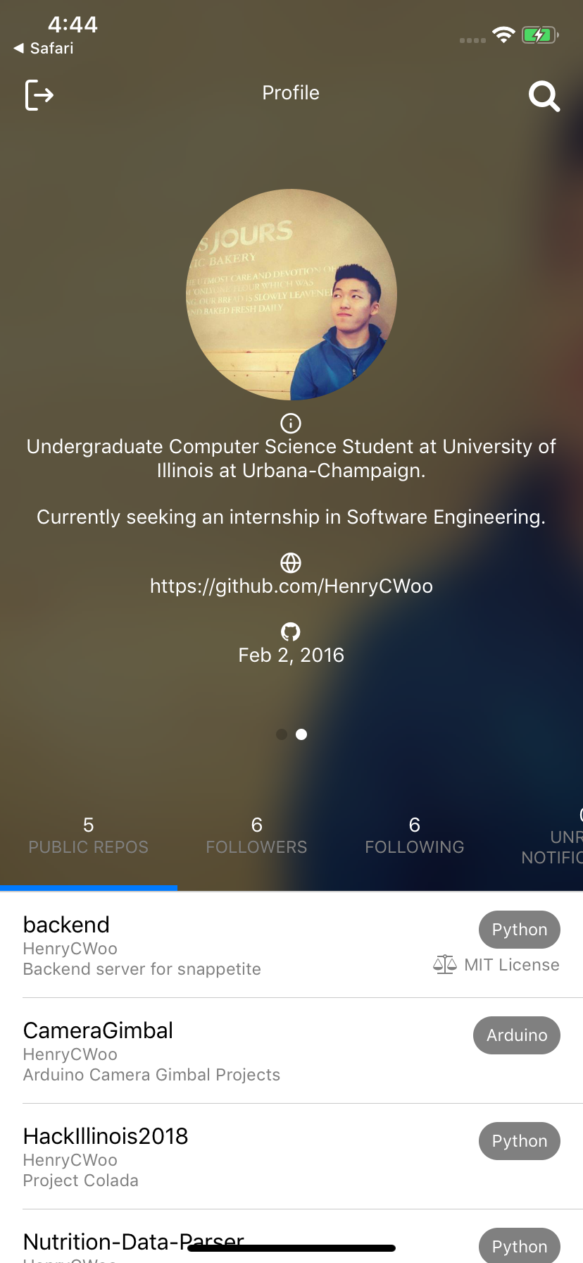
Swiping the name to the left will reveal multiple descriptors of their account like their bio and when they joined GitHub.

Slide 6
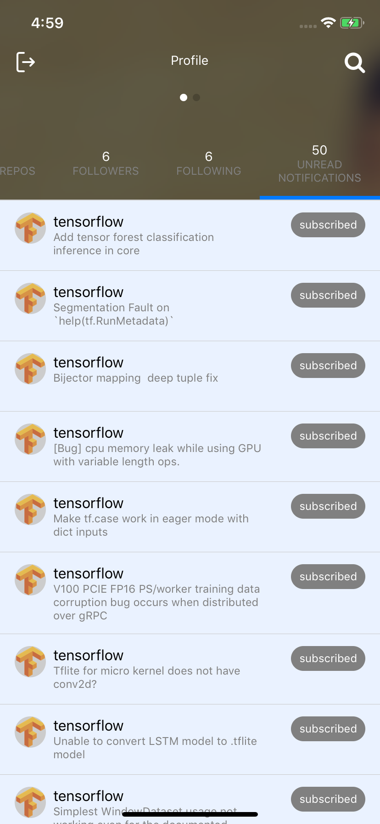
Clicking on an unread notification will send the user to the official GitHub page to view the notification. The message will then be marked as read.

Slide 7
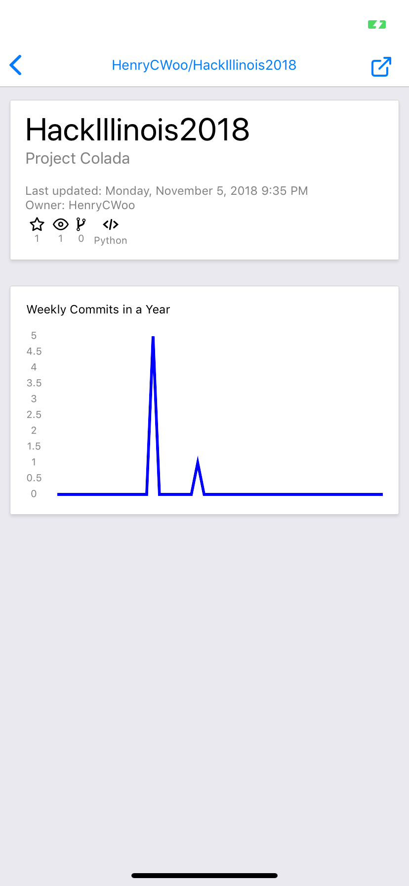
Pressing on one of the repositories will display this screen with some basic information with data visualization. They may choose to tap on the external link in the top right hand corner to visit the GitHub official repo page.

Slide 8
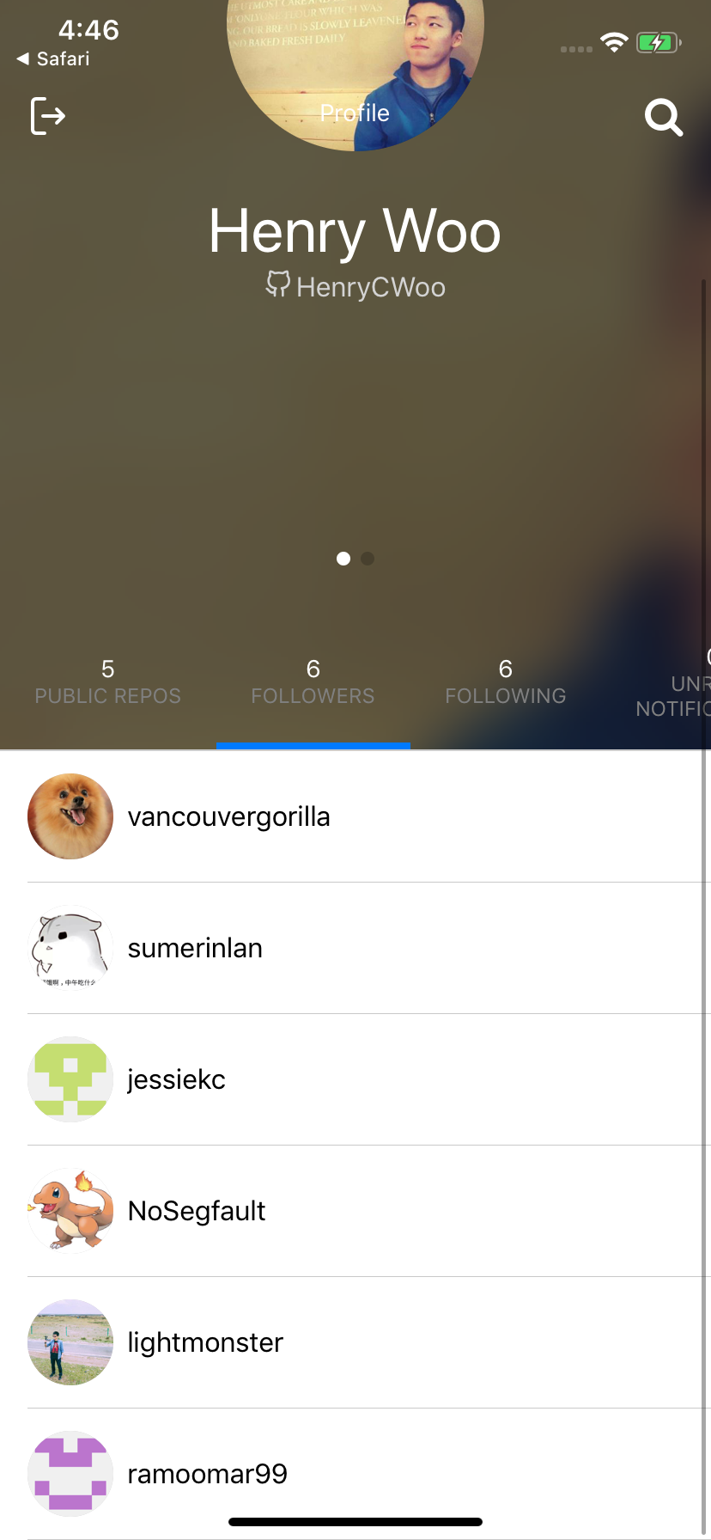
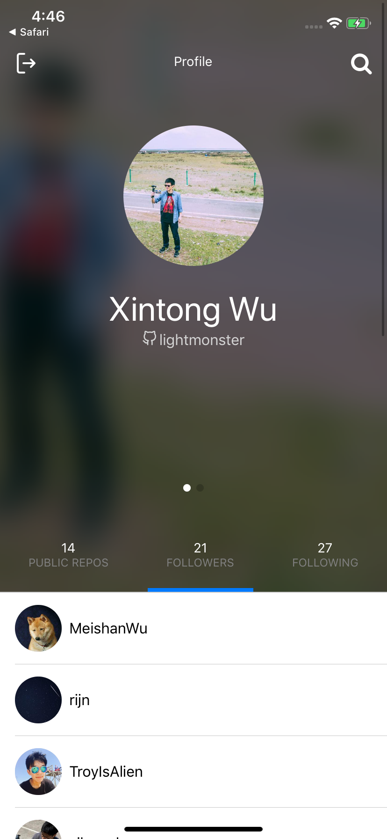
Press on one of the other users in the followers or following tab to get more information about them.

Slide 9
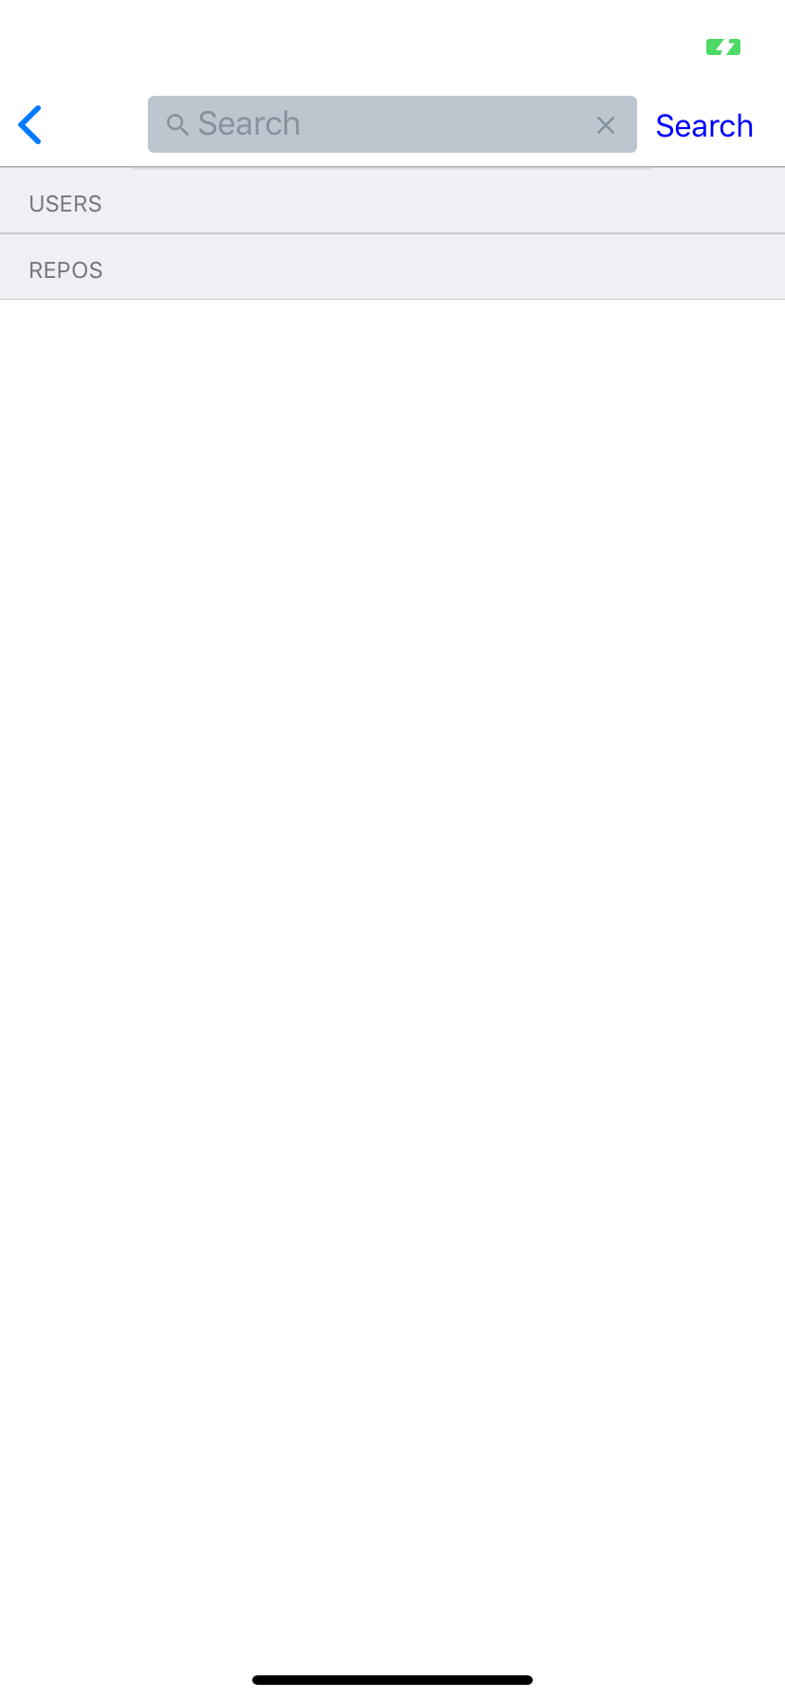
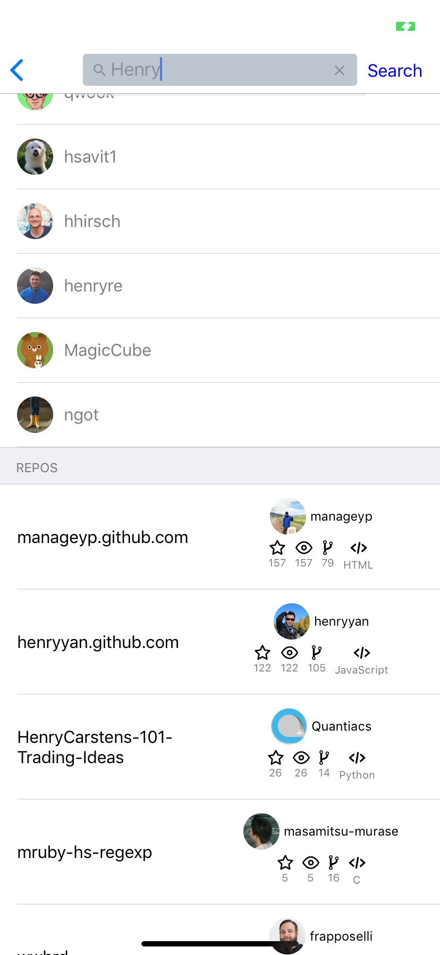
On the main screen, click on the magnifying glass to search for users and repositories. The search bar is on the header and the ”Search” button on the top right will execute the search.

Slide 10
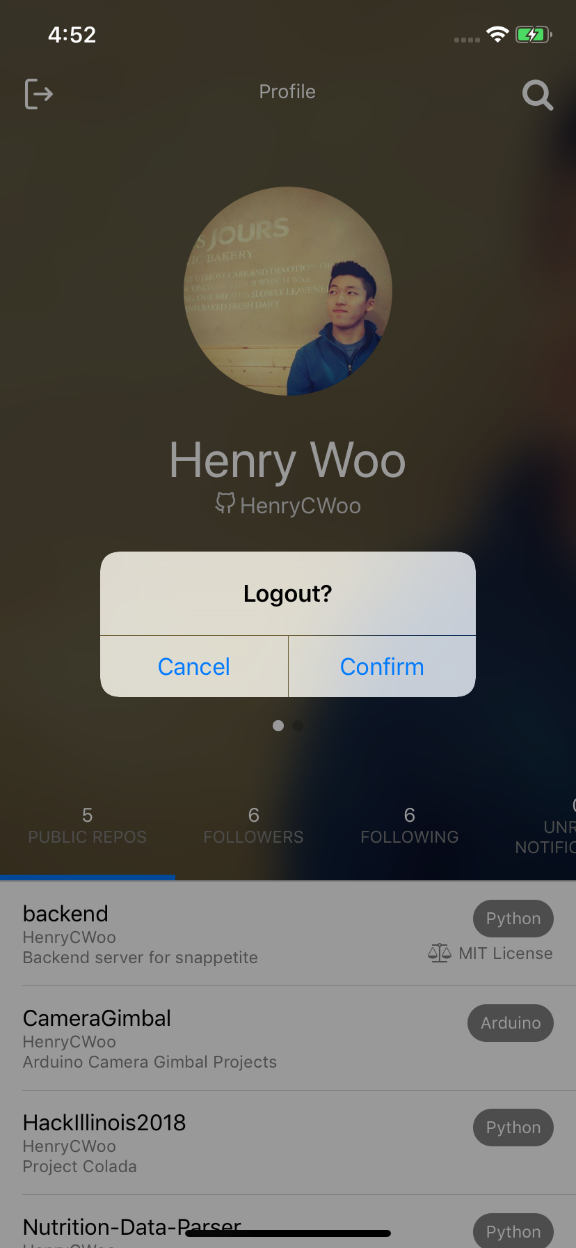
End a session by clicking on the logout icon in the top left. A confirmation screen will pop out.

