Slide 1
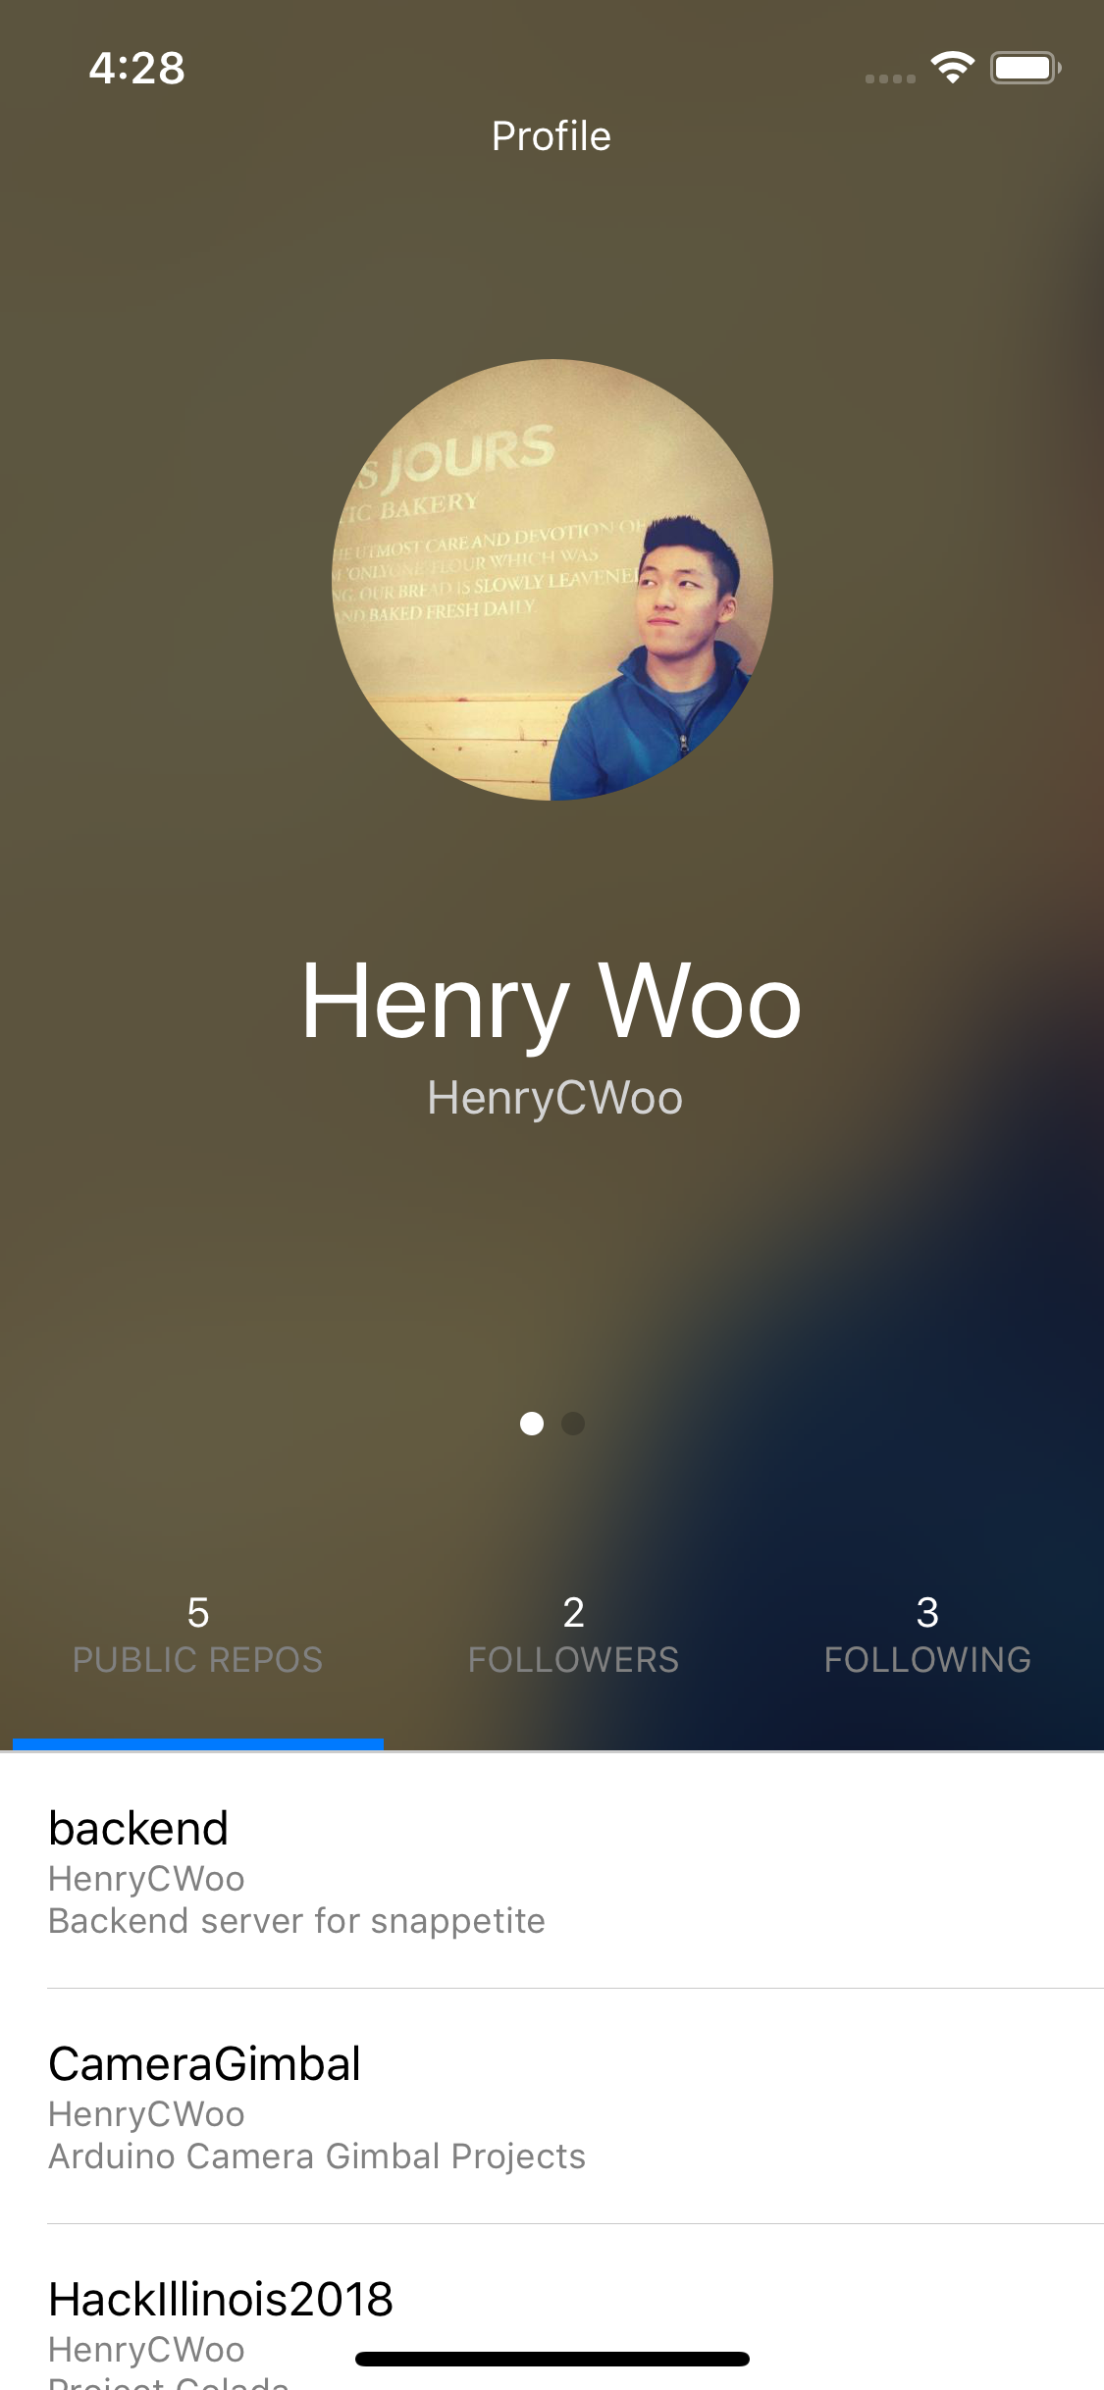
CS242 – Programming Studio
FA2018
Henry C Woo
hcwoo2
Assignment 3 Manual Test Plan
Users will be greeted with this screen. In this screen they will see their avatar, the descriptions from their Github account, and 3 tabs for their public repos, following users, and followers.

Slide 2
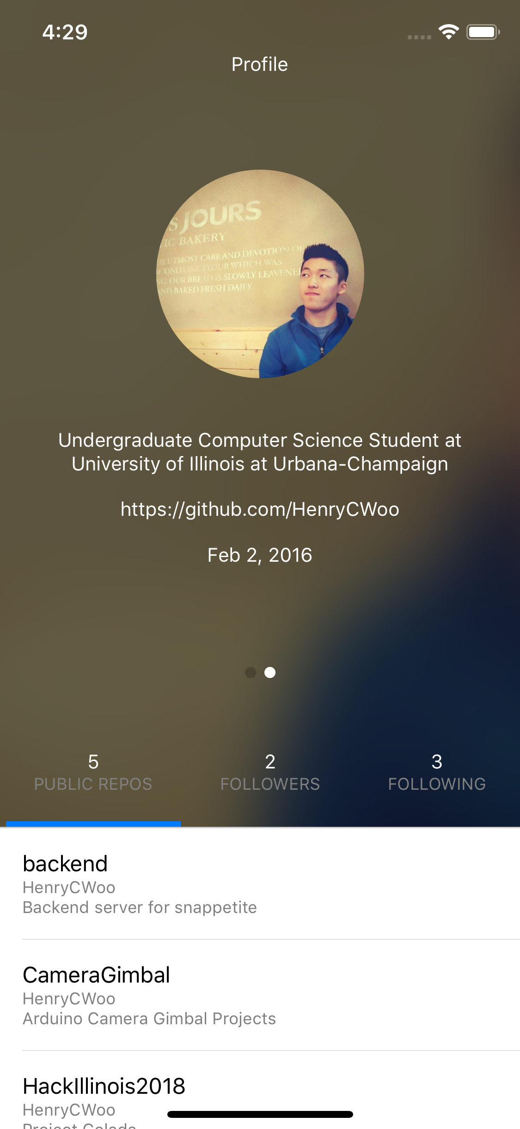
Swiping their name to the left will reveal multiple descriptors of their account like their bio and when they joined Github.

Slide 3
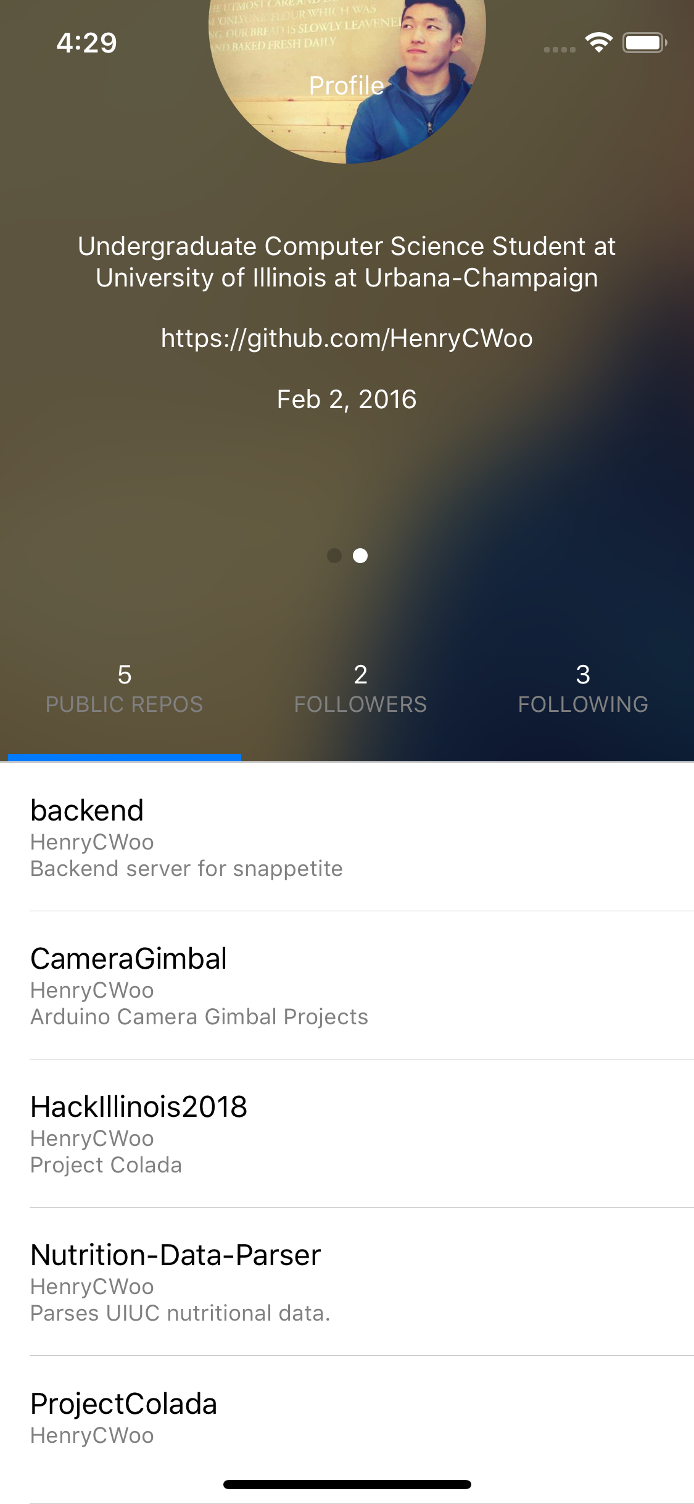
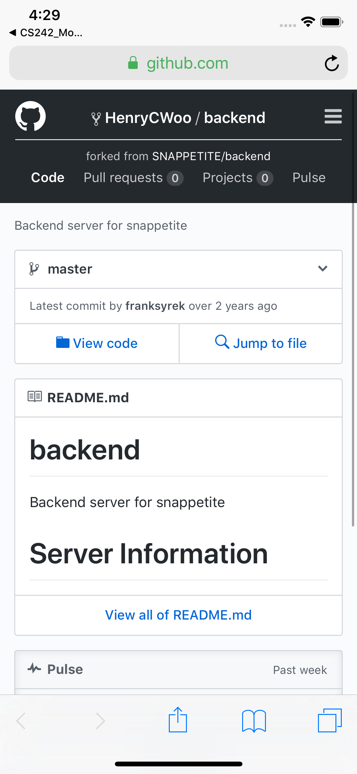
Pressing on one of the public repos will launch a default browser to the original Github URL.

Slide 4
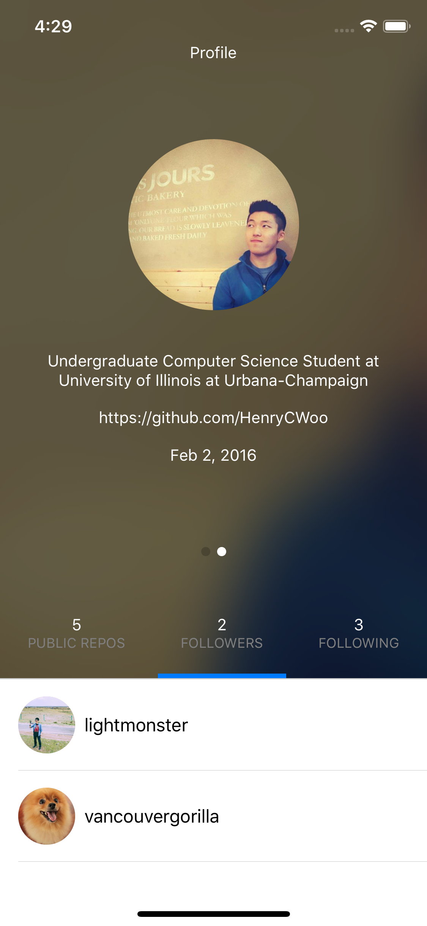
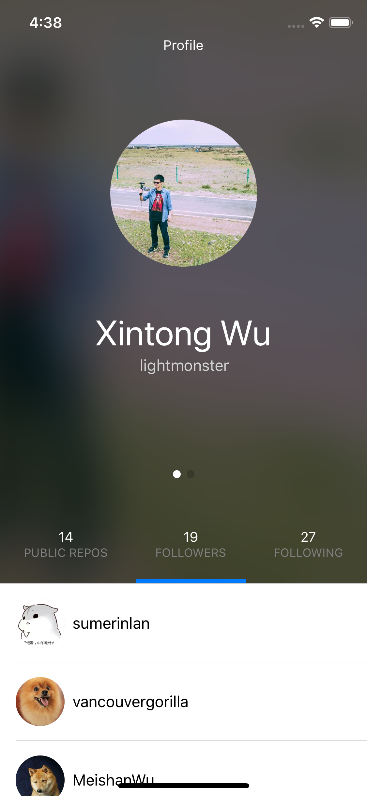
Press on one of the other users in the followers or following tab to get more information about them.

