Slide 1
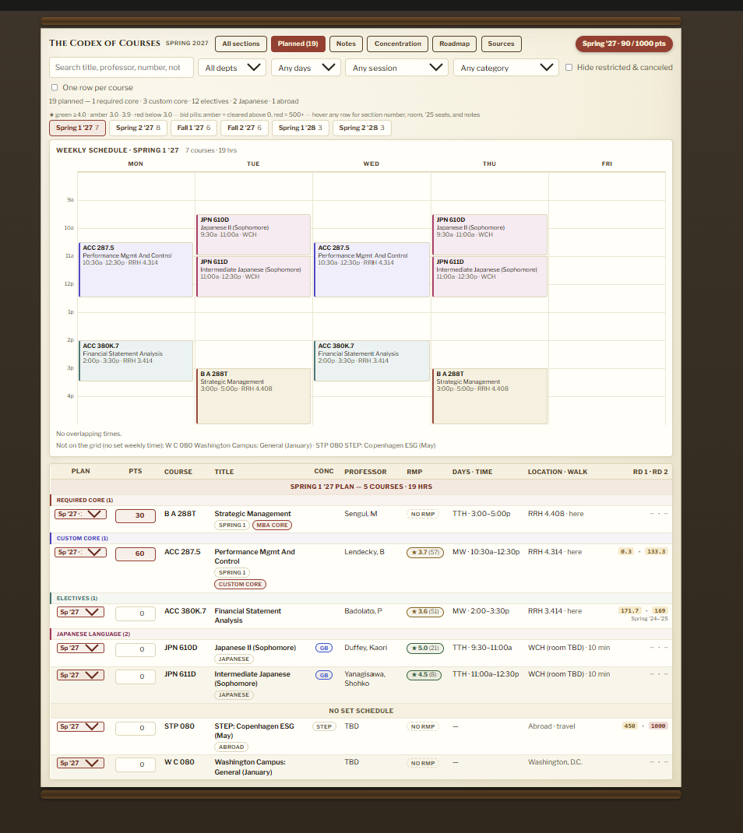
MBA Course Bid Planner
TEXAS
MCCOMBS
MBA
One planner for 180+ course sections, four semesters, and bid points per semester
SWIPE →
Notes:
Cover. Swap the screenshot by right-clicking it and choosing Change Picture.

Slide 2
Run like a product, not a spreadsheet
HOW I BUILT IT
1
Wrote requirements and planned features
I created spec sheets to preplan code changes following Agile development practice with Jira. AI code agent made the Pull Requests
2
Reviewed every change on GitHub
26 pull requests, each one approved before it shipped
3
Shipped features from real use
Per-semester budgets, conflict detection, walking times, fall vs. spring bid history
4
Cited every number
A Sources page shows where each figure came from and flags what's estimated

Slide 3
Scattered data with no way to compare
THE PROBLEM
McCombs electives are won by bidding a fixed points budget. Bidding well meant cross-referencing all of this by hand:
ORIGIN
DATA SOURCE
RESULT
Course schedule
Bidding platform
Registration list
University catalog
The Codex
of Courses
one planner
Spring '24 bid results
Bidding Excel sheets
Spring '25 bid results
Fall '24 bid results
Rate My Professors
Professor ratings
Concentration rules
Dashed arrows: built by matching class times and course lists across sources

Slide 4
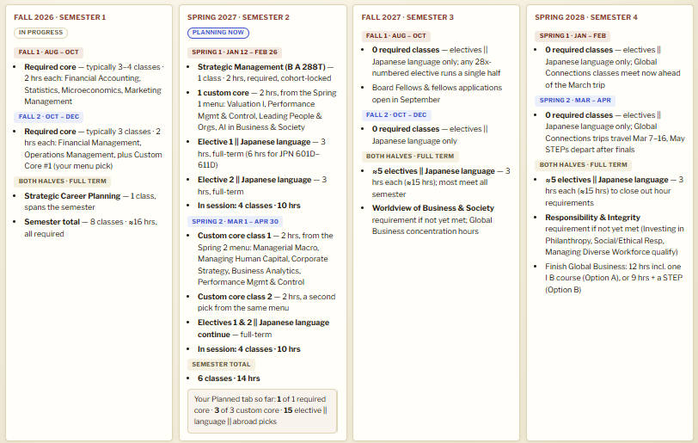
A roadmap of each semester
THE PLAN
Show courses required by semester including for my concentration and updates based on courses Ive fullfilled

Slide 5
Every bid in one plan
THE BIDS
The Planned tab lists each semester's picks by requirement, with my bid beside what each seat cost last time.
Bids against the budget
Points on each course, tracked against 90 of 1,000 for Spring '27
Picks by requirement
Grouped into required core, custom core, electives and language
Context on every row
Professor rating, walk time and past clearing bids beside each course

Slide 6
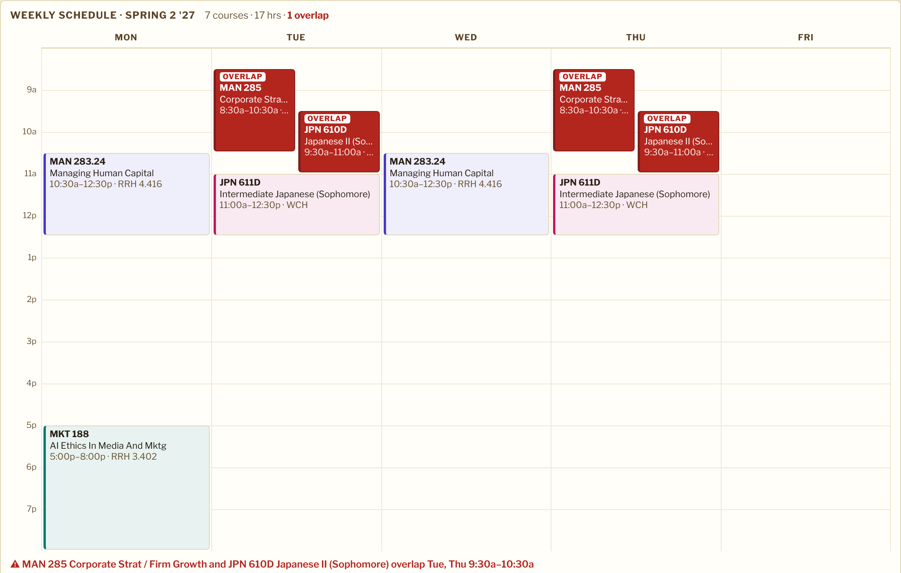
A clash I would have missed
WHAT IT CAUGHT
The weekly view turns overlapping classes red. Two of my planned courses meet at the same time every Tuesday and Thursday.
Found before add/drop, while there's still time to fix it.

Slide 7
Same course, very different price
WHAT THE DATA SHOWED
The average Round 1 clearing bid for one popular elective, by semester:
SPRING
FALL
172
1,133
points, 2024–25 average
points, Fall 2024
≈ 6.6× in the fall
Financial Statement Analysis · three sections each term
So the planner shows bid history for the semester you're planning, and fall points aren't budgeted on spring prices.

