Slide 1
Using ML to auto-classify database incidents
Henry Zhu

Slide 2
Project Overview
The goal of this project was to use machine learning in order to classify descriptions of database incidents / crashes into similar groups.
Procedure:
Convert text descriptions into vectors. Machine learning requires numerical data to be analyzed.
Cluster the vectors into their individual groups by using K-Means algorithm.
Output to console

Slide 3
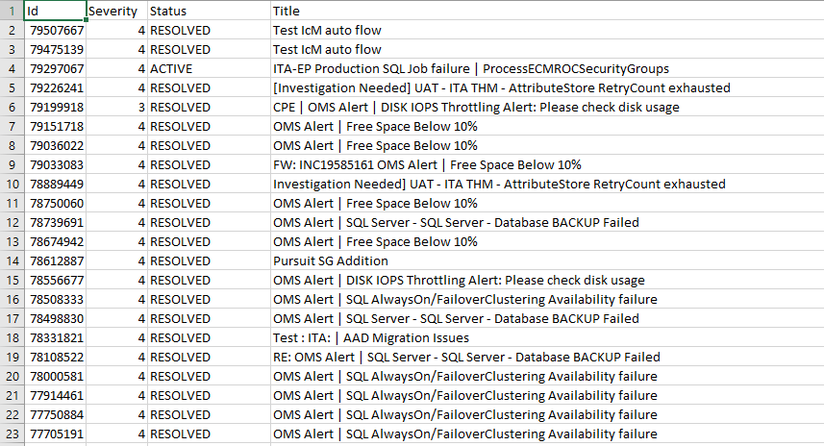
Input File Sample

Slide 4
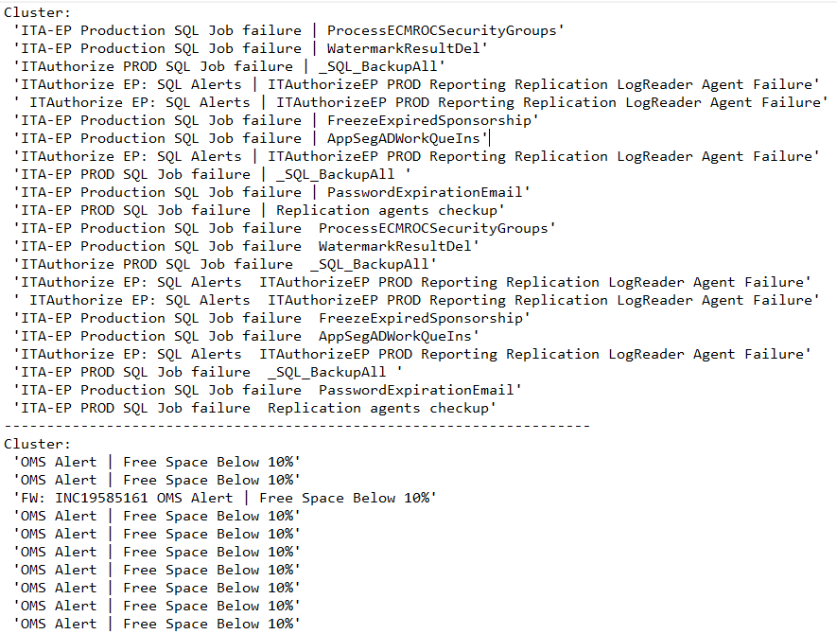
Output Sample

