Slide 1

AMAZON SALES
DATA ANALYSIS REPORT
Henry Difan

Slide 2
Problem Statement
Objective
Benefits
Help out to make better business decisions.
Help analyze customer trends and satisfaction, which can lead to new and better products and services.
Gives better insight of customers base.
Helps in easy flow for managing resources.
Sales management has gained importance to meet increasing competition and the need
for improved methods of distribution to reduce cost and to increase profits. Sales
management today is the most important function in a commercial and business
enterprise.
Develop a Report by Extracting-Transforming-Loading of data which contains Sales trend with respect to Yearl-wise,
Month-wise,Yearly_month-wise and find Some relationships through data to understand and Analyze the Facts.

Slide 3
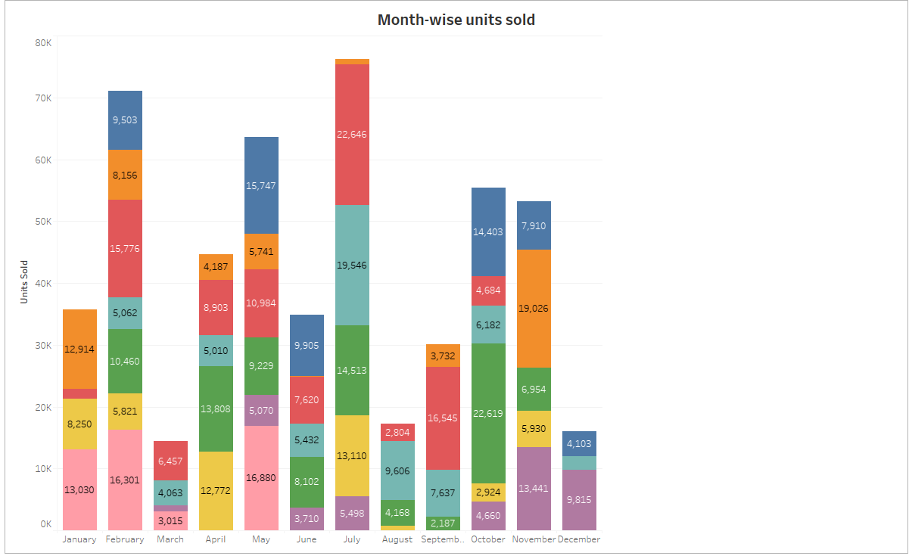
Monthly Sales Comparison
The sales in February, May & July is high when compared and we can observe for March, August & December the sales of units drops.

Slide 4
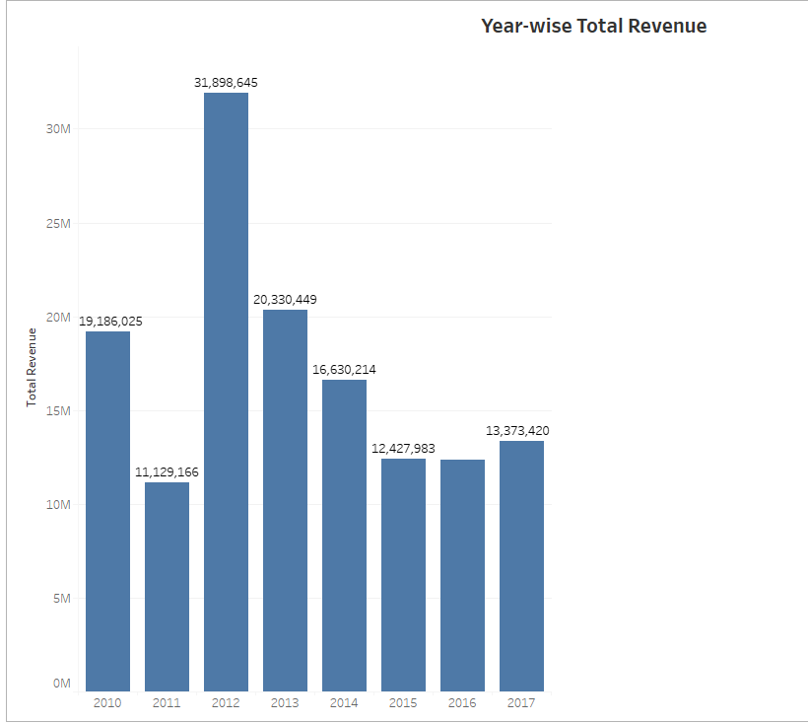
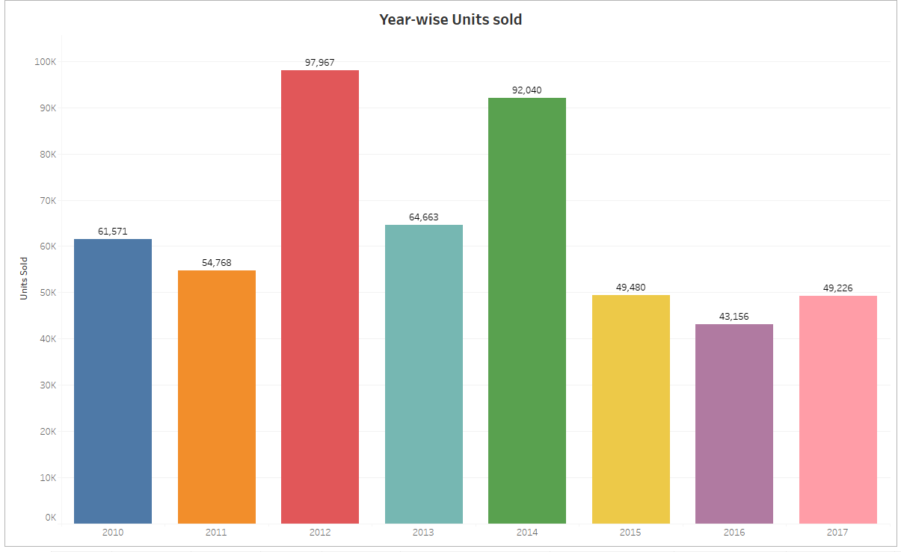
Total Sales for all the years
﻿2012 had the highest Revenue at 31.89M, followed by 2013 at 20.33M and 2010 at 19.18M﻿

Slide 5
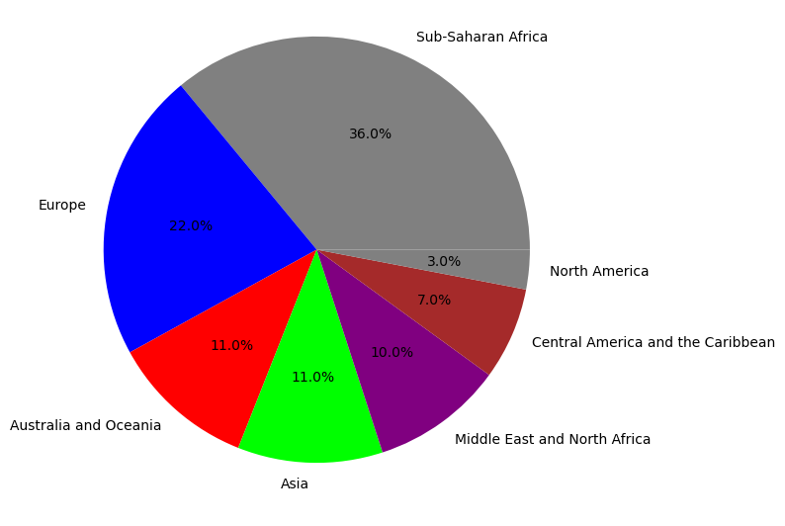
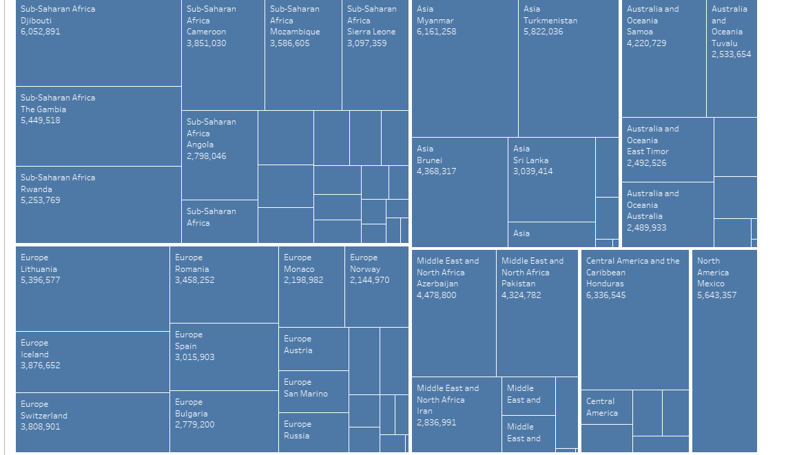
Revenue Categorized By Region
﻿
As we have seen more revenue is generated from the region Sub-Saharan Africa followed by Europe.
As we have seen more revenue is generated from the Country Djibouti at 6M.

Slide 6
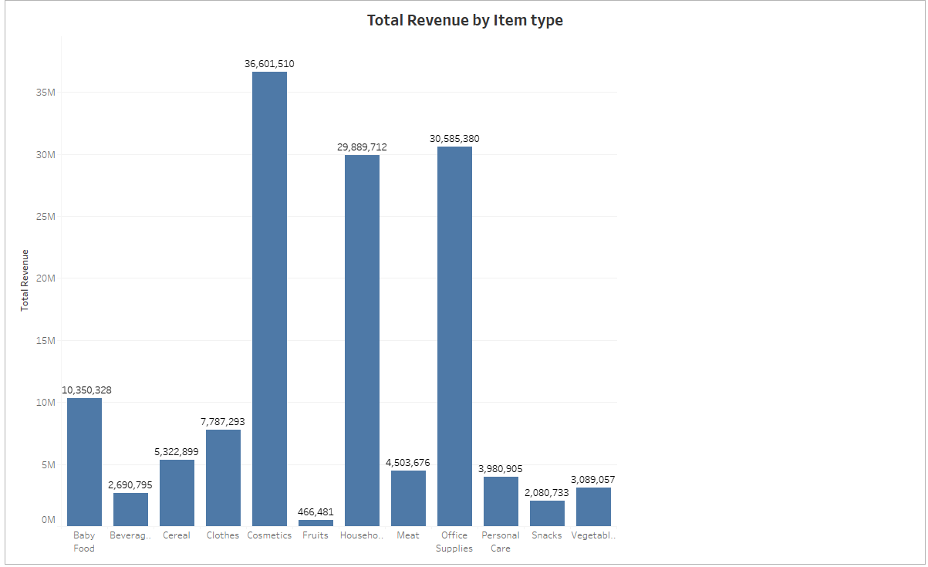
Item type w.r.t revenue
Cosmetics generated revenue of 36.60M followed by Office supplies that’s 30.58M

Slide 7
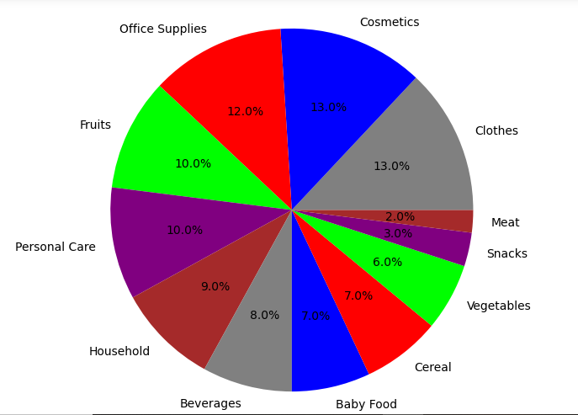
Item type of Products Sold w.r.t revenue
The Cosmetics and Clothes are the products with highest sales from all products followed by Office Supplies.
The Meat and Snacks are the products with lowest sales.

Slide 8
Conclusion
1.2012 had the highest Revenue at 31.89.M, followed by 2013 at 20.33M
and 2010 at 19.18M.
2. If we observe the monthly insights from 2010 to 2017, the sales are at their peak in February,April,May,July&October and are low in March, August & December. Amazon can come up with some good discounts and offers to generate high revenue.
3. The sales for the items are highest among all countries in SaoTome and Principe followed by Djibouti and lowest in Slovakia.
.
4. The Cosmetics& Clothes are the highest selling products followed by Office supplies in domestic and international markets.
5. Cosmetics,Household and Office supplies are the item types to generate
More Revenue.

Slide 9
Thank you

