Slide 1
Networking Presentation
What is an internet? A miserable little pile of packets?
ITMS 448
Henry Post
There is no formatting because LibreOffice Impress themes are broken for flat ODP files :)

Slide 2
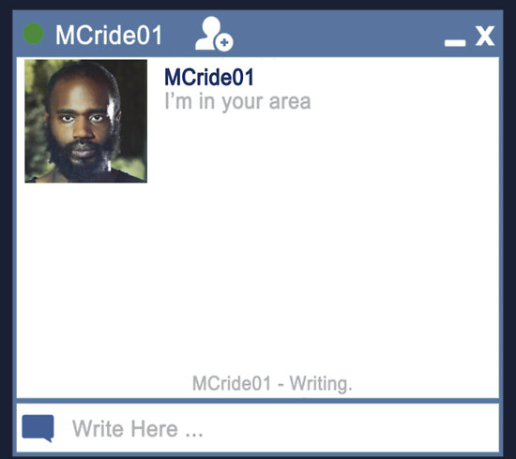
Analysis of Wireshark
I browsed news sites, music sites, and watched videos while capturing my packets.
Some was on HTTPS, some on HTTP, and some was other protocols.
I mainly focused on seeing what I could find out from the HTTP/S traffic because that’s web browsing activity, which is often interesting.

Slide 3
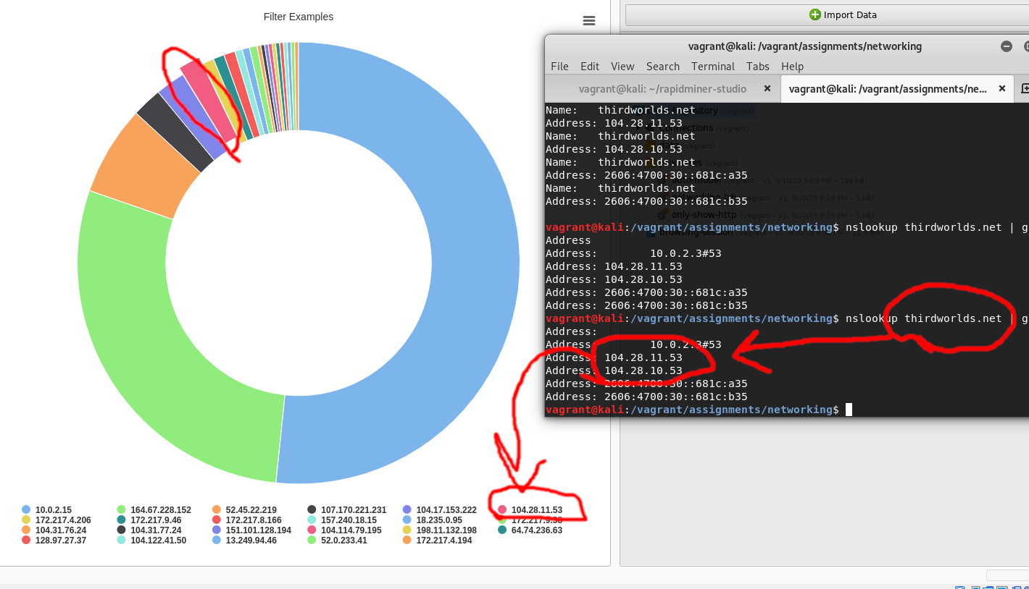

Most HTTP packets tx/rx by IP

Slide 4
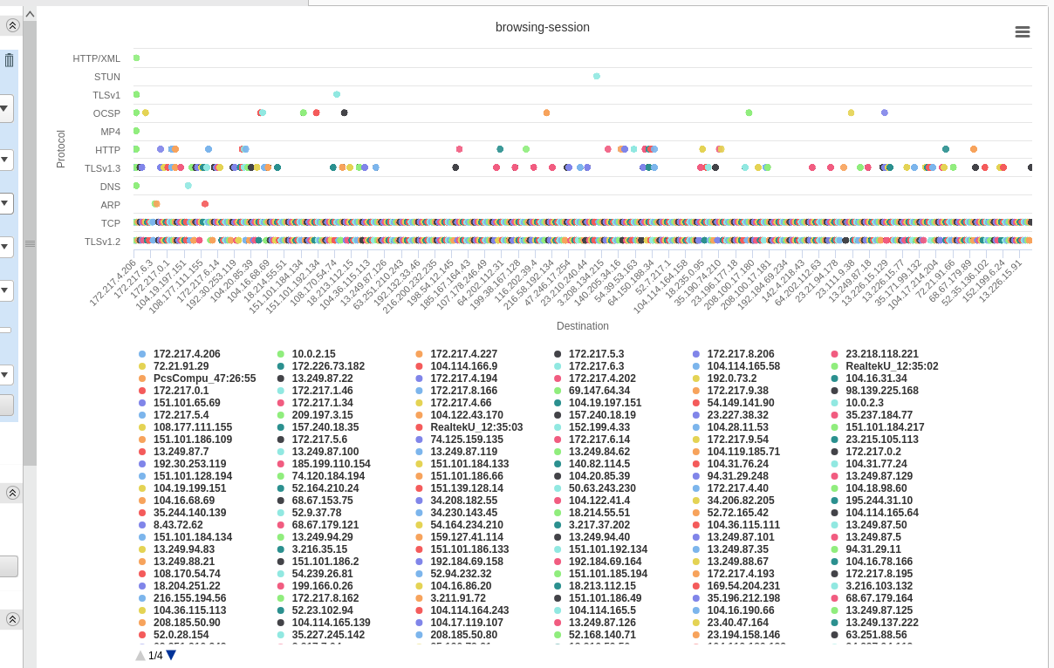
Popular protocols per host

Slide 5
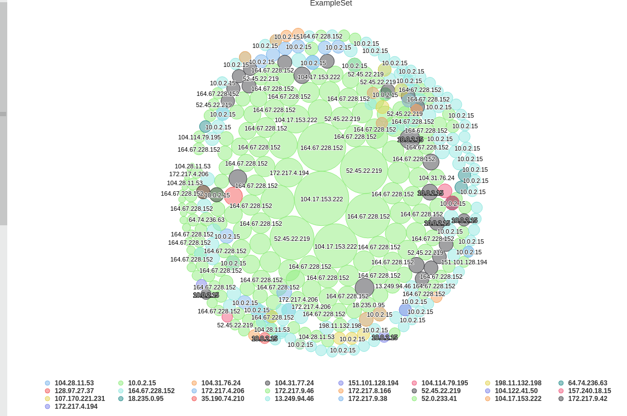
Most HTTP packets, bubble graph

Slide 6
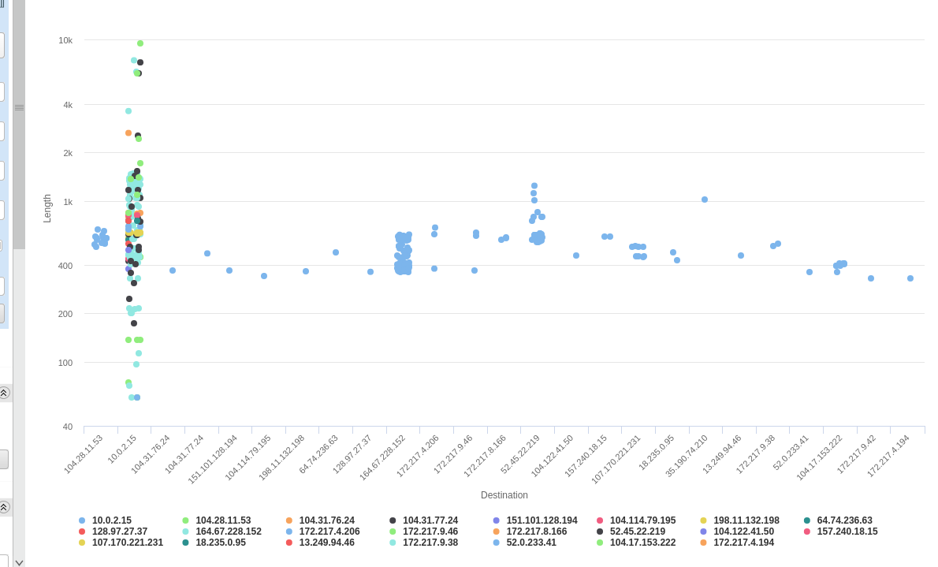
Longest packet sequences per host

Slide 7
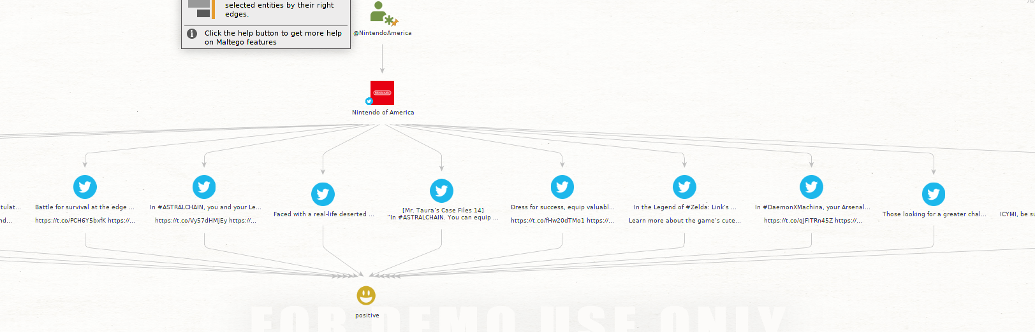
Game Retail Twitter Sentiments

Slide 8
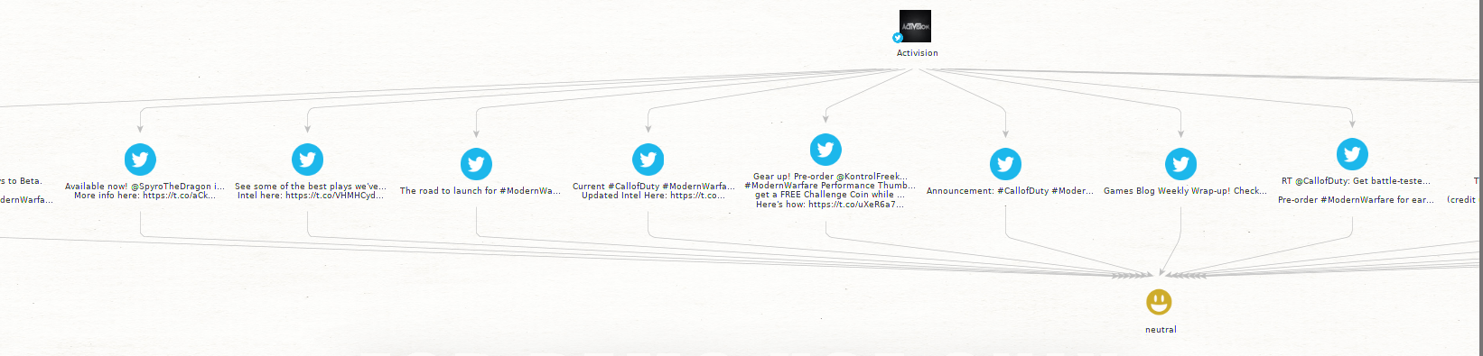
Game Retail Twitter Sentiments

Slide 9
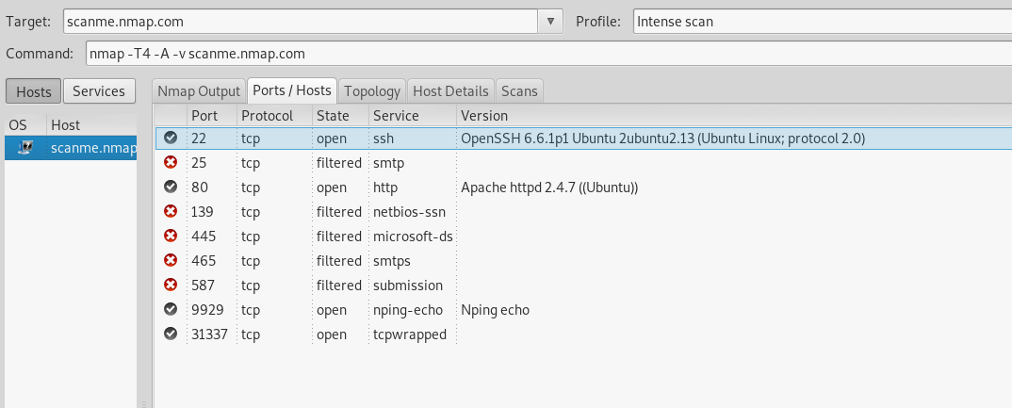
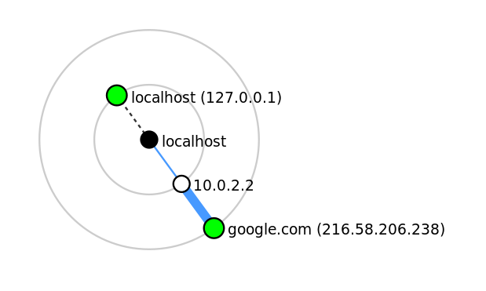
nmap and traceroute
(Don’t worry, I only ran traceroute on google.)

Slide 10
Thank you!
Questions?
(Prof. Dawson, go past this slide for other deliverables.)

Slide 11
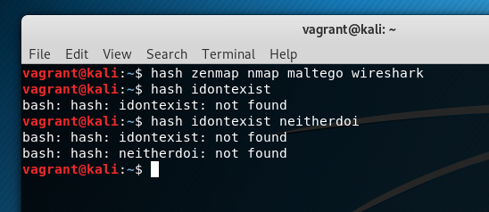
Installed Programs Proof

Slide 12
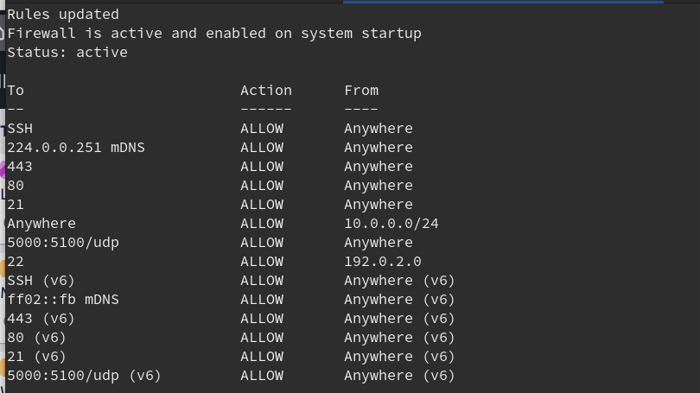
UFW config proof

Slide 13
Raw data/graphs/CSV
See other files in the ZIP file for raw data/graphs/CSV files

