Slide 1
Networking Presentation
What is an internet? A miserable little pile of packets?
ITMS 448
Henry Post

Slide 2

Analysis of Wireshark
I browsed news sites, music sites, and watched videos while capturing my packets.
Some was on HTTPS, some on HTTP, and some was other protocols.
I mainly focused on seeing what I could find out from the HTTP/S traffic because that’s web browsing activity, which is often interesting.

Slide 3
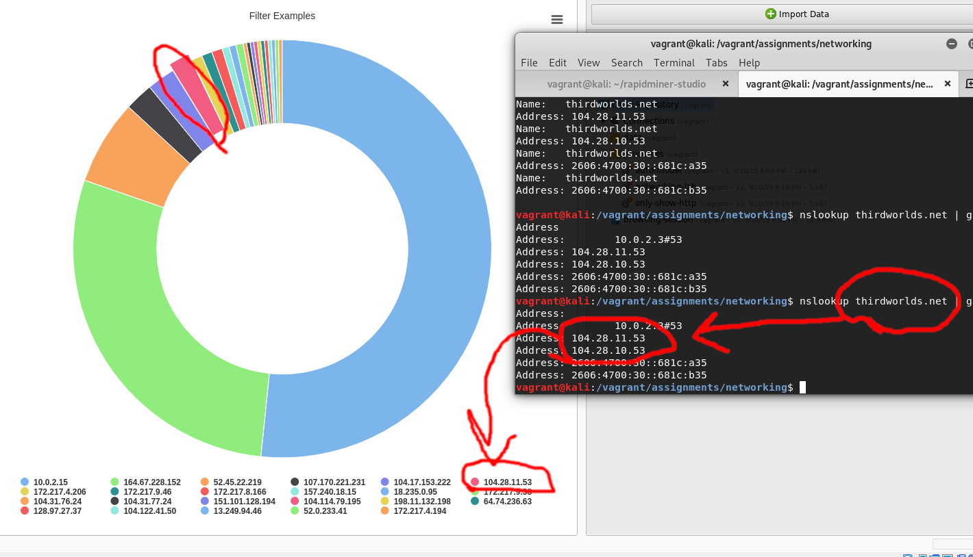
Most HTTP packets tx/rx by IP

Slide 4
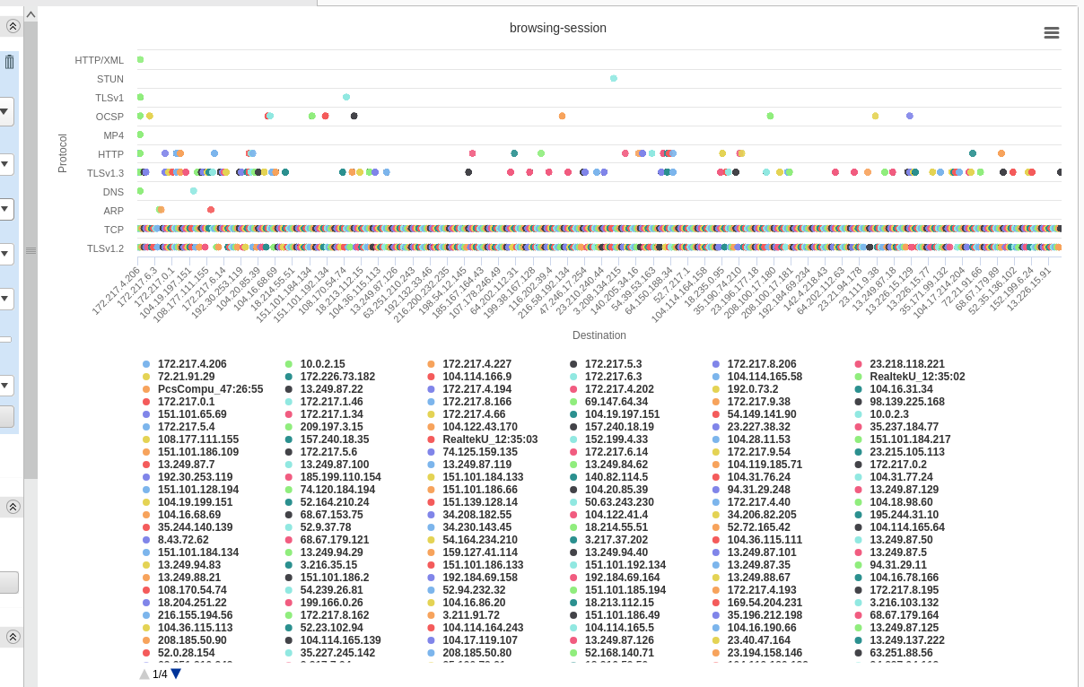
Popular protocols per host

Slide 5
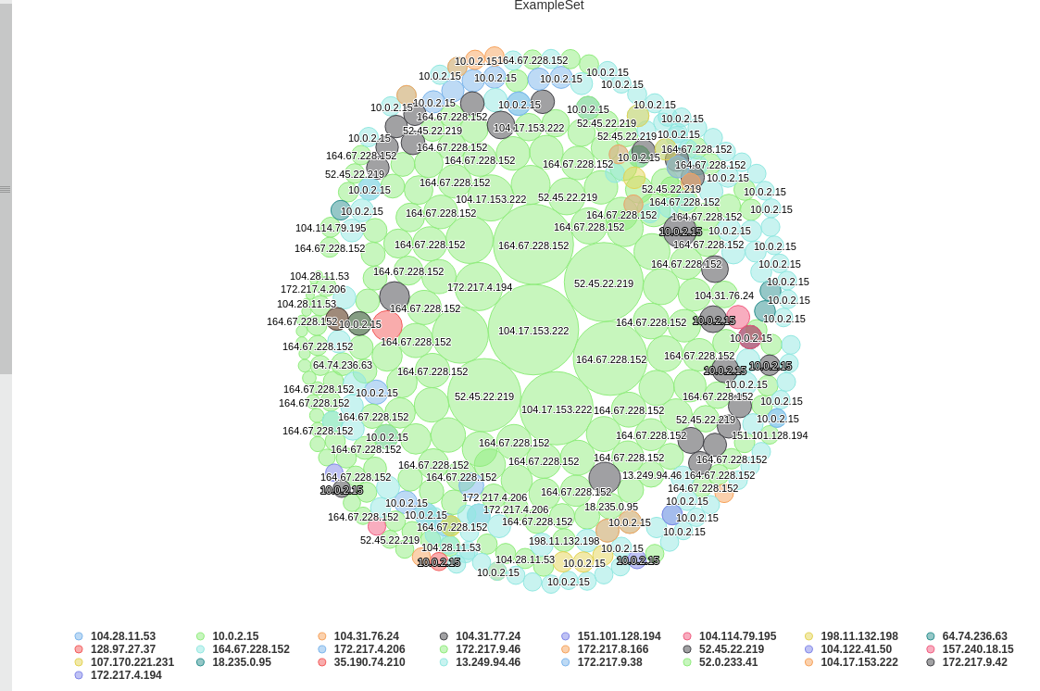
Most HTTP packets, bubble graph

Slide 6
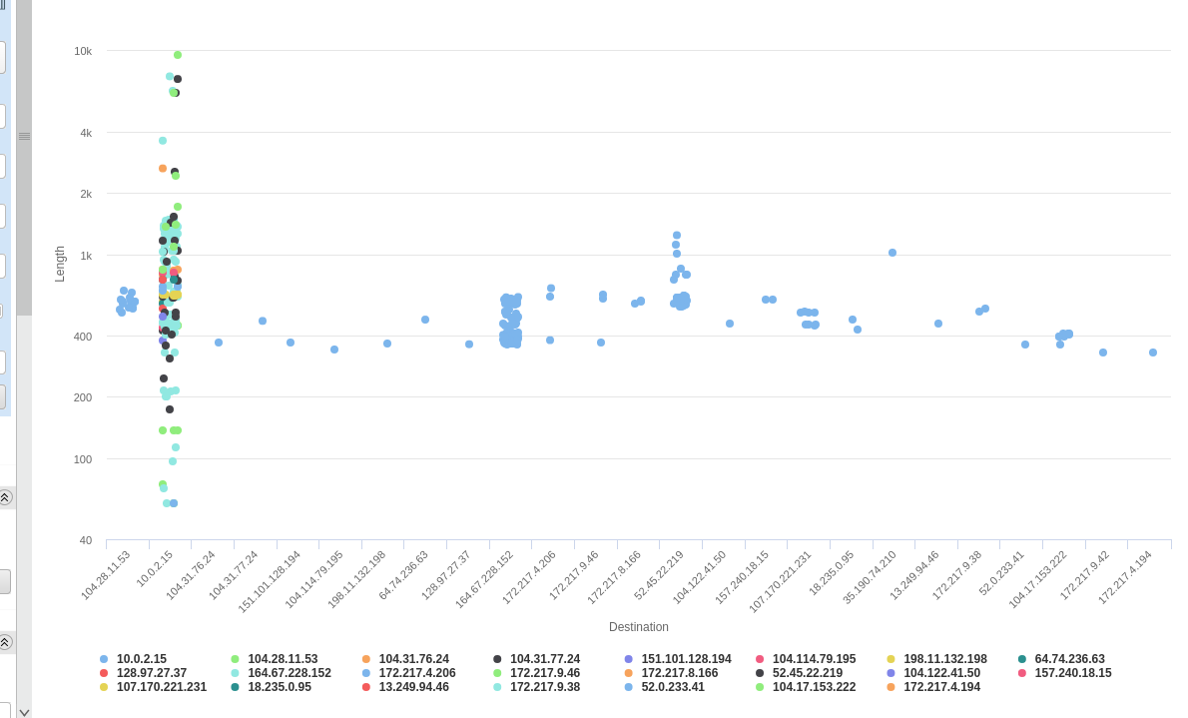
Longest packet sequences per host

Slide 7
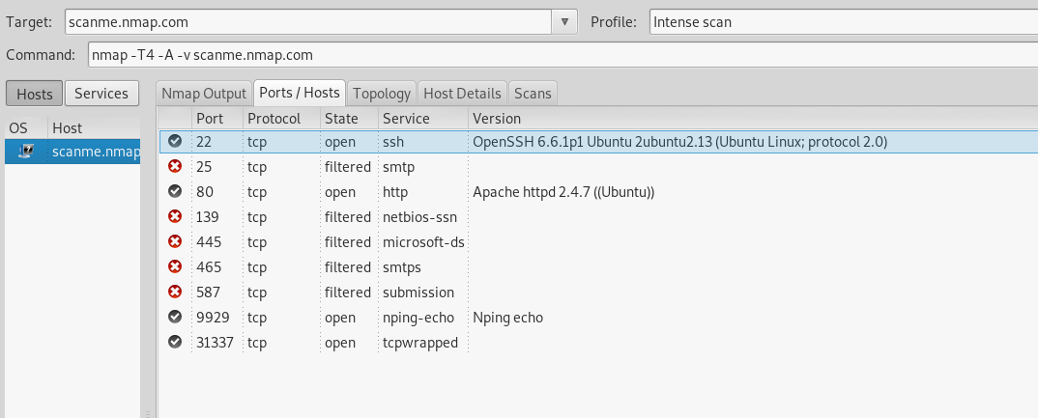
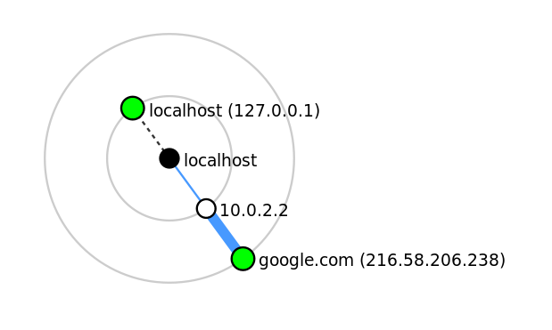
nmap results

