Slide 1
DDoS attack and mitigation in web applications
Rama Shah
ISP-Fall 2021
12.12.2021

Slide 2
DDoS Intro
P A R T 0 1
DDoS compromised and connected online devices known as botnets are used to produce artificial traffic in mass to overwhelm a target website

Slide 3
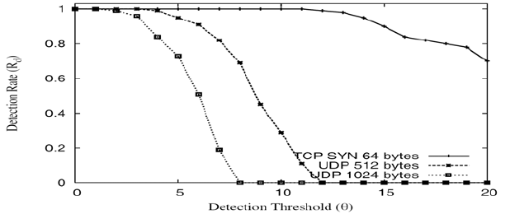
Metrics for DoS detection
P A R T 0 1
Fig. 1: Effects of server threshold on the detection rate of DDoS attack types of sample metrics

Slide 4
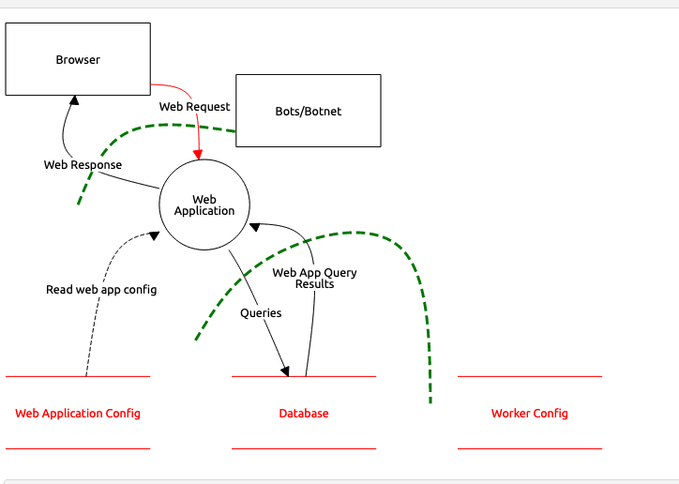
Threat Model Diagram
P A R T 0 1
Fig. 2 Threat Model for DDoS attack

Slide 5
Research I
P A R T 0 1
Mitigation method A
Mitigation method B
Contract a DDOS mitigation services to scrub DDoS traffic and forward only legitimate traffic
Discard traffic for specific prefixes at the IXP before reaching their target network by using so- called blackholing

Slide 6
Research II
P A R T 0 1
Mitigation method hypothesis
DDoS attack mitigation via Stateful multilayer inspection (SMLI) firewall

Slide 7
Motivating Example
P A R T 0 1
Crypto financial service, availability
Confidentiality, Integrity and Availability (CIA) Principle
Network security
HTTP flood attack

Slide 8
Empirical Evidence
P A R T 0 1
Components
Fake traffic using network traffic generator (WAN Killer, NetScanTools )
CAIDA’s Data set
Firewall simulator

Slide 9
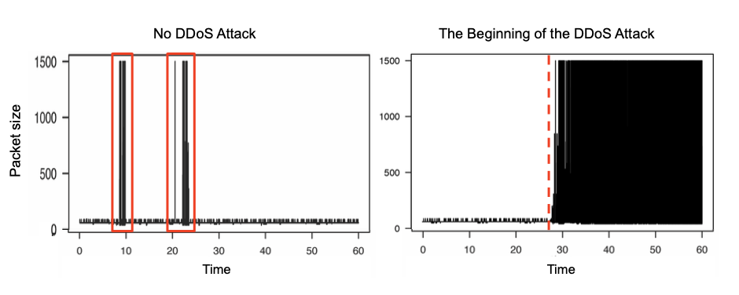
DDoS Network Traffic Diagram
P A R T 0 1
Fig 3. Time Series: Packet size vs Relative time which shows the time chart where the attack timeline was detected

Slide 10
Conclusion
P A R T 0 1
SMLI is an advanced firewall security system.
SMLI has a series of advanced firewall that work in tandem to work as a stateful and stateless packet filtering working on multi-layer such as network and transport layer which can be used to mitigate DDoS attack

Slide 11
The End
P A R T 0 1

Slide 12
The only system which is truly secure is one which is switched off and unplugged locked in a titanium lined safe, buried in a concrete bunker, and is surrounded by nerve gas and very highly paid armed guards. Even then, I wouldn't stake my life on it. -Gene Spafford, Director, Computer Operations, Audit, and Security Technology (COAST) Project, Purdue University
P A R T 0 1

