Slide 1


Bloodborne Pathogens (BBP)

Slide 2



Slide 3


Objectives
Applicable regulations
Common BBP/OPIM
Control Measures
PPE
Emergency Response

Slide 4
Bloodborne Pathogen Standard
The Occupational Health and Safety Administration (OSHA) developed the Bloodborne Pathogen (BBP) Standard to protect workers from human BBP exposures
The BBP Standard covers all occupational exposures to blood or other potentially infectious materials and serves to provide methods to protect workers from exposure to BBPs
Regulatory Citation: 29 CFR 1910.1030

Slide 5
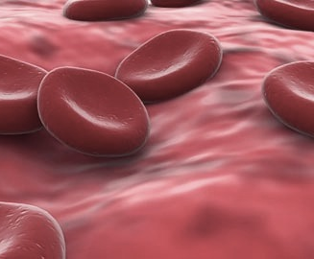
BBP Modes of Transmission
Sexual contact
Sharing needles
Form mothers to babies at / before birth
Contact with broken skin or parenteral
- Rashes, cuts, punctures, abrasions, acne, sores, abrasions
Contact with mucous membranes (splashes)
- Eyes, nose, mouth

Slide 6
Sources of Transmission

Slide 7
Other Potential Infectious Materials (OPIM)
Semen
Vaginal secretions
Cerebrospinal fluid
Synovial fluid
Pleural fluid
Pericardial fluid
Amniotic fluid
Saliva in dental procedures
Any other body fluid contaminated with blood

Slide 8
Other Potential Infectious Materials (OPIM)
Any unfixed cells, tissue or organs (other than skin) from a human or primate
HIV-containing cell or tissue cultures, organ cultures
HIV- or HBV-containing culture medium or solutions
Blood, organs or other tissues from experimental animals infected with HIV or HBV

Slide 9
Other Potential Infectious Materials (OPIM)
If visibly contaminated with blood, practice Universal Precautions. The following are not expected to be infectious unless visibly contaminated with blood:
Urine
Sweat
Feces
Sputum
Vomit
Tears
Nasal Secretions

Slide 10
OPIM and Universal Precautions
OSHA Bloodborne Pathogen Standard requires Universal Precautions to be used when coming into contact with human blood, OPIM, and human body fluids that are visibly contaminated with blood.
- Example: Vomit that has visible streaks of blood
Keep in mind: It is always a good practice to wear gloves when handling substances of human origin.

Slide 11
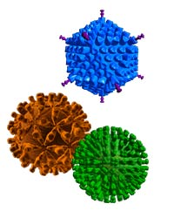
Definition – Bloodborne Pathogens
Bloodborne Pathogens are pathogenic microorganisms that are present in human blood & can cause disease in humans
These pathogens include, but are not limited to:
Human Immunodeficiency Virus (HIV)
Hepatitis C Virus (HCV)
Hepatitis C Virus (HCV)
Workers exposed to these pathogens are at risk for serious illness or death

Slide 12
Control Measures
Biological Safety
Universal Precautions
Work Practices
Engineering Controls
Sharps Safety
Administrative Controls
Personal Protective Equipment

Slide 13

Biological Safety
Biological safety is the control of the exposure to prevent or minimize health effects to the employee
This is accomplished through:
Engineering Controls
Administrative Controls
Personal Protective Equipment
Good Work Practices

Slide 14
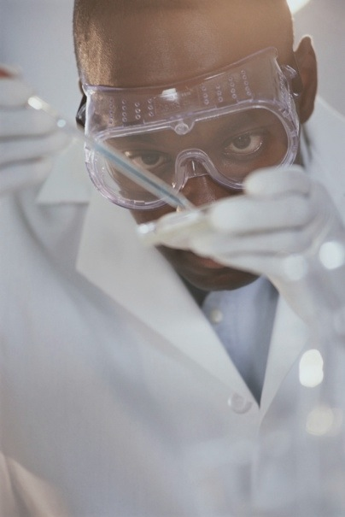
Preventing Exposure to BBPs
One way to prevent exposure to bloodborne pathogens is through the practice of universal precautions
Universal precautions are an approach to infection control in which all human blood & certain human body fluids are treated as if known to be potentially infectious for HIV, HBV, and other bloodborne pathogens

Slide 15

Perspective on Universal Precautions
“We treat all blood in our laboratory as if it could kill us if we weren’t careful. We follow the same practices for handling blood whether or not the sample is from a patient with a bloodborne disease – say, HIV or Hepatitis B – or from a normal uninfected donor. Labs that don’t take the same precautions with all blood are just wrong.”
Phillip J. Browning, M.D., Associate Professor of Medicine, Vanderbilt University

Slide 16
Recognizing Exposure Potential
To evaluate the effectiveness of engineering controls, work practices & personal protective equipment, you need to assess the risk of the task being performed
Look for the potential for exposure in the task being performed:
Potential for needle stick? Example: tail vein injections of tumor cells into rodents
Potential for splash? Example: vortexing human cell lines

Slide 17
Appropriate Work Practices
Routine use of barriers (such as gloves and/or goggles) when anticipating contact with blood or body fluids
Remembering to wash hands & other skin surfaces immediately after contact with blood or body fluids
Careful handling & disposing of sharp instruments during and after use

Slide 18
Appropriate Work Practices (continued…)
Performing human cell culture in a Biological Safety Cabinet
Discarding used needles in an approved sharps container without recapping the needle
Performing procedures involving blood or OPIM in a manner which minimizes splashes and generation of aerosols

Slide 19
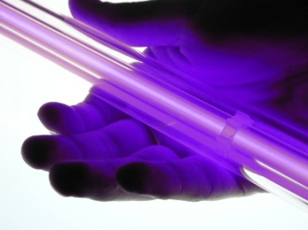
Work Practices – Hand Washing
Hand washing facilities must be readily available for employee use
Hands must be washed after removing gloves & after any exposure incident
Waterless hand sanitizer may be utilized if hand washing facilities are not available but hands should be washed with soap & water as soon as feasible

Slide 20
Work Practices – Hand Washing (Continued…)
When washing your hands be sure to:
Use warm water that is a comfortable temperature
Use liquid soap
Use friction by rubbing your hands together
Rinse downward
Dry thoroughly

Slide 21
Work Practice Controls
Engineering Controls: The equipment and devices that are used to minimize or eliminate employee exposure to bloodborne pathogens
Personal Protective Equipment: Any exposure risk remaining after the institution of engineering & work practice controls shall be mitigated via the use of personal protective equipment (PPE)

Slide 22
Std. Microbiological Practices, Research Labs
Good Practices
Restricted access
Good hygiene
Use mechanical pipetting devices
Minimize splashes and aerosol
Appropriate decontamination
Appropriate signage

Slide 23
Std. Microbiological Practices, Research Labs (Continued…)
Bad Practices
Eating, Drinking Smoking
Application of Cosmetics
Handling of Contact Lenses
Mouth Pipetting

Slide 24
Std. Microbiological Practices, Research Labs (Continued…)
Workers must not consume food and drink in areas where work involving exposure or potential exposure to blood or other potentially infectious materials
Food and beverages can become contaminated by work surfaces or by process that generate splashes, splatters, and aerosols
Eating and drinking is only permitted in designated areas

Slide 25
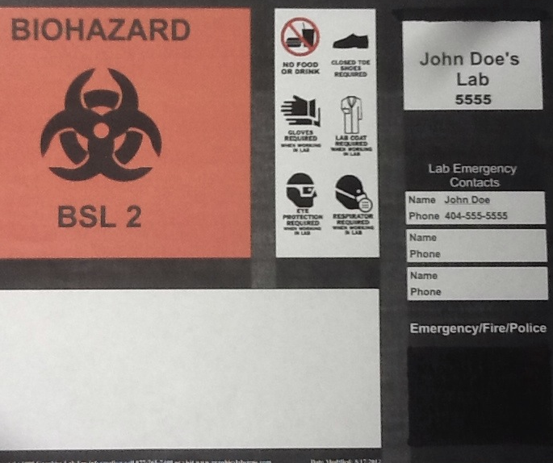
Administrative Controls – Signs
Biohazard Signs must be posted at the entrance of each HIV/HBV research laboratory
Each sign must include:
Special requirements to enter the area
Name and telephone number of lab director or other responsible individual

Slide 26
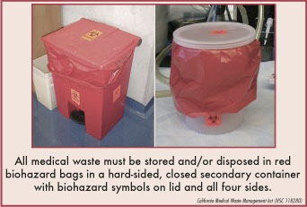
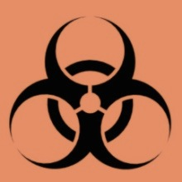

Administrative Controls - Labels
Biohazard Labels must be affixed to the container in a manner that prevents removal
Biohazard labels must be predominantly red or orange red with a prominent biohazard symbol
Red bags or red containers can also be used in lieu of biohazard labels

Slide 27
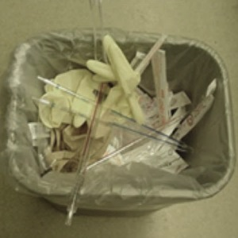
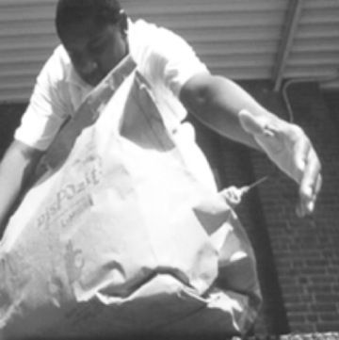
Administrative Controls – Waste Disposal
What is wrong with these pictures?

Slide 28
Administrative Controls – Waste Disposal (Continued…)
Always discard into proper waste streams
Inappropriate waste disposal can injure waste removal personnel

Slide 29
Administrative Controls – Waste Disposal (Continued…)
Human Blood, Human Body Fluids, and Other Potentially Infectious Materials must be disposed of through one of the following treatment methods:
Steam sterilization
Chemical disinfection
Disposal by an approved infectious waste treatment and disposal facility (e.g Stericycle)

Slide 30
Administrative Controls – Waste Disposal (Continued…)
Human Cell and Tissue Culture Waste
Disposable tissue culture supplies and solid waste
Collect in an orange or clear autoclave bag labeled with biohazard symbol
Autoclave and dispose in regular trash
Examples: Serological Pipets, Pipet Tips, Petri Dishes

Slide 31
Administrative Controls – Waste Disposal (Continued…)
Glassware
Broken Glassware – dispose of broken glass into the Glass Box
Contaminated Glassware – (e.g. pastuer pipettes used in human cell culture) dispose into sharps container
Liquid Waste
Autoclave (steam sterilization) or treat with bleach (1:10 dilution) prior to disposal in sanitary sewer

Slide 32
Personal Protective Equipment (PPE)
All employees should have access to PPE that is task appropriate & the correct size
PPE may include, but is not limited to:
Gloves, Gowns, Lab Coats, Face Shields and Goggles
Employee training on PPE should include:
Location, Proper use and Proper Disposal
Decontamination Procedures for Reusable Equipment
Selection of Proper PPE for the Task

Slide 33
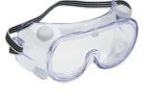
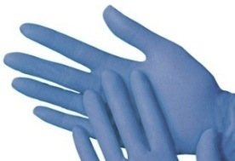
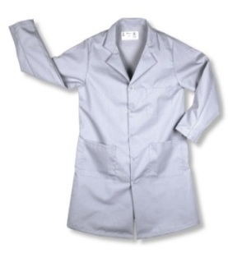
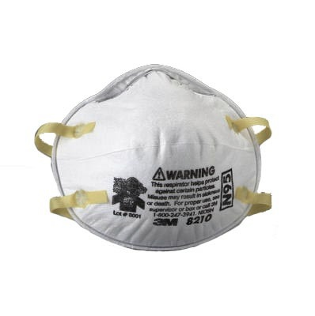
PPE | Picture | When to Wear | Examples
Eye Protection |  | Worn when there is a potential for splashes/splatters of liquid | Safety Glasses Goggles Face Shields
Gloves |  | Worn to protect hands May be single use or reusable | Vinyl Latex Nitrile
Protective Clothing |  | Worn to protect skin & clothing from hazards | Lab Coat Lab Apron
Respiratory Protection |  | Worn to prevent inhalation of airborne microorganisms, dust, mists, & chemical fumes Prior to wearing employees must obtain: medical clearance & training, then fit test This must occur annually | N95 Full Face

Slide 34
PPE – Working with Blood/OPIM
Always wear protective gloves to prevent them from becoming soiled with blood or OPIM.
Wear laboratory coat or gown, eye protection, and a surgical mask when conducting procedures that may cause splattering.
When pipetting, you should always use a mechanical pipetting device. Never mouth pipet.

Slide 35
PPE – Working with Blood/OPIM (Continued…)
Use a Biological Safety Cabinet to contain procedures that generate aerosols (i.e. vortexing samples).
Wash your hands as soon as the procedure is complete and always before leaving the laboratory

Slide 36
Contaminated Laundry – Handling Recommendations
Reusable lab coats should never be taken home to be laundered
Lab coats worn during the manipulation of blood or OPIM should be bagged & appropriately labeled with the universal biohazard symbol prior to pick-up or drop-off for laundry service
Attempts should be made to limit contact with contaminated laundry

Slide 37
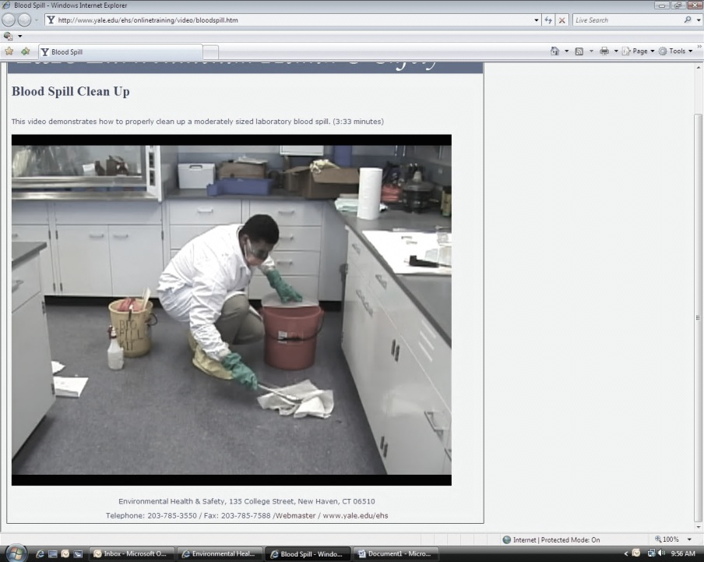
How to Clean Up Simple Spills
Wear appropriate PPE
Prevent/control spreading with absorbent materials
Collect residues
Decontaminate area / equipment
Complete incident report

Slide 38
Biological / Blood Spills
Disinfect human blood or OPIM spills with a freshly prepared one-in-ten dilution of household bleach.
Be aware that bleach degrades overtime due contact with organic material and sunlight.
Clean all work surfaces with 70% isopropyl alcohol when procedures are complete.

Slide 39
Biological / Blood Spills (Continued…)
Remember that if you are exposed to blood that you must wash the exposed area or wound with soap and water. Then, you must proceed directly to medical attention.
All incidents must be reported to your supervisor and others by following the procedures outlined by your institution.

Slide 40
Inhalation Pathogen Spill Guidelines
Applicable when handling cell culture that contains pathogens transmitted through inhalation or aerosol
Hold your breath and leave the laboratory immediately
Alert everyone else in the lab (i.e. post a warning sign that can be used as a signal to others )
Close the door and do not re-enter the space
Post a warning sign on the outside of the door
Contact your institution’s designated Emergency Response Personnel

Slide 41
Emergency Response Procedures
Immediately utilize eyewash, shower, soap, water and/or other incident protocol
Seek medical attention through employee health services or the emergency room
Report incident to your supervisor
Follow up with healthcare professional to receive a written opinion and instructions for additional testing requirements.

