Slide 1
Non-Profit Modeling Dashboard
Henry Goldkuhle, Zander Hartsuff
Project Mentor: Carl McQueen

Slide 2
Project Overview
-Goal: Perform Data Analysis on a dataset of a non-profit organization and use insights to build dashboard that allows you to view different models.
Data supplied by McQueen Analytics.

Slide 3
Demonstration

Slide 4
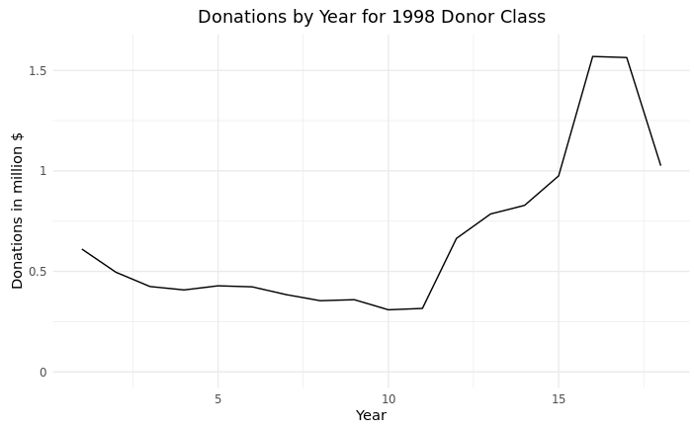
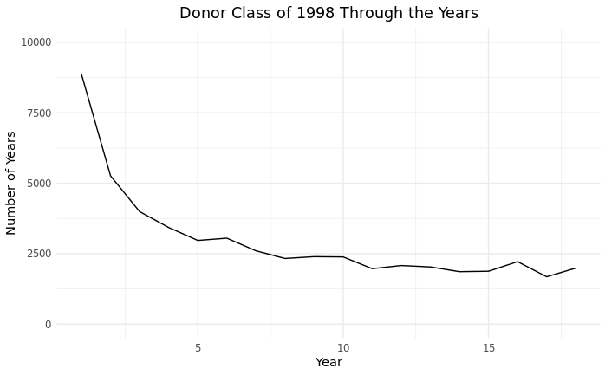
Data Wrangling

Slide 5
Design Norms
Justice: Brings more complex modeling into the hands of various users making it easier to draw conclusions on data without having to know coding languages.
Trust: Designed to be reliable, accounts for different datasets and different modeling needs.
Caring: Designed to help serve others and not only be a tool but help users better understand why use certain models.

