Slide 1
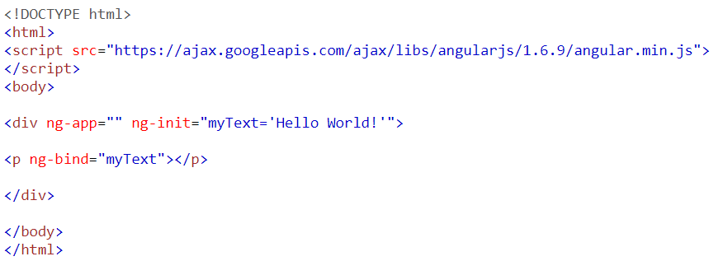
Quick review (ng-bind)
The ng-bind directive tells Angular to replace the content of an HTML element with the value of a given variable, or expression. If the value of the given variable, or expression, changes, the content of the specified HTML element will be changed as well.

Slide 2
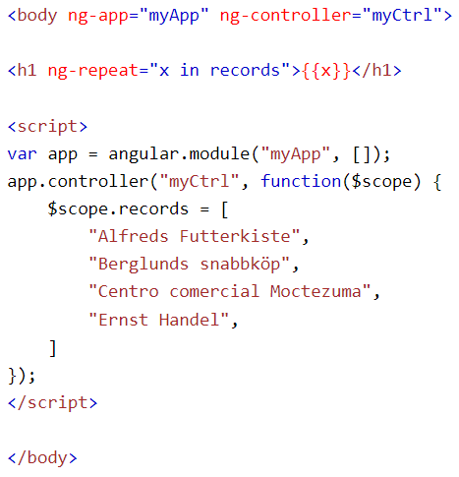
Quick review (ng-repeat)
The ng-repeat directive repeats a set of HTML, a given number of times.

Slide 3
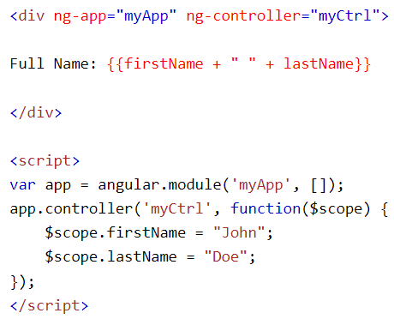
Quick review (ng-controller)
The ng-controller directive adds a controller to your application.
In the controller you can write code, and make functions and variables, which will be parts of an object, available inside the current HTML element. In AngularJS this object is called a scope.

Slide 4
Ip address
Matheus Moura martinho

Slide 5

What is an ip address?
IP address stands for “Internet Protocol address.” The Internet Protocol is a set of rules for communication over the internet, such as sending mail, streaming video, or connecting to a website. An IP address identifies a network or device on the internet.

Slide 6
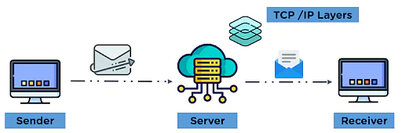
How ip addresses work?
Each device connected to the internet has a unique numerical identifier assigned to it — an IP address. IP addresses are how devices and websites communicate with one another, and how the information you’re looking for knows where to find you.
IP addresses are only one part of the internet’s architecture. Having a postal address for your house is meaningless unless there’s a post office responsible for delivering the mail. In internet terms, IP is one part of TCP/IP.

Slide 7
Questions?
What is the use of an IP address?
What is the size of an IP address?

Slide 8
answers
IP address is used to uniquely identify each host in a network. IP address is needed in order to communicate with other hosts in the network using the TCP/IP suite of protocols.
The size of an IP address is 32 bits (4 bytes).

Slide 9
WHat is a public and private ip?
A public IP address is an IP address that can be accessed directly over the internet and is assigned to your network router.
A private IP address is the address your network router assigns to your device. Each device within the same network is assigned a unique private IP address (sometimes called a private network address) .

Slide 10
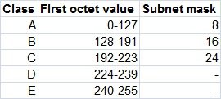
Ip classes
TCP/IP defines five classes of IP addresses: class A, B, C, D, and E. Each class has a range of valid IP addresses.
(Each of the decimal numbers in an IP address is called an octet)

