Slide 1
JavaScript 3: Extending JavaScript with jQuery
Chapter 10

Slide 2
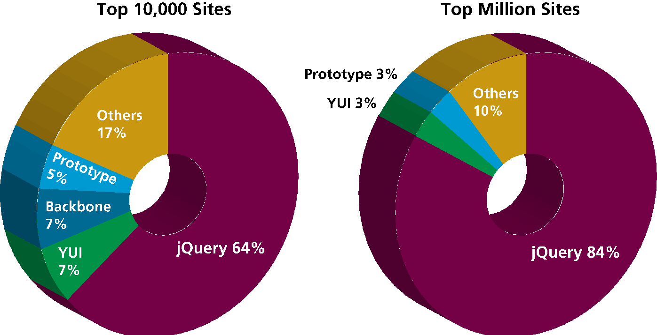
jQuery Foundations
A popular framework

Slide 3
jQuery Foundations
Including jQuery
Use a Content Delivery Network (CDN)
<script src="http://code.jquery.com/jquery-3.1.0.min.js"> </script>
Use a failsafe in case the CDN is down

Slide 4
jQuery Foundations
jQuery Selector
Remember getElementByID()…
The power of jQuery resides in the function named jQuery().
There’s also an alias for this function named $() .
You can combine CSS selectors with the $() notation to select DOM objects that match CSS attributes

Slide 5
jQuery Foundations
jQuery Selector
/* selecting using regular JavaScript */
var node = document.getElementById("here"); var link = document.querySelectorAll("ul li");
/* equivalent selection using jQuery */
var node = $("#here");
var link = $("ul li");
The $() function always returns a set of results

Slide 6
jQuery Foundations
Basic Selectors
$("*")—Universal selector matches all elements (and is slow).
$("tag")—Element selector matches all elements with the given element name.
$(".class")—Class selector matches all elements with the given CSS class.
$("#id")—Id selector matches all elements with a given HTML id attribute.

Slide 7
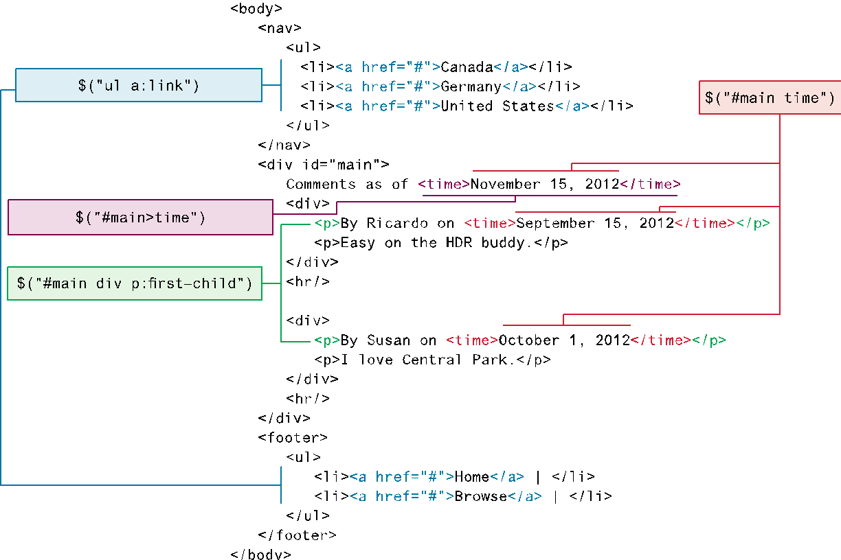
jQuery Foundations
Some examples

Slide 8
jQuery Foundations
Advanced Selectors (Go back to Chapter 4 in CSS for a refresher)
Attribute Selector
Pseudo-Element Selector
Contextual Selector
jQuery Filters
Form Selectors

Slide 9
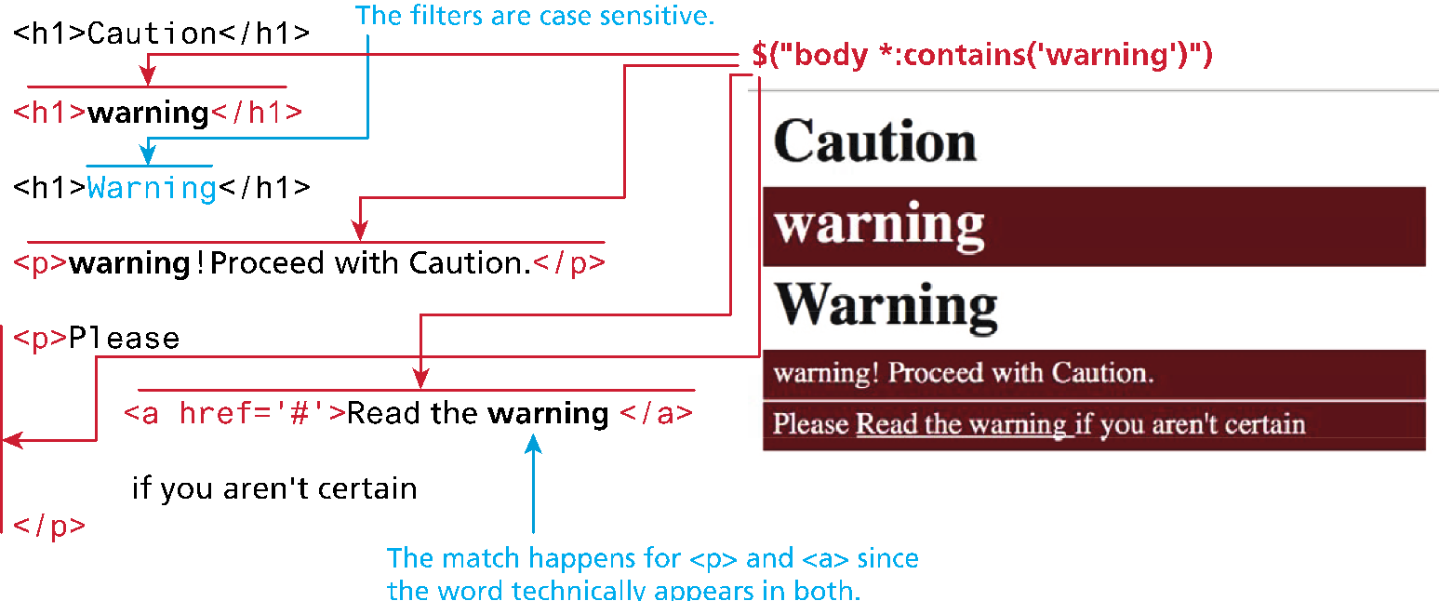
jQuery Foundations
jQuery's content filter selection

Slide 10
jQuery Foundations
Common element Manipulations - HTML attributes
We can both set and get an attribute value by using the attr() method.
// link is assigned the href attribute of the first <a> tag
var link = $("a").attr("href");
// change all links in the page to http://funwebdev.com
$("a").attr("href","http://funwebdev.com");
// change the class for all images on the page to fancy
$("img").attr("class","fancy");

Slide 11
jQuery Foundations
Common element Manipulations - HTML properties
The prop() method is the preferred way to retrieve and set the value of a property.
<input class="meh" type="checkbox" checked="checked">
var theBox = $(".meh");
theBox.prop("checked"); // evaluates to TRUE

Slide 12
jQuery Foundations
Common element Manipulations – Changing CSS
jQuery provides the extremely intuitive css() method.
var color = $("#element").css("background-color"); // get the color
$("#element").css("background-color", "red"); // set color to red

Slide 13
Event Handling in jQuery
Just like JavaScript, jQuery supports creation and management of listeners/handlers for JavaScript events.
While pure JavaScript uses the addEventListener() method, jQuery has on() and off() methods as well as shortcut methods to attach events.

Slide 14
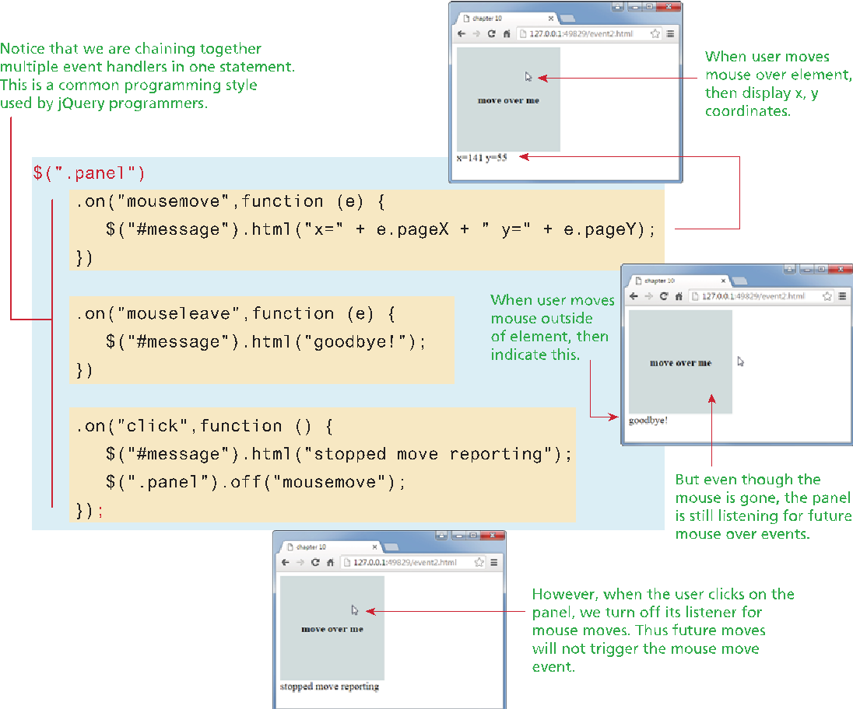
Event Handling in jQuery
Binding and Unbinding Events

Slide 15
Event Handling in jQuery
Page Loading
$(document).ready(function() {
// set up listeners knowing page loads before this runs
$("#example").click(function () {
$("#message").html("you clicked");
});
});
Or the even simpler
$(function () {
...
});

Slide 16
DOM Manipulation
Creating Nodes
// pure JavaScript way
var jsLink = document.createElement("a");
jsLink.href = "http://
www.funwebdev.com";
jsLink.innerHTML = "Visit Us";
jsLink.title = "JS";
// jQuery version 1
var link1 = $('<a href="http://funwebdev.com"
title="jQuery">Visit Us</a>');

Slide 17
DOM Manipulation
Creating Nodes
// jQuery version 2
var link2 = $('<a></a>');
link2.attr("href","http://funwebdev.com");
link2.attr("title","jQuery verbose");
link2.html("Visit Us");
// version 3
$('<a>', {
href: 'http://funwebdev.com',
title: 'jQuery',
text: 'Visit Us'
});

Slide 18
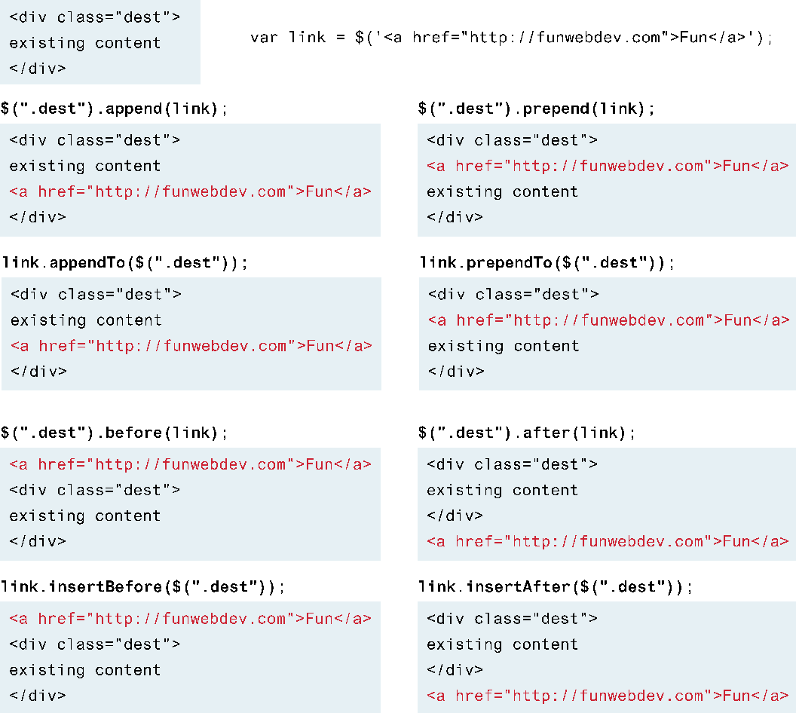
DOM Manipulation
Adding DOM Elements

Slide 19
DOM Manipulation
Wrapping Existing DOM in New Tags
Wrap all elements matched by a selector within a new element using wrap().

Slide 20
DOM Manipulation
Wrapping Existing DOM in New Tags
<div class="external-links">
<div class="gallery">Uffuzi Museum</div>
<div class="gallery">National Gallery</div>
<div class="link-out">funwebdev.com</div>
</div>
$(".gallery").wrap('<div class="galleryLink"><div>');
<div class="external-links">
<div class="galleryLink">
<div class="gallery">Uffuzi Museum</div>
</div>
<div class="galleryLink">
<div class="gallery">National Gallery</div>
</div>
<div class="link-out">funwebdev.com</div>
</div>

Slide 21
DOM Manipulation
Wrapping Existing DOM in New Tags
<div class="external-links">
<div class="gallery">Uffuzi Museum</div>
<div class="gallery">National Gallery</div>
<div class="link-out">funwebdev.com</div>
</div>
$(".gallery").wrap(function() {
return "<div class='galleryLink' title='Visit " + $(this).html() + "'></div>";
});
<div class="external-links">
<div class="galleryLink" title="Visit Uffuzi Museum">
<div class="gallery">Uffuzi Museum</div>
</div>
<div class="galleryLink" title="Visit National Gallery">
<div class="gallery">National Gallery</div>
</div>
<div class="link-out">funwebdev.com</div>
</div>

Slide 22
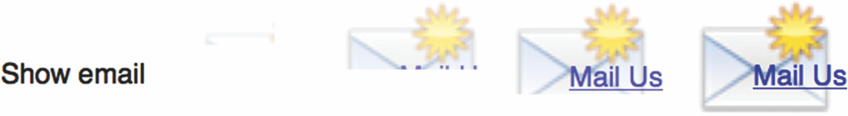

Effects and Animation
Show() and fadeIn()

Slide 23
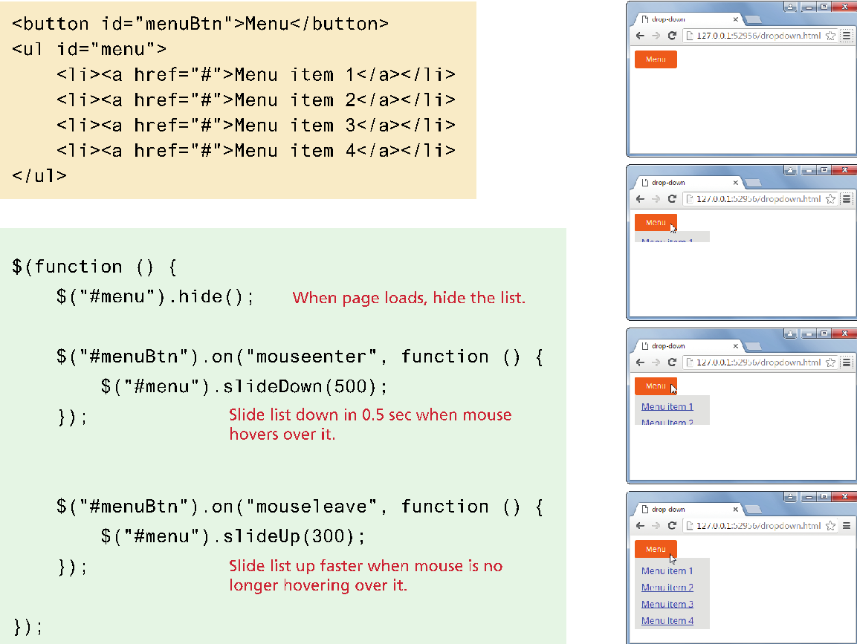
Effects and Animation
Using slide()

Slide 24
Effects and Animation
Raw Animation
$("#box").animate({left: '495px'});
Describes a final state in CSS.
The state before defines where the animations starts.
Animate() has many parameters including:
Duration
Step
Done
…

Slide 25
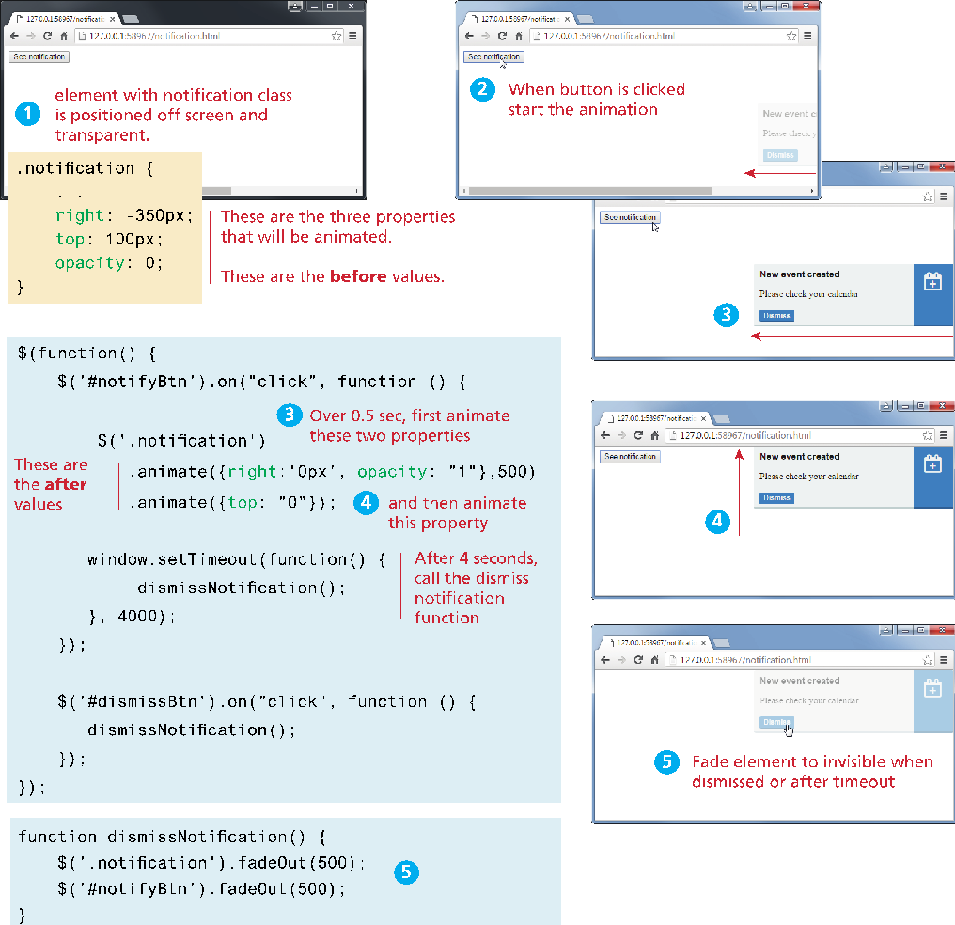
Effects and Animation
Raw Animation

Slide 26
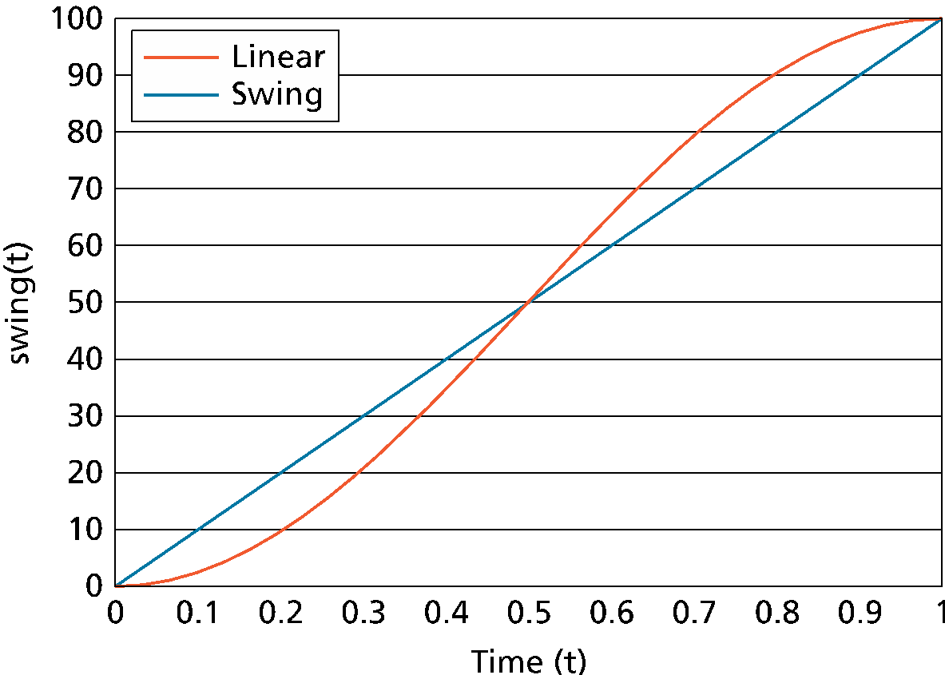
Effects and Animation
Easing Functions

Slide 27
Effects and Animation
Easing Functions

