Slide 1
Direct Link Networks
  Point-to-Point Links
  Shared Access Networks
FTP
HTTP
NV
TFTP
Our goals:
understand principles behind data link layer services:
TCP
UDP
IP
NET
NET
■ ■ ■
NET
1
2
n
Winter 2014
MU CS4850/7850

Slide 2
Shared Access Networks
Slides adapted from Larry Peterson
Outline
  Bus (Ethernet)
  Wireless (802.11)
Winter 2014
MU CS4850/7850

Slide 3
Media Access Control (MAC) Protocols: a taxonomy
Three broad classes:
Channel Partitioning
  divide channel into smaller “pieces” (time slots, frequency, code)
  allocate piece to node for exclusive use
Random Access (e.g., Ethernet CSMA/CD)
  channel not divided, allow collisions
  detect and “recover” from collisions
“Taking turns” (e.g., Token ring)
  tightly coordinate shared access to avoid collisions
Winter 2014
MU CS4850/7850

Slide 4
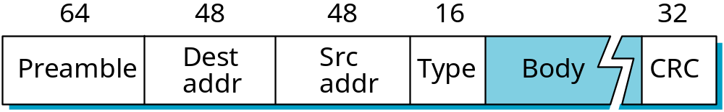
Ethernet Overview
History
  developed by Xerox PARC in mid-1970s
  roots in Aloha packet-radio network
  standardized by Xerox, DEC, and Intel in 1978
  similar to IEEE 802.3 standard
Media access control (MAC)
  CSMA/CD
    carrier sense
    multiple access
    collision detection
Frame Format
De-multiplexing key
Winter 2014
MU CS4850/7850
Notes:
Preamble? an introductory fact or circumstance; especially : one indicating what is to follow
Carrier sense: distinguish between idle and busy link, by transceiver
Type: demultiplexing key

Slide 5
Access Protocol for Ethernet
The algorithm is commonly called Ethernet’s Media Access Control (MAC).
  It is implemented in Hardware on the network adaptor.
Frame format
  Preamble (64bit): allows the receiver to synchronize with the signal (sequence of alternating 0s and 1s).
  Host and Destination Address (48bit each).
  Packet type (16bit): acts as demux key to identify the higher level protocol.
  Data (up to 1500 bytes)
    Minimally a frame must contain at least 46 bytes of data.
    Frame must be long enough to detect collision.
  CRC (32bit)
  Minimum size 64 bytes
Notes:
The University of Adelaide, School of Computer Science
Chapter 2 — Instructions: Language of the Computer

Slide 6
Ethernet (cont)
Addresses
  unique, 48-bit unicast address assigned to each adapter
  example: 8:0:2b:e4:b1:2
  broadcast: all 1s
  multicast: first bit is 1
Bandwidth: 10Mbps, 100Mbps, 1Gbps
Length: <2500m (500m segments with 4 repeaters/hub)
  Support less than 1024 hosts
  Why?
Use Manchester encoding
Problem: Distributed algorithm that provides fair access
Winter 2014
MU CS4850/7850
Notes:
Hexadecimal digit, separated by colons

Slide 7
Ethernet Length
Minimum Ethernet Frame size = 64bytes = 512bits
Propagation Delay/ Signal speed on cable = 200m/us
Time to transmit one bit in 10Mbps = 10E-7s = 0.1µs
Time to transmit the minimum Frame = (0.1µs* 512bits) = 51.2us
Length of the cable = speed * min frame TX time =
  (200m/µs * 51µs) = 10200m = 10Km.
10km RTT --→ 5km …no? repeaters introduce 6us delay
No of repeaters that introduce 25us delay = 25/6 = 4 Repeaters
Length of the cable = speed * min frame TX time = 200m * 51us = 10200m = 10Km.
Winter 2014
MU CS4850/7850

Slide 8
Ethernet Length
10km RTT --→ 5km …no?
  repeaters introduce 6µs delay. 5km need 9 repeaters (6*9 = 54µs)
  54µs > 51.2µs transmit time
  Delay introduced by repeater should be no more than 50% ~ 25µs
No of repeaters that introduce 25µs delay = 25/6 = 4 Repeaters
Cable length that introduce 25µs RTD = (25 * 200m/µs) / 2 = 2500m = 2.5Km
Winter 2014
MU CS4850/7850

Slide 9
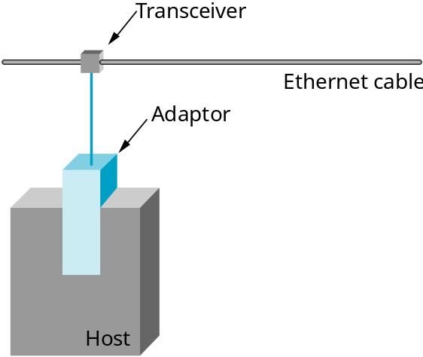
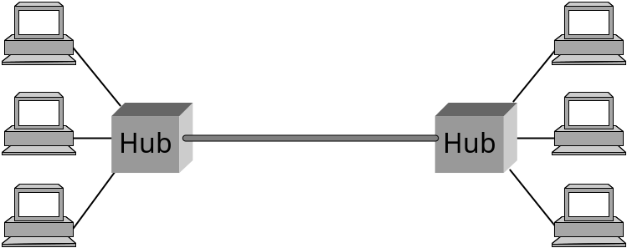
Ethernet (cont)
Layer 1 device
Same collision domain
Winter 2014
MU CS4850/7850
Notes:
Hubs and repeaters are Layer 1 (Physical) devices

Slide 10
Transmit Algorithm (in MAC)
If line is idle…
  send immediately
  upper bound message size of 1500 bytes
If line is busy…
  wait until idle and transmit immediately
  called 1-persistent (special case of p-persistent)
Winter 2014
MU CS4850/7850
Notes:
1-persistent or p-persistent? Ethernet always does 1-persistent except when a collision is detected.

Slide 11
Transmit Algorithm (p-persistence)
a p-persistent algorithm transmits with probability 0 ≤ p ≤ 1 after a line becomes idle
  defers with probability q = 1− p
Why p < 1?
  multiple adaptors waiting for line to become idle
  Don’t want all to transmit at the same time
  If p=0.33 then if 3 adapters need to send, odds are only one will
But in Ethernet hosts transmit immediately
  What potential problems does this cause?
Winter 2014
MU CS4850/7850
Notes:
1-persistent or p-persistent? Ethernet always does 1-persistent except when a collision is detected.

Slide 12
Algorithm (cont)
If detect collision…
  Send a 32-bit jamming signal, then stop transmitting frame
  minimum frame is 64 bytes (header + 46 bytes of data)
    For collision detection
  delay and try again (Concept of randomization)
    1st time: delay 0 or 51.2us
    2nd time: 0, 51.2, 102.4, 153.6us
    3rd time: 0, 51.2, 102.4, …, or 7*51.2us
    nth time: k x 51.2us, for randomly selected k=0..2^{n} - 1
    give up after several tries (usually 16) though most algorithms cap at n=10
    exponential backoff
Winter 2014
MU CS4850/7850
Notes:
Jam? Send 32 bit jamming sequence
Ethernet work best under lightly loaded conditions (<30% utilization)

Slide 13
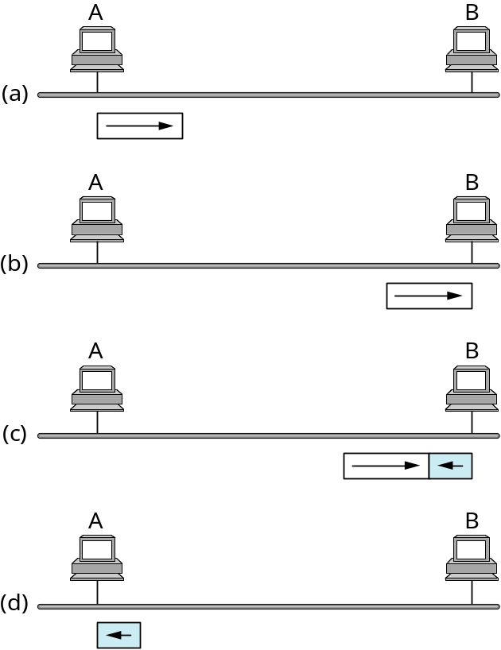
Collisions
Worst case scenario:
RTTmax = 51.2 us
Frame size >= BW * RTT_{max}
=512 bits (64 bytes)
B sends right before
A’s frame arrives
Collision detected by B,
B sends jamming signal
A receives jamming signal,
while still transmitting
Knows collision occurred
Winter 2014
MU CS4850/7850
Notes:
For 10 Mbps Ethernet. 100 Mbps and Gbps Ethernets are designed to be used in full-duplex, point-to-point configurations in switched networks.

Slide 14
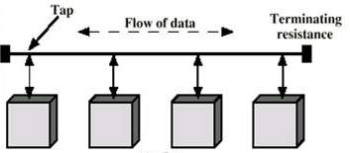
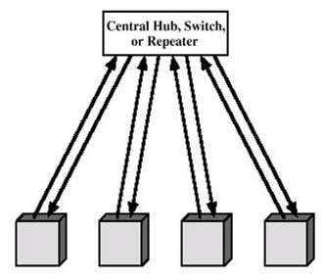
Ethernet
Old Ethernet (bus topology)
Current Ethernet (10BASE-T, 100BASE-T, 1000BASE-T)
star topology
half-duplex
full-duplex (no collisions)
Switch

Slide 15
Ethernet: Pros & Cons
Ethernets work best under lightly loaded conditions ~30%
  Too much time wasted on collisions under heavy load
Ethernets typically used in more conservative ways
  < 200 hosts. Not near the max 1024
  Networks far smaller than 2500m (RTT = 5µs)
Winter 2014
MU CS4850/7850

Slide 16
Ethernet: Pros & Cons
Classic Ethernets are easy to administer and inexpensive to implement
  No routing or configuration tables
  Easy to add hosts
  Cable is cheap
  Network adaptors are easy
Why move away from Ethernet?
Winter 2014
MU CS4850/7850

Slide 17
Wireless LANs
IEEE 802.11
Bandwidth: 1 - 11 Mbps (11b), 54 Mbps (11g, 11a)
Physical Media
  spread spectrum radio (11b/g: 2.4GHz frequency band)
  diffused infrared (limited to range of 10m)
    1 Mbps and 2Mbps
Winter 2014
MU CS4850/7850
Notes:
802.11 IR defines 1Mbps and 2Mbps operation by bouncing light off ceilings and walls to provide connectivity within a room or small office.
802.11a operates in 5G band.

Slide 18
Wireless LANs
Issues of bit errors are of great concern
Framing and reliability also have to be addressed.
Power usage is a big issue
Wireless media are also inherently multi-access so media access is a big issue
Eavesdropping is a big issue
Winter 2014
MU CS4850/7850
Notes:
802.11 IR defines 1Mbps and 2Mbps operation by bouncing light off ceilings and walls to provide connectivity within a room or small office.
802.11a operates in 5G band.

Slide 19
Spread Spectrum
Idea
  spread signal over wider frequency band than required
  originally designed to thwart jamming
Frequency Hopping
  transmit over random sequence of frequencies
  sender and receiver share…
    pseudorandom number generator
    seed
  802.11 uses 79 x 1MHz-wide frequency bands
Winter 2014
MU CS4850/7850
Notes:
Bluetooth uses frequency hopping.
802.11 defines one physical layer using frequency hopping.

Slide 20
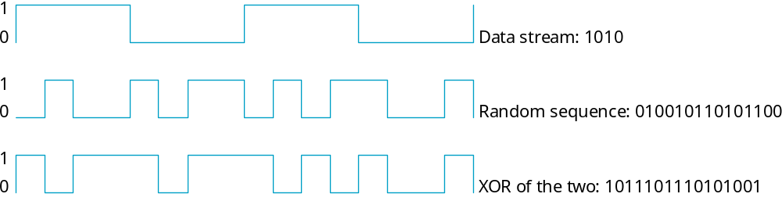
Spread Spectrum (cont)
Direct Sequence
  for each bit, send XOR of that bit and n random bits
  random sequence known to both sender and receiver
  called n-bit chipping code
  802.11 defines an 11-bit chipping code
Winter 2014
MU CS4850/7850

Slide 21
Medium Access Control
Wireless channel is a shared medium
Need access control mechanism to avoid interference
Why not CSMA/CD?
  All hosts on the network are known
  Forwarding
  Obstruction
  Eavesdropping
  Other security
  Signal Strength
Winter 2014
MU CS4850/7850

Slide 22
Medium Access Control
Wireless channel is a shared medium
Need access control mechanism to avoid interference
Why not CSMA/CD?
  All hosts on the network are known
  Forwarding
  Obstruction
  Eavesdropping
  Other security
  Signal Strength
Winter 2014
MU CS4850/7850

Slide 23
CSMA/CD in WLANs?
Most (if not all) radios are half-duplex
  Listening while transmitting is not possible
  Power generated by transmitter is much greater than the power of the received signal
Collision might not occur at sender
  Collision at receiver might not be detected by sender!
  Signal blocked due to obstruction
  Too great a distance away
Winter 2014
MU CS4850/7850

Slide 24
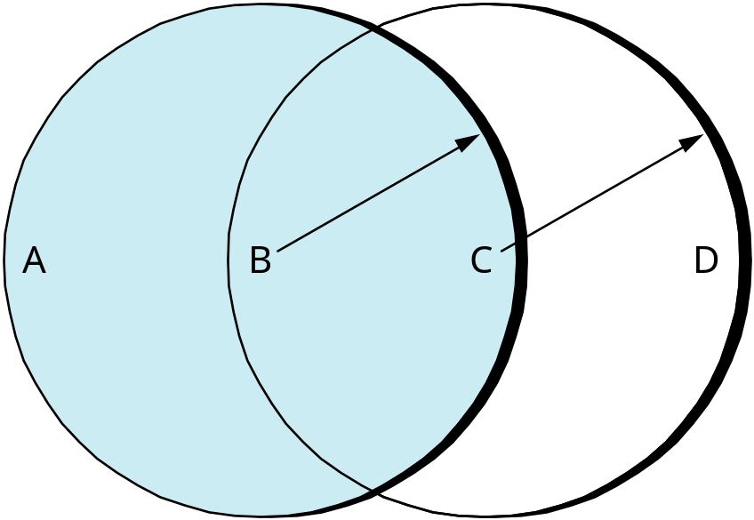
Collisions Avoidance
Similar to Ethernet
Problem: hidden and exposed nodes
How would you solve?
Hidden nodes: A and C
Exposed nodes: B and C
Winter 2014
MU CS4850/7850
Notes:
A and C are hidden nodes w.r.t. each other. They are not aware of collision of their packets at B.
C can still send to D even if B is sending to A.

Slide 25
MACA
(Multiple Access with Collision Avoidance)
Sender transmits RequestToSend (RTS) frame
  Contains length of data frame to be transmitted
Receiver replies with ClearToSend (CTS) frame
  Echo the length field back
Neighbors…
  see CTS: keep quiet for length of field long
  see RTS but not CTS: ok to transmit
Receiver sends ACK when has frame
  neighbors silent until see ACK
Collisions (of RTS)
  no collisions detection
  known when don’t receive CTS for their sent RTS
  exponential backoff before trying again
Winter 2014
MU CS4850/7850
Notes:
MACA? Multiple Access with Collision Avoidance
How about CTS? no collision of CTSs, as two senders will not be able to hear both CTS simultaneously.

Slide 26
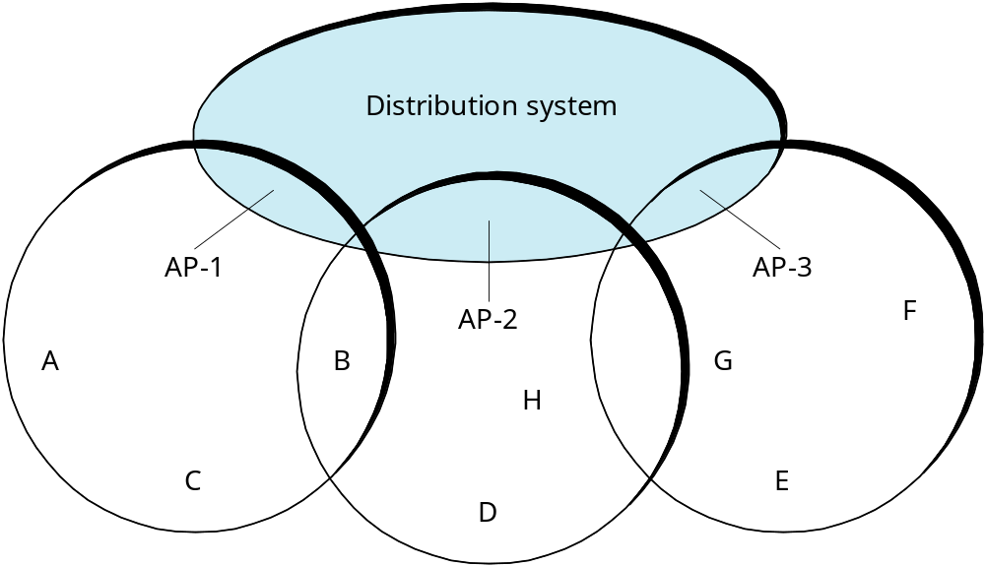
Supporting Mobility
Case 1: access points (AP)
  Tethered (distribution network runs at layer 2)
  each mobile node associates with an AP
Case 2: ad hoc networking:
  only partial connectivity
Winter 2014
MU CS4850/7850
Notes:
DN at layer 2? Within a LAN, not across different networks.

Slide 27
Mobility (cont)
Scanning (selecting an AP)
  node sends Probe frame
  all AP’s w/in reach reply with ProbeResponse frame
  node selects one AP; sends it AssociateRequest frame
  AP replies with AssociationResponse frame
  new AP informs old AP via tethered network
When
  active: when join or move
  passive: AP periodically sends Beacon frame
Winter 2014
MU CS4850/7850

Slide 28
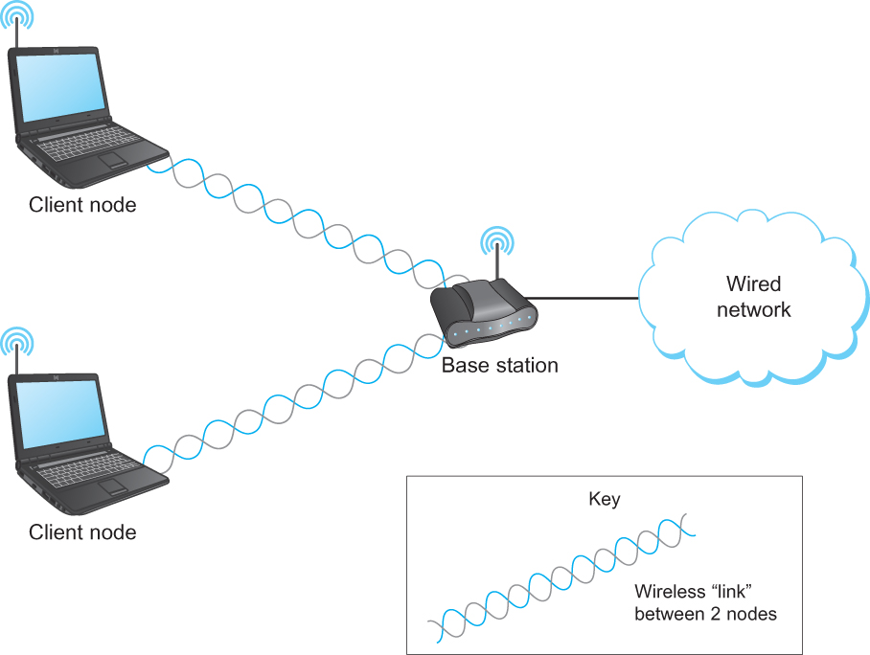
A Wireless Network Using a Base Station
Chapter 2
Winter 2014
MU CS4850/7850
Copyright © 2012, Elsevier Inc. All rights Reserved

Slide 29
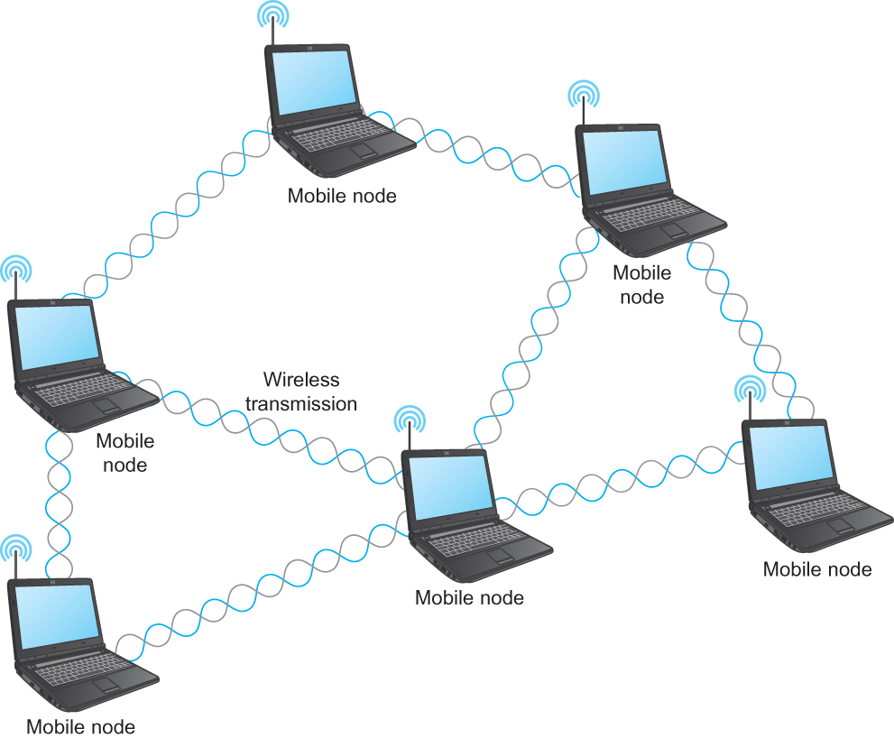
A Wireless ad hoc or Mesh Network
Chapter 2
Winter 2014
MU CS4850/7850
Copyright © 2012, Elsevier Inc. All rights Reserved

Slide 30
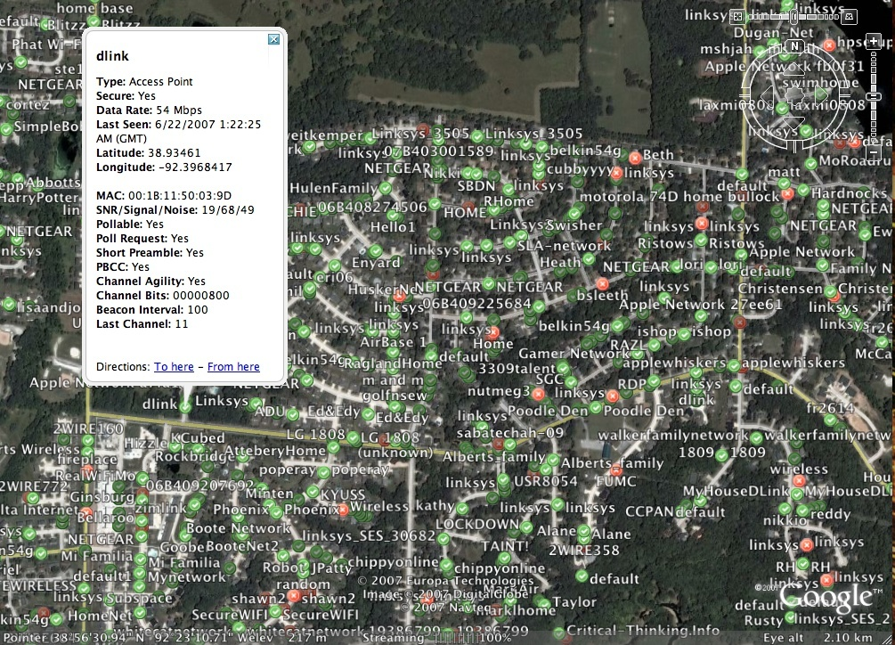
Example: Columbia’s Wireless (WiFi) Security
Green: secure; Red: insecure
(2007 REU)
Matthew Chittum
Clayton Harper
John Mixon
Johnathan Walton
Winter 2014
MU CS4850/7850
Notes:
59% of discovered APs in Columbia were secure, nearly 20% higher than the national average.

Slide 31
Shared Access Networks
Summary:
  Bus (Ethernet)
    CSMA/CD
  Wireless (802.11)
    MACA
Winter 2014
MU CS4850/7850

