Slide 1
CS 4850
Computer Networks I
Instructor: Kristofferson Culmer
EBW 250
krcd58@mail.missouri.edu

Slide 2
CS-4850/7850 Computer Networks I
Syllabus
Class Hours:
MWF 9:30 AM - 10:45 AM, Room: EBW116
Instructor:
Kristofferson Culmer, Room 250 EBW, Email Address: krcd58@mail.missouri.edu , The TA’s office hours will be posted on blackboard
Prerequisite:
CS 2270 or ECE1210, and Math 2320
Textbook:
Computer Networks: A Systems Approach, Larry L. Paterson and Bruce S. Davis, Morgan Kaufmann, 5th Edition, 2012

Slide 3
Course Topics:
Introduction
Requirements, network architecture, performance metric
Socket
Direct Link Network
Encoding, framing, error detection, reliable transmission
Ethernet, wireless
Packet Switching
Switching, LAN switches, cell switching (ATM)
Internetworking
IPv4, IP address and packet forwarding, ARP, DHCP, VPN, tunneling
Distance vector routing, link state routing
CIDR, subnetting, BGP
IPv6, NAT, multicast
End-to-End Protocols
UDP
TCP connection establishment/termination, flow control
Congestion control, congestion avoidance
Applications
HTTP, email, DNS
Overlay networks, CDN, P2P
Network security

Slide 4
Homework and Laboratory Policies: Written homework will be assigned throughout the semester. There will also be three labs (using Riverbed/OPNET network simulator) and one socket programming project. The socket programming project has two parts. Part one is required for all students. Part two is required for graduate students but optional for undergraduate student.
Assignments (homework and lab) will be due at the beginning of the lecture on the dates announced. It is your responsibility to keep track of assignments and their due dates. Late assignments will be accepted up to (3) three days but will be penalized a letter grade (10%) for each day late
Lectures: The lectures in this course are an important way to impart to students the concepts and skills to be gained in this course. It is assumed that all students attend all lectures unless a grievous emergency occurs.
Exams: There will be one midterm exam and a final exam. Both exams will be held in EBW116. All exams are closed-note/closed-book.

Slide 5
Grading: Homework ----------------------> 20% Laboratory Assignments ----> 20% Midterm --------------------------> 30% Final ------------------------------> 30% Quizzes for extra credit might be given throughout the semester.
Your final score for the course will be curved to derive your letter grade.
Makeup Exams: For those having verified reasons to be absent during an exam, makeup exams will be arranged on an individual basis. Please contact the instructor at least 1 week prior to the scheduled test date, as it will not be possible to schedule a makeup "after the fact".
Incompletes: A grade of 'I' will be given only for cases in which there are documented medical problems or family emergencies.

Slide 6
Abuses of Trust:
Academic honesty is fundamental to the activities and principles of a university. All members of the academic community must be confident that each person's work has been responsibly and honorably acquired, developed, and presented. Any effort to gain an advantage not given to all students is dishonest whether or not the effort is successful. The academic community regards academic dishonesty as an extremely serious matter, with serious consequences that range from probation to expulsion. See the information online at http://osrr.missouri.edu/academicintegrity/index.html and
http://engineering.missouri.edu/cs/degree-programs/academic-honesty/.
Duplicate homework/lab written in collaboration with others is NOT acceptable. Although it is permissible to discuss the homework/lab with others, these discussions should be of a general nature. All work at a detailed level must be done on your own. Students submitting the same or similar solutions to the homework or lab or a student who submits a lab downloaded off the Internet (or obtained from other sources) will be considered as having cheated. Any evidence of cheating, copying or collusion, plagiarism, etc., will be graded as zero for all students involved and will be referred to both the department Chairman and the Provost for other disciplinary action.
ADA Statement: If disability related accommodations are necessary (for example, a note taker, extended time on exams, captioning), please register with the Office of Disability Services (http://disabilityservices.missouri.edu), S5 Memorial Union, 882-4696, and then notify me of your eligibility for reasonable accommodations. For other MU resources for students with disabilities, click on "Disability Resources" on the MU homepage.

Slide 7


About the Instructor
5th year PhD in Computer Science
Have taught and TA’d this class before
Went to undergrad at Central Methodist University (CMU)
Ran Track & Field and Cross Country

Slide 8
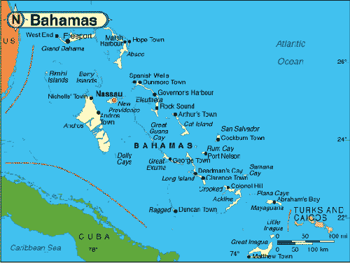


From the Bahamas

Slide 9
Introduction Slides adapted from Larry Peterson
Outline
Applications and Features
Statistical Multiplexing
Inter-Process Communication
Network Architecture
Performance Metrics
Implementation Issues
Notes:
High level issues of network system

Slide 10
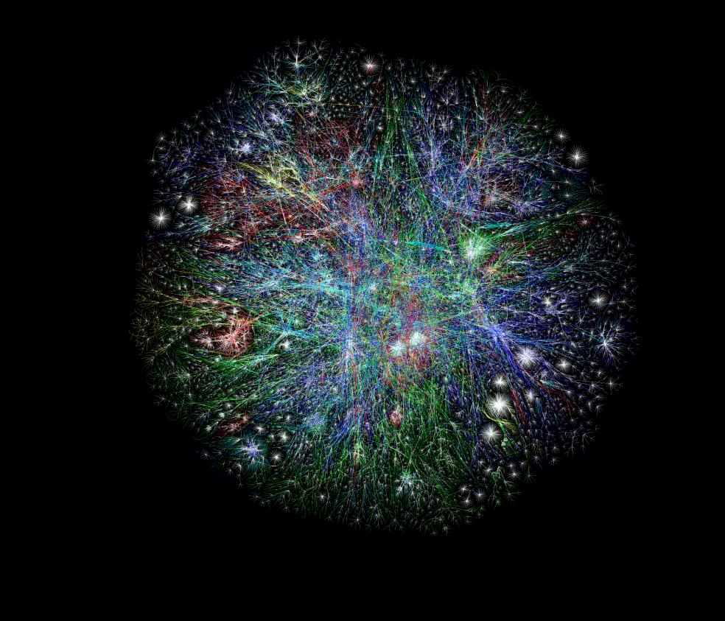
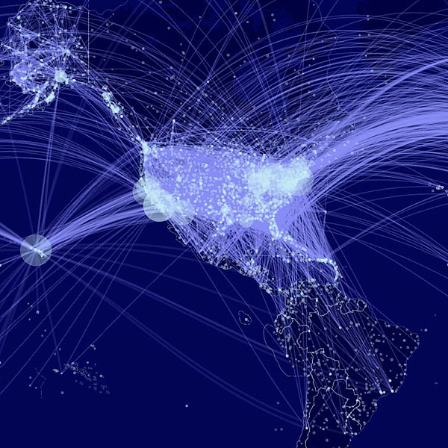
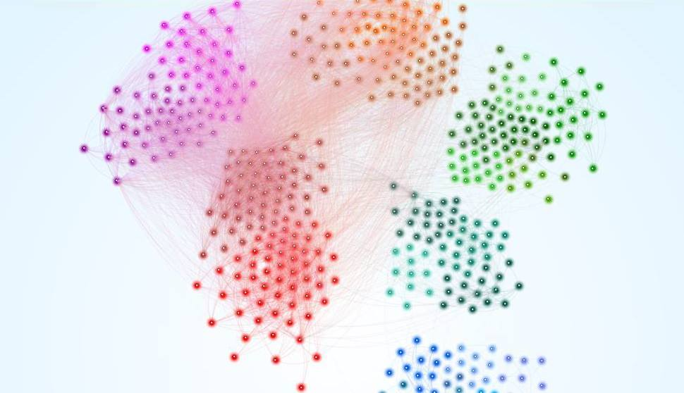

Slide 11
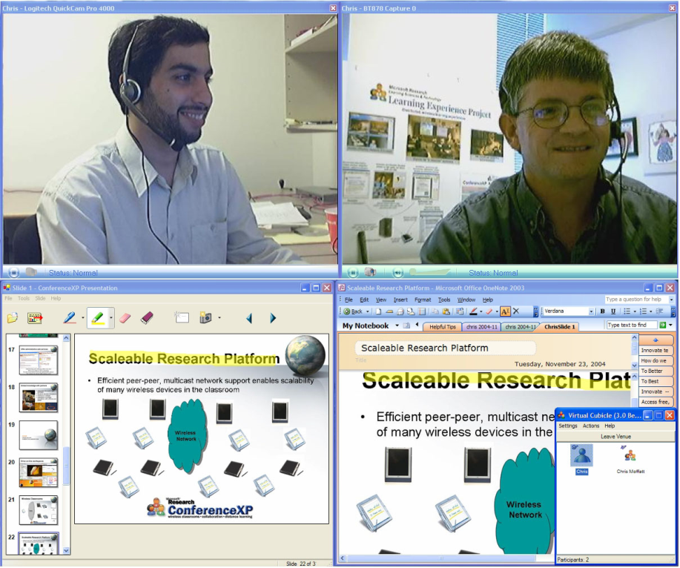
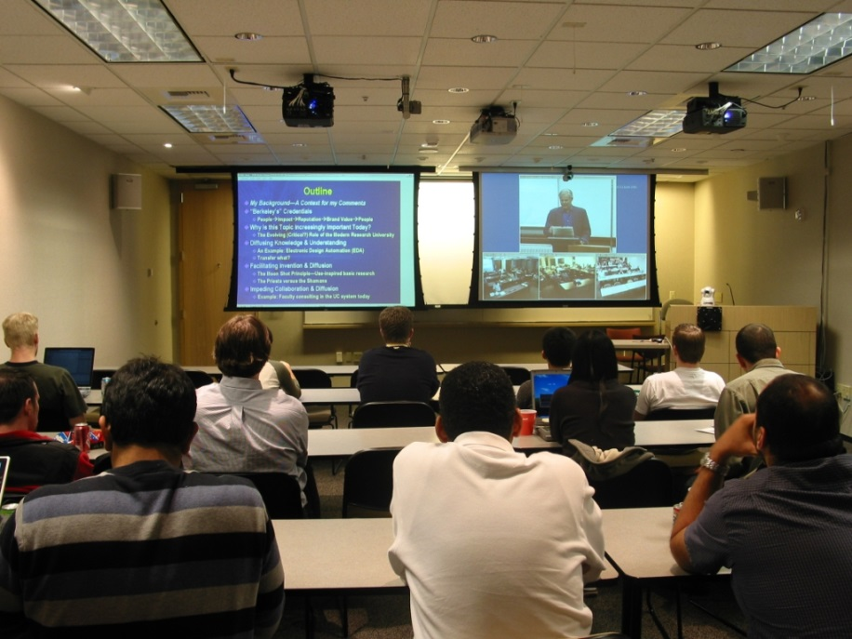
ConferenceXP Project In collaboration with Microsoft Research Internet2-based P2P video conferencing system
wireless classrooms
remote collaboration
distance learning

Slide 12
Goal
Network applications
WWW， email
File sharing, Napster; Social Media: Facebook, Twitter, SnapChat
Streaming media, Skype, Internet Video, IPTV
PPLive: http://www.pptv.com/
YouTube: http://www.youtube.com/
Spotify, Tidal
How does it work?
Scalable connectivity
Cost efficient resource sharing
Support for common services
Course objective:
Understand how to build a computer network from the ground up
Notes:
In your own words, tell me what a network is.
What purpose do they serve?

Slide 13

What is a network? What purpose do they serve?

Slide 14
What’s a Network: Key Features
Providing certain services
transport goods, mail, information or data
Shared resources
used by many users, often concurrently
Basic building blocks
nodes (active entities): process and transfer goods/data
links (passive medium): passive “carrier” of goods/data
Typically “multi-hop”
two “end points” cannot directly reach each other
need other nodes/entities to relay

Slide 15
What’s a Network: “Nuts and Bolts” View
router
workstation
network edge: millions of end-system devices:
pc’s workstations, servers
PDA’s, phones, toasters
running network apps
network core: routers, switches forwarding data
packets: packet switching
calls: circuit switching
communication links
fiber, copper, radio, …
server
mobile
local net
regional net
company
net

Slide 16
Building Blocks
Nodes: PC, special-purpose hardware…
hosts
switches (store-and-forward)
Links: coax cable, optical fiber…
point-to-point
multiple access
(a)
■ ■ ■
(b)
Notes:
Circuit Switch
Store and forward

Slide 17
Switched Networks
A network can be defined recursively as...
two or more nodes connected by a link, or
two or more networks connected by a node
Notes:
The internet is a network of networks
Does anyone know the history of the internet?

Slide 18
Where did the internet come from?

Slide 19
Brief History of the Internet
70’s: started as a research project, 56 kbps, < 100 computers
80-83: ARPANET and MILNET split,
85-86: NSF builds NSFNET as backbone, links 6 Supercomputer centers, 1.5 Mbps, 10,000 computers
87-90: link regional networks, NSI (NASA), ESNet(DOE), DARTnet, TWBNet (DARPA), 100,000 computers
90-92: NSFNET moves to 45 Mbps, 16 mid-level networks
94: NSF backbone dismantled, multiple private backbones
Today: backbones run at >10 Gbps, >600 millions computers in >190 countries
Notes:
World population: ~7 billion; Internet users: 2 billions
MILNET (Military Network)
ARPANET (Advanced Research Projects Agency Network)
NASA Science Internet (NSI)
, Energy Sciences Network (ESnet)
DARTNet (DARPA Research Testbed network).
Wideband Packet Satellite Network (WBNET)

Slide 20
Topic for Next Class
Switching
Routing
Multiplexing

Slide 21

Have A Great Day

