Slide 1
Direct Link Networks
Point-to-Point Links
Shared Access Networks
FTP
HTTP
NV
TFTP
Our goals:
understand principles behind data link layer services:
TCP
UDP
IP
NET
NET
■ ■ ■
NET
1
2
n

Slide 2
Point-to-Point Links Slides adapted from Larry Peterson
Outline
Encoding
Framing
Error Detection
Sliding Window Algorithm

Slide 3
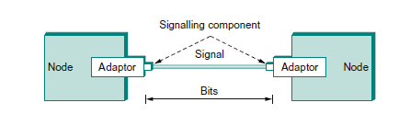
Signalling

Slide 4
Encoding
Signals propagate over a physical medium
modulate electromagnetic waves
e.g., vary voltage
Encode binary data onto signals
e.g., 0 as low signal and 1 as high signal
known as Non-Return to zero (NRZ)

Slide 5
Problem: Consecutive 1s or 0s
Low signal (0) may be interpreted as no signal
High signal (1) leads to baseline wander
Unable to recover clock
Notes:
Baseline wander: average signal biased to low or high.
Frequent transition is necessary for clock recovery/synchronization, to avoid clock drift.

Slide 6
Problem: Consecutive 1s or 0s
Low signal (0) may be interpreted as no signal
High signal (1) leads to baseline wander
the receiver keeps an average of the signal it has seen so far and then uses this average to distinguish between low and high signals.
signal is significantly lower than this average = 0
Higher than average signal = 1
The problem, of course, is that too many consecutive 1s or 0s cause this average to change, making it more difficult to detect a significant change in the signal
Notes:
Baseline wander: average signal biased to low or high.
Frequent transition is necessary for clock recovery/synchronization, to avoid clock drift.

Slide 7
Problem: Consecutive 1s or 0s
Unable to recover clock
frequent transitions from high to low and vice versa are necessary to enable clock recovery
both the encoding and the decoding processes are driven by a clock
every clock cycle the sender transmits a bit and the receiver recovers a bit
sender and the receiver clocks have to be precisely synchronized in order for the receiver to recover the same bits the sender transmits
If the receiver’s clock is even slightly faster or slower than the sender’s clock, then it does not correctly decode the signal
How to fix the clock problem?
Notes:
Baseline wander: average signal biased to low or high.
Frequent transition is necessary for clock recovery/synchronization, to avoid clock drift.

Slide 8
Alternative Encodings
Non-return to Zero Inverted (NRZI)
make a transition from current signal to encode a one; stay at current signal to encode a zero
solves the problem of consecutive ones
Manchester
transmit XOR of the NRZ encoded data and the clock
only 50% efficient (bit rate = 1/2 baud rate)
Notes:
Baud rate: the rate at which signal changes.

Slide 9
Encodings (cont)

Slide 10
Alternative Encodings
Non-return to Zero Inverted (NRZI)
make a transition from current signal to encode a one; stay at current signal to encode a zero
solves the problem of consecutive ones
Manchester
transmit XOR of the NRZ encoded data and the clock
only 50% efficient (bit rate = 1/2 baud rate)
Notes:
Baud rate: the rate at which signal changes.

Slide 11
Encodings (cont)

Slide 12
Encodings (cont)
4B/5B
every 4 bits of data encoded in a 5-bit code
5-bit codes selected to have no more than one leading 0 and no more than two trailing 0s
thus, never get more than three consecutive 0s
resulting 5-bit codes are transmitted using NRZI
achieves 80% efficiency

Slide 13
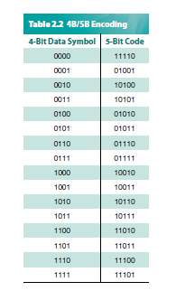
4B/5B

Slide 14
Framing
Break sequence of bits into a frame
Typically implemented by network adaptor

