Slide 1
Classification of Iris Flower Datasets
Using Decision Trees
Group 5

Slide 2
PART ONE
Background&Dataset
PART TWO
Problem&Solution
PART THREE
Model&Visualizationsu
Presentation
CONTENTS
PART FOUR
Results
PART FIVE
Conclusion
PART SIX
Challenges & what we learned
PART SEVEN
Division of labor

Slide 3
Background&Dataset
PART ONE

Slide 4
Iris Species
Classify iris plants into three species in this classic dataset

Slide 5
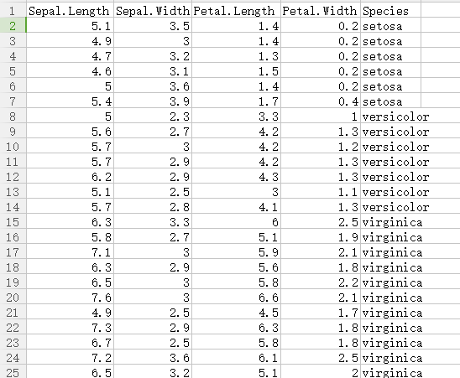
Description and background of the dataset
Fisher's classic 1936 paper ‘The Use of Multiple Measurements in Taxonomic Problems’.
It can also be found on the ‘UCI Machine Learning Repository’.
• one flower species is linearly separable from the other two
• the other two are not linearly separable from each other.

Slide 6
Problem&Solution
PART TWO

Slide 7
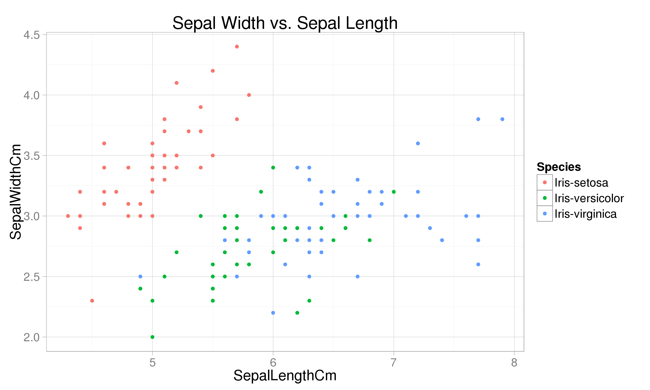

Slide 8
Solution of the problem
Flow chat of the solution
Read the data set
Split the data set
Classify using ID3 decision tree algorithm
Visualize the decision tree
Calculate precision, recall and f1-score
5 - fold cross validation

Slide 9
Model&Visualizationsualization
PART THREE

Slide 10
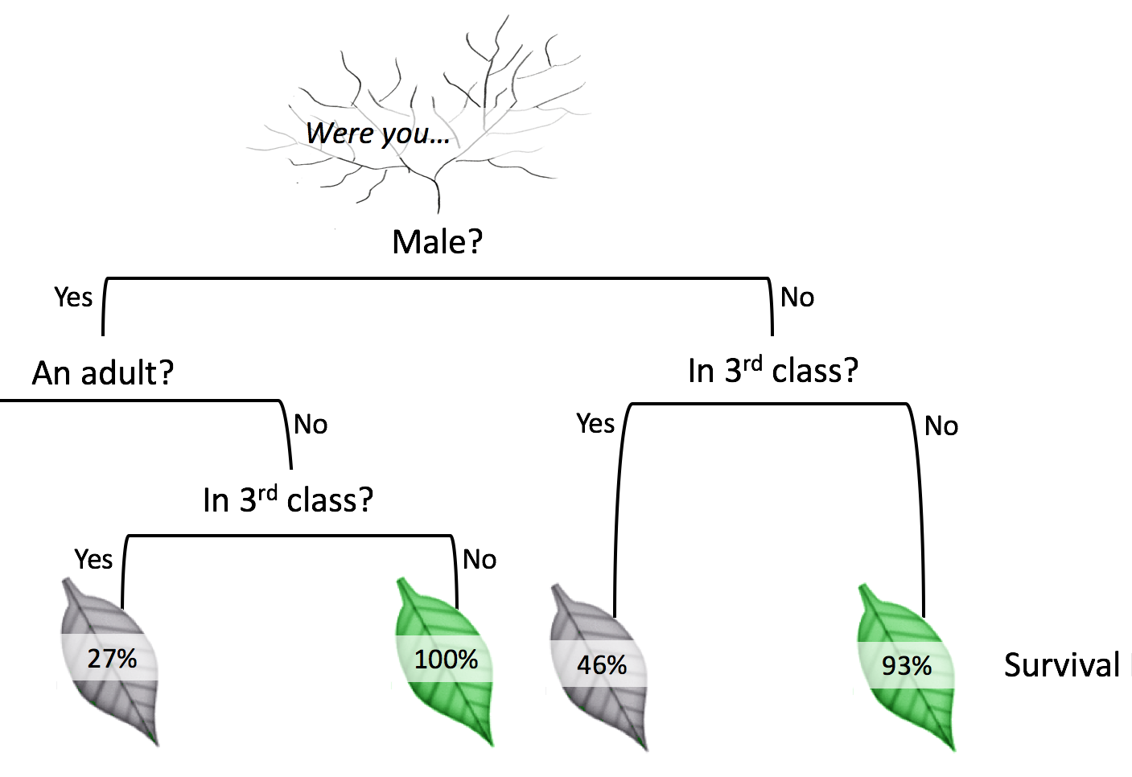
Decision Tree

Slide 11
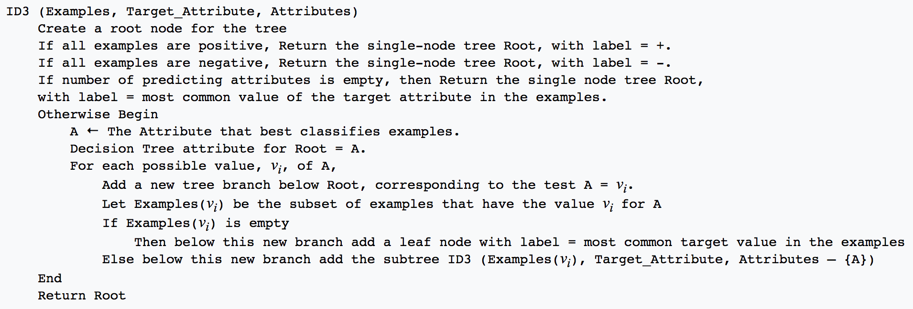
ID3 Decision Tree

Slide 12
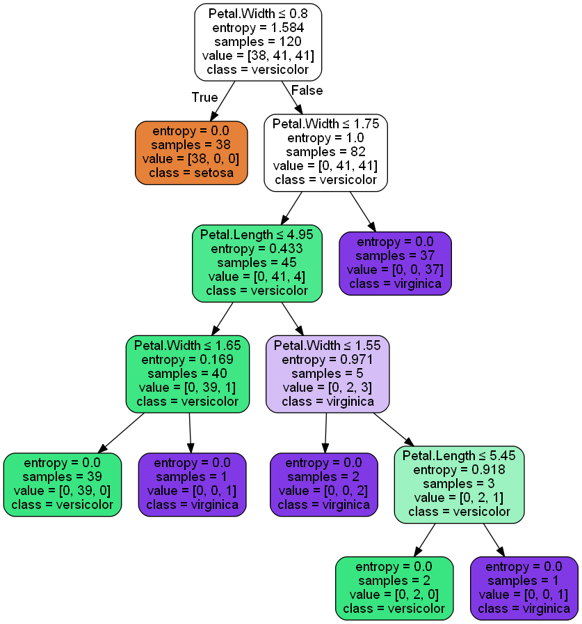
Visualization

Slide 13
Results
PART FOUR

Slide 14
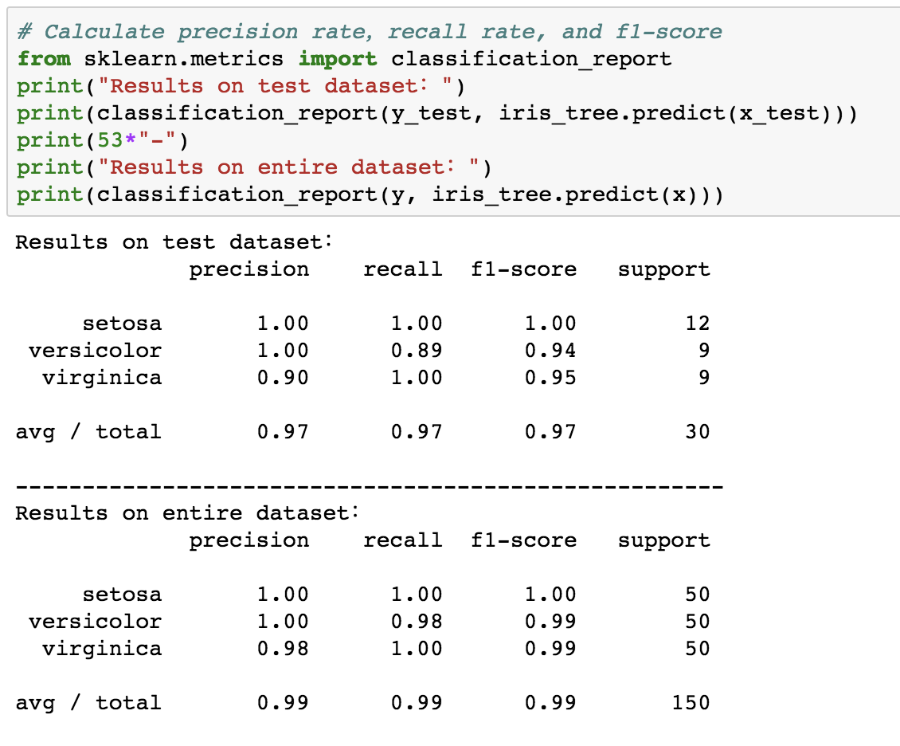
Results

Slide 15
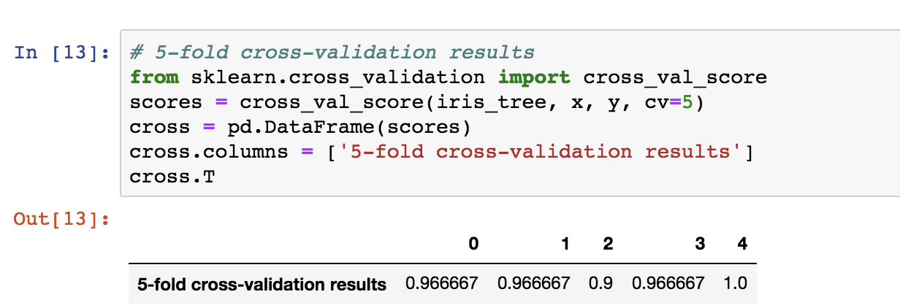
Results

Slide 16
Conclusion
PART FIVE
ID3 algorithm is quite good for Iris dataset

Slide 17
Challenges & what we learned
PART SIX

Slide 18
model selection
01
03
logistic
regression
linear
regression
02
decision tree
Challenges & what we learned

Slide 19
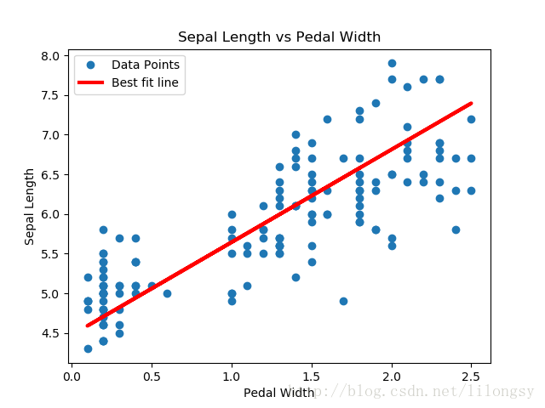
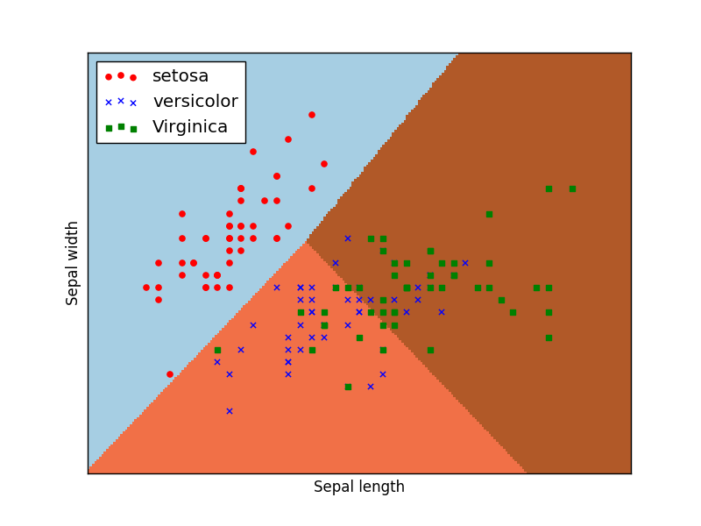
linear regression ：
logistic regression ：

Slide 20
Division of labor
PART SEVEN

Slide 21
Member | Work content | Contribution rate
Li Menglin | Model discussion programming PPT production | 25%
Zhao Yajie | Model discussion programming PPT production | 25%
Jiang Hanhua | Model discussion programming PPT production | 25%
Shi Xinran | Model discussion programming doing presentation | 25%

Slide 22
THANK YOU

