Slide 1
Proposal: Improving Ionospheric Modeling using Neural Networks
Henry Jordan, Ron Zamir

Slide 2
Overview
Physical Background
Why Ionospheric Modeling Matters
The PyIRI Model
Our Strategy of Improvement

Slide 3
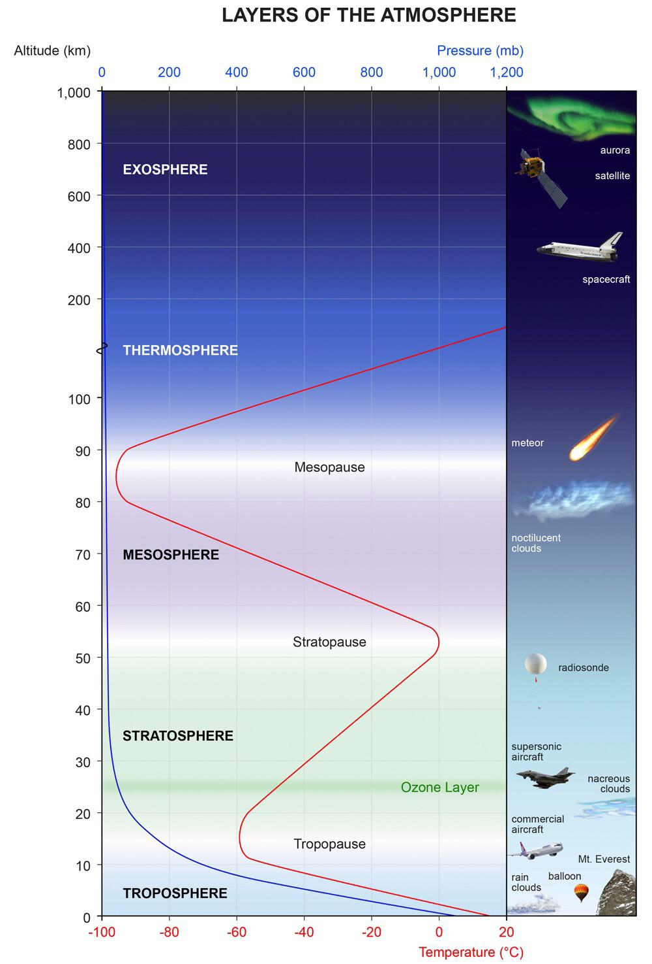
Layers of Earth’s Atmosphere
Ionosphere
Notes:
The Earth has a continuous atmosphere which decreases in density from the surface to space. However, the composition and properties of the atmosphere vary. We use these differences in properties to define atmospheric layers. What is known as the neutral atmosphere is consists of 5 layers from the troposphere to the exosphere. We refer to the charged plasma components within the atmosphere as the ionosphere. The ionosphere exists predominantly in the thermosphere and exosphere, where solar radiation is intense enough to ionize neutral species.

Slide 4
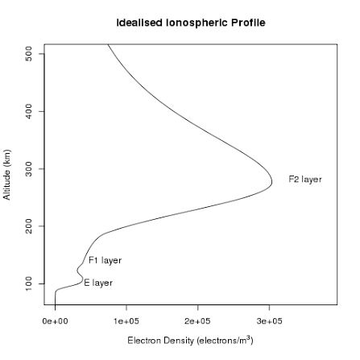
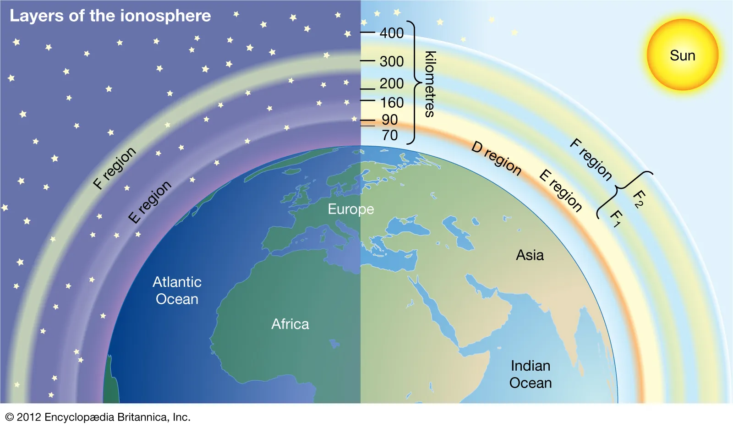
Structure of the Ionosphere
Notes:
The ionosphere consists of several distinct layer. Form bottom to top the D, E, F1, and F2 regions.

Slide 5
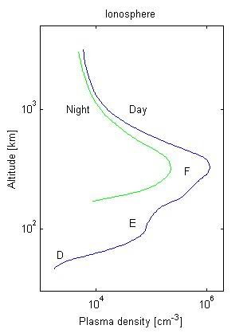
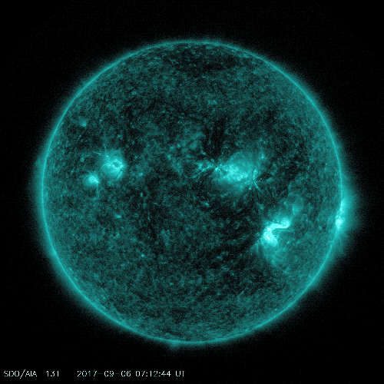
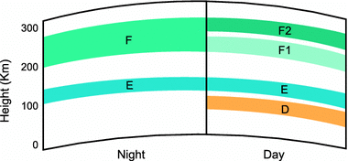
What Determines State of the Ionosphere?
Notes:
Solar radiation in UV spectrum is the primary driver of ionization in earths atmosphere. During non-solar storm periods the diurnal cycle drives electron density with ionization occurring during the day and recombination occurring at night. Solar flares emit enormous amounts of EUV so strongly ionize ionosphere as well. And charged particles ejected sun during solar storms can become trapped in the ionosphere

Slide 6
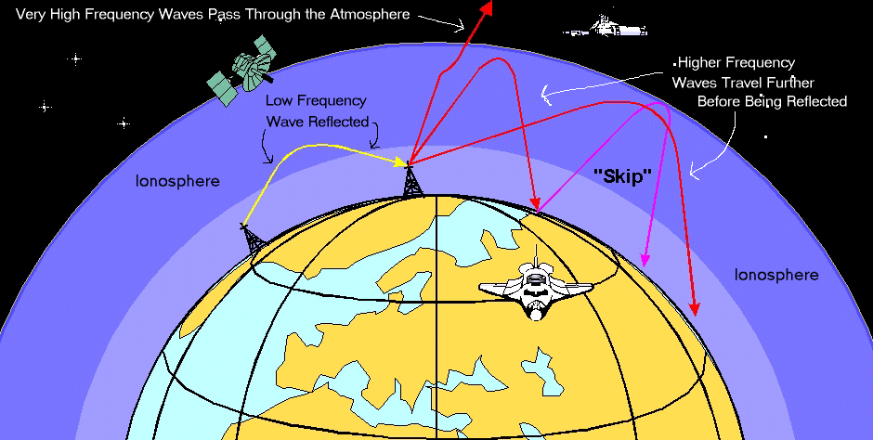
Why The Ionosphere Matters
Notes:
The ionosphere changes the properties slightly of all radio waves which pass through it. How it is changed depends on both the properties of the ionosphere and the frequency of the radio signal. It can reflect the wave, which enables over the horizon radar, or refract, or delay the wave which is a critical correction that must be done for GPS. Understanding the state of ionosphere is critical for effective radio communication of all forms.

Slide 7

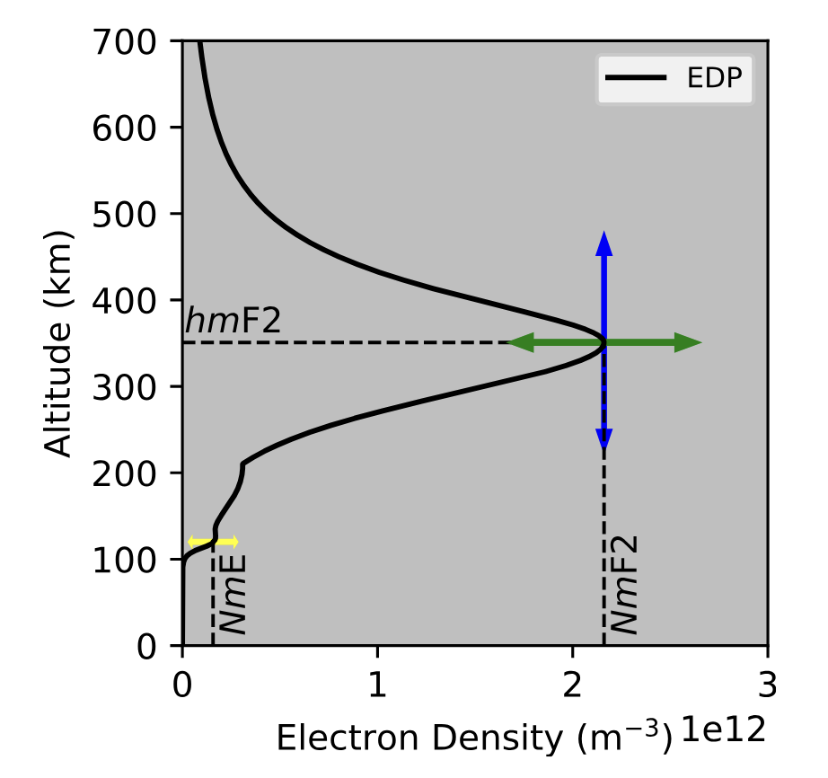
PyIRI
PyIRI is a python version of the International Reference Ionosphere (IRI) model. Which is the global standard for
This is an empirical, climatological model of the ionosphere. Meaning that it is designed to reproduce the average conditions of the ionosphere for a given set of inputs
Model inputs:
Month of year
Day of month
Time of day
Latitude
Longitude
Altitude
F107 solar irradiance index
Model outputs: Ionospheric state parameters

Slide 8
CCIR Coefficients
The critical empirical step of PyIRI in calculating ionospheric parameters is in utilizing the CCIR coefficients. This is a grid of over 1000 empirically derived coefficients (one for each grid point, time of day, solar state etc.).
All further calculations are conducted on this baseline
The model is fundamentally limited by the information contained in the CCIR coefficients and our ability to accurately pick them
They are designed to reproduce the average condition and not the exact, real condition

Slide 9
IRTAM
IRTAM uses real-time data assimilation to correct CCIR coefficients in IRI to generate a more accurate real-time ionosphere
Basically take IRI output and an ionosonde data point and tune CCIR coefficients until IRI output matches ionosonde data

Slide 10
Improve CCIR using NN
Idea: Use NN to predict CCIR coefficients based on the current factors but also drivers and real data not included in either base model or IRTAM
Allow IRI to account for geomagnetic storms and solar flares
(Line about how our training process works. I.e what data we are planning on using and the pipeline we want to use for training)

Slide 11
Metrics of Success

