Slide 1
An Analysis of the Effect of Social Media Use on Productivity
Henry Likness

Slide 2
My Research Question
Does social media use have a stronger negative effect on productivity than screen time alone?
Why it matters?
Productivity is important for students, professionals, and really everyone else.
Social media use is growing rapidly, so knowing it’s effect on productivity is key for future generations.
Approach
We will analyze a large productivity survey from Kaggle with multiple regression, using model building techniques discussed in STAT 311.

Slide 3
Dataset and Variables
6,000 respondents
Variables
Productivity_score (response 0-100)
Daily_screen_time
Study_hours
Sleep_hours
Notifications_per_day
Focus_score
Age
Addiction Level (Low/Med/High)
4,982 after cleaning
Source: Kaggle (self-reported survey)

Slide 4
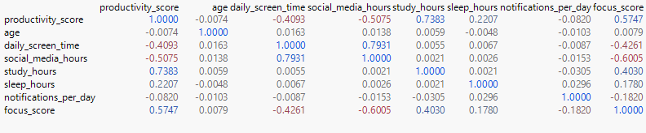
Exploratory Data Analysis
Key Takeaways:
study_hours and productivity: +0.738
social_media_hours and productivity: −0.508
daily_screen_time and social_media_hours: +0.793 possible multicollinearity

Slide 5
Methods: Sequential Model Building
All quantitatave predictors
Add addiction_level
Stepwise selection (reduced model)
Second Order Terms
Interaction Terms
→ Final Model validated with 80/20 train/test split

Slide 6
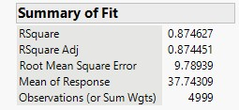
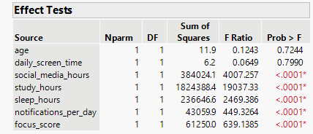
Testing our research question
Let’s use Model 1 to try and answer our research question.
SocF = 4007, p < 0.0001
DaiF = 0.065, p = 0.799 → not significant

Slide 7
Stepwise Selection
Let’s further tune our model
age (p = 0.7244)
daily_screen_time (p = 0.7990)
addiction_level (both effects)
social_media_hours
study_hours
sleep_hours
notifications_per_day
focus_score
DROPPED
KEPT
Stepwise dropping screen time supports our hypothesis!

Slide 8
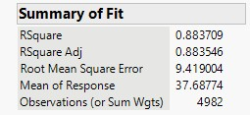
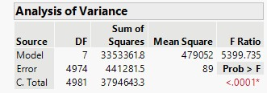
Second order model
From our reduced model, we test and select two influential second order terms:
Focus_score Squared and Study_hours squared
E(y) = β₀ + β₁x₁ + β₂x₂ + β₃x₃ + β₄x₄ + β₅x₅ + β₆x₅² + β₇x₂²

Slide 9
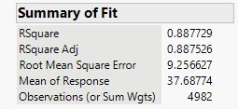
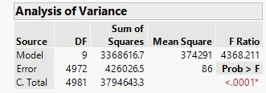
Interaction Terms
From our second order model, two interactions stood out as both highly significant on their own and as providing the largest improvement to Adjusted R-squared:
study_hours × social_media_hours and study_hours × focus_score
E(y) = β₀ + β₁x₁ + β₂x₂ + β₃x₃ + β₄x₄ + β₅x₅ + β₆x₅² + β₇x₂² + β₈(x₁·x₂) + β₉(x₂·x₅)

Slide 10

Validating our Final Model
Training
Validation
R² = 0.8882
R² = 0.8858
RASE = 9.24 n = 3,968
RASE = 9.29 n = 1,014

Slide 11
Conclusion
Social media has a stronger negative effect on productivity than total screen time alone.
daily_screen_time is non-significant once social_media_hours is in the model (p = 0.799)
Stepwise (all methods) dropped daily_screen_time and kept social_media_hours
Social media interacts with study hours — high SM use erodes the productivity gain from studying

