Slide 1
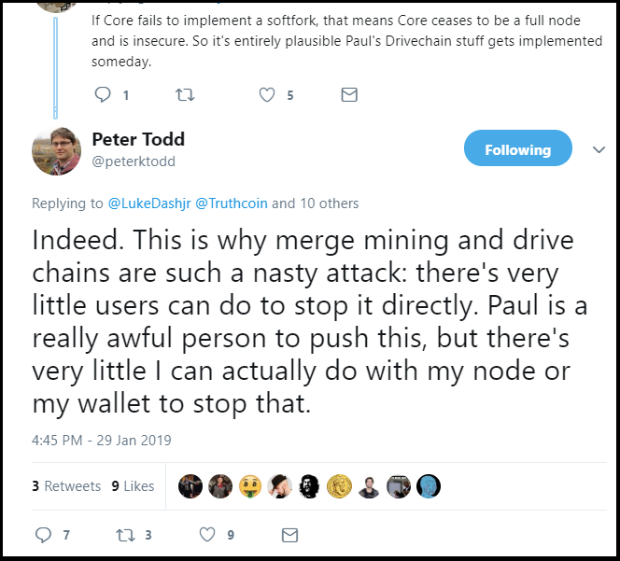
Sidechains and Inter-chain Combat
Paul Sztorc
TAB Conf 2 – Atlanta, GA
Feb 10th, 2019

Slide 3
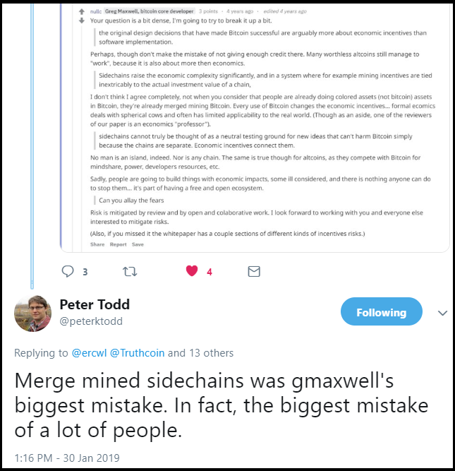
Gmaxwell’s Biggest Mistake

Slide 4
Who Am I?
Pre-Bitcoin
BA Economics, Psychology; Mathematics, MS-M OR, MBA Finance
Financial Consulting -- Healthcare IT
Statistician Yale Econ Dept – Bill Nordhaus (2018 Nobel)
Roger Ver – Truthcoin / Hivemind
Bloq early 2016 – Drivechain ; current affiliation: Tierion
Truthcoin.info Blog
“Nothing is Cheaper than Proof of Work” (Nov 2014, Aug 2015)
“Private Blockchains, Demystified” (Nov 2014, Mar 2016)
“Measuring Decentralization” (Sep 2015)
“Fork Futures” (Jul 2015, Oct 2017)
“Drivechain: The Simple Two-way peg” (Nov 2015)
‘Scaling Bitcoin’ 1-3 (Presenter); Scaling 4 (Program Committee)

Slide 6

Timeline
Like 6 months ago
December
Jan 30th
Feb 10th
Interchain combat.
Agree to give talk.
Choose topic.
Cryptotwitter intrigue.
Today

Slide 7
Agenda
Sidechains: Universal Altcoin Simulation (and Compression)
How it works
Critiques of Sidechains
Sidechain Privatization (“Interchain combat” and “flipped work”).
Name-leeching.
Oracle reputation-leeching.
Fee-leeching.

Slide 8
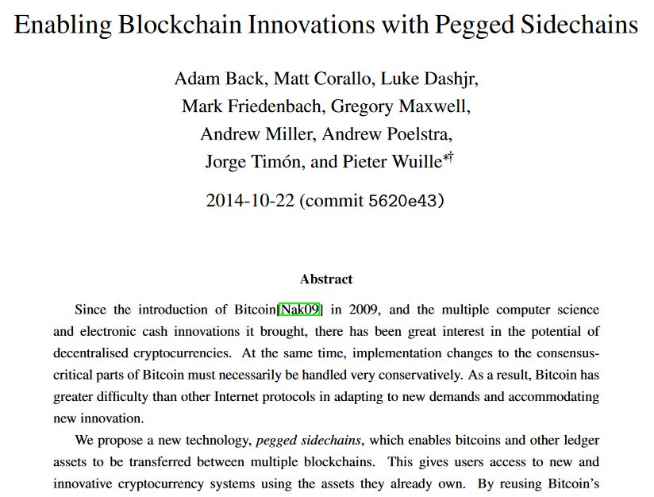

Slide 9
Hard forks bad
Opt-in “compart-ments” good.

Slide 10
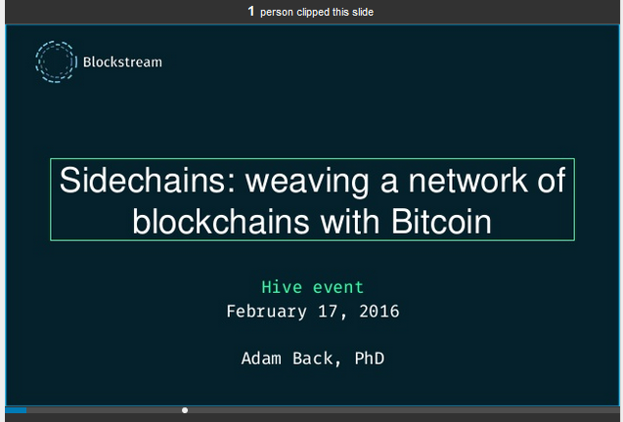

Slide 11
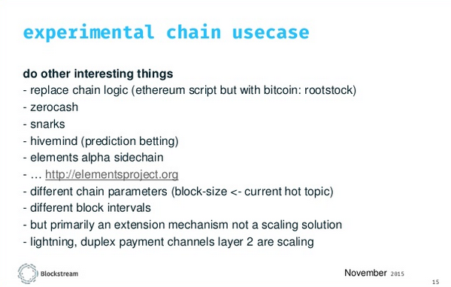

Slide 12
Bitcoin “pretending” to be Altcoins, like Eth or Zcash or BCH.
BCH

Slide 13
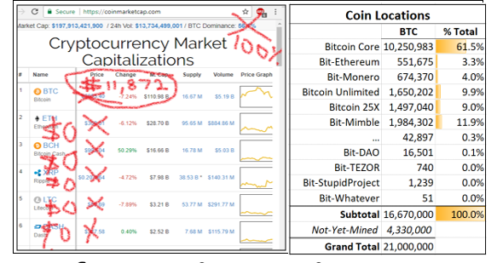
My definition: universal altcoin simulator.
Iterative Deletion
Popularity → location, not price
When I made this, BTC was at $6,800

Slide 14
Hard forks bad
Opt-in “compart-ments” good.

Slide 15
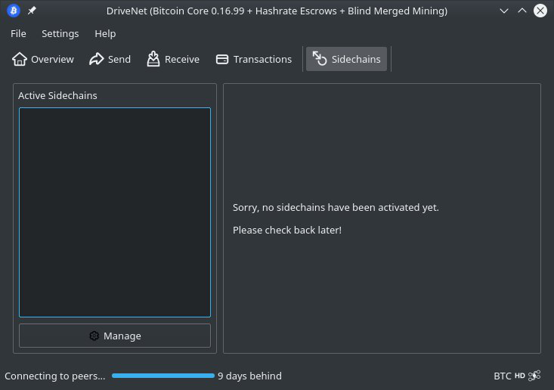
We Built It

Slide 16
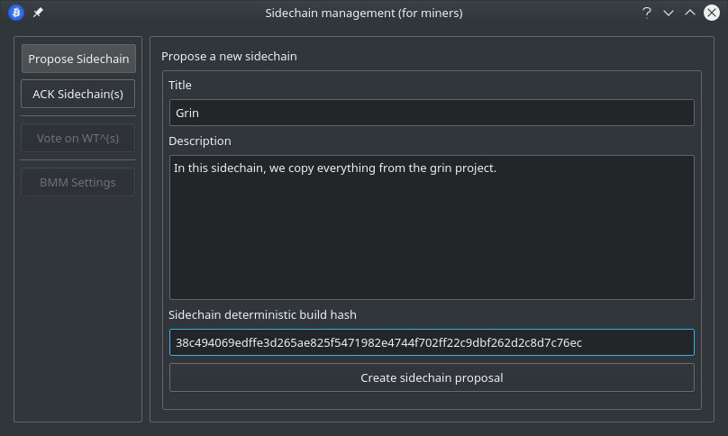
Make new software.
Put hash of new software here.

Slide 17
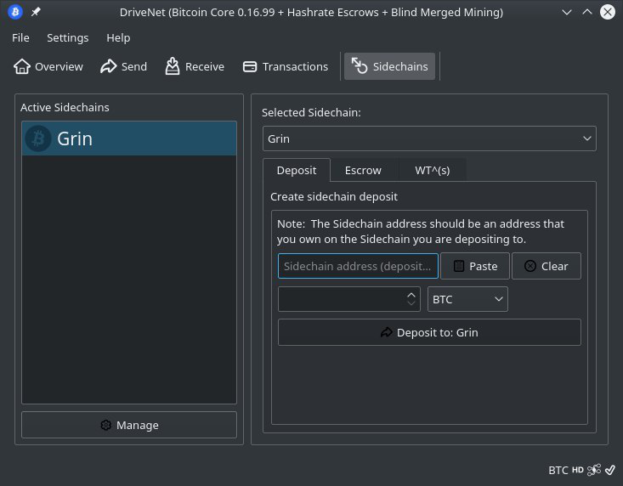

Slide 18
How does it work?

Slide 19
Two pieces
Hashrate Escrow -- A "Container UTXO" that compresses 3-6 months of sidechain data into a fixed 32-bytes.
Blind Merged Mining -- Replaces the act of running a sidechain node with the act of including a single high-fee transaction.

Slide 20
Sidechain Compression
Mainchain full nodes do not validate sidechain’s rules/data.
But, then, an invalid withdrawal must be treated exactly the same as a valid one! There is no basis for discriminating between them.
M
A
M
A
B
E
B
F
H
B
C
B
C
S
S
D
E
D
F
I
II
Two Possible Histories
Time
Time
Notes:
I’ve placed the regular Bitcoin blockchain in orange. And a sidechain below it in green.

Slide 21

Sidechain Compression
Mainchain full nodes do not validate sidechain’s rules/data.
But, then, an invalid withdrawal must be treated exactly the same as a valid one! There is no basis for discriminating between them.
M
A
M
A
B
E
B
F
H
Veil of Ignorance
B
C
B
C
S
S
D
E
D
F
I
II
One of these is SC-theft. But which one?

Slide 22
Sidechain Compression
32-bytes per 3-6 months.
We just assume that the bytes are correct.
Sidechain full/SPV nodes are both yelling these bytes as loud as they can.
M
A
M
A
B
E
B
F
H
Veil of Ignorance
B
C
B
C
S
S
D
E
D
F
I
II
One of these is SC-theft. But which one?

Slide 23
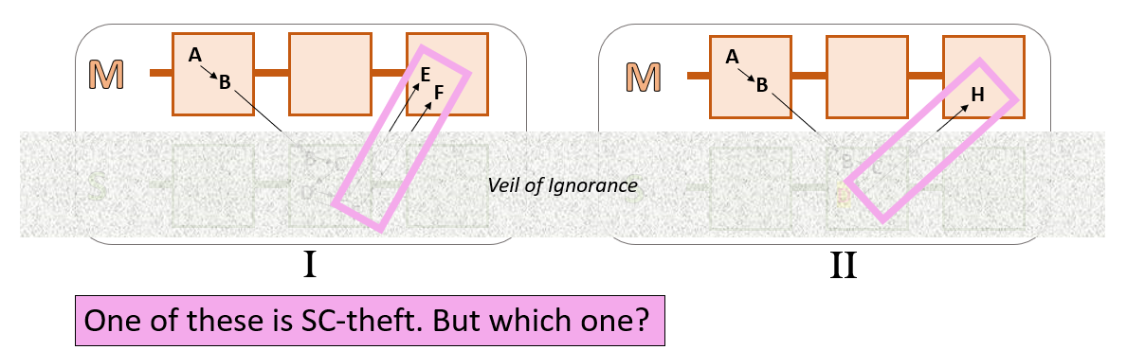
[E,F] vs [H] – Traincar metaphor.
If a traincar advances 13,150 places (3 months worth of confirmations), it crosses the ‘finish line’. Its txns can be included in a main:block.
“Passengers” can “disembark”.
BTC has moved from sidechain to mainchain, finally.
Trains “expire” after 26,300 blocks (6 months).
13,150
[E,F]
[H]

Slide 24
Per Sidechain, Only One Traincar can advance at a Time
The others move back.
DoS prevention.
t = 10
START
Sidechain #6

Slide 25
Per Sidechain, Only One Traincar can advance at a Time
The others move back.
t = 11
START
Sidechain #6

Slide 26
Per Sidechain, Only One Traincar can advance at a Time
The others move back.
t = 12
START
Sidechain #6

Slide 27
Per Sidechain, Only One Traincar can advance at a Time
The others move back.
t = 13
START
Sidechain #6

Slide 28
Per Sidechain, Only One Traincar can advance at a Time
The others move back.
Abstain
t = 14
START
Sidechain #6

Slide 29
Per Sidechain, Only One Traincar can advance at a Time
All traincars move back.
Alarm
t = 15
START
Sidechain #6

Slide 30
Per Sidechain, Only One Traincar can advance at a Time
The others move back.
t = 16
START
Sidechain #6

Slide 31
Per Sidechain, Only One Traincar can advance at a Time
The others move back.
t = 17
START
Sidechain #6

Slide 32
Blind Merged Mining
Will explain it in a second.

Slide 33
Two Big Critiques
“Miners can steal”
“Increased likelihood of mainchain txn-censorship.”

Slide 34
Critique #1
“Miners can steal”
(Nothing guarantees that the 32 bytes that win the race, will be the 32 bytes that the sidechain full nodes sent.)
The act of moving a traincar forward, only “costs” the miner the opportunity to move any other traincar forward.
Increased likelihood of mainchain txn-censorship.

Slide 35
“Miners Can Steal” – Response

Slide 36
“Miners Can Steal” – Response
Would you prefer mandatory hard forks? (Or Altcoins?)

Slide 37
“Miners Can Steal” – Response
Would you prefer mandatory hard forks? (Or Altcoins?)
Theft is: transparent, 32-bytes, takes 3-6 months. MC enforced.

Slide 38
“Miners Can Steal” – Response
Would you prefer mandatory hard forks? (Or Altcoins?)
Theft is: transparent, 32-bytes, takes 3-6 months. MC enforced.
Evict bad SCs. No loitering! No blockchain-crime!

Slide 39
“Miners Can Steal” – Response
Would you prefer mandatory hard forks? (Or Altcoins?)
Theft is: transparent, 32-bytes, takes 3-6 months. MC enforced.
Evict bad SCs. No loitering! No blockchain-crime!
Use of the word “can” = does not understand Bitcoin/blockchain.

Slide 40
“Miners Can Steal” – Response
Would you prefer mandatory hard forks? (Or Altcoins?)
Theft is: transparent, 32-bytes, takes 3-6 months. MC enforced.
Evict bad SCs. No loitering! No blockchain-crime!
Use of the word “can” = does not understand Bitcoin/blockchain.
Let people make their own mistakes. It doesn’t affect you!

Slide 41
Critique #2
“Miners can steal”
Increased likelihood of mainchain txn-censorship.
Sidechain(s) node costs = 5 (M $ per year)
Sidechain revenues = 100 (M $ per year)
Miner with 4% hashrate, must join larger pool.
All pool operators must eventually run all SCs.
Burdensome SC-software forces pools to run in large datacenters, making them easy targets for coercion.
Regulators will be able to force pools to exclude some mainchain txns from the mainchain.

Slide 42
Regular Merged Mining
Miners must run a full node for each chain.
Miner
N1
N2
N1
N2
N1
N1
N2
N2
N1
N2

Slide 43
Regular Merged Mining
Blind
Miners do NOT run SC nodes, but still get 100% fee-profits.
Much less data exchanged.
100% of network → small fixed amount of data
Miner
N1
N2
N1
N2
N1
N1
N2
N2
N1
N2

Slide 44
5 Reasons Why It’s Nonsense, Anyway

Slide 45
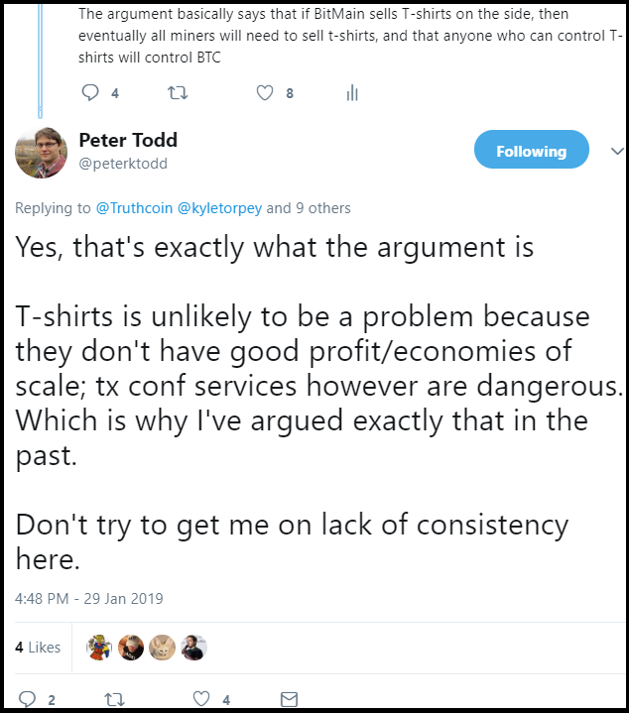

Slide 46
5 Reasons Why It’s Nonsense, Anyway
Inducement != Slavery; Argument Contradicts Itself

Slide 47
5 Reasons Why It’s Nonsense, Anyway
Inducement != Slavery; Argument Contradicts Itself
Caring about miner-comfort = does not understand Bitcoin.

Slide 48
5 Reasons Why It’s Nonsense, Anyway
Inducement != Slavery; Argument Contradicts Itself
Caring about miner-comfort = does not understand Bitcoin.
Txn-censorship is a privacy issue. Not pools/SCs.

Slide 49
5 Reasons Why It’s Nonsense, Anyway
Inducement != Slavery; Argument Contradicts Itself
Caring about miner-comfort = does not understand Bitcoin.
Txn-censorship is a privacy issue. Not pools/SCs.
We need those MM fees!!

Slide 50
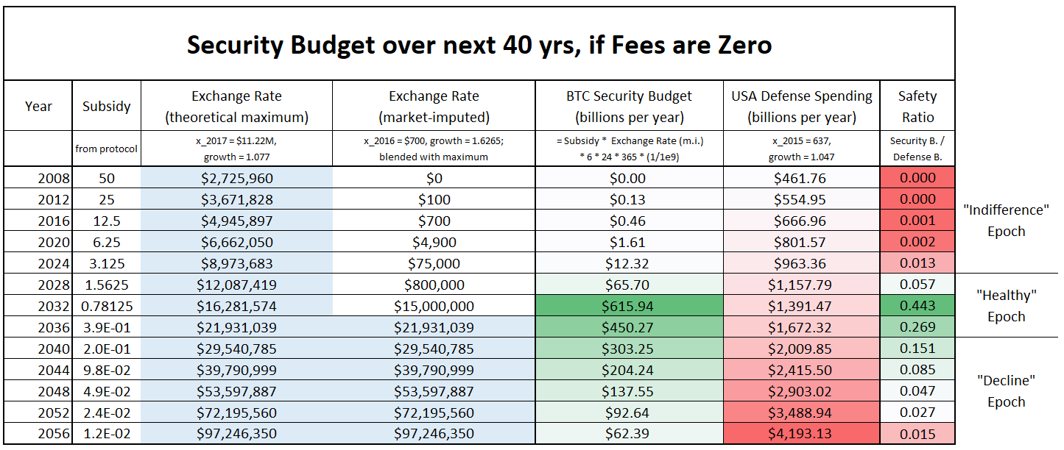

Slide 51
Completely Different Realms
Revenue-Source | Block Subsidy (12.5 BTC) | Transaction Fees
Meme | Store of Value | Medium of Exchange
Slogan | “Digital Gold” | “P2P Cash for the World”
Supply and Demand | …of BTC | …of block space
Critical Price | $ (PPP) / Bitcoin | $ (PPP) per byte
If BTC price = moon… | …Security Goes Up | …Unaffected

Slide 52
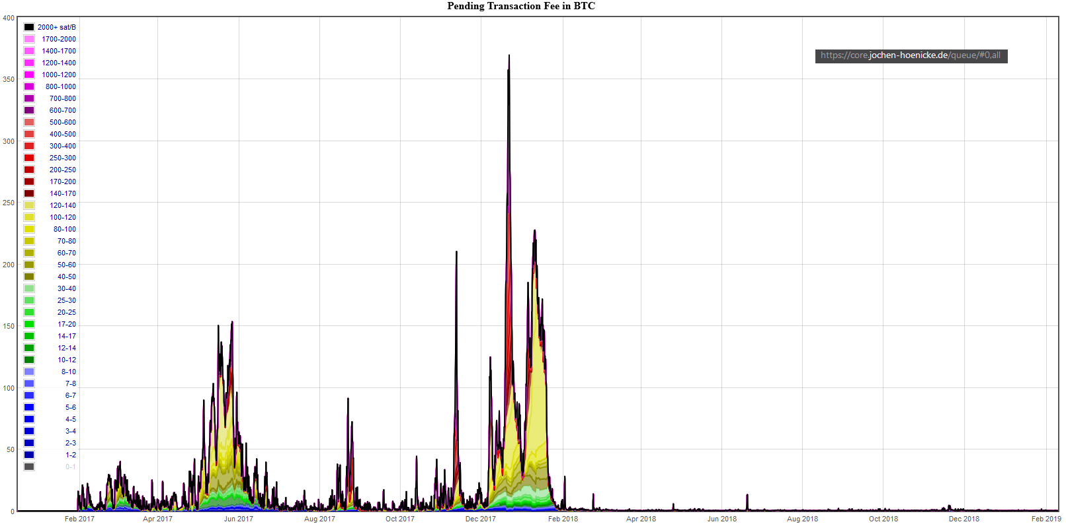

Slide 53
Market learned (?) to use Altcoins for medium-of-exchange?

Slide 54
Completely Different Realms
Revenue-Source | Block Subsidy (12.5 BTC) | Transaction Fees
Meme | Store of Value | Medium of Exchange
Slogan | “Digital Gold” | “P2P Cash for the World”
Supply and Demand | …of BTC | …of block space
Critical Price | $ (PPP) / Bitcoin | $ (PPP) per byte
If BTC price = moon… | …Security Goes Up | …Unaffected
Bottom Line: Today, fees = $200/block ; a mere $ 10,512,000 per year. Without MM, they might plausibly NEVER be higher than that.

Slide 55
10M = $ 0.01 billion = joke

Slide 56
5 Reasons Why It’s Nonsense, Anyway
Inducement != Slavery; Argument Contradicts Itself
Caring about miner-comfort = does not understand Bitcoin.
Txn-censorship is a privacy issue. Not pools/SCs.
We need those MM fees!!

Slide 57
5 Reasons Why It’s Nonsense, Anyway
Inducement != Slavery; Argument Contradicts Itself
Caring about miner-comfort = does not understand Bitcoin.
Txn-censorship is a privacy issue. Not pools/SCs.
We need those MM fees!!
Vanilla MM cannot be stopped. So, get used to it.

Slide 58
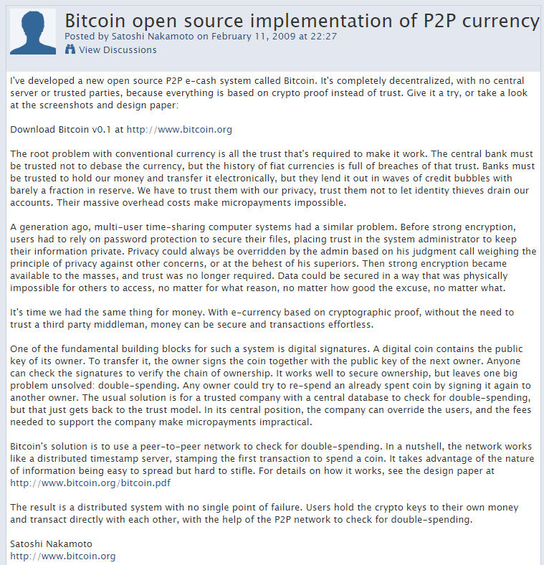
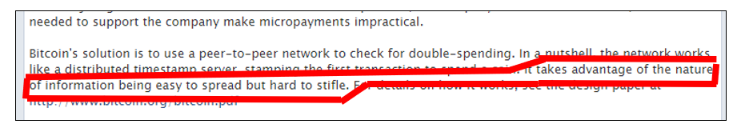
How Does Drivechain Work?

Slide 59
Conclusion
Goals
Defeat Altcoins
Resolve Scalability Conflict, permanently.
More innovation.
Call to Action
Join telegram group: t.me/DcInsiders
Help us test.
Stop FUD – I will post refutations to Critique 1 and 2, on website
Drivechain.info

Slide 60
Agenda
Sidechains: Universal Altcoin Simulation (and Compression)
How it works
Critiques of Sidechains
Sidechain Privatization (“Interchain combat” and “flipped work”).
Name-leeching.
Oracle reputation-leeching.
Fee-leeching.

Slide 61
Agenda
Leeching
Sidechains: Universal Altcoin Simulation (and Compression)
How it works
Critiques of Sidechains
Sidechain Privatization (“Interchain combat” and “flipped work”).
Name-leeching.
Oracle reputation-leeching.
Fee-leeching.
Of all types of blockchain interference, generally the easiest to understand.
Notes:
I was originally going to talk about several different types of interference, and the talk would have gotten quiet complicated.

Slide 62
“Miners Can Steal” – Response
Would you prefer mandatory hard forks? (Or Altcoins?)
Theft is: transparent, 32-bytes, takes 3-6 months. MC enforced.
Evict bad SCs. No loitering! No blockchain-crime!
Use of the word “can” = does not understand Bitcoin/blockchain.
Let people make their own mistakes. It doesn’t affect you!
If miners couldn’t get rid of bad SCs, could not kill leeches. They would prevent really cool contracts from existing. (Fortunately, “miners can” get rid of them.)

Slide 63
Name Leeching
Someone makes an identity sidechain. You register a name, for example “Bitcoin.com”.
Someone makes a second identity sidechain, and registers “Bitcoin.com” over there.

Slide 65
Market learned (?) to use Altcoins for medium-of-exchange?

Slide 66
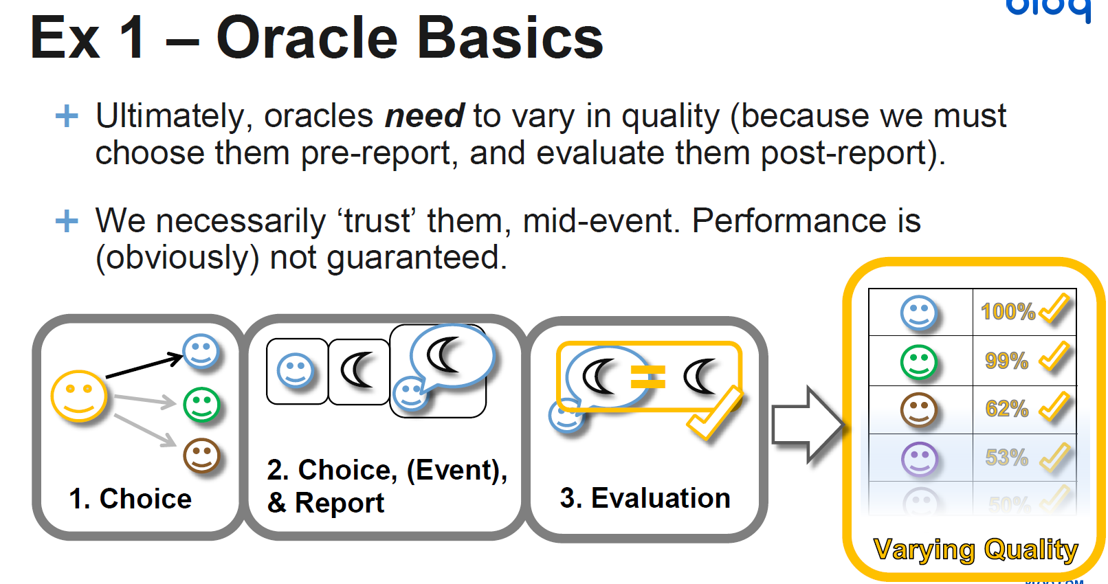
Corporation Model Breaks Sometimes
Multiple oracles
Notes:
Each reporter gets their own evaluation.

Slide 67
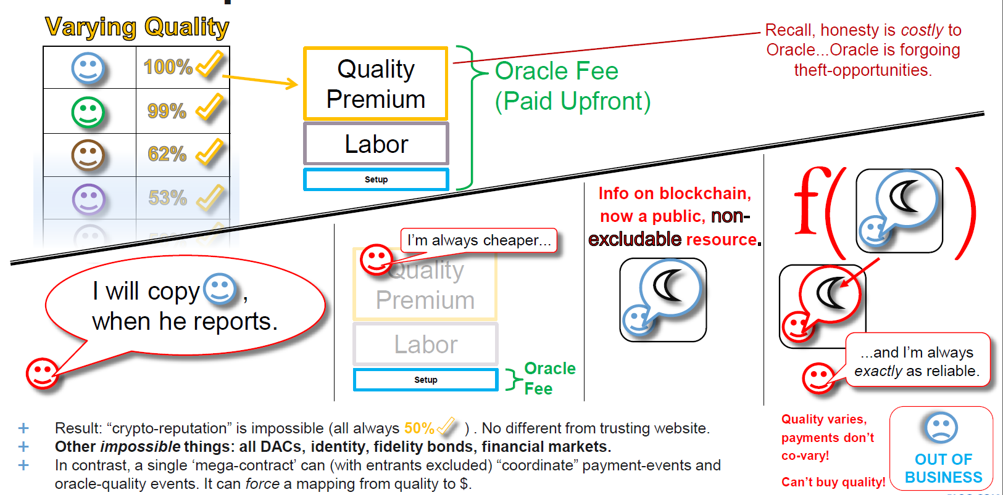
To Purchase Quality, Need pseduo-“©”

Slide 68
To Purchase Quality, Need pseduo-“©”

Slide 69
Questions

