Slide 1
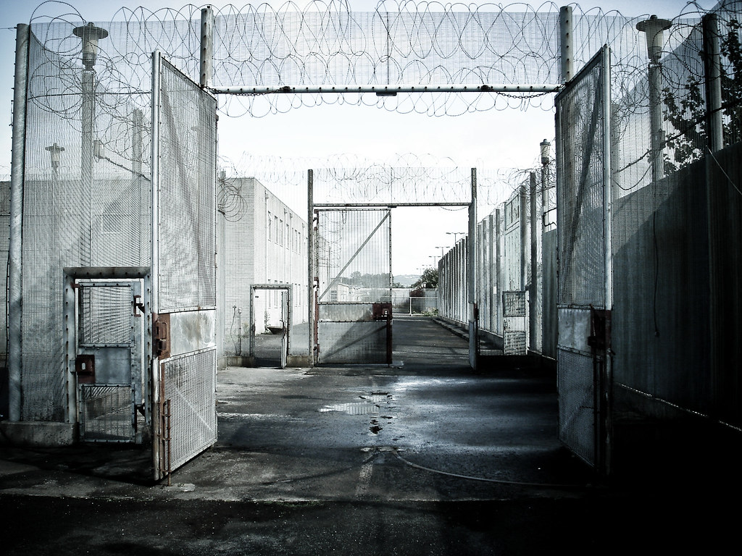
Drivechain An Interoperability Layer-2 Described in Terms of the LN – something you already understand
Paul Sztorc
Research Director, Tierion
May 27th, 2019

Slide 2
About Me
2012 -- Bitcoiner
2014 -- Truthcoin.info Blog
2015-Present – Scaling Bitcoin 1,2,3,4; TabConf and BoB
Currently: Research Director at Tierion
Previously: Statistician at Yale Econ Department

Slide 3
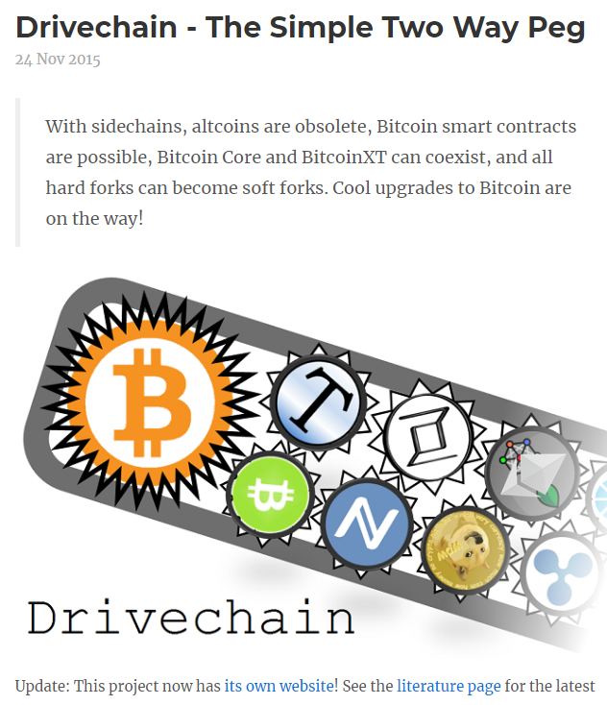
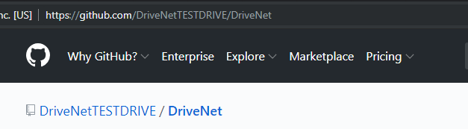
Topic: Drivechain
A Bitcoin Layer-2 (… or, a “Layer 1.5”)
Interoperability AND Scaling
Soft Fork -- BIPs 300 and 301
www.drivechain.info
#642 #643
GitHub
Original Nov 2015 Post

Slide 4
In One Slide
Problem | Meta-Consensus (Altcoins, Hard Forks, and Contentious Features)
Solution | Interoperability (One Token, traveling among many blockchains)
Goal | Don’t compete to win -- instead just play all the hands (so you can’t lose).

Slide 5
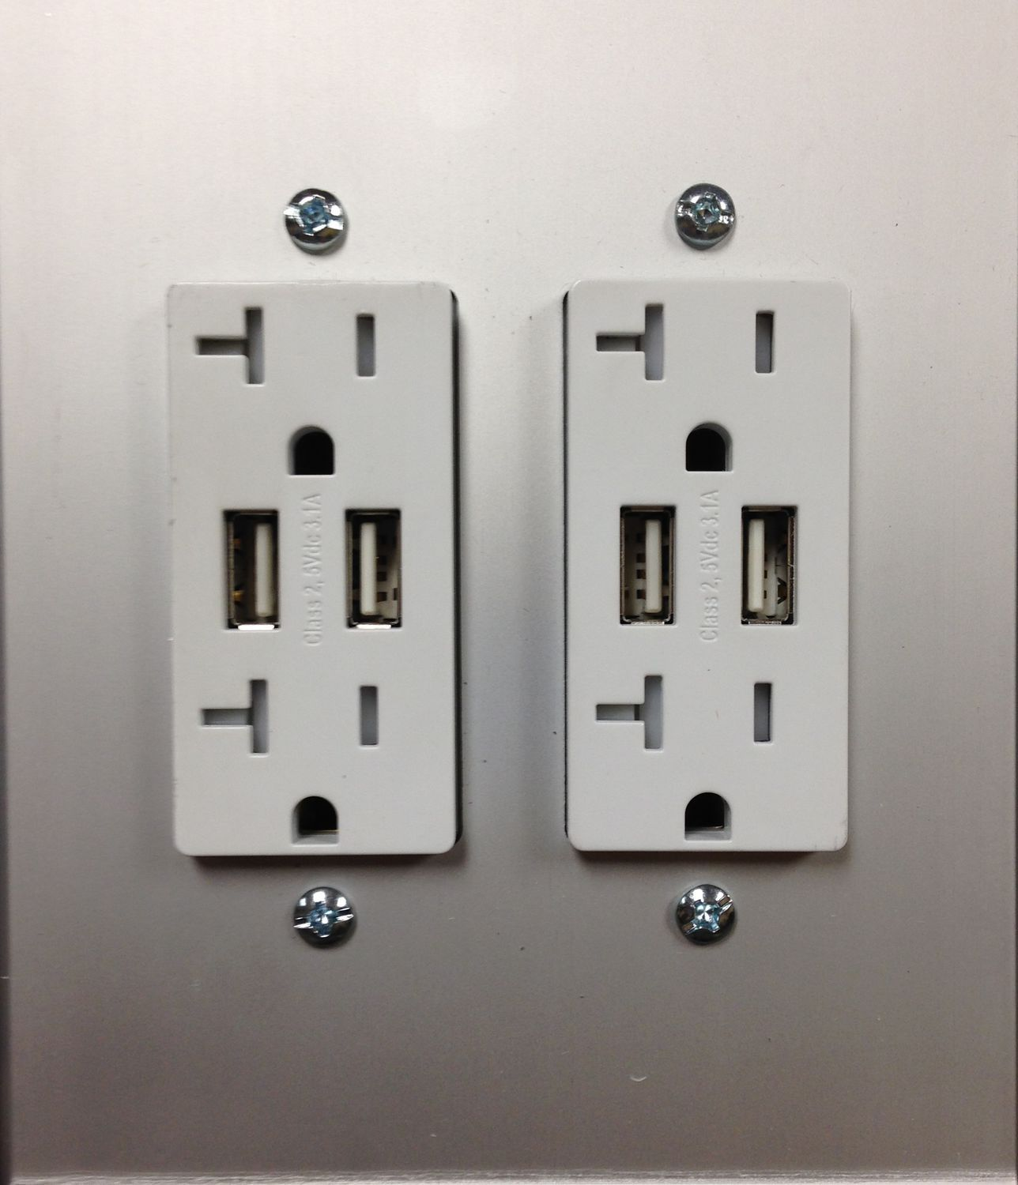
Interoperability
Teamwork + Differences = Interoperability
“Team” Agrees on bare minimum – otherwise free to disagree

Slide 6
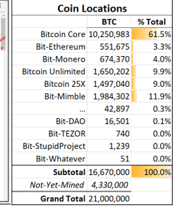
Interoperability
Teamwork + Differences = Interoperability
“Team” Agrees on bare minimum – otherwise free to disagree
In DC: Agree on total coins and their location among blockchains.

Slide 7
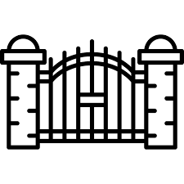
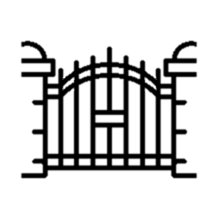
How Drivechain Works
New Kind of Output: “Hashrate Escrow”
Anyone can deposit to it at any time.
But withdrawals are very slow.
Series of gates.

Slide 8
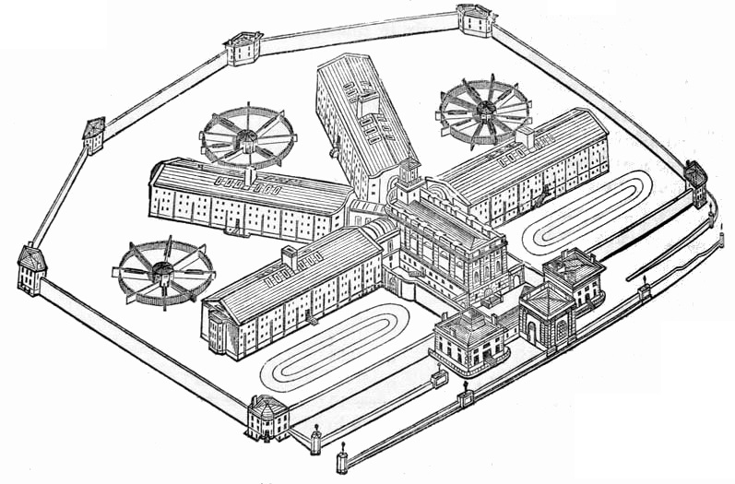

Prison Metaphor
Prison
BTC
…
Only way out.
13,150 Gates

Slide 9
Example
A “Payments Sidechain” Similar to Lightning

Slide 10
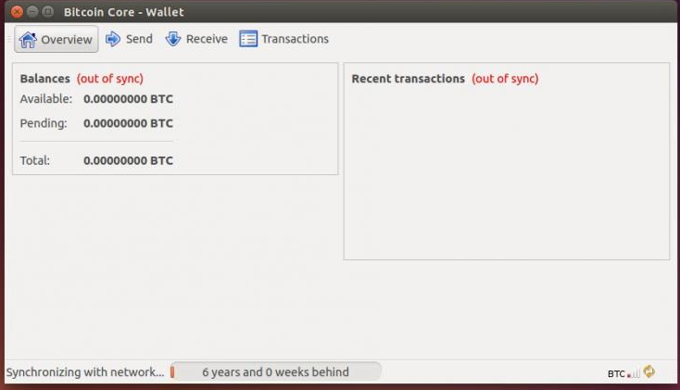
Example
1. Start with Bitcoin Core

Slide 11
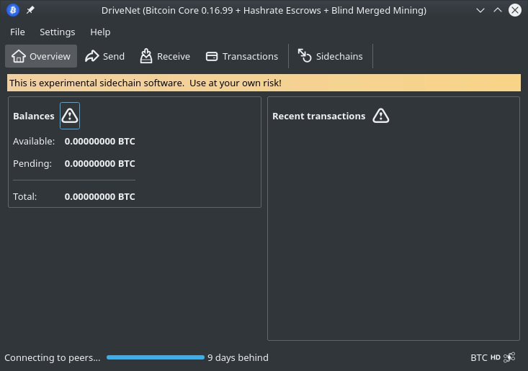
2. Add BIP 300 + 301

Slide 12
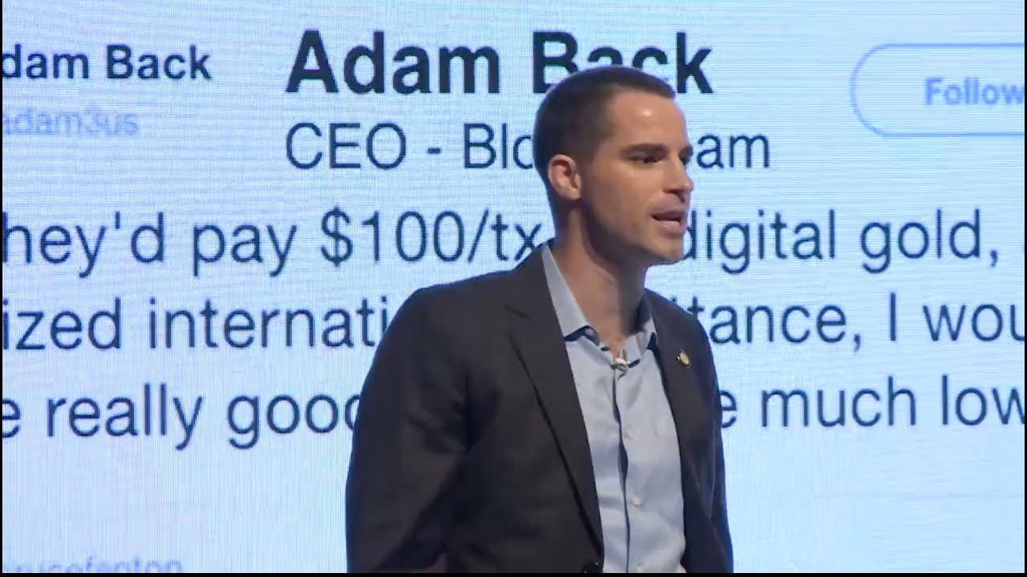
3. Meta-Consensus Problem

Slide 13
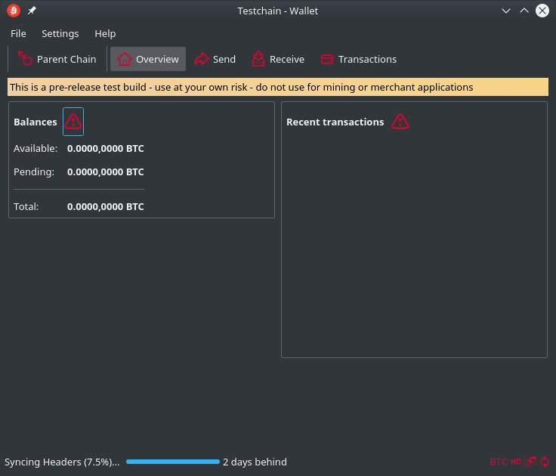
4a. Fork Our Template

Slide 14
Bitcoin Payments
Change Name
Change Blocksize / SIGOP Limits
This software requires a BTC Core Node.
4b. “Bitcoin Payment”

Slide 15
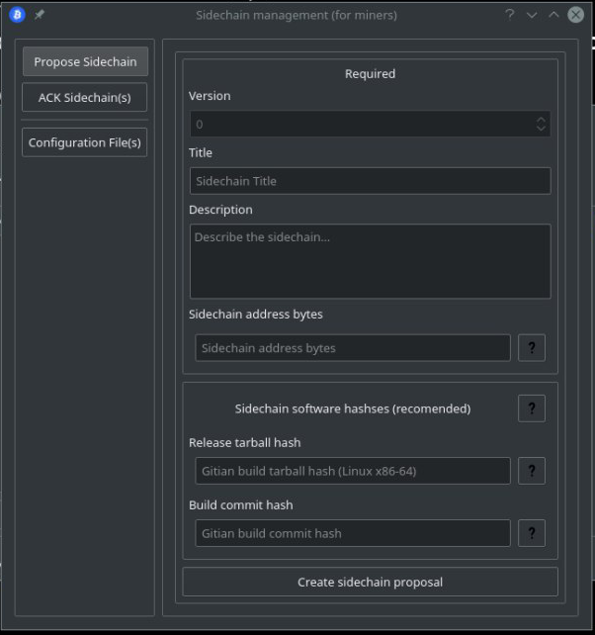
“Bitcoin Payments”
Now Open For Business
5. Add New Escrow

Slide 16
Escrow UTXO
Escrow UTXO
On layer-1:
Roger’s UTXO
Roger’s 50,000 BTC
“Bitcoin Payments”
6a. Spend from Layer-1 to Layer-1.5

Slide 17
Escrow UTXO
Escrow UTXO
Escrow UTXO
On layer-1:
Roger’s UTXO
Brian’s UTXO
Brian’s 7,000 BTC
“Bitcoin Payments”
6b. Spend from Layer-1 to Layer-1.5

Slide 18
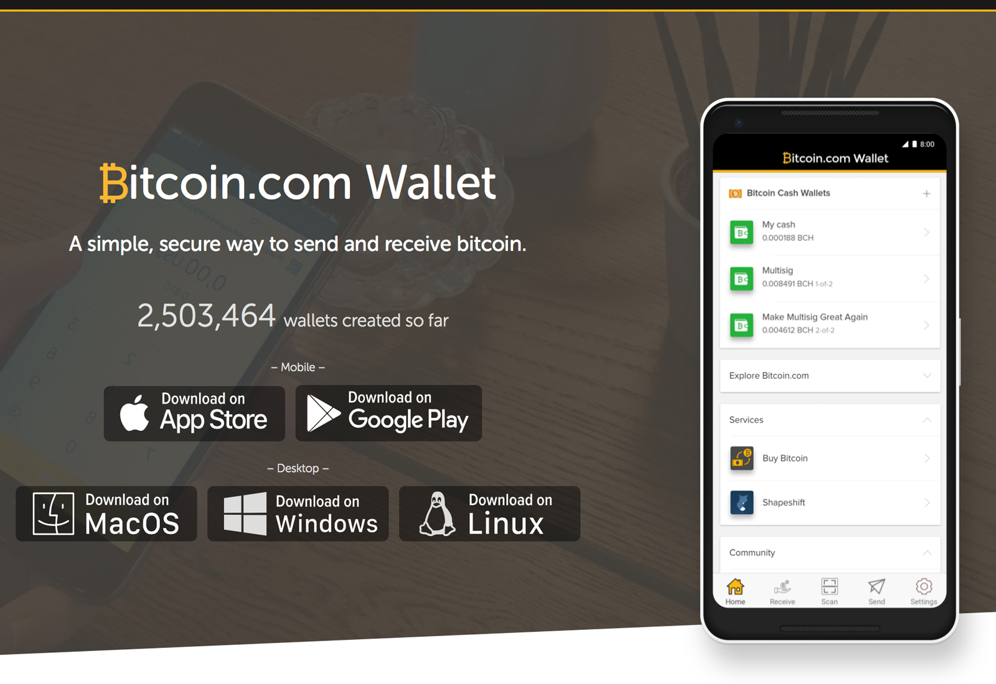
Escrow UTXO
Escrow UTXO
Escrow UTXO
On layer-1:
Roger’s UTXO
Brian’s UTXO
“Bitcoin Payments”
Generates txn fee revenues for miners
7. Spend within the Escrow

Slide 19
Blind Merged Mining
Transactions “within the prison”
Generate txn fee revenues for miners
Even Though Miners Don’t see Them!
“Bitcoin Payments”
19

Slide 20


Blind Merged Mining
Mainchain Blockchain
Sidechain
Assembles blocks, even though has zero hashrate.
Same Person Infinite Trust
Candidates for Next Sidechain Block
20

Slide 21
Blind Merged Mining
Mainchain Blockchain
Sidechain
Earns sidechain funds
(because mining sidechain blocks)
Pays mainchain funds (to “real” miners)
Same Person Infinite Trust
21

Slide 22
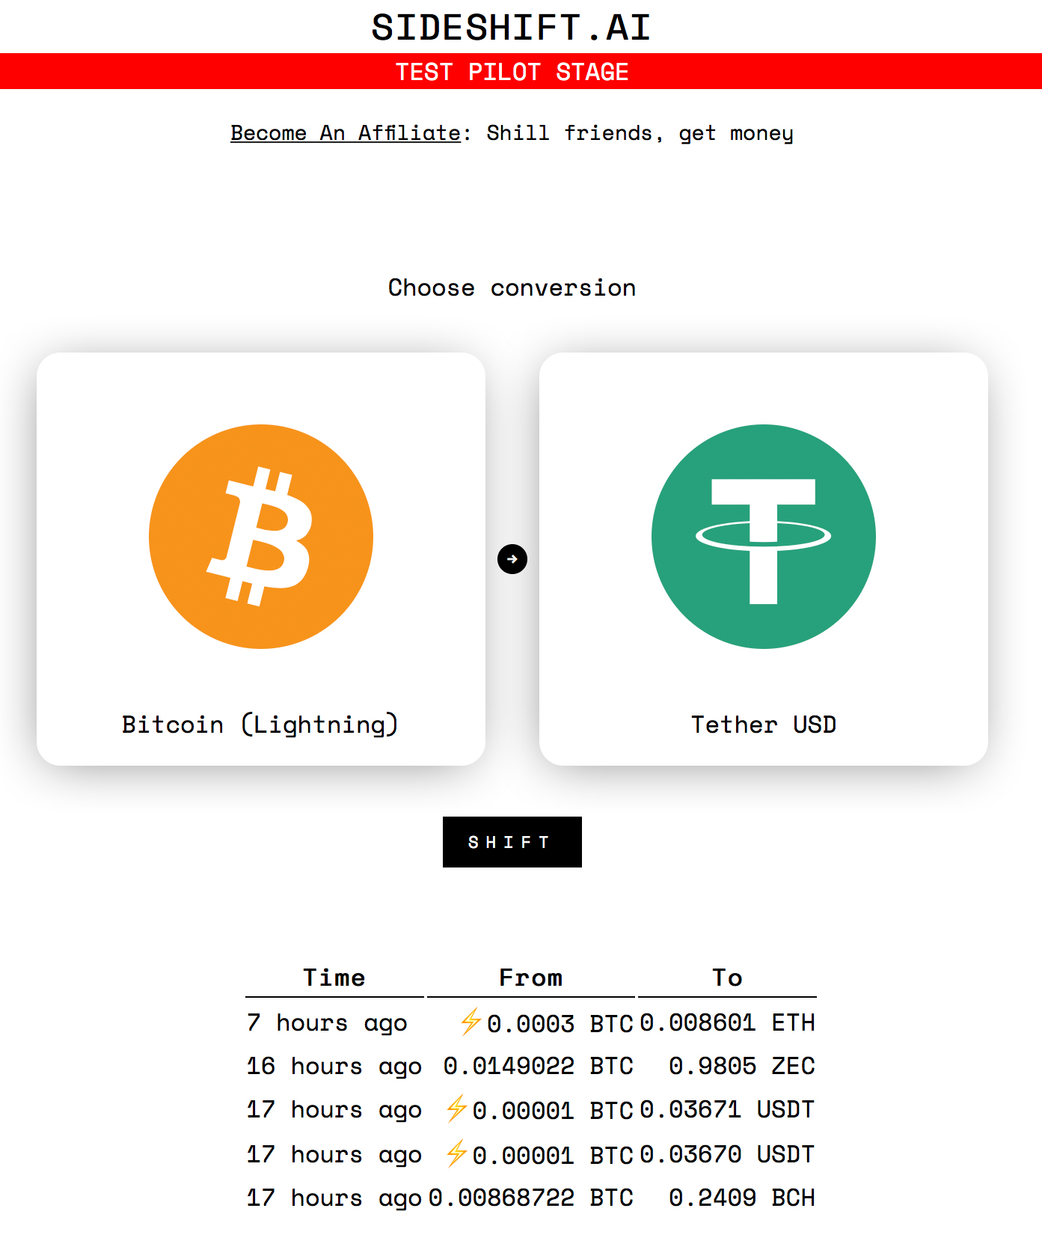
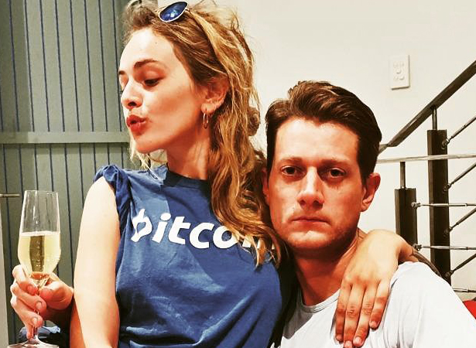
Sideshift, Shapeshift, Atomic Swaps, Etc
Andreas
8a. Swapping to Instant Freedom

Slide 23
Escrow UTXO
Escrow UTXO
Escrow UTXO
On layer-1:
Roger’s UTXO
Brian’s UTXO
Andreas’ UTXO
Jeff’s UTXO
“Bitcoin Payments”
8b. Prisoner Exchange

Slide 24
Escrow UTXO
Escrow UTXO
Escrow UTXO
On layer-1:
Roger’s UTXO
Brian’s UTXO
Andreas’ UTXO
Jeff’s UTXO
Take these 2,980 BTC out please..
Andreas
Roger
Erik
…and these 114.
“Bitcoin Payments”
9. Leaving Prison

Slide 25
Escrow UTXO
Escrow UTXO
Escrow UTXO
Escrow UTXO
Roger’s UTXO
Brian’s UTXO
2980 to Andreas
114 to Erik
Take these 2,980 BTC out please..
32 bytes
…and these 114.
Andreas
What do I need?
Roger
Erik
“Bitcoin Payments”
10. The Withdrawal Txn

Slide 26
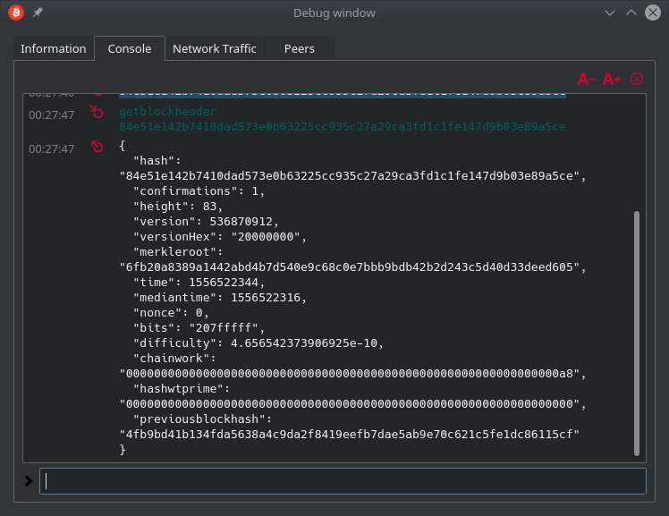
getblockheader
32 bytes
10. The Withdrawal Txn

Slide 27
Prison Metaphor
1st gate
32 bytes
13150th gate
…
11. Starting Off…

Slide 28

Prison Metaphor
32 bytes
Miners
…
12. Making Progress…

Slide 29
Escrow UTXO
Escrow UTXO
On layer-1:
Roger’s UTXO
2980 to Andreas
114 to Erik
Andreas
Erik
…
32 bytes
13. Withdrawal Complete

Slide 30
Costs and Risks
Using any escrows? | No | Yes
Costs | A soft fork. | A soft fork + New security considerations for the layer-1.5 coins.

Slide 31
Upper Layers = Different Threat Models
Upper Layer: | Lightning Network | Hashrate Escrow
New Security Considerations | Notice fraud in time. Emergency Broadcast to Layer-1 Shrug off custodial period. | …

Slide 32
Upper Layers = Different Threat Models
Upper Layer: | Lightning Network | Hashrate Escrow
New Security Considerations | Notice fraud in time. Emergency Broadcast to Layer-1 Shrug off custodial period. | Are these escrows making miners wealthier? Are they popular?

Slide 33
Miner Theft
(Evil 32 Bytes)
32 bytes
Escrow UTXO
Escrow UTXO
50,000 to Jihan Wu
Oh no…
…
32 bytes
11. Starting Off…

Slide 34
3 Awkward Months…
32 bytes
Miners
…
12. Making Progress…

Slide 35
Escrow UTXO
0 BTC
On layer-1:
50,000 to Jihan Wu
I’m rich!
…
Miners
32 bytes
13. Withdrawal Complete

Slide 36


Summary
Txn Fees
Token Value
Miners
e
New source of miner-profits.
Miners choice: claim this revenue, or destroy it.
High-Auditability:
Reducing “all txns” down to “net transfers”.
Crunching all xfers down to 32 bytes.
One transfer at a time.
Transfers take 3 months to settle.

Slide 37
Good News: 100% Optional
Layer-1 Full nodes: track coins as they enter/exit prisons.
“Vanilla” Layer-1 contains everything that is needed…
…to validate Drivechain txns.
…to maximize mining-revenues.

Slide 38
Retail Payments – Comparing the Process 1) Onboard; 2) Make n payments; 3) Settle
Aka “Largeblock Sidechain” (a hashrate escrow; a prison)
You know it. You love it.
 | Lightning Network | “Bitcoin Payments”
Extra Software | LN Node | SC Node (SPV option)
Onboard a User | Layer-1 txn | Layer-1.5 txn
Preparation | 1 channel-open txn | --
N Payments | ..on LN | ..on L-1.5
Settle to Layer-1 | 1 channel-close txn | 1 “sideshift” out

Slide 39
Total Transaction Fees
 | L.N. | B.P.
%-based (LN or SS) | n | 1
Layer-1 (larger) | 3 | 1
Layer-1.5 (smaller) | 0 | n
So, LN is only cheaper when there are many low-value payments. Ie, LN is cheaper than BP, for micropayments.

Slide 40
User Experience
If you are willing to swallow the new security consideration…
* I assume that an automated hot-wallet is out of the question!
 | Lightning N. | BTC Payment
Onboard without Layer-1 | No | Yes
Receive Payments while Offline* | No | Yes
Recover Wallet From Seed | No | Yes
Immune to Greif-ing / Routing | No | Yes
Option to use SPV Mode | No | Yes
Reckless | Yes | Yes
Txn Settles Instantly | Yes | No
…then we see that the primary advantage of LN is fast settlement, especially when both buyer and seller are online. So, LN probably best for in-person retail; SC better for online shopping, perhaps.

Slide 41
Goals
Neutralize Meta-Consensus Threats – Altcoins, Hard Forks
Boost Hashrate Security In the Long Run
Bring Cool New Features to BTC
Payments Sidechain (Just Explained)
New, Risky Crypto (Liquid / MimbleWimble / zCash)
BitAssets ( see truthcoin.info/blog/BitAssets )
Identity ( see truthcoin.info/blog/codex-identity-sidechain )
Prediction Markets ( BitcoinHivemind.com )

Slide 42
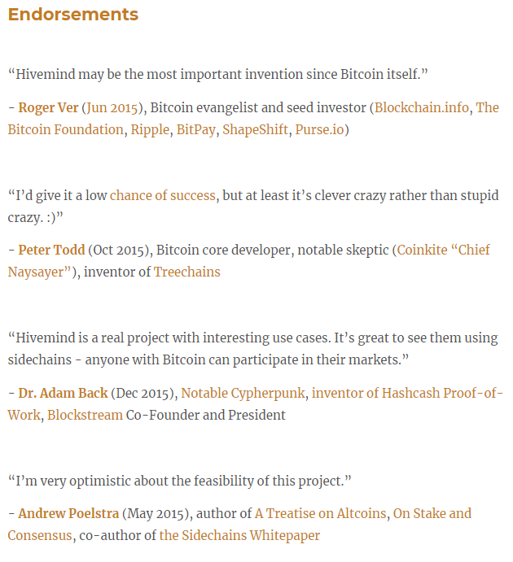
Hivemind Endorsements
Please watch my other (short) talks: BitcoinHivemind.com

Slide 43
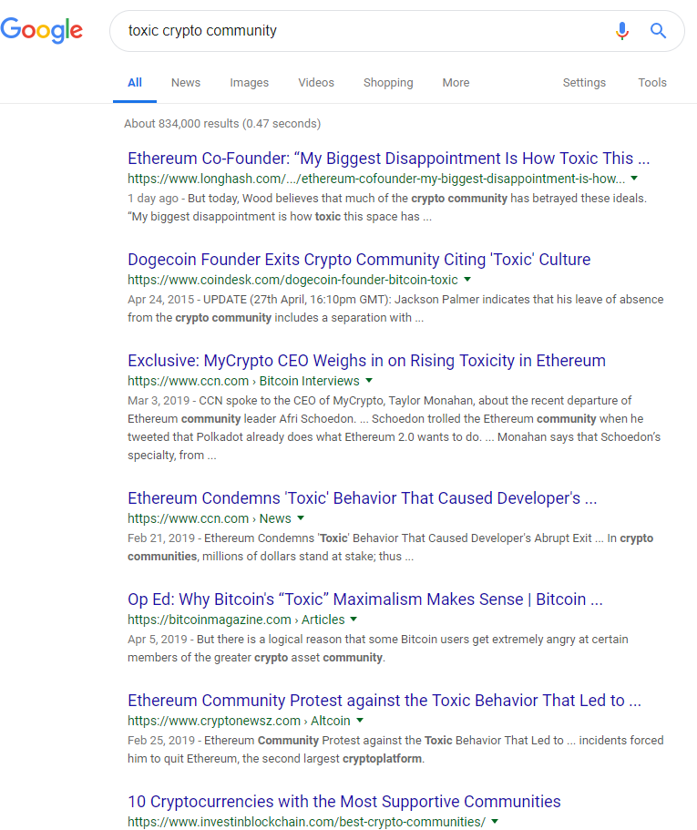
“Toxicity”

Slide 44

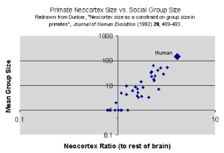

Slide 45


Interoperability – Adding OP Codes
“Bitcoiners”
(aka Human People)
Software Implementations (aka “Protocols”)
Bitcoin Core 0.11
Bitcoin Core 0.12
Bitcoin Core 0.13
Bitcoin Core 0.14
UTXO Sets

Slide 46
Interoperability – Adding OP Codes
OP NOP2 → OP CLTV
OP NOP3 → OP CSV
Bitcoin Core 0.11
Bitcoin Core 0.12
Bitcoin Core 0.13
Bitcoin Core 0.14
Soft Forks
Soft Fork Ensures Interoperability:
Blocks – If one Node accepts a block, we know that all nodes will accept.
UTXOs – All Nodes have the exact same UTXO set, at all times.

Slide 47
“Soft” Coercion
Tx1
Tx2
Tx3
Tx4
A txn you don’t understand
A Txn Paying You
Should I upgrade?
?!
…to what?

Slide 48
Thank You

