Slide 1
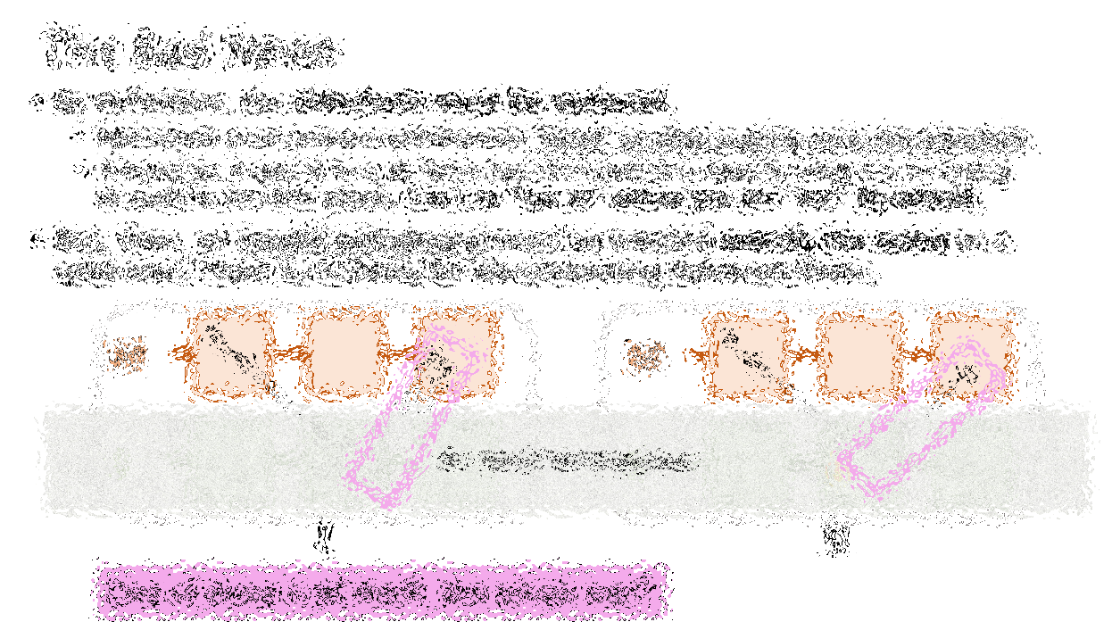
Drivechain
Paul Sztorc
TAB Conf – Atlanta, GA
Jan 27, 2018

Slide 2
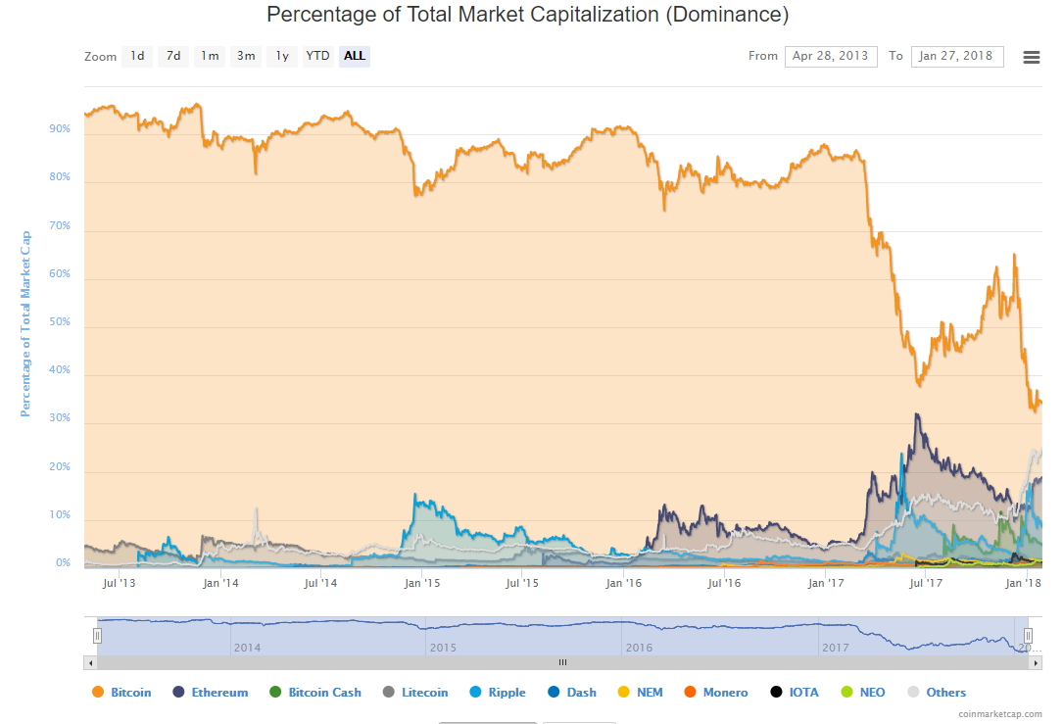
Bitcoin Dominance Index

Slide 3
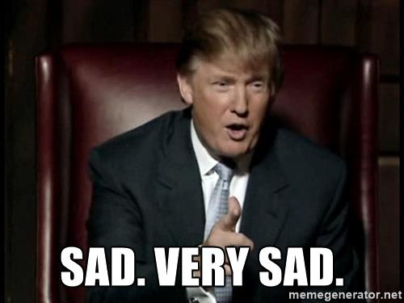
Bitcoin Dominance Index

Slide 4
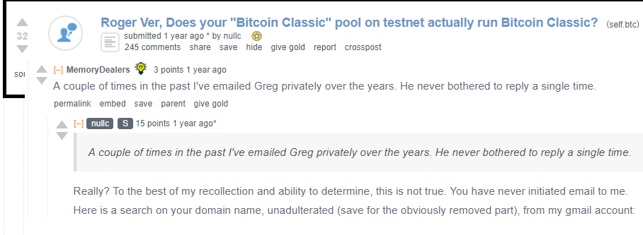
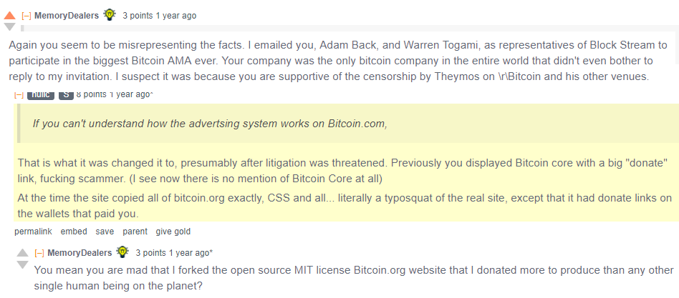
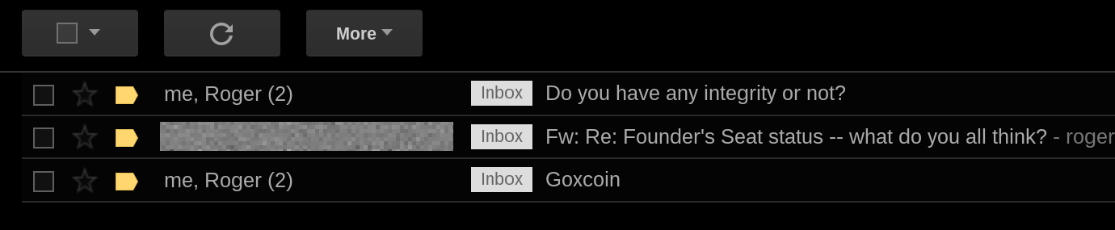
Community Infighting

Slide 5
Community Infighting

Slide 6

Who Am I?
Pre-Bitcoin
BA Economics, Psychology; Mathematics, MS-M OR, MBA Finance
Financial Consulting -- Healthcare IT
Statistician Yale Econ Dept
Roger Ver – Truthcoin / Hivemind
Bloq early 2016 – Drivechain
Well-Rounded
Blockstream (Attempted) Job Offers
‘Scaling Bitcoin’ 1-3 (Presenter); Scaling 4 (Program Committee)
Hivemind has Endorsements from Adam Back, Andrew Poelstra, and ~~Peter Todd – check BitcoinHivemind.com
Drivechain – praise from Adam Back, Austin Hill (Blockstream) -- Luke Dashjr (super-SmallBlocker) post stickied by Theymos; support from Rootstock.
Truthcoin.info Blog
“Nothing is Cheaper than Proof of Work” (Nov 2014, Aug 2015)
“The Limits of Blockchain Tech” / “Private Blockchains, Demystified” (Nov 2014, Mar 2016)
“Measuring Decentralization” (Sep 2015)
“Fork Futures” (Jul 2015, Oct 2017) – SegWit2x
“Against the Hard Fork” (Dec 2016)

Slide 7
Agenda
What are Sidechains?
‘Drivechain’ Specifically
Security Model of Drivechain – often misunderstood

Slide 8
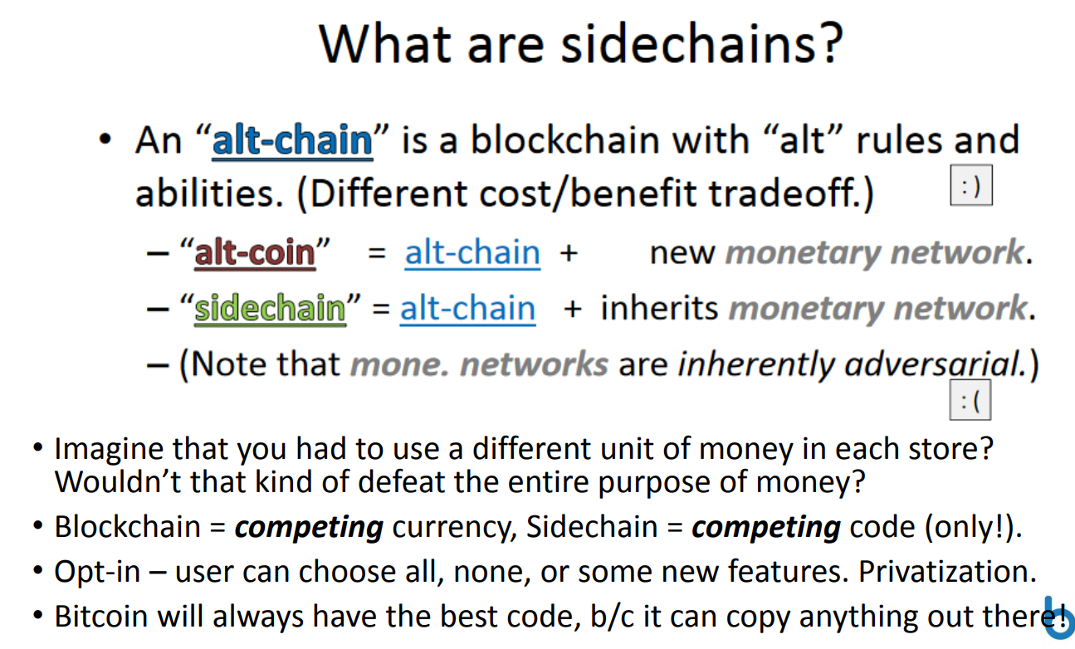
What are sidechains?

Slide 9
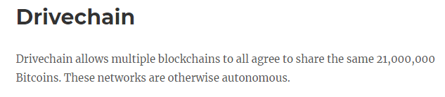
What are sidechains?
From www.drivechain.info

Slide 10
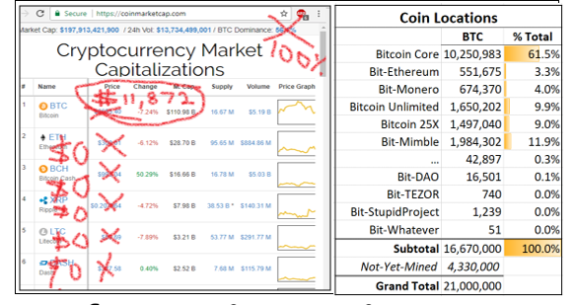
What’s the point?
Popularity → location, not price
Bitcoin Cash
When I made this, BTC was at $6,800
Notes:
If roger pumps Bitcoin Cash

Slide 11
What’s the point?
All value concentrated in the winning coin = ($$__$$)
No ‘intrinsic value’ in Altcoins, except as collectibles (DOGE / PepeCash).
More total value (Metcalfe’s Law).
No more technological risk – investors in BTC will know it will always have the best tech.
Infinite Blockspace + More Hashrate Security
Altcoins currently provide users with a de facto ‘Unlimited Blocksize’.
But the txn fees (among other things) on Alts, don’t go to our Bitcoin Miners…
…so SC improve over this –unlimited blocksize + fees go to Bitcoin Miners.
Scalability Contention
True cause: people are different (vs blockchain 100% consensus)! Some ppl transact a lot, others don’t. Some can afford expensive node, others can’t.
Lightning network does not solve scalability contention – it improves “miles per gallon” (scalability) but does not let different people use different “fuel tank size (gallons)”.
“Scalability” debate isn’t about scalability. It is about decentralization -- how much a node should cost to run.
Alts can’t win
Roger / Luke
Notes:
No reason for Altcoins to have value, because they can’t win.
If Lightning Network

Slide 12
Part 2 – Drivechain How do we make such a wonderous technology?

Slide 13
Existing Ingredients -- get us Mostly There
Altcoins Themselves – LTC, Eth – would already be sidechains if not for…
…they print their own money.
…they reliably have their own miners/consensus.
…they lack accounting rules for interchain transfers.
Mainchain balance down by 1 → Sidechain balance up by 1
Sidechain balance down by 1 → Mainchain balance up by 1
Embedded Consensus – Counterparty, Colored Coins
Inherits Consensus (“Merged” Mining)
Asymmetric Protocol “Child Watches Parent” – “deposits” tightly controlled
Instant Atomic Cross-Chain Swaps
Zero-trust, simple, and fast… (1 block w/o LN, immediate w/ LN)
…but not ‘pegged’ (not forced to be at desired 1:1 fixed rate).
coinbase txn
miners
transfers
a
b
BTC
crazy
XCP
(You deposit 10 Core-BTC into RSK, making it 10 Ethereum-BTC. But will anyone willingly give you 10 Core-BTC for Eth-BTC?)
(We want all the Altcoin-related price risk to be hedged away.)
Notes:
Stealing a lot of work! After all, someone already made Litecoin, Ethereum.

Slide 14
Before I talk about that main-to-side price-peg, I need to talk about some other things.

Slide 15
The Bad News
By definition, the sidechain must be optional.
Mainchain must process withdrawals “blind” to what is going on in the sidechain.
Otherwise, it would be a de facto hard fork (which is exactly what we are trying to avoid in the first place). Can’t be “opt in” unless you are “out” by default.
But, then, an invalid withdrawal must be treated exactly the same as a valid one! There is no basis for discriminating between them.
M
A
M
A
B
E
B
F
H
B
C
B
C
S
S
D
E
D
F
I
II
Two Possible Histories
Time
Time

Slide 16

The Bad News
By definition, the sidechain must be optional.
Mainchain must process withdrawals “blind” to what is going on in the sidechain.
Otherwise, it would be a de facto hard fork (which is exactly what we are trying to avoid in the first place). Can’t be “opt in” unless you are “out” by default.
But, then, an invalid withdrawal must be treated exactly the same as a valid one! There is no basis for discriminating between them.
M
A
M
A
B
E
B
F
H
The “Opt-In” Veil of Ignorance
B
C
B
C
S
S
D
E
D
F
I
II
One of these is SC-theft. But which one?

Slide 17
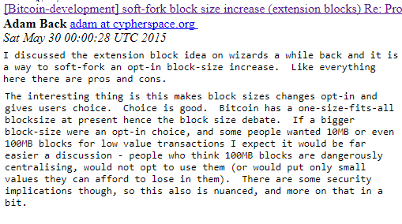
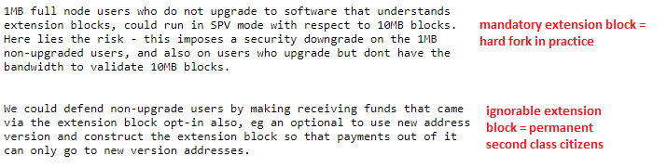
More About the Hard Fork (Evil Fork)
optional
Soft fork, not yet activated
Soft fork activated a long time ago
21 million coin limit
secure
One-way extension block – optional, and pretty secure. But not pegged and thus not as useful.

Slide 18
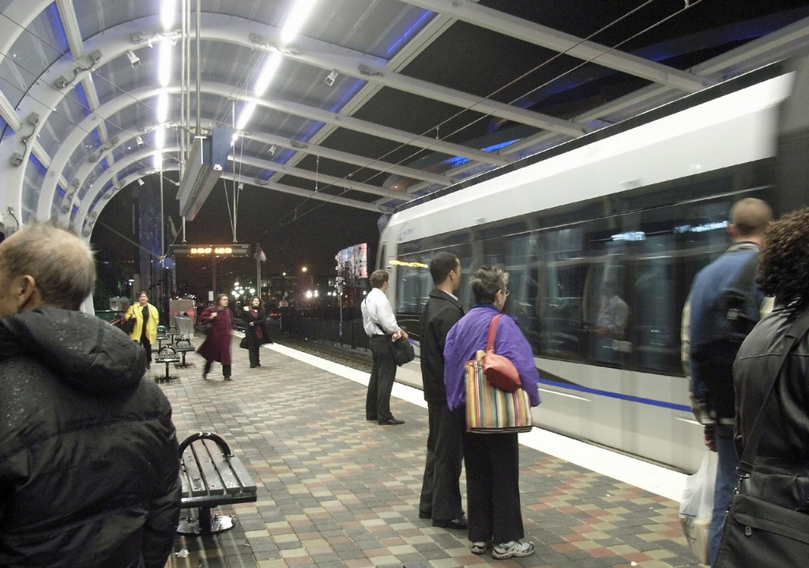
Drivechain -- Long Slow Transparent Vulnerable Withdrawals
optional
Slow, at least 3 months, but pegged (1:1 rate).
Recall, users get speed elsewhere:
main-to-side “deposits” via Embedded Consensus
((main→side), (side→main)) trades via atomic swaps.
Cross-chain LN
Users shouldn’t be using the slow withdrawals –equivalent to having a legal contract enforced. (Similar to “closing a LN channel” – only done if something goes wrong.)
Batch the withdrawals.
secure
Notes:
Greg Maxwell not smart enough to figure it out

Slide 19
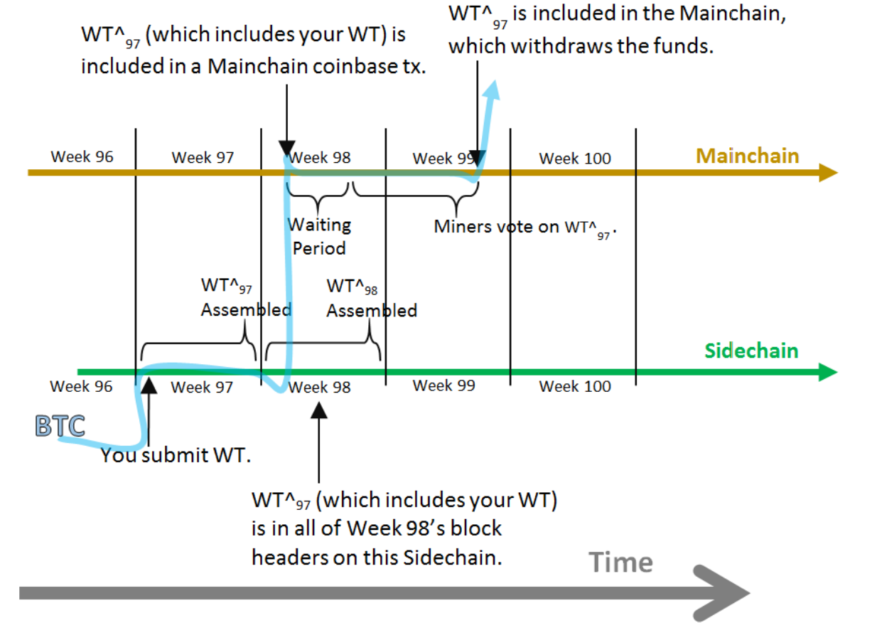
Batch the Withdrawals

Slide 20
Per Sidechain, Only One Traincar can advance at a Time
The others move back.
t = 9
START
Sidechain #6

Slide 21
Per Sidechain, Only One Traincar can advance at a Time
The others move back.
t = 10
START
Sidechain #6

Slide 22
Per Sidechain, Only One Traincar can advance at a Time
The others move back.
t = 11
START
Sidechain #6

Slide 23
Per Sidechain, Only One Traincar can advance at a Time
The others move back.
t = 12
START
Sidechain #6

Slide 24
Per Sidechain, Only One Traincar can advance at a Time
The others move back.
Abstain
t = 13
START
Sidechain #6

Slide 25
Per Sidechain, Only One Traincar can advance at a Time
The others move back.
Alarm
t = 14
START
Sidechain #6

Slide 26
Per Sidechain, Only One Traincar can advance at a Time
The others move back.
t = 15
START
Sidechain #6

Slide 27
Per Sidechain, Only One Traincar can advance at a Time
The others move back.
t = 16
START
Sidechain #6

Slide 28
Which traincar should advance?
If a traincar advances 13,150 places (3 months worth of confirmations), it enters the ‘happy zone’. Its txns can be included in a main:block.
“Passengers” can “disembark”.
BTC has moved from sidechain to mainchain, finally.
Trains “expire” after 26,300 blocks (6 months).
13,150
[E,F]
[H]

Slide 29
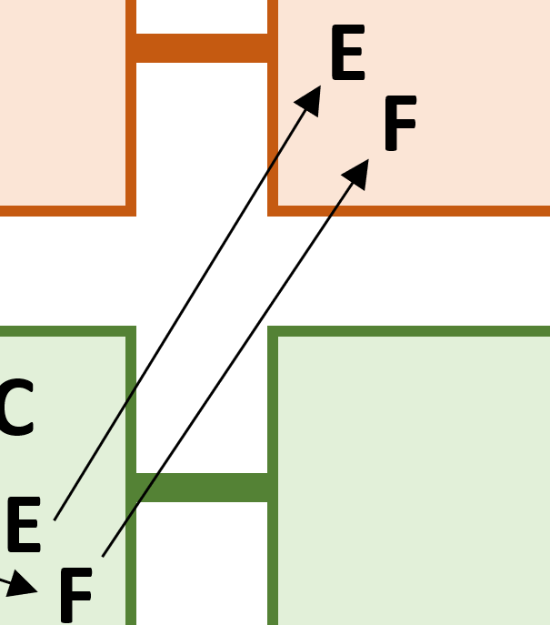
Meanwhile, the sidechain…
Many ways to do it, DC won’t force a particular way...because it can’t. Remember the veil.
…should be making it very easy for observers to learn its valid withdrawal set.
Include it in every sidechain header.
Include it as the left node in a compound Merkle tree.
Mainchain has no idea which, if any, of these headers are valid. But they can have conjectural knowledge by:
Running the sidechain in SPV mode (super-easy), and examining the withdrawals there for stability and consistency.
Asking their friends who run this sidechain.
Asking reputable authorities / mining pool administrators.
Observing the fallout on Social Media.
(Remember, the only foolproof way is to upgrade to a full sidechain node, but this is not allowed.)
2 GB per week, vs one “bit” (is everything ok, or not?) per 3 months -- improvement by factor of 192,000,000.
Notes:
“Flaky”
Must contain error as well as truth.
Corallo / Maxwell don’t understand this.
CoinWItness – deals only with sidechain validity, not double-spending on the sidechain – if CoinWitness worked, it would actually be a hard fork (evil fork) adding the features to the mainchain (it would just be irrelevant).
Instead of actually getting 2 GB worth of data a week, you just need one “bit” – is everything ok or is something wrong.

Slide 30
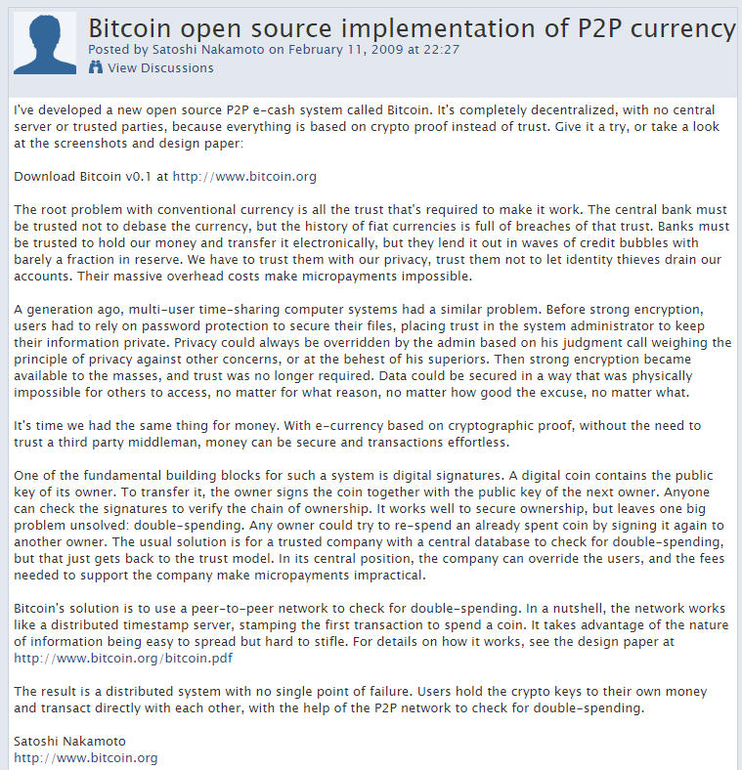
Part 3 – Security Model

Slide 31
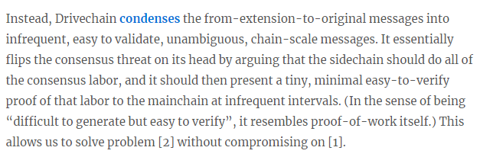
Part 3 – Security Model

Slide 32
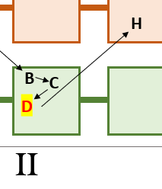
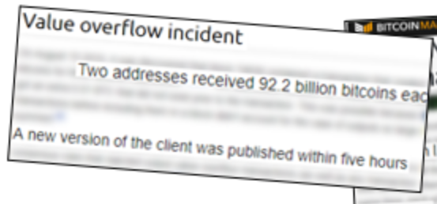
[Credible threat of] UASF Defense
If users detect a problematic withdrawal, they can reject any block that includes it. (Ie, train arrives, but the passengers aren’t allowed to disembark.)
Plans to make this very easy in the UI – just a few clicks. ( +Dialog box that warns user of the danger of doing this if not joined my economic majority. )
Users will never be surprised. Recall that it takes the train at least 1 month to advance 4,000 spaces, and it still has 2 months to go. So user can take his/her time.
Miners don’t know if users plan to UASF-defend (ie, users can bluff for free).
Since it won’t accomplish anything, why bother attacking? Ideal.

Slide 33
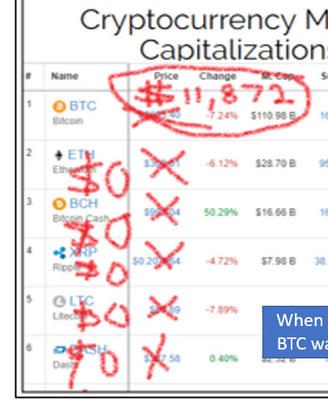
Miner Economics
Miners have a very strong incentive to maximize the value of the token they mine.
If users enjoy sidechains, the price will reflect this.
After the price rises (due to sidechain usefulness), network will climb to a new equilibrium difficulty.
At a certain point miners will only be able to stay alive, if they have a 100% sidechain support policy.

Slide 34
Vs Miner Centralization (51% Attack), even more secure than LN
(FYI, I think all three are secure).
With 51%, I would not attack the entire LN at once. I would attack via a mosquito strategy – where miners connect to LN-hubs and try to defraud <1% of the channels. Perhaps: 1 channel/day, or 1/hour.
 | Regular Bitcoin | Drivechain | Lightning Network
Method of Theft: | Intentional large (6+ block) chain reorganization | Advance a dishonest withdrawal 13,150 times. | Broadcast an old channel state & refuse to include fraud proof.
Proving Fraud: | Automatic (You’ll notice the reorg) | Easy (1 bit/3 months) -- DoS Resistant | Easy (auto-watch for valid, ultra-high fee, LN-channel-shaped txns)
Attack Requires 51% for…? | 7+ blocks (70 +minutes) | 13150 blocks (3 months) [ reorg 7+ blocks 70 min ] | 1000+ blocks (1 week) [ reorg 7+ blocks 70 min ]
Affects: | All main and side chains. | All sidechains. | Single individual txn.
Will Others Care? | Yes | Probably | Probably Not
Recourse: | PoW Change (Hard) | UASF (Easy) | PoW Change (Hard)
If attack succeeds: | Exchange rate falls (unreliable network); Tx-Fees fall (lower demand) | E.R. falls (token no longer multi-chain); Tx-Fees fall (no SC fees) | E.R. falls (LN unsupported); On-chain txn fees rise.
harassment
perverse incentive
Notes:
Lightning is good, and Drivechain is even better – at reducing theft. Obviously LN has greater speed and privacy, and greater scalability. But I think Drivechain is actually more secure.
Create and maintain a culture / industry where they are important, just like Ben Lawsky.
Greg Maxwell Stalin joke

Slide 35
Conclusion
Goals
Defeat Altcoin Competition, permanently
Resolve Scalability Conflict (“win-win”), permanently.
Resolve questions of governance. Experiments can be tried safely on opt-in basis.
Status
BIPs and Code are finished!!
Recently rebased to latest Bitcoin Core.
Still, not perfect -- issues are open on GitHub.
Drivechain.info
(Who knows what we screwed up. I sure don’t.)
Thank you!
Thanks CryptAxe
Thanks Ben Goldhaber

