Slide 1

Consensus and Dissent or: “Meta-Consensus” – “Consensus about what we have consensus on”
Building on Bitcoin Lisboa, Portugal -- 4 July 2018
Paul Sztorc Twitter: @truthcoin
paul@tierion.com
16C8 1597 E76E 86E6 C01E F037 AA4B 3330 F162 C410

Slide 2
Agenda
Two Sidechain Philosophies
The Soft Fork, and Bitcoin’s Ongoing Identity Crisis

Slide 3
Belief #1
“Sidechains affect the [mainchain] miners.”
(Explanation – next slide)
Implies that:
SCs are not a true “layer-2”.
SC-censorship is justified.
Important because: last trench of the anti-SC-er.

Slide 4

“Sidechains affect the miners”
Yes
Gain txn fees.
No
Don’t earn fees.
Run SC?
SCs offer a conditional payment to miners,
Miners have no choice but to accept,
The conditions are bad for Bitcoin.
Ergo: SCs are bad for Bitcoin.
Notes:
The claim is that:
1. sidechains offer a conditional payment to miners
2. the conditions are bad for Bitcoin
3. the miners have no choice to accept,
Therefore, sidechains are bad for Bitcoin.

Slide 5
Belief #2
“Sidechains allow miners to steal BTC.”
Implies that:
Users may be “tricked” into losing coins.
Security is different. Moves from “math based” to “incentive based”.
Important because:
Justifies Tx-censorship. (Must “””protect””” user.)

Slide 6
Do they contradict?
Belief #1
Belief #2
SCs affect miners.
SCs enable miner-theft.
SCs → miners.
Miners are weak, pliable.
Miners → SCs.
Miners are strong, do the plying.

Slide 7
Do they contradict?
Belief #1
Belief #2
Anything could…
Everything [txn]…
SCs affect miners.
SCs enable miner-theft.
(Theft has always been “enabled”.)

Slide 8
“Sidechains affect the miners”
Yes
Gain txn fees.
No
Don’t earn fees.
Run SC?
?
SCs offer a conditional payment to miners,
Miners have no choice but to accept,
The conditions are bad for Bitcoin.
Ergo: SCs are bad for Bitcoin.
Notes:
The claim is that:
1. sidechains offer a conditional payment to miners
2. the conditions are bad for Bitcoin
3. the miners have no choice to accept,
Therefore, sidechains are bad for Bitcoin.

Slide 9

“Sidechains affects the miners”
Chinese gov’t
inducement
1 BTC
Yes
Gain txn fees.
No
Reveal mailing address?
Don’t earn.
Run SC?
Bad thing
We will pay 1 BTC per month,
to any miner who
reveals their mailing address.
?
SCs offer a conditional payment to miners,
Miners have no choice but to accept,
The conditions are bad for Bitcoin.
Ergo: SCs are bad for Bitcoin.
Notes:
The claim is that:
1. sidechains offer a conditional payment to miners
2. the conditions are bad for Bitcoin
3. the miners have no choice to accept,
Therefore, sidechains are bad for Bitcoin.

Slide 10

“Sidechains affects the miners”
The US FED
inducement
1 satoshi
Yes
Gain txn fees.
No
Obtain mining license?
Don’t earn.
Run SC?
Bad thing
We will pay 1 satoshi per year,
to any miner who
obtains a mining license.
?
SCs offer a conditional payment to miners,
Miners have no choice but to accept,
The conditions are bad for Bitcoin.
Ergo: SCs are bad for Bitcoin.
Notes:
The claim is that:
1. sidechains offer a conditional payment to miners
2. the conditions are bad for Bitcoin
3. the miners have no choice to accept,
Therefore, sidechains are bad for Bitcoin.

Slide 11
Belief #2
“Sidechains allow miners to steal BTC.”
Hashrate majority can steal from anything.
(SCs, mainnet, LN)
All have identical security assumptions.

Slide 12
“Hashrate majority can steal coins”
80 BTC
A
B
90 BTC
10 BTC
80 BTC txn
From A to B.

Slide 13
“Hashrate majority can steal coins”
80 BTC
79.99 BTC
B
M
A
90 BTC
10 BTC
00.01 BTC
Take either “upper path”
or “lower path”,
but nothing else.
Enforceable by soft fork. First user to surrender gets 0.01 BTC.
79.99 BTC
M
10.01 BTC

Slide 14
“Hashrate majority can steal coins”
21
21
2
09
09
28
Blue says: “Let me broadcast tx1, and I will give you 18.99 of the 19.00 that I steal. “
Notice, though, if Yellow pays a 19 BTC txn fee, she is only left with 11 (instead of 28)
Yellow may be shaken down for the whole 30.

Slide 15
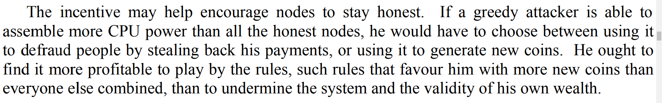
“He ought to find it more profitable…”

Slide 16
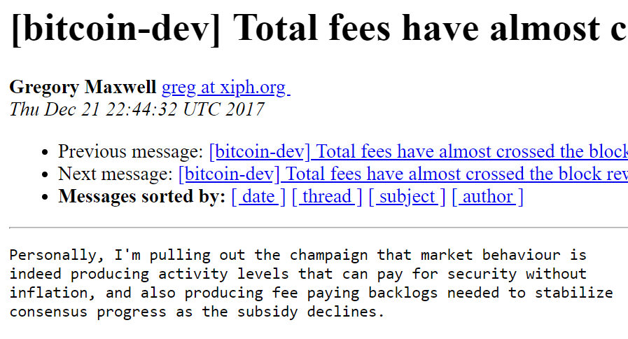
What does affect mainchain miners: Altcoins

Slide 17
What does affect mainchain miners: Altcoins
Price
(sat/byte)
R1
Quantity
(bytes)
R1 > R2

Slide 18
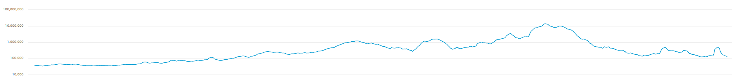


High Fees → Less Usage Last 2 Years, Log Scales, 7d average

Slide 19
Fee revenues are important…

Slide 20
…and supply affects Fee Revenues.
Price
(sat/byte)
R1
Quantity
(bytes)
R1 > R2

Slide 21
What does affect mainchain miners: Altcoins
Price
(sat/byte)
Quantity
(bytes)
R1 < R2
( See my blog post: “Two types of Blockspace Demand” for more. )

Slide 22
Agenda
Two Sidechain Philosophies
The Soft Fork, and Bitcoin’s Ongoing Identity Crisis

Slide 23
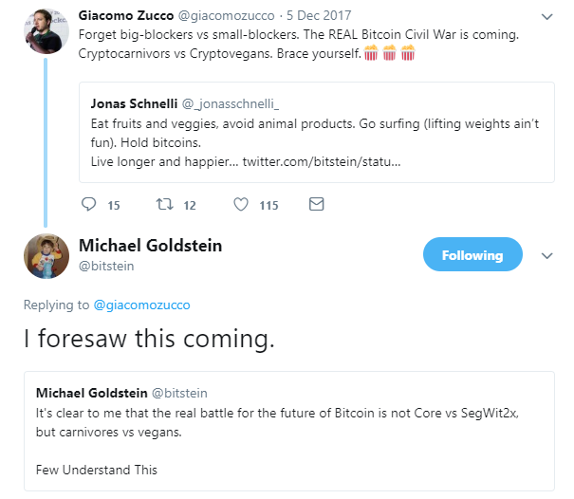
Consensus…About What?
Bitcoiners sometimes disagree.
Meta-Consensus – Consensus about consensus ( ^^ it must be prior to Consensus itself )

Slide 24
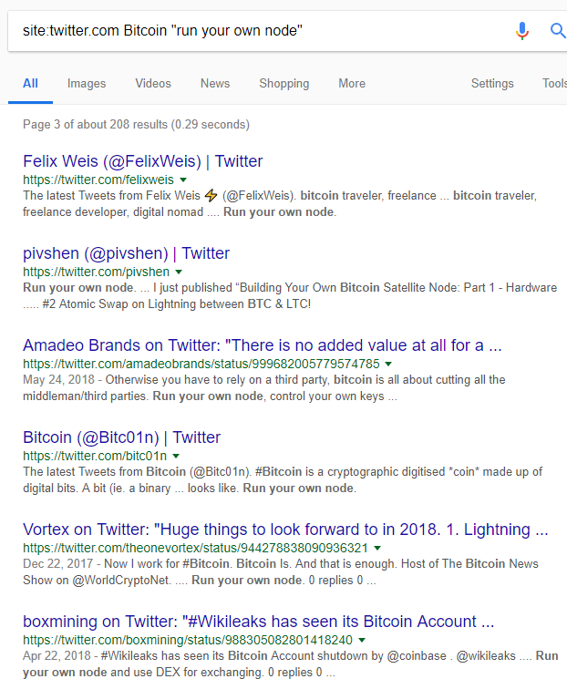
Full Node Mandate
Advice contains a little circular reasoning.
How do we tell “a full node” from “NOT a full node”?

Slide 25
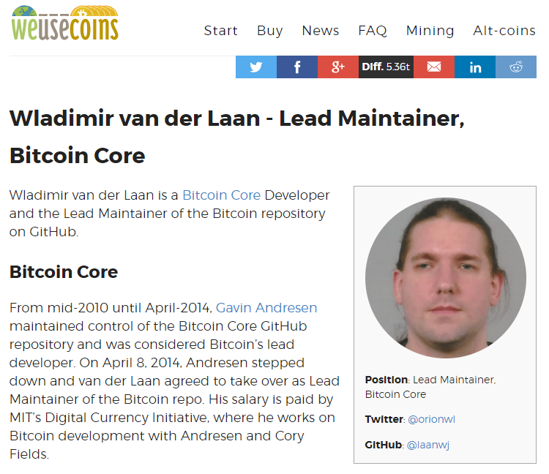
Wladimir Dictatorship / Vague Oligopoly (??)

Slide 26
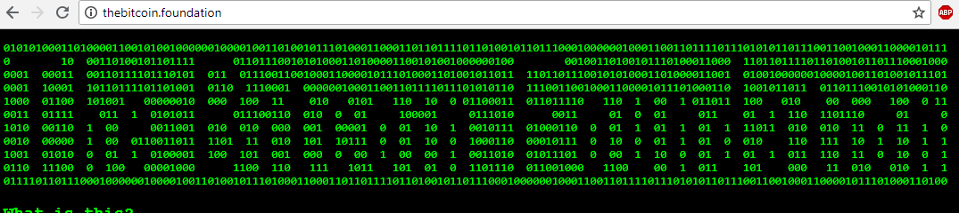
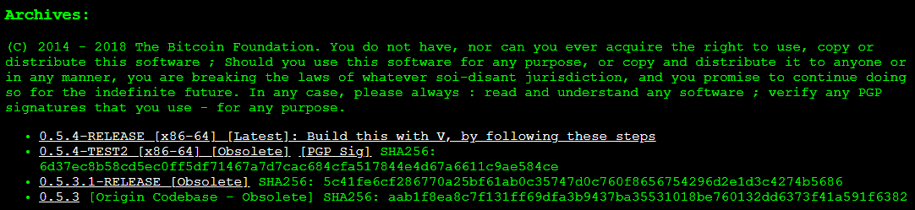
The “Static Protocol” Position
Bitcoin Foundation

Slide 27
The “Static Protocol” Position
I call this the “loudness” of the fork.
( See my blog post
“Better Fork Terminology” for more. )
Clear Errors -- value overflow, spend other's BTC, and malleability.
Protocol can be unilaterally changed (MASF, UASF) -- then, payments made to you, might go "through" these "new txns".
Extremely Pessimistic -- Bitcoin can never improve, ever.
Stimulates creation of Altcoins / Hard Forks

Slide 28
Upgrading via Soft Fork
“line” of protocols that are all compatible with each other
Bitcoin 0.5.0
Compatibility
Bitcoin 0.6.0
Bitcoin 0.7.0

Slide 29
Two Incompatible SFs at once = HF
NOP 8 = Q
NOP 8
NOP 8 = T (!= Q)
Begins with a formally-defined “ignorable state”,
And ends with a formally defined “new state” that achieves consensus socially.

Slide 30
Two Incompatible SFs at once = HF
NOP 8 = Q
NOP 8
NOP 8 = T (!= Q)
Begins: “explicitly ignorable” state.
Ends: “common new” state.
(Social consensus?)

Slide 31

Two Incompatible SFs at once = HF
Both of these phases preceded by some “authoritative” meta-consensus event.
NOP 8 = Q
NOP 8
NOP 8 = T (!= Q)
“Soft” fork needs a “Hard” Setup
Begins: “ignorable state”.
Ends: “new state”.
(Social consensus?)

Slide 32
Examples of “Hard Setups”
Unused OP Codes
Transaction Version Numbers that are Higher-than-Current
Block Version Numbers that are “.
Added by Satoshi
Redefined by: Satoshi / Core Developers

Slide 33

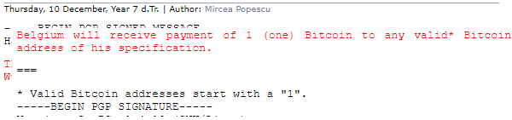
The Problem: Soft Fork Infinite Regress (?)
“What’s up for grabs?” ie, what is in the “ignorable set”.
OP Codes
Txn/Block Versions
Witnesses (SegWit)
Legacy Bitcoin Script (P2SH)
Everything? (The Evil Fork)
Nothing? (Mircea Popescu crowd)
Is the replacement acceptable?
Due to loudness, the replacement is semi-mandatory.
Extension Blocks – famous example.
“Loudness”

Slide 34
Original Question: Consensus About What?
More arbitrary than we care to admit:
1. Can't stay at slot 1. (“the loud payments")
2. Accurate movement
from slot to slot
is based on "authoritative" criteria.
3. Rules of movement
(meta-consensus)
are themselves disputed.
Bitcoin 0.5.0
Bitcoin 0.6.0
Bitcoin 0.7.0
Compatibility – Regresses to the consensus problem we originally wanted to solve.

Slide 35
Original Question: Consensus About What?
What did these two halves of the presentation have to do with each other?
Sidechains! No events, and no loudness.
Explicit, fixed definitions for:
What is “ignore-able” (ie what is “up for grabs”)
What it can be changed to (defined in a given sidechain BIP).
Ironically, there is no loudness *because* “theft” is possible.

Slide 36
Conclusions
Sidechains *are* a layer-2.
Sidechains use the same security assumptions (although, different security model).
In fact, the lack of sidechains is a much bigger threat to mainchain miners.
Soft fork has “zones” (of “ignorable” and “defined”), the boundary and range of these zones is not clearly defined, which leads to conflict. “Bitcoin” does not have a fixed definition.
Advice
Remember user-sovereignty, resist sidechain FUD.
Check out the project at drivechain.info , specifically the diffs.

Slide 37
Thank You! Questions?

