Slide 1
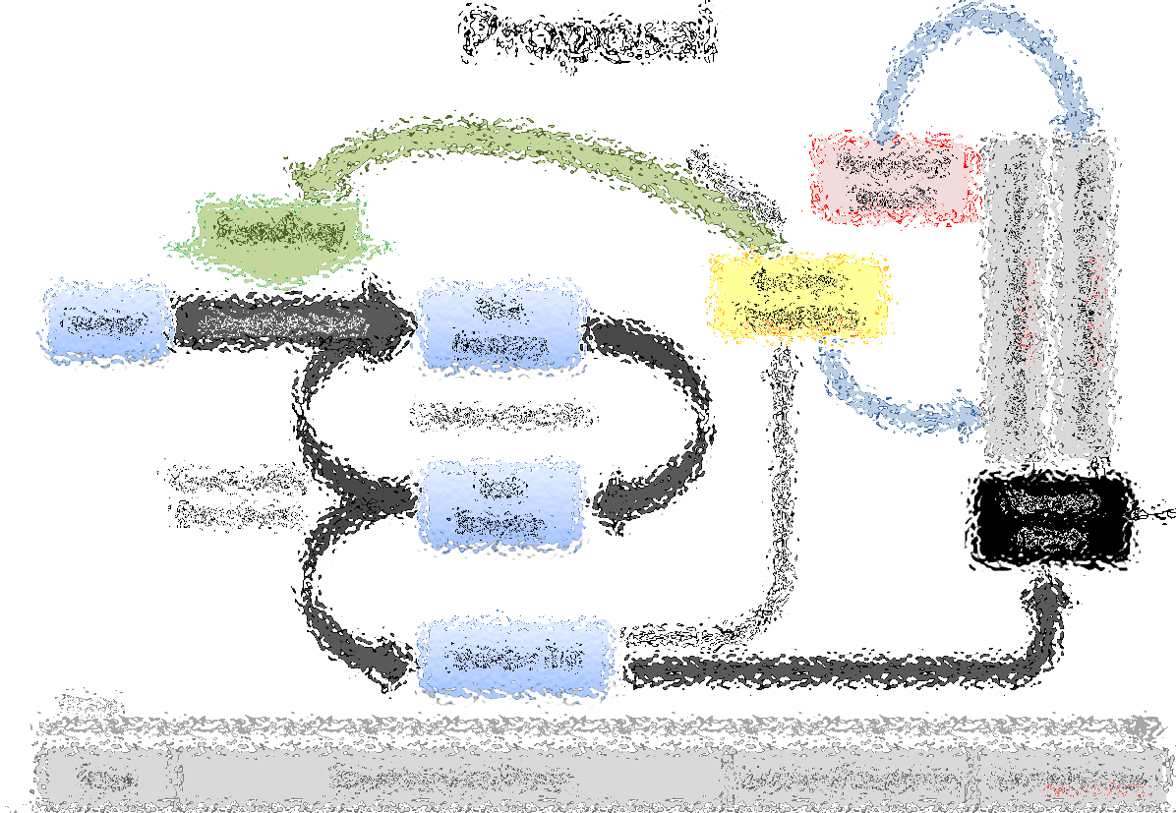
Initial Coin Allocations Truthcoin Project
Paul Sztorc
truthcoin@gmail.com
V1.0 – 8/30/2014

Slide 2
5 Slides
Proposal Graphic
Goals for Allocations
CashCoins – 100% Giveaway to Bitcoiners
VoteCoins – A Trickier Problem
Benefits of a “VTC Auction”
(4 of the 5 are ‘reading slides’ – sorry!)

Slide 3
Proposal
Snapshot Bitcoin
Proceeds
Funding
Auction VoteCoins
Initial CashCoin Owners
Design
Development
Test Release
Initial VoteCoin Owners
Improvements
Community Discussion
Test Release
Genesis Block
Version 0.1
Time
Now
Development Phase
Auction/Snapshot
Live Mainnet
Notes:
Note that, unlike most projects today, the auction is done post-development, and is actually for allocation reasons and not for fundraising reasons. An investor will already have

Slide 4
What are the goals?
Obtain critical mass of users.
Allocate VoteCoins efficiently (“usefully”).
Those who value this specific endeavor the most.
Those who can prove their interest in voting honestly.
At some point reliably raise an influx of $$.
Hardest: Initial allocations must be in strategic equilibrium.
Must be infeasible for others to implement a different allocation, (“Aethereum”).
However, individuals must have opportunities to make informed changes to their allocation.

Slide 5
CashCoins - 1:1 for Bitcoins
Give 100% of CashCoins away to Bitcoin users.
Clearly in strategic equilibrium.
Pre-emptive (might happen anyway).
Only fair (grabs the best network effect).
Can design software to be backwards compatible with all existing Bitcoin hardware/software.
Doesn’t “break” Bitcoin (mkt cap; 0.5 + 0.5 = 1).
Future integration with sidechains/whatever.
Super-marketing: provides critical mass.
Differentiation: Truthcoin (improve tech) from ScamCoins (‘obtain’ coins, then cash out).

Slide 6
VoteCoins
Trickier Allocation Problem
VoteCoins essentially represent an investment, or ongoing commitment, vs. a store-of-value.
User misses votes: VTC are lost (no “option to switch later”).
New-VTC-owners who don’t care: can attack for free.
Design implies VTC are “100% premined”.
Cannot “give away” to arbitrary groups (founders):
Not in strategic equilibrium (other versions which differ only by the initial giveaway, “AltTruthCoins”).
Leaves no opportunity for the raise (as we would then be giving everything away).
VoteCoins also represent the marginal benefits of Truthcoin over Bitcoin. This implies that they should be directly related to the raise.
Solution: Auction off the VTC for Bitcoin, just prior to official release.

Slide 7
Benefits of a VTC Auction
VoteCoins are allocated efficiently (to those who value them the most) and usefully (to those who plan to use them to actually vote).
Skeptical users can wait for actual software before purchasing VTC at auction.
Unlike other auction-allocations, with this post-development auction-scheme the community can be reassured that this is not a scam.
Users can avoid purchasing VTC altogether, BTC and CashCoin can co-exist, users retain free option to switch later “if everyone else does”.
Higher quality product implies a higher yielding auction. (Incentive for high-quality product).

