Slide 1



Truthcoin Blockchain InTrade / “Bitcoin 2.0” Needs Backers and Advisors
As Seen On:
Y Combinator Hacker News
( #1 story weekend of May 3rd )
Let’s Talk Bitcoin ( Episode 117 “Truth Matrix” )
NYC BitDevs Meetup
( September 9 Headline Presenter )
BitDevs

Slide 2


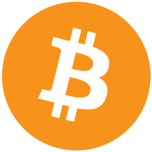

What the heck is my exchange rate these days, anyway?
It’s $500/BTC. …hello? Hello?!
Problem: Blockchains are ignorant of ‘real world’ data.
Biggest BTC Complaints:
“No intrinsic value” ( can’t use it unless someone else wants it ).
Price too volatile ( poor value-storage ).
I study ‘prediction markets’ & ‘mechanism design’.
Used some game-theory to design a system which grabs accurate reports from people even if 100% of them are untrustworthy and motivated to lie.

Slide 3
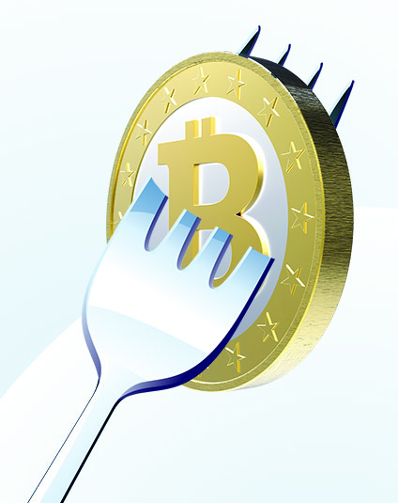

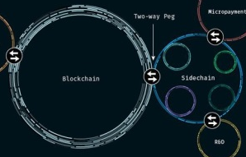
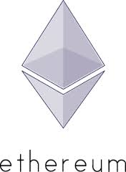



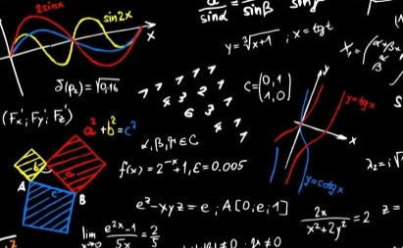




How is Truthcoin Different? Network-Effect, Simpler, Stronger
Others | My Design
Must switch to new coin. | Maintains the ownership network-effect by profitably giving away coins to BTC Owners (100% adoption)!
New/Risky …computer science, security, or business model. | Exactly the same everything as Bitcoin, but with a few more transaction types and data structures.
If core idea fails, entire system collapses. | A user can safely ignore all 2.0 features. Talebian robustness: fail safely and often.
Smart contracts by “doing the computation”. | Smart contracts by “asking for the answer”.
Do not solve “external data problem” in secure/scalable way. | Problem solved!

Slide 4

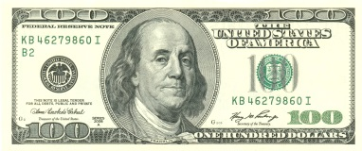
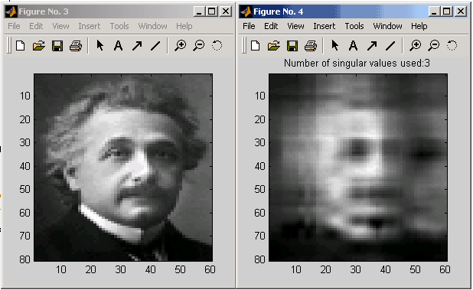
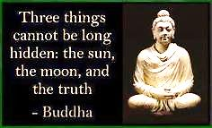
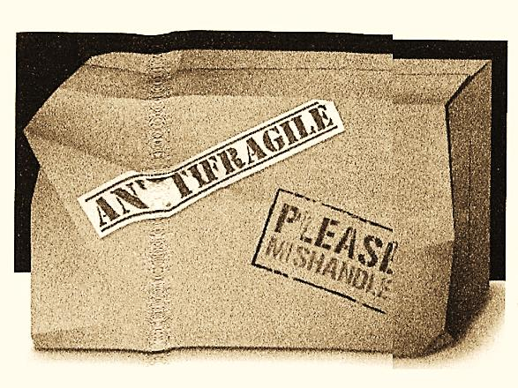
How it Works
1) Tradable Reputation
Abstract corporation which exists to prove its consistency within and across time.
Collects $ to power the mechanism.
TRUST
2) SVD Cross-Validation
Statistical technique: seeks importance.
Gleans truth, measures conformity.
3) Strategic Use of Time
Funds can be ‘locked’ across time.
Yet info-search-costs constantly fall.
Net effect: time penalizes attackers only.
4) “Talebian” Robustness
“Fail quickly and safely” (instead of “we never fail”).
Lying-Voters, Voter-Cartels, and Monopolist-Voters can each help (not hurt), up to a certain (high) point.

Slide 5
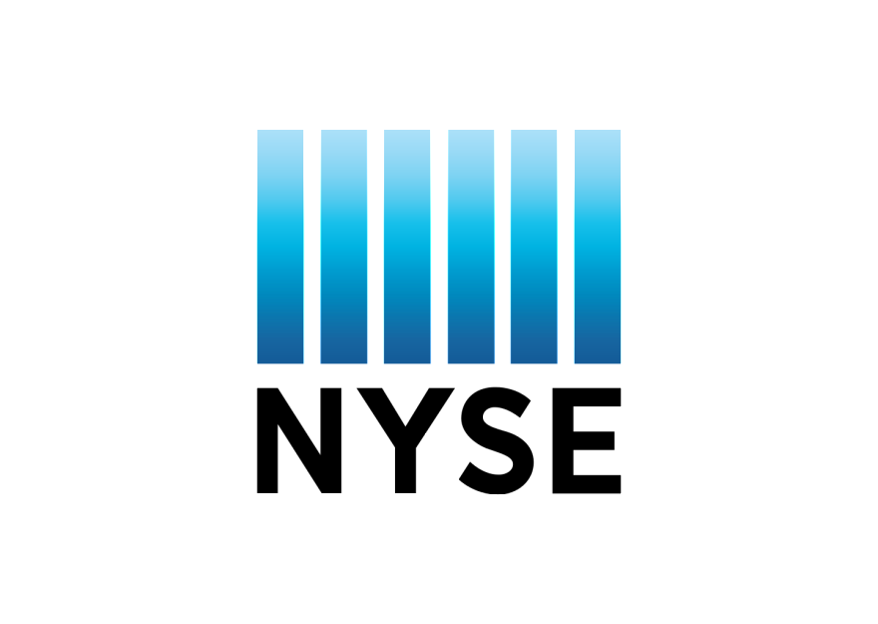

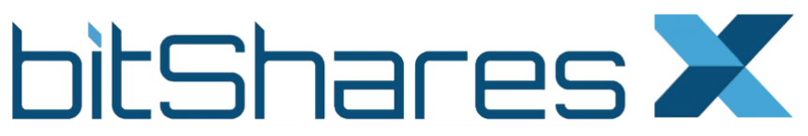
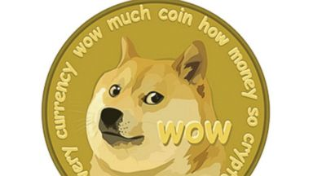
Market Size (millions)
10,350
NYSE Trading Volume*
113
‘Grey Market’ Sports Betting*
65
BitsharesX Market Cap
25
Dogecoin Market Cap
19
Ethereum Crowdsale
Revenue Model / Developer Kickbacks: Post-development, auction off the “VoteCoins” (which earn ½ of trading fees).
Compare to (Ethereum, NXT):
Must defy Bitcoin and its network.
Require a confused initial-distribution, open to immediate hard-forks.
* Per year, taking ½ of 5 basis points (0.0005), NPV of 3 years at 45% discount rate (see valuation).

Slide 6

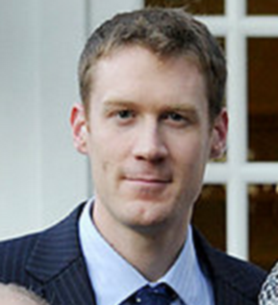

Team
Formal training in economics, psychology, math, statistics, and finance.
Lifelong passion for prediction markets.
Ruthlessly strategic and paranoid.
Paul Sztorc
Talented, hardworking volunteers from around the world!
(No official organization).
“The Heroes”
Needed:
Marketing
Optimistic (non-scientist) ‘salesman-type’ promoters
A “Big Name” endorsement ( Byrne / Draper / Ver )
Consultants (Bitcoin devs, academic cryptographers)
Managerial / Legal / Administrative Infrastructure
JOIN
US
forum.truthcoin.info

