Slide 1
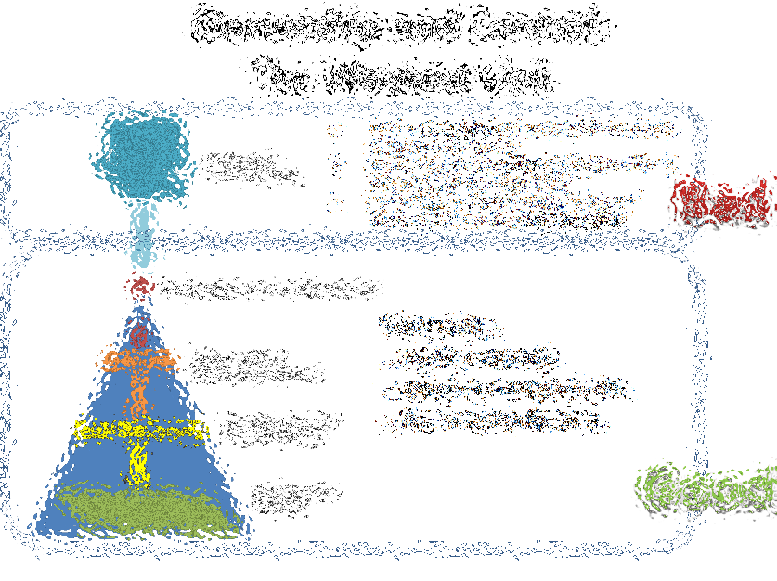
Truthcoin Prediction Markets for Bitcoin “Ending the Age of Bullshit”
First Half Of Slides Presented to MIT Bitcoin Club
on
Jan 20th, 2015
Paul Sztorc

Slide 2
Agenda
Intro
Prediction-Market Hype / What Truthcoin Does
How Truthcoin Works*
*Questions
Presentation Goals: That you…
…get excited for upcoming software release.
…impress your friends by already knowing about this, when it comes out.
Join the forum ( http://forum.truthcoin.info ), read, ask questions, discuss, hang out.
Note: Will be a Bitcoin-sidechain, to use the features of this, you only need to buy anything or invest in anything else.
Notes:
Status: This is an in-progress software project. There aren’t a lot of ways to meaningfully contribute, and there isn’t (yet) a whole lot to
A little strange, because I’ll be describing the vision
Enough people working on it for free, enough people being paid to work on it, and enough smart people (people at Blockstream, Ethereum, XCP and Bitshares) have looked carefully through the idea. So I’m not here to sell you on anything other than, “get ready”. It’s happening right now but almost no one knows about it, mostly because I have a longstanding contempt for the dialogue on the bitcoin subreddit / bitcointalk, and the other places where people might find out about this.
Currently most discussion takes place off-forum, I would like that to change.

Slide 3


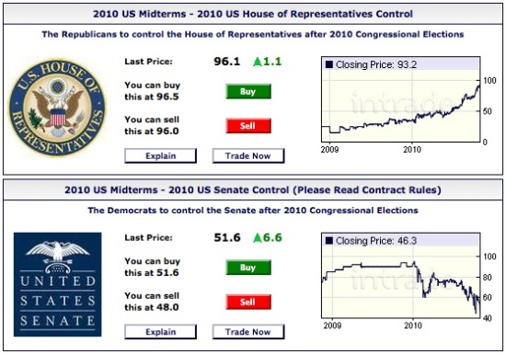
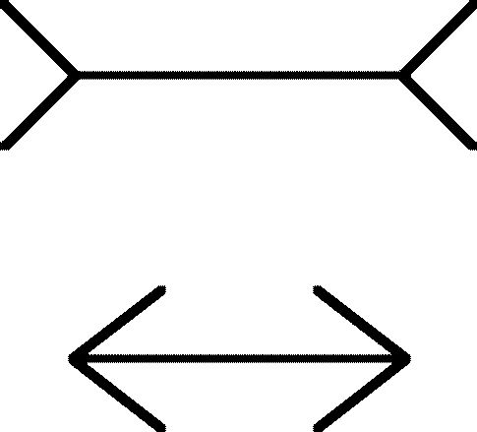
Who / Why
Degrees (BA, MS-M, MBA) from CWRU in economics, psychology, statistics and finance.
Researcher at Yale Economics Dept for 2 years.
Consulting experience - Finance role.
Lifelong interest in human biases and prediction markets.
I used to believe in learning and sharing knowledge through discussion. Now I think that’s a waste of time.
In fact, I feel it is immoral:
Talk is cheap (and you get what you pay for).
Encourages trust in experts/authority
Better to trust one’s own experience, or, even better one’s own skepticism (cautious people do “OK”).
Notes:
Prediction markets….which you will become painfully familiar with. Humiliating: (Peter Schiff mortgage bankers), Climate Change vs Fox News.
What if the audience is stupid?
who are enslaved to a fickle mob mentality.
Just profit from stupidity. People who are misinformed usually end up dead.

Slide 4
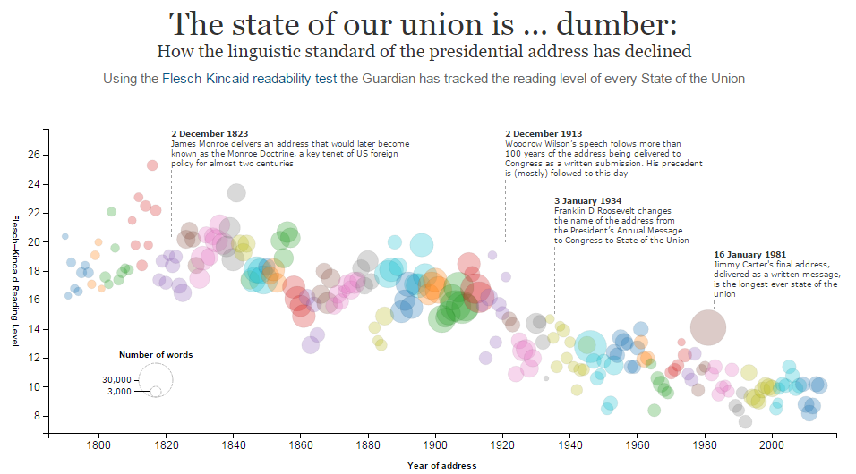
Our Age: The Age of Bullshit

Slide 5
Why so bad? Scale. Ex: Voting
My vote doesn’t matter. I’ll put no effort into this decision whatsoever.
I have the tiebreaking vote…better make it count.
I hope they make a good choice. I’m going golfing today.
Benefit if became informed.
Group Size Cost to become informed.
Power of group (tax revenue, military strength).
Temptation to Corruption
We are choking on information: too much on each plate, no reason to chew.
Too many info-sources, not enough info-aggregation.

Slide 6
Rot From Above: Who controls what?
Informed or otherwise…
CEO / President / Senator / Editor-in-Chief
Group Opinion
C-Suite / Cabinet /
Coordinators / Reviewers
Managers / Directors /
Aides / Researchers
Shareholders /
Voters / Colleagues
Staff / Research Assistants
Result
Satisfaction of: Customers / Citizens / Readers
Notes:
Ownership and Control = efficiency

Slide 7

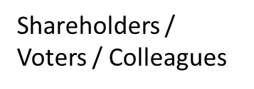
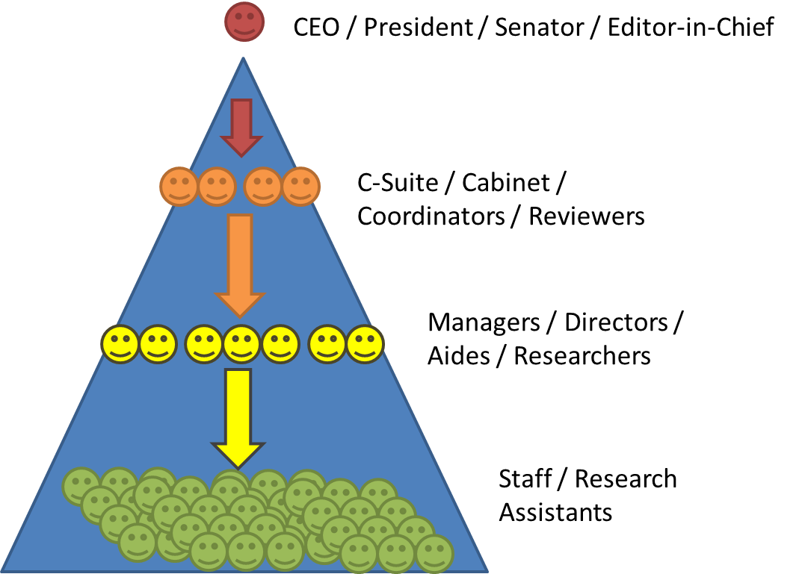
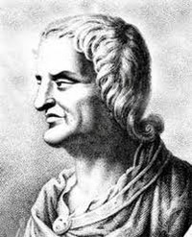

Ownership and Control: The Weakest Link
How to we combine the many preferences of this group into one request?
Do we each have to monitor the leader’s work? If not, who do we trust (and why)?
If I don’t like this leader, how do I find out if others agree? How do we fire the leader?
Bad
Can easily…
…make requests.
…observe work/results.
…fire insubordinates.
Good
Quis custodiet ipsos custodes? – “But who is in charge of those who are in charge?”
Notes:
I don’t see it that way.

Slide 8

Truthcoin enables Prediction Markets to Aggregate Info
For the Public: Reliable and Common Information
For example: no more bullshit about climate change (either way).
It’s broadcast to everyone (and everyone knows that everyone got it).
It’s right.
?
= Info Source
= Prediction Market
Notes:
Empiricism (do real world observations agree with this data source) as easily as checking the weather or score to a game.
Have to do a lot of work to learn something, but, because of the benefits of deception, you can’t easily share what you’ve learned.
Everyone knows not to be gullible, so we have to check others’ work. People can not-believe-you if you’re right, or they can believe you if you’re wrong. Every step degrades the quality of the signal. Most people don’t have the time to solve either of these problems. On the off-chance that climate change actually is fake or something, this software would be the only possible way of that message getting out. Given the way CO2 has always worked everywhere, I won’t hold my breath.

Slide 9
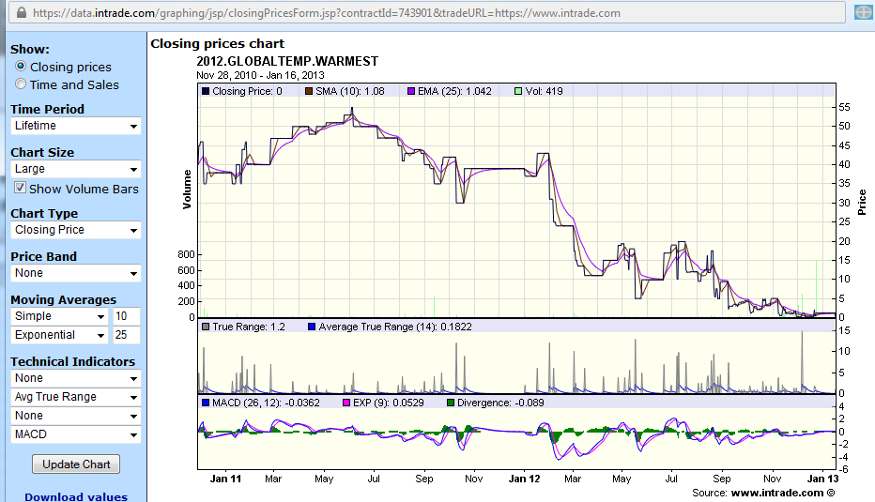
1. PMs: ‘stock market’ for a special kind of derivative. Below: event derivative (InTrade.com) on 2012 global warming
Worth $100 if 2012 is the warmest year on record.
Ran from Jan 2011 to End of 2012

Slide 10
Climate Change: PM vs Talk
Talk: Why even bother becoming informed?
Hard to learn this stuff (and I only have so much time)
How am I supposed to convince others?
Why résumés must be short (info-processing costs).
Minimal-info strategies (join a tribe/“political party”).
PM forces a clear definition.
Prices are constantly and unanimously acceptable. At all times, everyone agrees with the price (if not, they can profitably trade).
Note: Suppose climate change were false. The “reliability” and “broadcast” problems are much worse.
Notes:
Torrential stream of lies by our blatantly corrupt federal government have now made it basically impossible to have a conversation about climate change. Nietzche: insidiousness via false support P

Slide 11
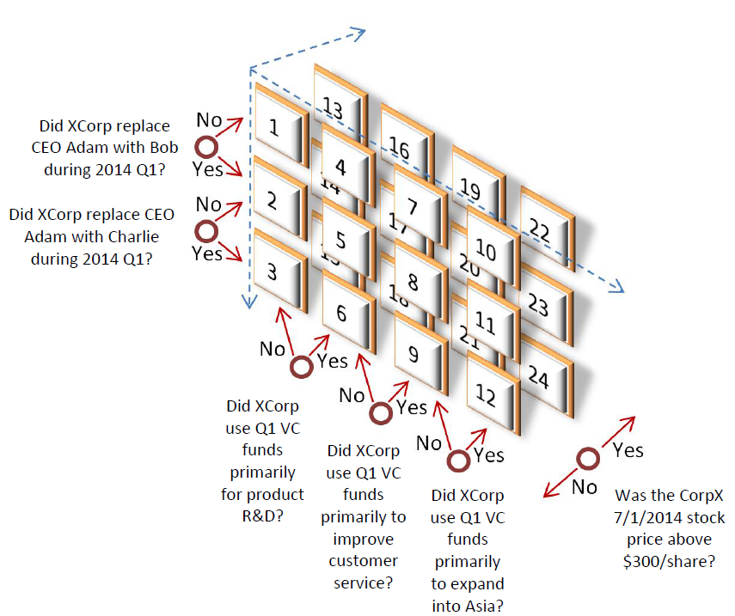
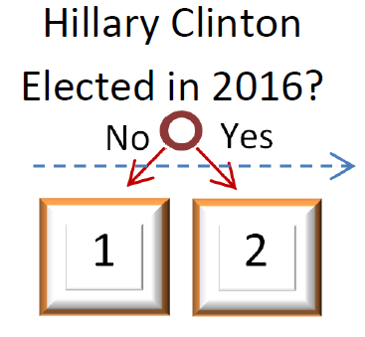
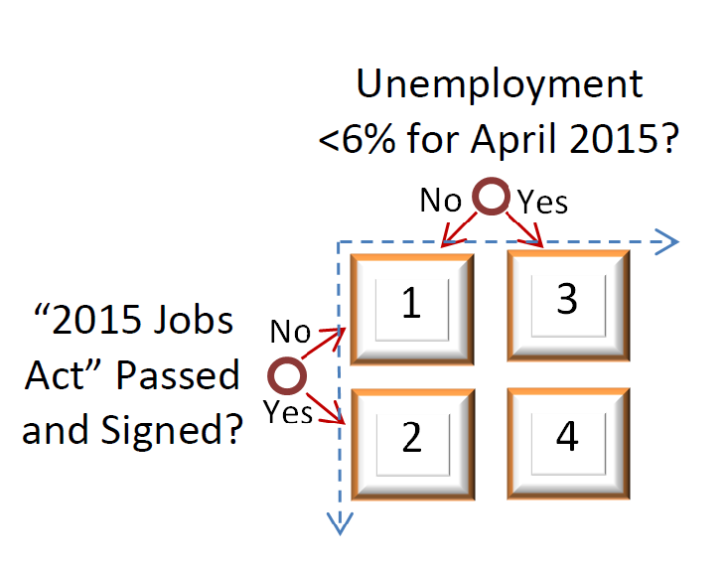
Prediction Market Magic: More Than One Dimension
3
1
2

Slide 12
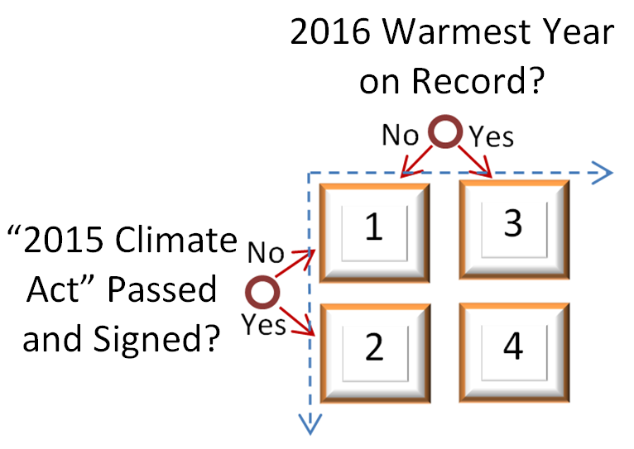
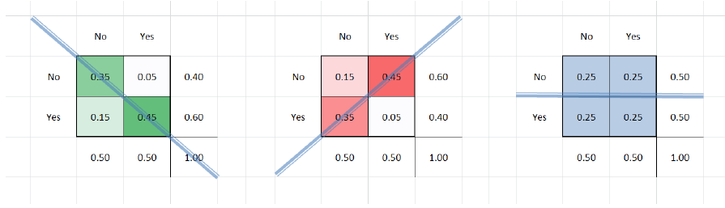
More Dimensions: More Forecasts, AND More Relationships
Joint, Marginal, and Conditional Probabilities
MSRs Bayesian Net
The Point: Probabilities are not only: “Will X happen?”…
…they are also: “Would Y influence X?”
Notes:
Could conceivably

Slide 13
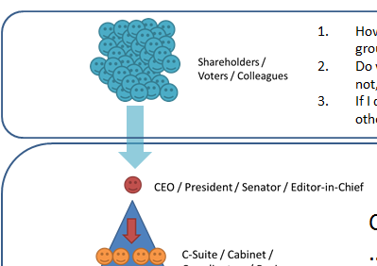
Multidimensional Governance
Applications
“Which CEO would most increase our stock price?”
“Which President would most decrease unemployment?”
“Which FED Policy would most increase GDP?”
“Which law would most decrease violent crime?”
So much more:
Betting “in” USD / DJIA / etc.
Provision of Public Goods (without taxes)

Slide 14
If Prediction Markets are so great, why don’t we already use them everywhere?
We do, privately (Best Buy, GE, Google, IBM, Intel, Siemens, Yahoo!, etc.)…
Why not for public orgs/decisions…?

Slide 15
PM Problems
Agency Cost
New info: find replacements for inefficient leaders.
Who tries this experiment first? What if competitors don’t? (“Norming”, Need globally accessible set of new rules).
Where allowed, would not be needed.
Public Awkwardness / Old Taboos
Resembles vulgar gambling (history of banned finance).
“I know that my vote doesn’t count, but you don’t have to be rude about it.” Re: Unpopular election-betting.
Regulatory response to (Irish) company. PAM vs Wyden.
Counterparty Risk
The age-old betting problem: “Will this guy pay up?”
Value-Storage as a single point of failure / Fall of InTrade
Will the admin censor PMs (that I like)?
Sound familiar…?
Notes:
Corp A and Corp B: Corp A either tries to norm, or tries to make contracts on Corp B (improving it?)
Church vs Science Ron Wyden “Internet casino”

Slide 16

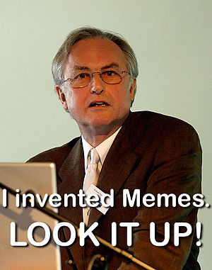
Protocol (Decentralized) | Centralized Non-Protocol
Spoken English | Shakespeare’s Globe Theatre, The Library of Alexandria, MLA Citation Format, Walt Whitman, J.K. Rowling.
Rules to American Football | The NFL, ESPN, The Buffalo Bills.
Bluetooth | A Set of Stereo Speakers, The iPhone 6, A Car Radio Equipped with Bluetooth
Bitcoin | VISA, PayPal, SWIFT, Western Union, Airline Miles, Amazon Coins, e-Gold, Liberty Reserve.
Protocols are Immortal
Protocols are self-replicating “informational viruses” (like memes) which can easily outlive their creator!
Benefits of Immortality:
Will still be around to pay you back (cannot be killed, cannot go out of business).
Tamper/Censorship-Resistant (contracts enforced as signed).
No middlemen (self-sustaining, less overhead, lower cost).
Ankh – Egyptian Symbol of Eternal Life
Notes:
Preaching to the Bitcoin-choir.

Slide 17
Many Other (Better) Resources: Whitepaper / Code / Demo / Forum / FAQs www.truthcoin.info
So How Does The Protocol Work?

Slide 18
Truthcoin Graphic: Two Coin Types
Main
Sports
Owners
(“Reputation”)
Branches
Decisions
Markets
Owners (“Cash”) (“Bitcoin”)
Authorship
Trades
Authorship
Notes:
Hazy lines are Scaled Decisions, Boxes are Binaries. Note that Scaled Decisions span an entire Dimension, whereas Binaries just Partition-from-Null.
Multidimensional Markets have more than one Decision.

Slide 19
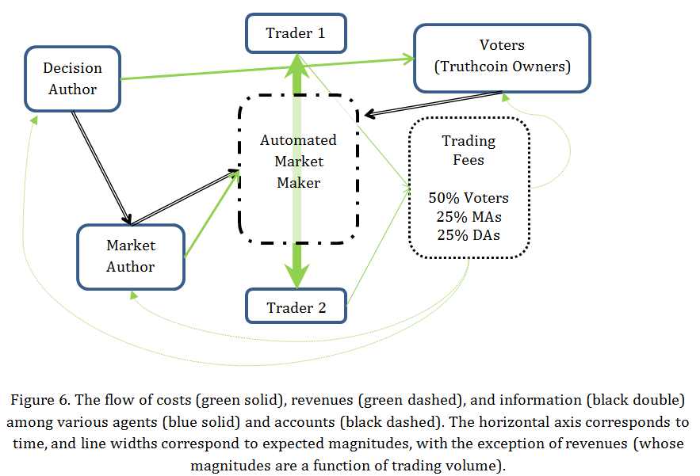
Timeline (on one Branch)
(Votecoin Owners)

Slide 20
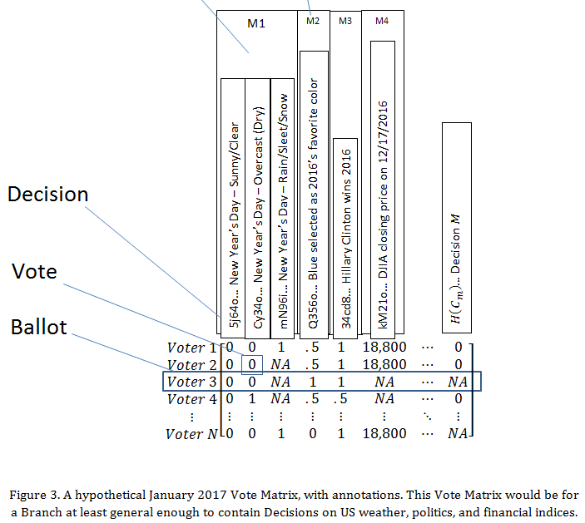
Vote Matrix

Slide 21
Adding Decisions in Big, Distant Groups
Q1 2015
Q2
2015
Q3
2015
Q4
2015
Vote
Vote
Vote
Branches compete:
Markets will not be added to later rounds, if Branch-voters misbehave.
Fancy use of PMs allows far off events to be insured against themselves – Authors can withdraw the “cash cow” at any time.

Slide 22
Groups And Their Incentives
Role | Pays | Rewarded With
Decision-Author | Listing Fee (Large) | 25% of Trading Fees, for Market which used this Decision
Market-Author | Market Fee (Small) + Liquidity Subsidy | 25% of Trading Fees, for Market which used this Decision
Voters | Time Spent Voting + Votecoins at Risk + Opportunity Cost of Attacking the market-resolution process | 50% of Trading Fees, for Market which used this Decision Additional Votecoins (greater ownership/ responsibility) if correct other Voter’s mistakes. Ability to cash-out good reputation at any time.

Slide 23
Why Vote Honestly? See Supporting Material for More Details
Mechanism Design (Ownership and Control)
Voters ‘buy in’, simulating perjury / real-world reputation at stake. What they bought is worth little if it produces no value.
Trades are mutually beneficial, even with fees (risk-pooling, insurance, recreation, etc). This produces overflow value which can be captured and repaid to Voters.
Truth-Heuristics for Keeping Voters In Line
SVD / Eigentrust / Bayesian Truth Serum as a way of approximating “truth” (Bayes’ Rule, Scientific Method, logical consistency, etc).

Slide 24
Mechanism: how to ‘tie’ people to a permanent reputation (as in real life)?
Allow them to become owners in an abstract corporation.
Must ‘buy in’ (prevents Sybil attacks).
Positive selection effect (only those who want to do this can buy).
Financial Asset
No ‘retirement attack’ (retirees can simply sell). This neutralizes the opportunity cost to attack.
All users earn dividends on all future resolutions.
Penalize bad behavior by reducing ownership.
Non-conformity (measured via SVD-consensus)
Laziness (failure to vote on-time, every-time).
Notes:
Would be nice if we could have people keep reporting on the same thing. That’s possible, but it’s a little inconvenient (waiting until 2017 or 2018 until “certain” enough to resolve your Hillary 2016 contract)
Doesn’t stop “tech disaster”, but tech is what we can improve, human nature we can’t.

Slide 25
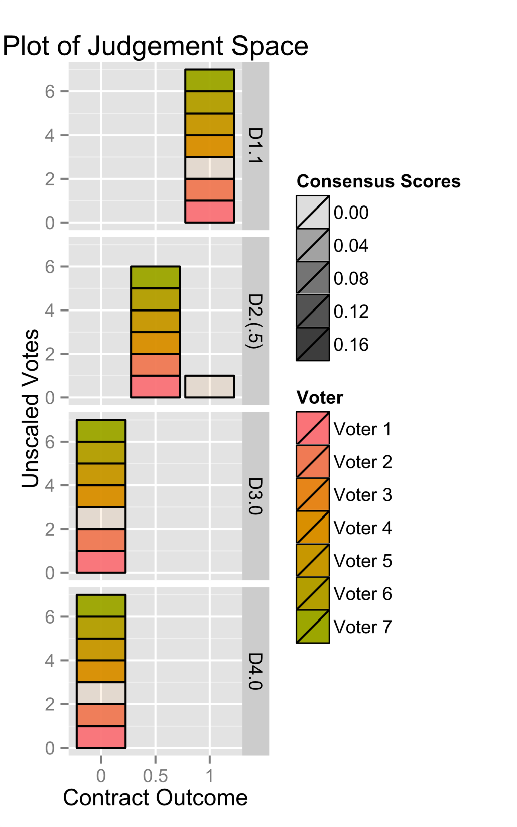
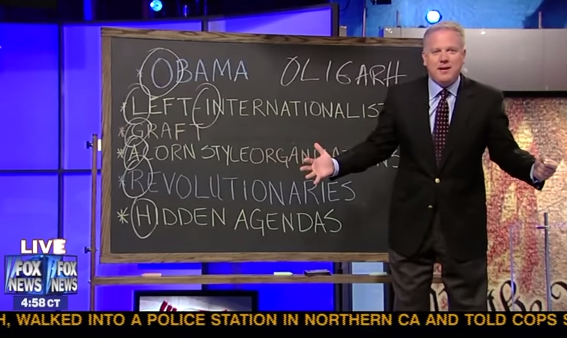
The SVD Penalty
Experience “reports” on many things from many people in real-time (‘Ballot’).
Constantly evaluate logical consistency of the person.
“I’m unreliable.”
Notes:
…there are many techniques for doing this.

Slide 26
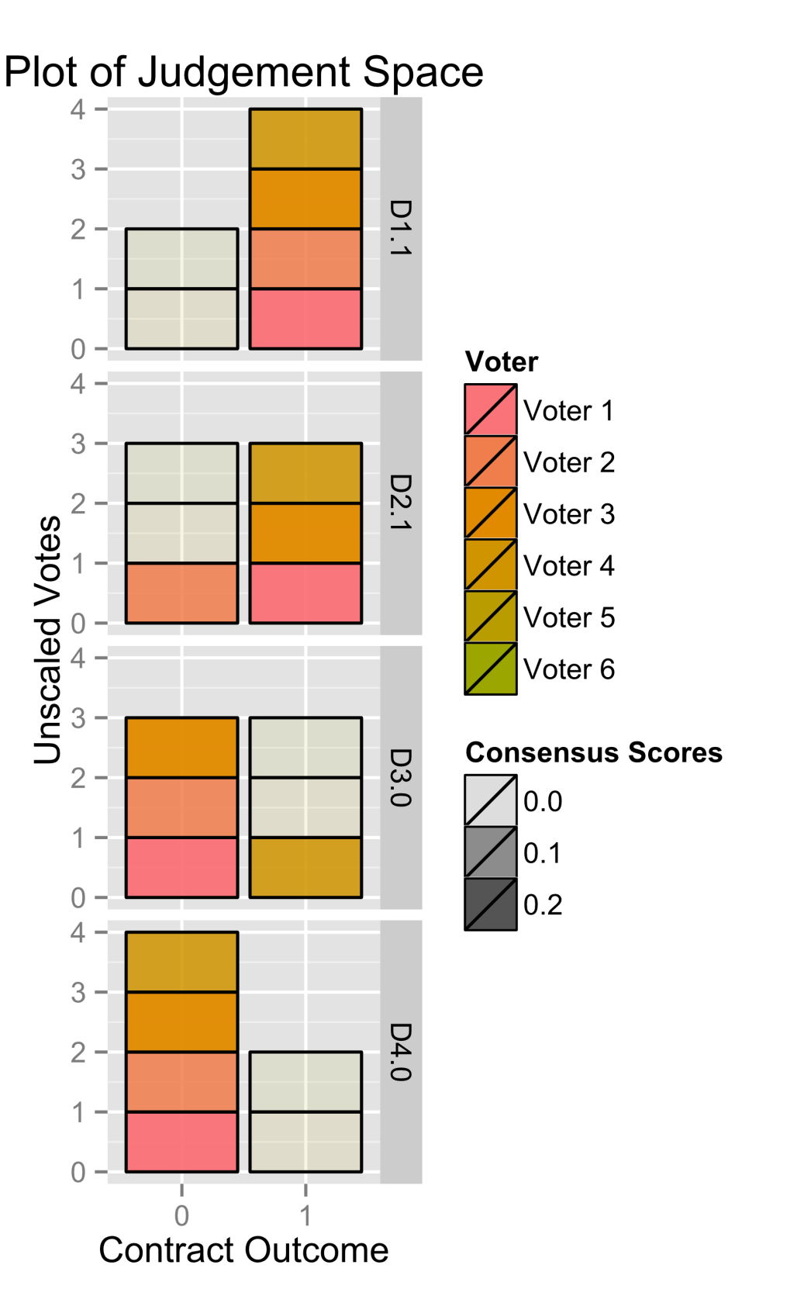
Example 2:
 | D1 | D2 | D3 | D4
Voter 1 | 1 | 1 | 0 | 0
Voter 2 | 1 | 0 | 0 | 0
Voter 3 | 1 | 1 | 0 | 0
Voter 4 | 1 | 1 | 1 | 0
Voter 5 | 0 | 0 | 1 | 1
Voter 6 | 0 | 0 | 1 | 1
Total | 4 - 2 | 3 - 3 | 3 - 3 | 2 - 4
Demo: http://forum.truthcoin.info/index.php/topic,134.0.html

Slide 27
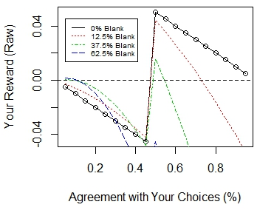
As others disagree with you, you benefit (up to a point)!
Result: Cannot trust rival voters…no cartels or “voting pools”.

Slide 28
Questions

Slide 29
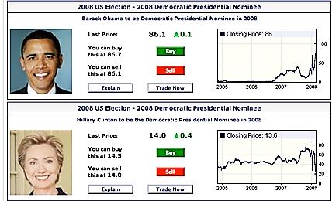
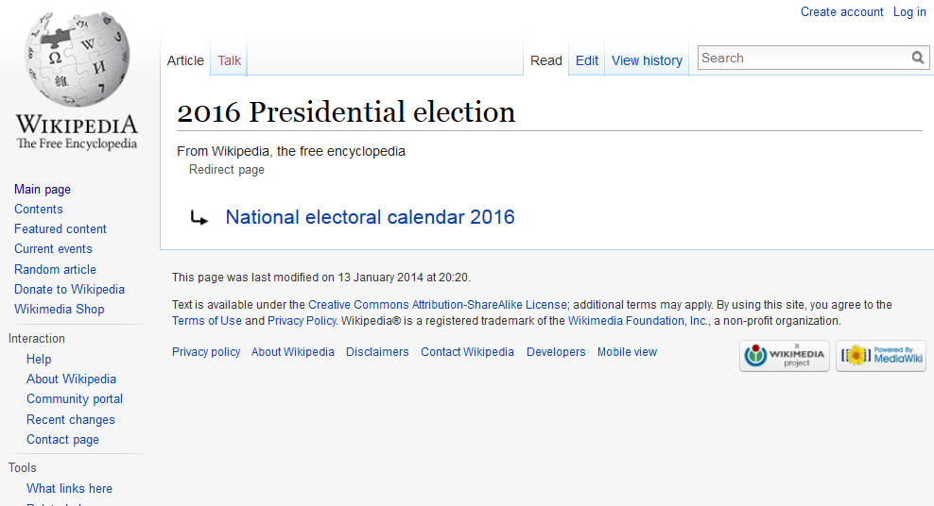

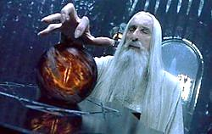
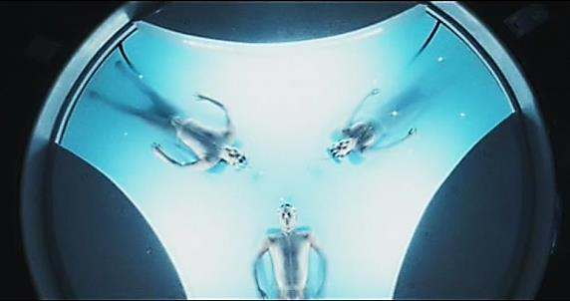
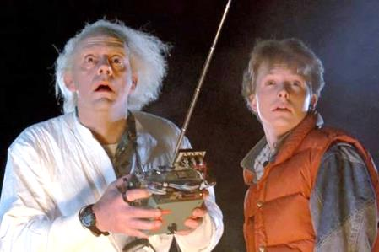
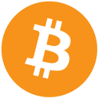
Combining three existing ideas…
Prediction Markets
‘Future’ Wikipedia.
A software
protocol.

Slide 30
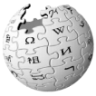



Why Combine These Three?
Items: | 1) Prediction Markets | 2) Future Wikipedia | 3) Bitcoin Protocol
Core Advantage | Optimally-Accurate (Market Efficiency) | Optimally-Open (Anyone can teach/learn) | Optimally-Durable (Can’t be shut off)
Disadvantages | Historically, these businesses (InTrade) close down due to interference, public misunderstanding (betting taboo). Which derivatives to create, and who creates them? | Whose edits are inaccurate? How to aggregate multiple opinions to a single correct answer’? Would Wikipedia really withstand censorship? | Asset markets require third-party trust, do not scale (theft, non-P2P). Accused of having low intrinsic value.

Slide 31
The Outcome Problem
Goal: Guarantee to Traders that their ‘event derivatives’ will eventually be worth their promised value.
Resources:
Reports from users, aggregated (“votes”).
Some $ to pay the reporters (“voters”).
Problems:
Completely self-determined ( reliable data must be only a function of the reports ). Decentralization = no “special users”.
Laziness: (No one will vote unless they have to).
‘Virtual Voters’ likely pseudonymous, can’t be sued, shamed, or whacked. No 9 month waiting period.
Special Problems:
Half of all trades will be ‘losers’: these traders have an inherent reason-to-lie.
“Retiring users” have an inherent reason-to-lie.
“The Powers That Be” / Crazy “Joker” types.
Notes:
We’ve got to tie reality to these prices. Chicken-and-egg. Overcome their laziness.

Slide 32
Public Goods Finance
The Lighthouse
Dominance Assurance Contracts and beyond
Rewarding early donors more
Getting odds

Slide 33
Trends in CryptoEconomics

Slide 34
Distinguishing Features
Simple, do-able (Bitcoin + alt transaction types)
Almost no input from users required (fees / data structures calculated automatically via economic feedback).
Sidechain / Hard-Fork: Does not interfere with Bitcoin’s network-effects
Useful:
Need for stored value (Bitcoin’s design parameters)
Betting
Markets
Exchanges … decentralized (
BitUSD (USD is better)
Ethereum: software rot, systemtic risk, Hydrogen
XCP (small risk, small reward)

Slide 35
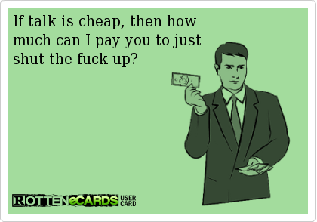

Slide 36
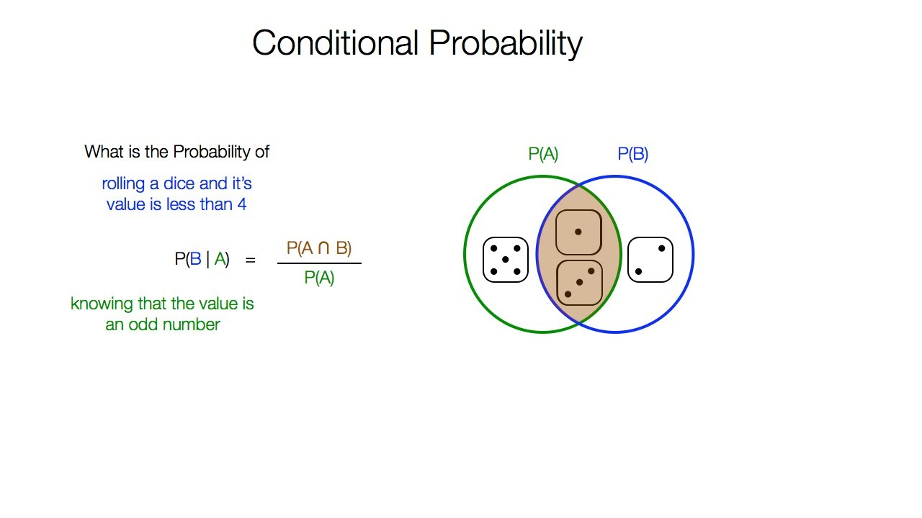
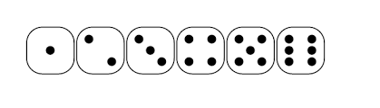
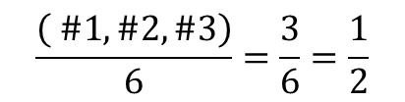
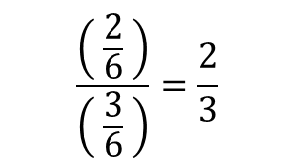
Conditional Probability
$$\frac{\left( \#1, \#2, \#3\right)}{6}=\frac{3}{6}=\frac{1}{2}$$
$$\frac{\left( \frac{2}{6} \right)}{\left( \frac{3}{6} \right)}=\frac{2}{3}$$
The Point: Probabilities are not only: “Will X happen?”…
…they are also: “Would Y influence X?”
Notes:
Point is at the bottom. You probably either know-this-already, or you don’t care are are willing to take my word for it. Will this happen, will these two things happen together?

Slide 37
…Other Benefits, Depending on Who You Are
User | Benefit
Traders | Exchange expertise / risk-tolerance by making mutually beneficial trades with other traders.
Authors | Purchase space for Decisions and Markets, profit if they are used.
Voters | Earn a return in exchange for (very) simple reporting work.
Bitcoin Miners | More tx fees … for free!
Bitcoin Users | Increase in Bitcoin’s Intrinsic value, live-demo of sidechains.
Citizen | Politicians work toward improving metrics, not looking impressive.
Consumer | CEO’s under the same competitive environment as janitors = more growth.

Slide 38

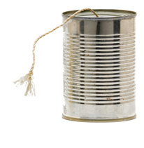
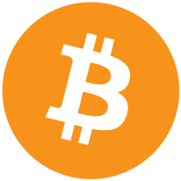
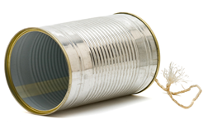
What the heck is my exchange rate these days, anyway?
It’s $500/BTC. …hello? Hello?!
Problem: Blockchains are ignorant of ‘real world’ data.
Biggest BTC Complaints:
“No intrinsic value” ( can’t use it unless someone else wants it ).
Price too volatile ( poor value-storage ).
Need a system which grabs accurate reports from people even if 100% of them are untrustworthy and motivated to lie.

Slide 39
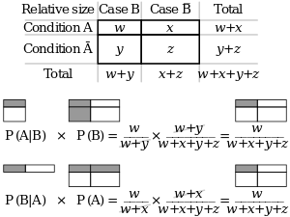
Prediction Market Magic (2 of 3)
Marginal Probability

Slide 40
Benefits
Complaints about intrinsic value
In fact, catalyst for

Slide 41
My Style
Slow/Academic: Don’t present until it’s done. (this is a little exception…idea is done but software is not).
Theory: fun in bars, waste of the audience’s valueable time.

Slide 42
Next Steps
Stay tuned (follow on twitter “Truthcoin”)
Website: truthcoin.info
Forum: forum.truthcoin.info

Slide 43
How Did Things Get So Bad?
Too Many People: hypocrisy/deception have always existed, but scale problems have accelerated the pain:
Internet connects everyone, even the uninformed.
Larger Nations/Corporations: Senators/CEOs control more $$$$ than ever (by manipulating opinions, or causing disinterest).
Entrenched leaders (CEO empire-building, Clinton/Bush families).
Warped research incentives
Publication bias. “most published findings are false” (Ioannidis 2005)
Least-publishable-units
Empiricism crushed by authority yet again.

