Slide 1
Data and Analytics Essentials: Logical Data Warehouse
Henry Cook
Last Updated: 10-January-2021
Notes:
The logical data warehouse is a well established current best practice for the design of data and analytics systems.
This presentation goes through the main concepts and advice that Gartner provide for these systems.
Gartner clients can download this presentation and then adapt if for their own use, either to explain the concepts to their customers and colleagues, or to customize when designing their own systems.

Slide 2
Agenda
What is the Logical Data Warehouse
How is the Logical Data Warehouse used
How to get the benefits
Useful concepts
Notes:
First we’ll remind ourselves of what the logical data warehouse is.
Then we’ll discuss how its used.
Finally we’ll discuss how to get the benefits.
We’ll also then includes some useful concepts that are usually discussed when talking about the LDW.

Slide 3
Quick Recap: Logical Data Warehouse (LDW) …
Modern best practice incarnation of the DW
Is a multi-engine, multi-component logically integrated system.
Fulfils original data warehousing objective: “Give me one place to go to access all my data and the means to analyse it”
Unlike the old DW which was a single relational database, the LDW:
Can store and process all kinds of data; big, small, structured, unstructured
Can process the data in all kinds of ways; SQL, OLAP, ML, Stats …
Is an integration of multiple components, typically a DW, a Data Lake, data marts, real time DW (a.k.a Operational Data Store — ODS) and others
Is modular, LDWs evolve organically modules added as needed, none are prescribed.
Provides a “Single View of the Truth” not by a single physical consolidation but via:
Consistent metadata and naming conventions across the component servers
Use of federation / data virtualization — usually, though strictly this is optional
Reuse, of both data and technology is key
No one component can do everything (in 2021) but the collection of components can.
Implements the minimum number of components to cover all the bases
It is not a single DW component, but neither is it 500 data marts …
Is a portfolio approach to covering the full workload
Notes:
The Logical Data Warehouse is the modern incarnation of the traditional data warehouse, as its name suggests.
The simple objective of the original data warehouse was to provide people with access to all of the data in the organization and methods to analyze it. Originally all the data was structured, and the only means of analysing it was with SQL. However, with advent of a larger number of data types many of the semi-structured or unstructured, and the rise of new processing methods, such as machine learning, natural language processing, text processing the single relational database component could not cover the whole scope.
This was solved by allowing the DW to use multiple server components and spread the data and workload between them in a “divide and conquer” approach.
To the outside world the LDW could still provide the single view of the truth, or more exactly the data, by using common metadata and naming standards across its components, and using data virtualization to provide a logical integration instead of a physical one.
Physical co-location and aggregation is still required for performance, but there are a small number of big servers that provide this - rather than trying to everything in one server. The aim is to have the minimum number of server components that can cover the whole workload.
A key theme is reuse; of technology and data. Data should wherever possible be stored once and shared may times, and when processing techniques are added they too are reused. Whilst this is not a single physical server, neither is it 500 data marts. Instead of trying to force fit a whole workload into a single server we use a portfolio approach where the workload is handled by a small number of (admittedly big) servers.

Slide 4
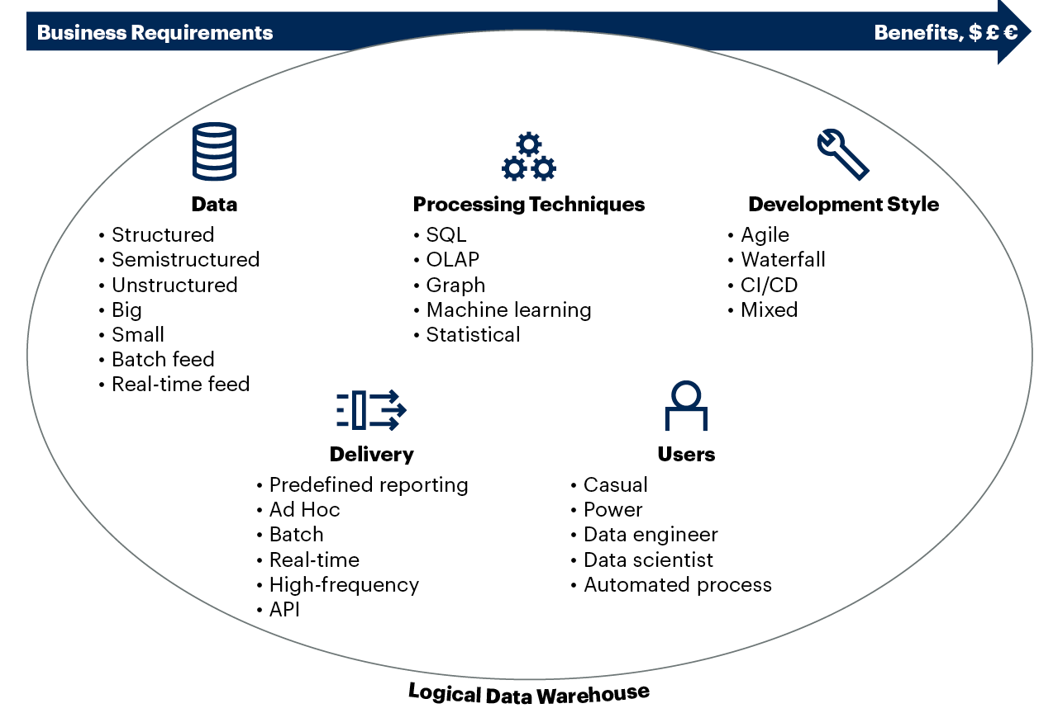
The Problem We Are Trying to Solve With the LDW
Notes:
Before designing any system it is worthwhile to ask what the problem is that we are trying to solve. For the LDW the problem is accommodating modern analytical workloads, and the core problem with this is accommodating he variety of different data, processing techniques, types of users, delivery modes and development styles.
At first glance this problem looks impossible to solve. In fact it is impossible (as at 2021) — if you try and do it all with a single system. For example if you just use a data warehouse you’ll find it difficult and expensive to accommodate large data sources with less structured formats. But if you use a data lake to handle the “big data” you’ll struggle with support for large numbers of users, concurrency, response times and workload management.
Likewise it will be hard to cater for agile development being done simultaneously with the checks and balances necessary to ensure the integrity of the curated data within the data warehouse to handle requirements such as financial analysis and reporting.
However, we wish to preserve the idea of having a single place to go to where we can find all the data we need, together with the analytical tools necessary to process them. We do not want to go back to the old days where we had many different and fragmented analytical systems.
The trick here is to divide and conquer the problem, to construct a system that appears as a single unified system but which is, under the surface, is an integration of a small number of analytical system components, each of which specializes In part of the job of holding and analyzing the data.
The users can approach the system as a single source, but we can distribute the various different parts of the workload across components each of which specializes in a part of it. On the next slide we see how this is done.

Slide 5
LDW Architecture
Operational
reporting
Query and Reporting Standard and Ad Hoc
Self-service Reporting / Data Sourcing
APIs
Data Science, AI, Machine Learning, Statistical, Predictive
Feedback
Loops
Logical Data Warehouse
Access / Data Virtualization / Federation
LDW and Non-Core Systems
Operational Intelligence Platform
DW Platforms
Nonrelational Platforms
Archive
Source:
Data Warehouse(s)
Marts
Data Lake(s)
Source:
Remote and Third-Party Systems
OpInt
Graph
Sandboxes
Sandboxes
Hot / Cold data store
Marts
Metadata / Model, Governance, Change Control, Security, Reliability, Serviceability, Availability, Recoverability
Source:
Reporting accelerators
Reporting accelerators
Source:
Legacy BI
Source:
Ingest: ETL, ELT, Replication, Streaming, Data Hub, Data Fabric, Data Virtualization, Business Rules
Source:
Infrastructure Platforms – Cloud or On-Premises
Source: Gartner 719608_C
Note: BI = Business Intelligence; DW = Data Warehouse; ELT = Extract, Load, Transform; ETL = Extract, Transform, Load; LDW = Logical Data Warehouse
Notes:
The logical data warehouse is an architecture that combines multiple analytical components into a single logical whole. A modern data and analytics workload cannot be run on a single physical server. However, by having a small number of specialist servers the different data and parts of the workload can be distributed across them. This still meets the need to provide a single source for all of a companies data. Data is taken in from multiple sources and loaded into the various components. There is a common interface enabled by data virtualization / federation and common metadata to assist in accessing, joining or moving data around the architecture. Virtualization is not strictly necessary — access could be manual, but is usually included, it may even extend into source systems for data gathering and prototyping. A good way of thinking about this is that the data warehouse and data lake are not competing solutions but collaborating engines. The architecture is modular and can be built incrementally. As data, users and applications are added the components can be individually scaled.
The alternatives are either trying to do everything on a single server which is very hard, or allowing a fragmented systems with tremendous inefficiencies, risks and complexities. LDW strikes the right balance and provides optimum performance and cost.
There may also be a series of data marts and sandboxes for agile experimental development — physical or virtual, and one or more real time data warehouses (also known as Operational Data Stores). An archive for long term data storage too - most likely part of the data lake.
Feedback loops from the front-end applications back to the sources (which are the operational systems) can provide continuous feedback and adjustment to the business.
New technologies can be added, or existing technologies replaced. The architecture enables high rates of re-use both for the technology and for the data held, this in turn provides a good return on investment for the system. Vendors also offer a lot of pre-built integration, it is very common for the data warehouse and data lake to have off the shelf integration in place.
Thus, at the expense of some integration and setup the LDW architecture can cover a full range of modern data and analytics workloads.

Slide 6
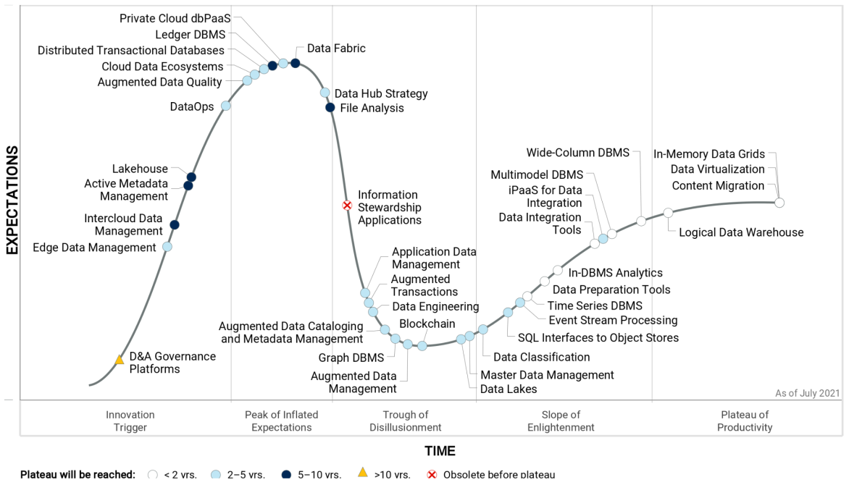
The LDW on the Hype Cycle for Data Management
The Logical Data Warehouse is firmly established in the Plateau of Productivity.
Users should adopt the LDW
Well understood
Flexible
Practical
Covers a wide range of data and analysis techniques
Ideal jumping off point for the data fabric
From “Hype Cycle for Data Management, 2021," July 2021 G00450207
Notes:
The LDW appears on the right-hand side of the Gartner hype cycle for data management. This shows that it is a well understood design, and a modern best practice for data and analytics systems.
It has traversed the complete life cycle, climbed the slope of enlightenment and is now firmly established on the plateau of productivity.
The Logical Data Warehouse is a best practices architectural approach for data and analytics. It is not an off the shelf product, though, as we’ll see many vendors are adopting its principles and pre-integrating many of their systems or services. In particular, most offer integration between a data warehouse and a data lake.
Note that systems will over time move towards the data fabric which will provide even easier integration of and access to data, but that technology is estimated to take five to ten years to mature.
In the meantime the LDW provides a proven and well understood way of implementing modern data and analytics solutions.

Slide 7
Metadata, Data Virtualization for the Semantic Layer
Metadata
Analytics, Business Intelligence and Collaboration Tools
Access / Virtualization / Federation
Metadata
Remote and Third-Party Systems
Operational Intelligence
(ODS)
Legacy BI
Data Warehouse
Marts
Sand-boxes
Data Lake
Metadata
Metadata
Metadata
Metadata
Metadata
Metadata
Metadata
Notes:
The logical data warehouse needs to handle many different metadata stores. If we are lucky some of the components will use a common metadata store and this will reduce the amount of integration that needs to be done.
Otherwise, it is necessary to design a method of passing metadata back and forth between the different components. In some situations the means of integration will already exist in the form of an interface. An example would be the links between the data warehouse and data lake. It is very common for the data warehouse to be able to push down processing into the data lake. This is done by passing SQL across an interface – having translated it to the dialect that the data lake can accept. The data warehouse will have previously interrogated the data lake (or in fact any remote data system that it wishes to retrieve data from) by reading from its catalog. The descriptions of the remotely accessible tables and their attributes are returned as results and then are stored in the local metadata table. The tables appear to the main DW as if they are local.
If the data warehouse and data marts use the same technology, and especially if the data marts are simply different partitions of the same physical system, then there will be a shared metadata store in place. Some of the cloud providers have introduced shared metadata stores as part of their services.
It is common to use a data virtualization tool within the LDW provides a unified view of all the components of the LDW. This too will have its own pool of metadata that it uses to guide the translation of SQL requests, data formats and error messages from the requests going to and from between the tools and the component databases. This is useful because the LDW can present a common interface to the outside world.
This principle extends into the analytics and business intelligence tools themselves that are accessing the data. These too will have their own metadata stores, and they too will request data from the catalog(s) within the LDW. In addition, there will be metadata that is only relevant to the tools themselves. This includes metadata for reports that have been written, collaboration between users, organizational structures and other information.
The complexity of the various metadata stores is hidden from the users, who only see the common upper layers of metadata.

Slide 8
Systematically Consider Data, Metadata Interfaces
Operational
Reporting
Query and Reporting Standard and Ad Hoc
Self–Service Reporting / Data Sourcing
APIs
Data Science, AI, Machine Learning, Statistical, Predictive
D / μ
D / μ
D / μ
D / μ
D / μ
Access/Virtualization/Federation
LDW Noncore Systems
Operational
Intelligence
D / μ
D / μ
D / μ
Relational DW Components
Data Lake / NoSQL Platforms
D / μ
Data Warehouse(s)
Data Lake
Remote and Third-Party Systems
D / μ
D / μ
ODS
Metadata Store / Catalog
ODS
Sandboxes
Reporting Accelerators
ODS
D / μ
Marts
Sandboxes
Legacy BI
D / μ
D / μ
D / μ
Ingest: ETL, ELT, Replication, Streaming
The LDW architecture also helps us to systematically focus on all the data and metadata flows — the “data and metadata transports” — we’ll need
For each interface ask “Exactly how does data and metadata flow across this interface”
Many vendors are pre-integrating these components already, in particular the data warehouse, the data lake and machine learning services
Key: Data and Metadata Interface
D / μ
Notes:
An advantage of the modular design of the LDW is that it allows the designers to systematically consider each of the components — to check that the right components have been chosen and they are appropriately sized and implemented.
Another advantage is that the designer can also systematically examine all the interfaces between the components and determine how data and metadata will travel between them. The various interfaces can be identified and checked and things like transfer rates, bandwidth and latencies can be determined. This is shown in the diagram, which is similar to the negative image of a photograph, to highlight the connections between the components rather than the components themselves.
On the diagram the arrows marked “D/µ” stand for “Data and metadata” and show where specific interfaces needs to be implemented.
All interfaces are not created equal; some may make use of parallel transmission paths and parallel transfer sessions; some may be able to use fiber optic links or other fast transfer methods, including direct access to memory.
If running in the cloud, or if the LDW is to be distributed across regions of clouds, or even different clouds, the performance characteristics of the cloud networks can and should be considered.
Similarly, these interfaces can be examined from the point of view of permissions, security and governance — and how this information is passed around the various parts of the architecture.

Slide 9
A Typical LDW Growth Path
“We need to support quick prototyping and agile working so we add sandboxes alongside our data warehouse and lake – these are physical or virtual as needed”
“We had a data lake but then needed to support many users and support stringent SLA’s”
“The warehouse made it easy to design for performance for these requirements – and freed the lake from that responsibility”
Data Warehouse
Data Lake
Structured data
IoT
Audio
“… so just as we can accommodate different processing styles we can also mix development styles … ”
Data Lake
Semi-structured
Video
Social Media
Data Warehouse
+
+
IoT
Audio
Structured data
“💡 We can develop agilely without destroying the integrity of our DW and ensure good governance of the DW without slowing down experimentation”
+
Sandbox
Data Mart
Reporting Accelerators
Video
Semi-structured
Social Media
OR …
+
+
Sandbox
Data Mart
“We need to support many users and support stringent SLA’s”
“💡 The shared data definitions in the data warehouse and lake makes data easily consumable – and I can monitor how its being used and by whom”
Data Warehouse
Data Lake
Data Warehouse
Data Lake
Real-Time DW
/ ODS
Structured data
IoT
Audio
Data engineering
Structured data
Machine Learning
+
Semi-structured
Video
+
Schema on read
Structured data
Social Media
Semi-structured
+
“Users then demanded real time monitoring of critical business processes – needing very high performance and availability – so we added an ODS and streaming”
Sandbox
Data Mart
Reporting Accelerators
Reporting Accelerators
+
+
Streaming
Sandbox
Data Mart
“Our EDW worked just fine for many years, then we added IoT, all that IoT data wouldn’t fit in the EDW, and in any case wouldn’t have been economic to store there. ”
Notes:
Another advantage of the LDW is that it is modular and can be built in an incremental and modular fashion. The picture here shows a typical growth path.
Organizations will often own a suitable platform as a starting point, a data warehouse system or a data lake. If the organization is happy with their current warehouse or lake then this can be retained and used as the starting position for the LDW.
The system is expanded when it needs to start handling new types of data and processing that the existing system is not suited for.
If the organization started with a warehouse then the need to store and process very large amounts of less structured data, such as IoT or social media data prompts the addition of a data lake, since data lakes are well suited to this.
If the organization started with the data lake then they may find it difficult to support large numbers of users with fast response times, high concurrency and good workload management, adding a data warehouse solves these problems. As noted before, look at the warehouse and lake not as competing solutions, but rather as complementary engines.
The lake and the warehouse are core engines of the LDW and most software vendors provide features to pre-integrate them. Smaller private areas can be added too for analysts to do experimental work without jeopardizing the integrity of the main warehouse. These can be physical instances, or they may be virtual views of underlying data.
As an aside, another common situation is merging multiple warehouses or lakes as the result of mergers and acquisitions. An organization may find themselves owning multiple data warehouses and lakes. These can be consolidated into a single LDW if that makes sense.
Another requirement may be to add the capability for real time query requests, this would be a real time data warehouse, sometimes called an operational data store (ODS) to service users such as call center staff, or as the back end for a high traffic mobile application.
Likewise, as systems are enabled to emit real time streams of data a stream ingestion and analysis sub-system can be added.
This is an example rather than prescriptive development path many others are possible.

Slide 10
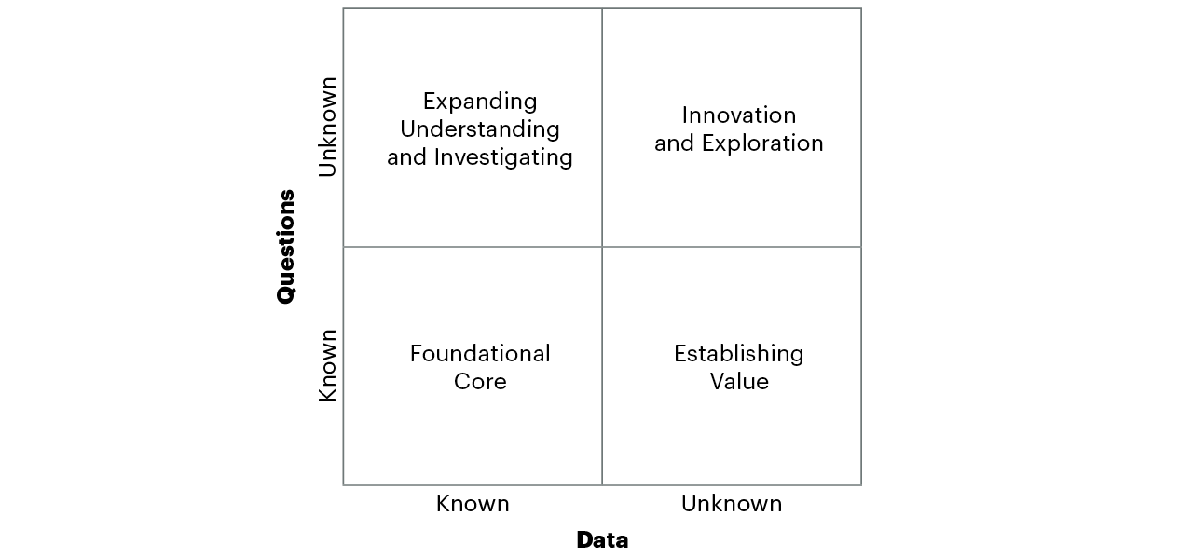
The Data and Analytics Infrastructure Model
Notes:
A useful tool in developing the LDW is the Gartner Data and Analytics Infrastructure Model, the DAIM. This characterises all data and questions according to whether each is known or unknown.
Known data means that the form and structure of the data are known in advance. This would include data sources dealing with finance, the supply chain, HR and other well understood data.
Known questions would be the regular reports and standard queries that are run as part of the predictable day to day queries.
Unknown data might be data sets that have recently been provided for analysis, for example if a company acquires another and wishes to examine their customer records to look for overlaps In customer bases. Some of this data may have loose, or unknown structure, for example social media messages, video or audio. This data needs further processing before useful information can be extracted from it.
Unknown questions refers to being able to ask new questions that haven’t been asked before against the data. For example being able to join data from different parts of the business in ways that previously haven’t previously been possible. These are the ad hoc questions that have only just been thought of, the system cannot anticipate them, but must provide a means of asking them. Asking newly arising questions on existing loaded data was one of the prime use cases of the early data warehouses.

Slide 11
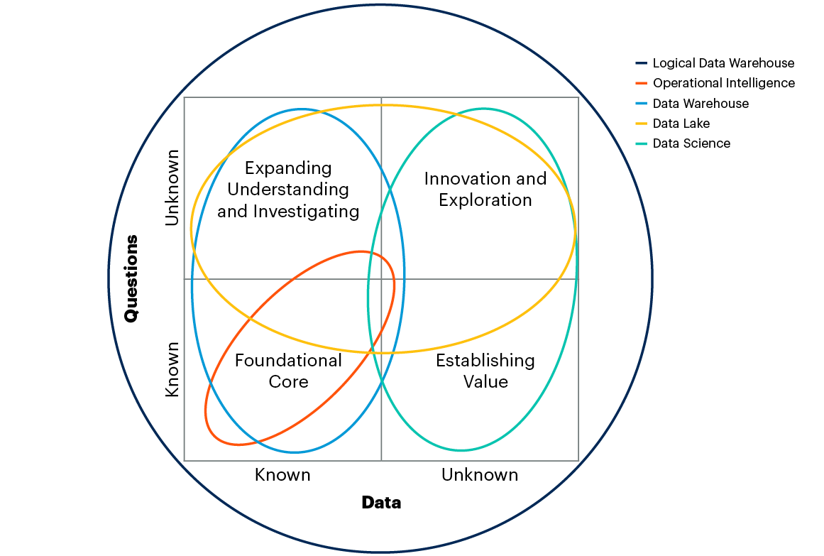
Logical Data Warehouse Overlay for the DAIM
Notes:
The DAIM can be used to provide multiple perspectives. One of them is to overlay onto it the various technologies that we know apply to each of the four quadrants.
We can identify which technology we need to be able to deal with each quadrant, and therefore the overall set of components to be integrated together that will enable us to cover ALL requirements in a modern workload.
We are familiar with each of the types of systems that can be used for data and analytics systems, as listed on the right of the slide. The eclipses show which parts of the DAIM those systems cover.
This starts a process of being able to divide and conquer the complex problem of being able to handle the diverse workload that our modern data warehouse systems need to handle.

Slide 12
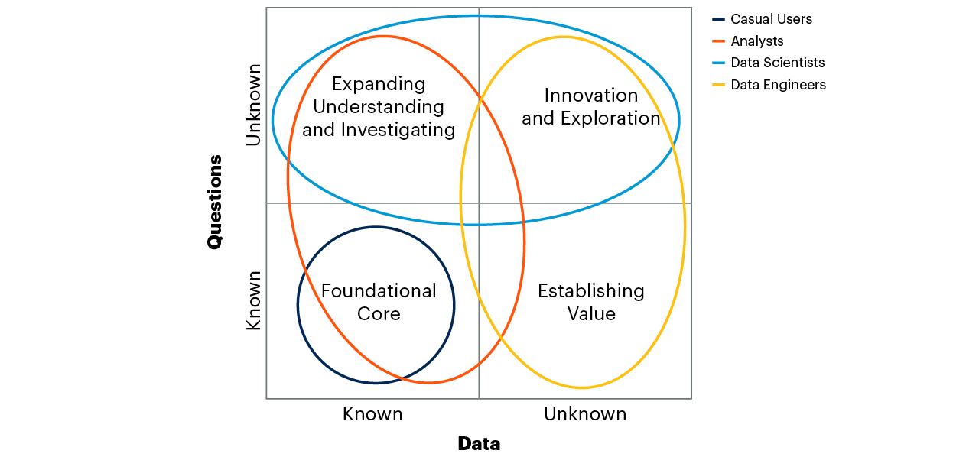
Roles, Skills Alignment and Data Contexts
Notes:
Another perspective that the DAIM can be used for is skills and user support planning. This time the different types of users are listed and the areas of the DAIM model that it would be expected for each type of user to be active within.
This allows us to systematically consider what kind of tools are needed, what skills, what kind of training, what governance and security is required and other user related questions.
The different perspectives mapped on onto the DAIM can also be cross referred to each other in order to check that the system design supports the capabilities that are assumed in each individual perspective.
Many different overlays can be defined to help with thinking about security, governance, end user BI tooling, training, documentation etc.
For more information about the use of the DAIM see the appendix to these slides.

Slide 13
Aligning Requirements to LDW Components
Cost | Requirements – Prioritized by Return on Investment / Strategic Value | Benefit
0.5 | Provide new profitability calculations for finance | 10
0.1 | Monitor activity within real estate assets using Internet of Things | 5
0.5 | Provide real-time interactive data feeds to customer service via API | 12
1.0 | Provide offline self service tools for roving consultants and staff | 25
Key Question:
What kind of data?
What kind of service levels?
Logical Data Warehouse
Operational Intelligence, real time, ODS
Marts
Data Warehouse(s)
Data Lake
Marts
Marts
Notes:
The LDW architecture may looks complex at first glance, but it is much less complex than the usual proliferation of many different data and analytics systems. Instead of having tens or hundreds of incompatible systems there are a handful of major components. This begs the question as to which data belongs whereabouts within the architecture.
This is an important point, it has not been possible to reduce the number of components to one, but having a handful of components is preferable to having a hundred or more. So the real choice is not between having one or more, but between having a few and very many. So while some work is needed here to place the data and processing this is much easier than having to handle a jumbled mess of many different systems.
The placement of the data and processing is actually fairly intuitive. The different components have different characteristics that usually easily map to different requirements.
Thus, large volumes of data being generated by an IoT application will most likely be held in the data lake. Structured data for finance naturally fits in the data warehouse.
The type of data normally decides where the data belongs, however in some cases we need to consider the service level to be provided for the analysis on the data. If the analysis needs to be provided to large numbers of users with low response times, high concurrency, high availability and good workload management then the relational components are likely to be needed.
When prioritizing the users requirements it is worth thinking about how different requirements might be placed into the communications plan for the project. Getting good results in an initial project that is simple to understand can do a great deal to encourage other requirements and use cases to be brought to the system.

Slide 14
Data Modelling Types
This is a human and not just a technical requirement.
For a group of humans to use data for a business purpose they need a common understanding of the data:
Structure
Meaning
Access
Trustworthiness
etc.
… all of which require definitions
Third Normal Form
Reduce redundancy, complex relationship
Dimensional
Intuitive, slice and dice
Data Vault
Minimise the impact of changes
Also, particular techniques:
Bill of Material
Hierarchical structures
Slowly changing dimensions
“The reports of my death are greatly exaggerated” — Mark Twain
Notes:
Data modelling is alive and well despite the industry going through a phase denying its ongoing usefulness. When the new so-called “big data” arrived it was much less structured. A problem with relational technology was that data needed to be structured before it could even be loaded. This was inconvenient — Hadoop, Spark and cloud object stores solved this problem. This enabled users, data scientists and engineers to load and start investigating this data. However, it should be noted that unstructured data usually does not stay unstructured very long. If it was to be fed into other processes, or shared amongst people, it needed descriptions that enabled a common understanding. The same for new interpretations of existing data. For example, with feature engineering for machine learning new columns might need to be added to enable analysis. Creating a DAY-OF-THE-WEEK column from a record date is common — it may predict what happens on a particular day of the week.
There remain three main styles of data modelling. First the traditional third normal form (3NF) modelling. This is based on modelling entities, attributes and relationships. These are the things represented, their defining attributes and the relationships between them. This enables the modelling of complex data relationships, minimizes data redundancy and thus the opportunity for unsynchronized version of the data (and I/O) but it is not easy for users to understand and navigate.
Second, dimensional modelling, this represents data as cube type structures of facts which are described by various dimensions; time, geography, product. This is efficient to process and intuitively easy to navigate, but is more restricted in the relationships it can represent.
The third, Data Vault modelling, a more recent type builds on the previous two and adds guidelines that aim to minimize the impact of change on the data warehouse. It uses a dimensional style presentation layer on top of a 3NF like core. It needs good discipline to use.
There are also specific techniques that are useful, representing hierarchical structures which can support roll ups into high level KPIs, bills of material in manufacturing etc.

Slide 15




Data Modelling Levels and Areas
Conceptual
High level
Fast access, business users
Logical
Application neutral
Common definition, lineage
Physical
Technical implementation, lineage
Social
Commentary on usefulness, experience
Beginning to become “active” metadata collected by the system.
Business / Organizational
Identify the entities, processes, structures and relationships being modelled
Notes:
It is also worth considering the different kind of levels of metadata that should be used. It is useful to have a conceptual level of data model or metadata. This is typically a high level, short narrative description of a type of data, such as CUSTOMER, SUPPLIER, PRODUCT etc. It provides a first entry point for discovering what data is available, especially for non specialist users.
The next level is a definition of the data to show what it consists of, and the relationships between data items, but in an application neutral form. This defines what we mean by CUSTOMER and what kind of attributes we define to distinguish different customers, also the relationship of those types of data to others, such as ACCOUNT or TRANSACTION. This level is not intended to be physically implemented, although with modern technology often we can often implement a system with a data model that is very close to this idealized application neutral form. The logical level and the business / organisational aspects are shown alongside each other above, sometimes they are considered separate areas, sometimes they are just part of the logical modelling level.
It is necessary to physically implement data within real systems, and that is the purpose of the physical metadata, typically used by developers to build systems. CUSTOMERS may be defined slightly differently on different software and hardware systems, but will still retain a close correspondence to the logical descriptions previously mentioned. This is necessary to allow the data to be physically designed, maintained and performance tuned.
Both logical and physical levels of metadata may participate in governance activities like showing the lineage of data flow. This enables impact analysis for source system changes and traceability from reports and queries back through the processes of the LDW and back to the sources.
More recently another level of “social” metadata is also used, recording the experiences that analysts have in using the data, its usefulness, other data sets that can be used with it,how current it is, which types of analysis it can be used for. This type of metadata will increasingly be gathered automatically.

Slide 16
Exploiting Multiple Types of Data Modelling
Enterprise Model
Agreed, Standard, Understood
Where? Warehouse, mart,
ODS, lake
Experimental / Agile Models
Models of new data,
or alternate views of existing
Warehouse, mart, lake, sandboxes data virtualization
Input for agile devt.
Discovered Structures
New agreed models
Hints and Clues
Exploratory
Exploring new and unknown data to find meaning
Mainly in Lake
Discovered Structures
?
“Hints and Clues”
?
Discovered Data fed to Agile Devt. or Virtualized
?
?
Notes:
The LDW reconciles multiple data stores, processing types and development styles. The LDW architecture allows for different processing types to co-exist. The LDW has sufficient components to cover all the (storage and processing) requirements, but no more. The system has a small number of large servers, each of which has high reuse.
However, it can also be used to separate different types and development styles, modelling techniques etc. Instead of having to choose a one size fits all approach for everything different parts of the system can use different approaches in a way that complement each other.
As shown in the figure the main enterprise model is used for those jobs that require precision and high integrity, and for describing complex relationships. This applies to areas that need high integrity, like finance, regulatory support, supply chain and customer service. This description is the gold standard for company data.
However sometimes analysts need to be more agile and may wish to be able to experiment with different data models and modelling styles. For this you can use a data mart or sandbox to make your own copies of data, and then experiment with different data structures. Sometimes these don’t need to be physical copies, they may simply be view of underlying data. Existing data and definitions can be picked up from the main system, the data can be experimented with, or prototype analyses developed. If useful, new or modified data structures can be merged back into the main body of data.
Sometimes the data is unknown, maybe even the kind of data has been loaded. For this exploratory capabilities, like those typically found in data lakes can be used. There is no data structuring required prior to loading the data. Tools are used to discover what the data is and how it might be structured in order to work with it.
These can coexist in separate parts of the architecture. The exploration may be informed by hints and clues from other data sources — the kinds of patterns to expect. Once a rough idea of the structure has been formed it may be useful to start to iterate around potential data models using the agile development area. The data may then have its structure firmed up and potentially then merged into the main system. Each of these tasks can be done without conflicting with the others, or jeopardizing the integrity of the main system.

Slide 17
Enabling Agile Development and DW Integrity
Common Tooling
Query and reporting
Standard and Ad. Hoc.
Self-Service Reporting & Data Sourcing
Data Science, AI, Machine Learning, Statistical
Access / Virtualization / Federation
Relational Platforms
Non-Relational Platforms
Data Warehouse
Change Control
Data Lake
Production Changes
Production Changes
Data Copies / Views
Data Copies / Schema on Read
Agile Experimentation / Prototyping
Mart
Sandbox
Mart
Sandbox
Mart
Sandbox
Mart
Sandbox
Key: Development Acceptance Criteria
Higher
Lower
Notes:
A frequently occurring dilemma for data and analytics groups is how to balance the need to ensure the integrity of the main data sets whilst allowing agile working for urgent and innovative development. There are now several flavors of agile development and here we use it as a general term. Ensuring the integrity of the main data implies that there are checks and balances built into the development process. This clearly slows things down, but the payback is confidence in the data. The development process can still be agile, but the acceptance criteria for moving code and data into production will be higher.
For other requirements where we need to get hold of data quickly and be able to do fast experiments and prototypes. Maybe a competitor has come out with a competitive pricing scheme and its an urgent priority to find which customers are susceptible. Here the development standards can be relaxed in order to get a quicker result. In this mode results can be generated quickly — whilst still observing regulatory and security rules. Once developed the results are then carried into the business and acted upon in order to get benefit. This has been done without putting the integrity of the main data sets at risk. Likewise, the results have been produced fast, without being impeded by the more stringent development acceptance criteria needed in the main parts of the system.
However, what happens if the experimental prototypes should be run regularly as part of production? For this the artefacts developed the fast experimental mode are taken and put through a change control process where they are converted and productionized. Just as the acceptance criteria were relaxed as data and definitions were passed to the agile environment, coming back in the reverse direction triggers the change control process to re-introduce these higher acceptance standards. The artefacts generated in the agile mode are converted and merged into the main system. Thus, there is a clean firebreak between the main system and the agile areas which decouples them and allows both types of processes in parallel.
Often this way of working is part of normal development. A challenge with BI is that there may be 10 different requirements, of which 3 will provide payback. Therefore, the mission is to quickly find the three. This can be done quickly using the agile area, then follow them through with development for the main system. Agile working can be used to qualify and prioritize requirements rather than relying on paper exercises.

Slide 18
Project Key Deliverables
5
Phased Project Plan
Phase I
Phase II
Phase III
Phase IV
2
4
3
1
Data Sources
Existing
New
LDW Architecture
Planned
Self-Service
Agile / Sandbox
Data Model
Analytics Requirements
Predefined
Self Service
Notes:
The LDW is a modular system and therefore supports a number of different routes to its implementation. A useful way to think about this is around the key deliverables or artifacts that will be used to do the design and development. These are:
The analytics requirements. The LDW should be business driven, the team should have a clear idea of what they are building and why. Some data sources and elements of the data model will be obvious in their need for implementation, but for the most time the team will progress top down and be business driven.
Data, the raw material for the system. An inventory of potential sources is drawn up, this will include both existing sources and those that are projected to become available shortly.
Where the previous two deliverables meet is in the data model. Each requirement will need data to be implemented and the data inventory has been prepared. These can be cross referred to each other; which data is needed to meet each requirement – “pulling the data into the model”; which requirements can be met by loading which data sources – a “push” model. Both are valid. Most of the time the business requirements will drive this, but it is also valid for IT to let the business know that certain data and analyses are possible and whether they want to prioritize loading that data. The requirements can be prioritized according to the return on investment they represent. What is the expected benefit but also the expected cost, in time, people hours, money ... ? Sometimes requirements are accelerated because they support a strategic initiative.
Once the requirements and the data that is necessary is known the architecture of the system can be developed.
Because this is a lengthy and complex project with many tasks and moving parts a project plan is necessary. The shading shows the phased approach, taking a horizontal slice through the architecture, loading data, building out requirements in the first phase, then looping back to do the same for subsequent phases. The deliverables are built incrementally and in parallel.

Slide 19
Hints and Tips
Use staging areas to provide workarounds for incoming data, avoid becoming dependent on change control in production source systems because its slow.
When given access to a data source, take as much data as possible, you can store it until needed and you don’t need to load all of it immediately, when data needs expand extra fields / column can be ‘unlocked’ without going back to change the source extraction.
If appropriate, use the data lake as a general staging area to gather and transform data, also for refinement, sandboxes, archive, etc. Design and build data zones accordingly.
Keep copies of raw input (cheaply in the lake) helps with audit, debugging and reprocessing to recover from errors.
Use agile development as part of regular development, and use it to quickly identify requirements that will be worthwhile.
Use metadata standards so data and processing can easily be moved around the architecture so as to maximize return on investment.
Use modern techniques, such as parallel processing and in-memory computation, to reduce data structure complexity by removing the need for indexes, pre-aggregates etc.
Design in governance, restart / recovery / High Availability / Disaster Recovery and monitoring from the start, as they are hard to retro-fit.
Notes:
Aside from the more comprehensive architecture and advice there are useful hints and tips worth knowing.
These tactical points can save a lot of time and rework later on. The principle here is to anticipate things that will be difficult to retro-fit later and design them in from the start. Also, design for change and for flexibility so that the LDW can adapt to change without too much fuss.

Slide 20
Frequently Asked Questions
Do I need to build everything on those slides?
No. The LDW is a modular architecture and you just add the pieces as and when they make sense. Look ahead a little and understand how components will be added, but don’t add them until they are needed.
Do I always have to have a Data Lake?
No. All components are optional. In fact, you may begin with a data lake, add a real time database and then later on add a data warehouse. Usually, the path is to have an existing warehouse, add the lake (or vice versa) then add more specialized components like real time, graph, etc — but only if they and when needed.
Is a data virtualization layer essential?
Strictly, it is optional, you could manually direct queries move data around. However, in practice most of these systems use data virtualization, either a third-party product, or as part of the vendors DBMS.
Is there a simpler way of doing this?
Not at the moment. You need to do some integration (increasingly, the vendors do it for you) but this enables you to handle a very wider range of workload. If it looks complex and expensive then compare it to a) Trying to do everything in a single server at greater effort and cost or b) Having multiple, fragmented disjoint systems. If you quantify the cost and effort you will most likely find this gives you the optimum performance, cost and agility. “If you think LDW is expensive, try not having one.”
Should everyone use an LDW?
No, for small to medium organizations or those focussed narrowly they are not necessary. However, large companies or those with big complex workloads will benefit greatly.

Slide 21
Recommendations
Familiarize yourself with the multiengine, multicomponent LDW architecture.
Future-proof your system by matching the analytical requirements to workloads and service-level agreements including anticipated future needs. Delegate processing to the right components inside and outside the LDW.
Provide an integrated view of the data and analytical techniques of the LDW through metadata standardization, data virtualization and data catalog.
Deliver a complete integrated system, think in terms of key deliverables; requirements, data, data models, architecture, phased project plan.
Use the Gartner Data and Analytics Infrastructure Model (DAIM) to assess your requirements, technology, user roles, training and other facets of your system.
Notes:
First become familiar with the LDW architecture, not just its general form but the key principles that it follows; A divide and conquer approach, a logical integration of a small number of proven components, maximum reuse of technology and data.
The architecture is flexible, it should be possible to plan for a wide variety of different types of workload. By delegating the right parts of the stored data and processing to the right components it should be possible meet new requirements with the minimum of re-architecting, most of the time it will just be expanding capacity when needed.
The individual engines and storages should be hidden where possible beneath an abstraction layer provided by a data federation / virtualization layer.
Guide the development by tracking the key high-level deliverables that define the project; requirements, inventory of data sources (existing and expected), data model, architecture and multi-phase project plan.
Make use of the Gartner DAIM model to help think around the different aspects of the system from multiple perspectives.

Slide 22
Recommended Reading
The Practical Logical Data Warehouse
Best Practices for Designing Your Data Lake
How to Avoid Data Lake Failures
How to Optimize Business Value From Data and Analytics Investments … Finally
Use Gartner’s Value Pyramid to Connect Data and Analytics to Business Value
Solution Path for Planning and Implementing the Logical Data Warehouse
Building Data Lakes Successfully — Part 1 — Architecture, Ingestion, Storage and Processing
Building Data Lakes Successfully — Part 2 — Consumption, Governance and Operationalization
Market Guide for Analytics Query Accelerators
Notes:
The recommended reading covers the principles of the LDW and its component parts.
It also includes recommendations for how to tackle determining and realizing the benefits.

Slide 23
Useful Concepts
Notes:
A key question for any LDW system is how the benefits are delivered. As with any system it should not be built without a clear idea of the expected benefits. This section contains information on connecting the LDW to business aims, and other useful concepts that are often mentioned during Gartner calls on the LDW.

Slide 24
Business Justification: The Gartner Value Pyramid (modified)
Vision
Stakeholders
Objective Monitoring
Vision, P&L, Balance Sheet, Strategic Goals, etc.
Business Strategy
Outcomes
Operational Targets
Business processes
Executives
Performance Metrics
Feedback on Strategy
Tactical Efforts
Information
Process Owners
Business Process KPIs
(Applications, Workflow)
Efficiency and Effectiveness
Processing - analysis
Information Stewards
Data and Metrics
(Workflow, Data)
Data and Business Data Quality (Hygiene)
Data
Stakeholder
Level
Focus
Early Warning*
Architecture
* Use data metrics to forewarn of pending business process failure
Notes:
A very useful tool for thinking about the business benefits is the Gartner Value Pyramid. This enables you to connect the most high-level strategic objectives (such as key aspects of the organizations P&L) to the lowest level of data in your business applications. The KPIs and metrics associated with the data (and metrics) at the foot of the pyramid now operate as ‘early warning’ indicators: should the KPIs for data turn to red (from green), this indicates a possible future failure in business process integrity later.
This is done by considering the various levels, as shown on the left:
Vision. What is the purpose of the company? Why does it exist? What is its place in society, the industry?
Business strategy: How will the business grow, become more successful, profitable? New products, acquisitions, new geographies?
Business processes, both existing and new, those that could be make possible. The processes enable the strategy which realizes the vision.
What new information would be needed to improve the existing processes or enable new ones? Could it be more timely, accurate, detailed, trusted, or maybe it is just a new source.
Which analytical techniques would be needed to provide the improved information. SQL reporting, machine learning, statistics, ETL, data quality?
What data would be needed to feed those analytical techniques? What kind of data, transformed in what way, how much history would be needed?
Architecture: Knowing the above the right storage and processing components can be identified and placed in the LDW architecture, with the maximum reuse of each type of storage and processing.
What this does is set up a clear linkage between the aims of the business and the architecture and its components. This will be mainly business driven, top down. However, it is also relevant for IT to go bottom up, if new data or processing techniques become available asking the business how they might be used to improve the business.

Slide 25
LDW Lends Itself to Handling Hot/Warm/Cold Data
Frequent
Access Frequency
Occasional
Rare
Current
Recent
Historical
Data Warehouse
Data Lake
Data Volumes
Notes:
A topic that often needs to be handled with when building a modern data and analytics architecture is how to handle hot, warm or cold data.
The diagram illustrates how the frequency of access to data is usually closely related to its age. This phenomenon has been common more computer systems since the early days. Frequency of access determines the compute power needed for the analysis. Data volumes the storage costs and capacity required.
Most of the time people want to work with current data. A call center will be dealing with new or recent orders. In a Telco queries will mostly be about recent bills or calls.
There will be a lower level of access to recent data too. People querying their bills will be a small proportion of customers and then just on a monthly basis when the bills come out.
Large amounts of history will be stored, for audit or regulatory reasons, and inquiries into this data will be relatively rare. The historic data will also be used for things like analysis of trends, but usually people are not analyzing all the data all the time. For example, from a ten year history, each piece of analysis may be analyzing a single product for a year upon year analysis over three years. In addition, these trend analytics are likely to be big sequential batch runs that access the data very efficiently.
Therefore, the data can and should be spread across different storage and processing types. For current data is likely held on fast disk, solid state disk or held in memory. Recent data can be held on fast, but less performance devices and the historic data can be held on large slow drives that hold the data very cost efficiently.
Using this kind of data tiering results in a much better return on investment.
The LDW architecture maps well onto these schemes with the data lake providing an ideal place to hold large amounts of historic data. The data is near and at hand, and can be accessed quickly and simply, but it can be stored extremely cost efficiently. It can be moved to other faster components as needed.

Slide 26
Zoning to Classify and Handle Data
Zoning typically by
Processing stage
Raw, preprocessed, optimized
Bronze, Silver, Gold …
Source
Security / Privacy level
Also:
Structure, latency, container, known value, data domain, use case, user constituency
Anything really
You may regard
DW is zone of lake
Lake attaches zones to DW
Both contain zones of LDW
LDW Platforms
Data Lake
Data
Warehouse
Reporting accelerators
Notes:
A very useful concept for the LDW is data “zoning”, that is dividing the data up amongst different areas, each of which has a specific purpose. This technique mainly applies to the data lake, where large numbers of data inputs are held, many of them may be holding less structured data. In the data warehouse component, the data is divided amongst different tables and row ranges and there are well established protocols to control access to data, these can be regarded as identifying different zones and access requirements.
Within the data lake the zones are implemented as file folders and sub-folders. The data in the zones can be classified using many different criteria but principally they will be:
1) The stage that the processing has reached. Typically, this would be raw input data, preprocessed data that has been quality assured and basic security checks taken or data that has been preprocessed in order to make it suitable for efficient analytical processing.
2) According to its data source
3) Privacy or security level, for example whether it contains private personal information.
Therefore, for each zone it is possible to know what the data is, where it came from and what it can and cannot be used for. Access rights can then be applied to the zones to control who is allowed access to it. Otherwise, if zones are not used, any restriction on any data could potentially apply to the whole lake and this would either incur risk if all the data is made available or it will make access to the lake overly restrictive.
If some of the zones of the lake contain data that has been put into a particular physical format to make it efficient to process and is going to be processed by special software that has specialized algorithms to take advantage of that special format — well, that is what a database is! Therefore, you can logically regard the DW as being a special zone of the lake, or the lake as attaching a series of extra zones onto the DW. Either way an effective zoning scheme can make the lake, and the LDW containing it much easier to manage. Synonyms for zones are data buckets, data tenants, virtual warehouses, data volumes, etc.

Slide 27
Additional Information on the DAIM
Notes:
Earlier in the presentation the DAIM model was discussed, this section provides some further background for those needing a bit more detail.

Slide 28
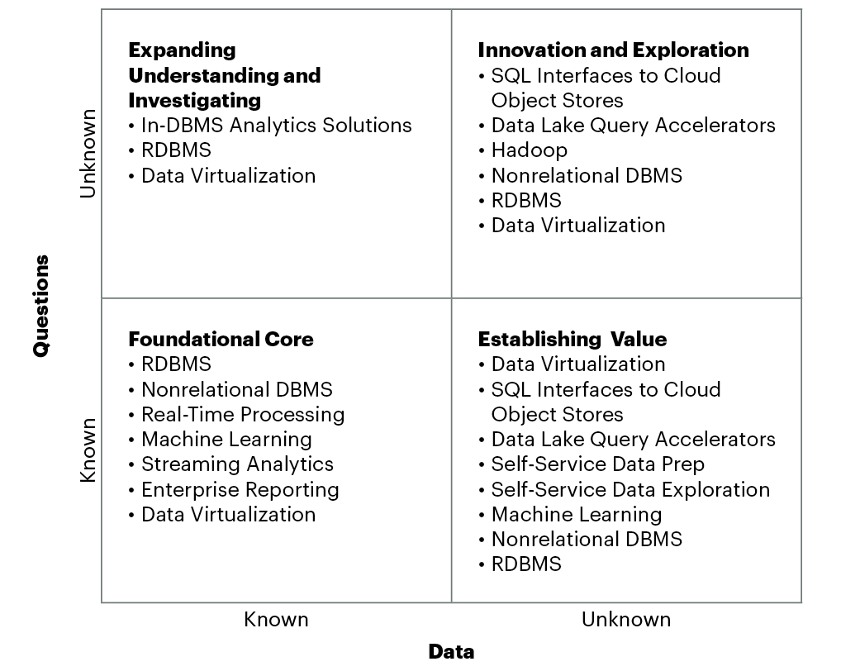
Data and Analytics Infrastructure Model: Technology Options
Notes:
We can use the DAIM to also break this down to a further level of detail and identify specifics technologies used to store and process the data.
Some technologies appear in more than one quadrant, which is fine. What we are looking for is an irreducible superset of component technologies that will provide us with the coverage we need.
This enables us to assemble a system that has all the essential components we need, but no more. A technology may appear in the new LDW system but it is then reused over and over again. This way the whole workload can be covered, but we do not see the kind of uncontrolled sprawl that we saw in the past. That sprawl would consist of many data marts each holding sets of overlapping and often redundant data. That unconstrained system design used to result in redundant processing and many different versions of the data which resulted in uncertainty as to which data was correct and up to date and therefore which figures that were produced were the accurate ones. This in turn made it difficult to determine whether a data mart could be reused — and therefore the easiest way to implement the new requirement was to implement a new data mart! A major objective of the LDW is to maximise the reuse of data and of technology.
In the old systems this proliferation was not only less efficient in providing information it created a whole separate additional problem — reconciling the results of all the reporting and query outputs from those different systems!
Using the DAIM model in the way above provides a quick and easy way to assemble a superset of technology needed to cover all the quadrants. Some technologies appear in more than one quadrant, but it only needs to be built into the final LDW architecture once.

Slide 29
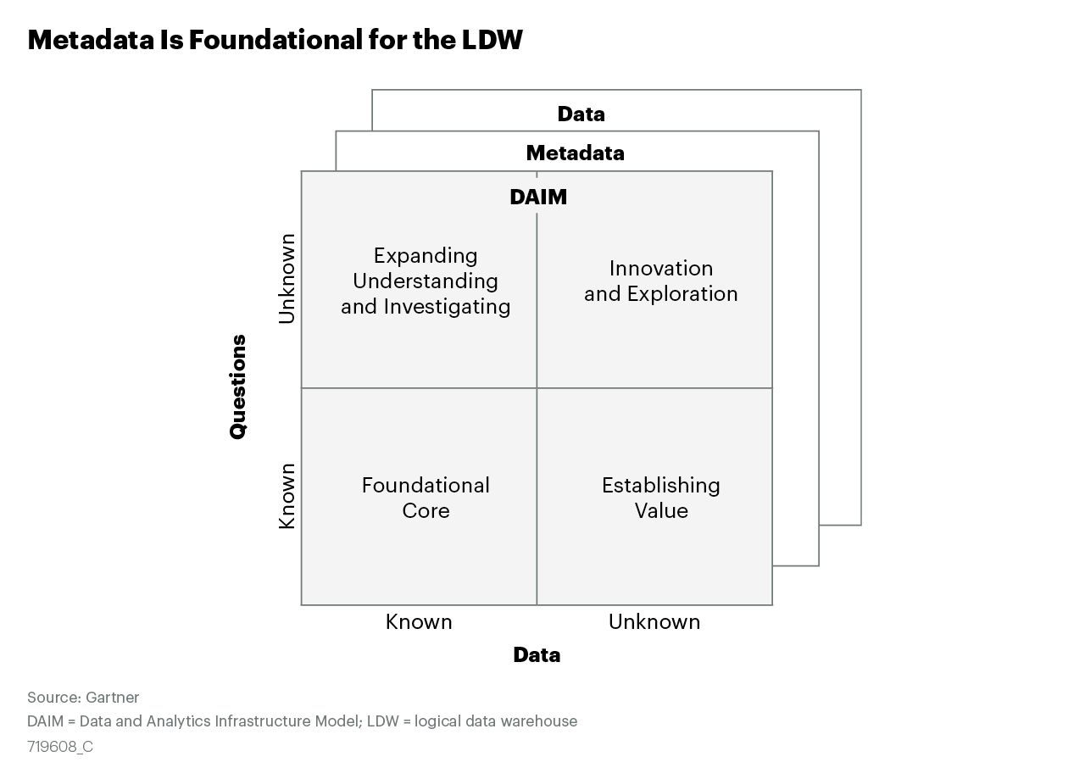
Metadata is Foundational for the LDW
Notes:
The DAIM provides a level of abstraction at a high level, it is supported by the actual data being held in the system, and that in turn is described by a layer of metadata.
This enables users and designers to understand what data is available, what can be used for what purpose, where to find it, how to access it and other essential questions for the design, maintenance and running of the system.
In practice the data and metadata is distributed across the small number of servers making up the LDW and these servers are synchronized and coordinate their processing, data and metadata to a common purpose.
This enables the original objective of the data warehouse the “single version of the truth” to still be met, but with a logical integration between physical servers rather than having to rely on physical consolidation within a single server.

