Slide 1
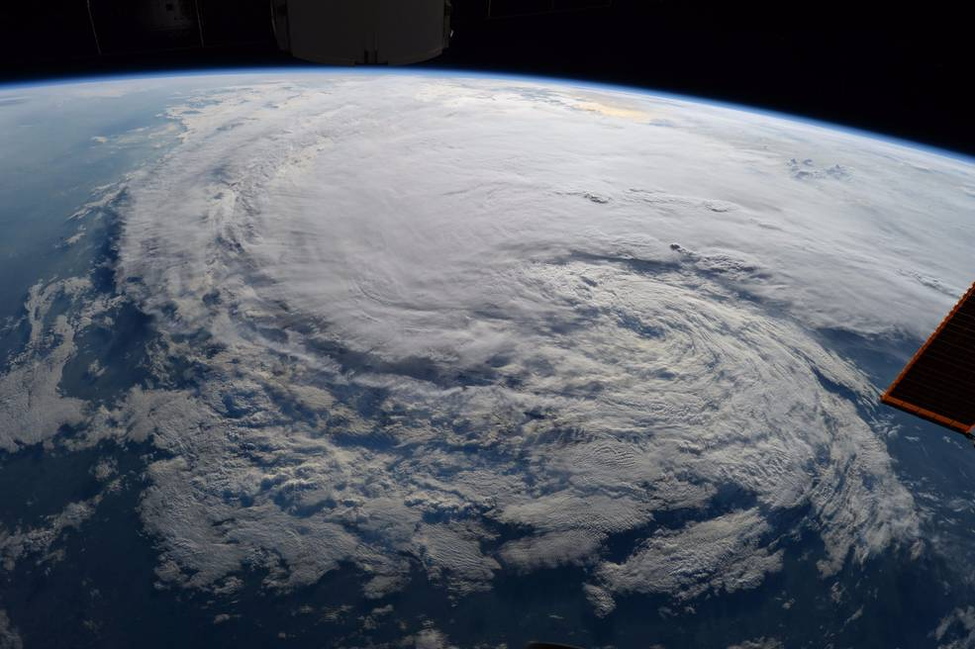
GLOBAL WARMING – ARE WE READY?
Courtesy of NASA; photo taken by Astronaut Randy Bresnik on ISS - Tropical Storm Harvey

Slide 2
Introduction
Team Member:
Sarah Sutar
O.J. Ndebbio
Henry Le
Agenda:
Intro & Topic Discover 01 min H. Le
50-yrs Hurricane Review 02 min H. Le
50-yrs Tropical Storm 02 min H. Le
Notes:
Include the name of the Project and Group Members

Slide 3
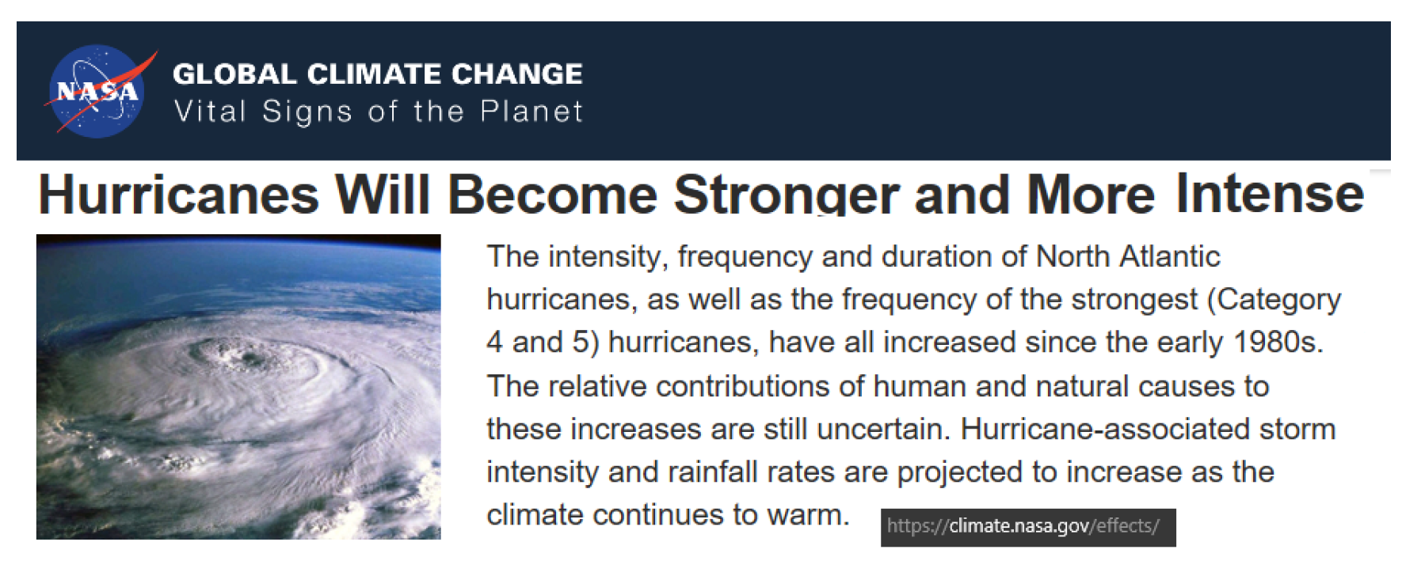
Topic Discover
???
Notes:
Hypothesis: Is it true that hurricane is stronger and more intense and increasing in frequency?
What is the trend of number of hurricanes in the past 25-50 years, or may be more?
How often do we see catastrophic hurricane (Cat 3, 4, 5 )?
Are all tropical storms become hurricanes?
Where are all the hurricanes on the map? Any trend of a certain concentrated region?
To validate by data and hard evidence the claim from NASA about hurricane

Slide 4
Data Sourcing, Clean-Up and Exploration
Data Type:
Historical data of hurricanes and tropical storms
Continuously updated for 50+ years
Data Sourcing & Exploration and Clean-up:
NOAA, EPA, Uni. of Colorado, NASA, Kaggle
Drop null values, extract relevant column, covert date to year and month, separate hurricane and tropical storm data, convert coordinates, convert number format.
Techniques: .groupby | .loc | del | matplotlib | gmaps | pandas
Final clean data is exported for team utilization
Notes:
We know for sure, to answer this question, we need to look for historical data of global hurricanes and tropical storms. We have looked through multiple sources including NOAA, NASA, EPA and we finally found on Kaggle 2 csv files of hurricane dated from 1851 to 2015. After inspecting the files, we found both of the csv contains great data for analyzing and answers our questions. We glad that the data we found helps us gain understanding about the real truth behind the claim.

Slide 5
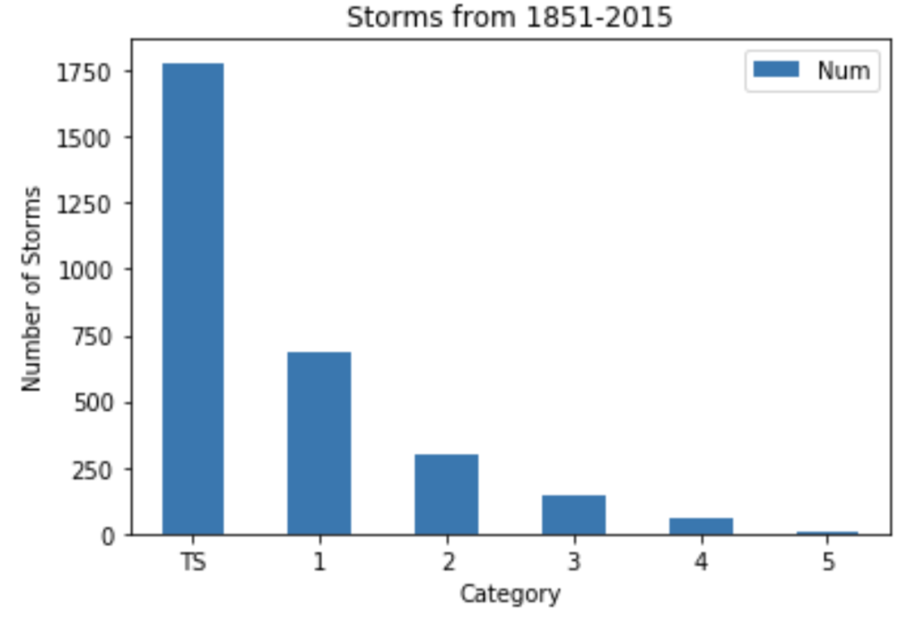
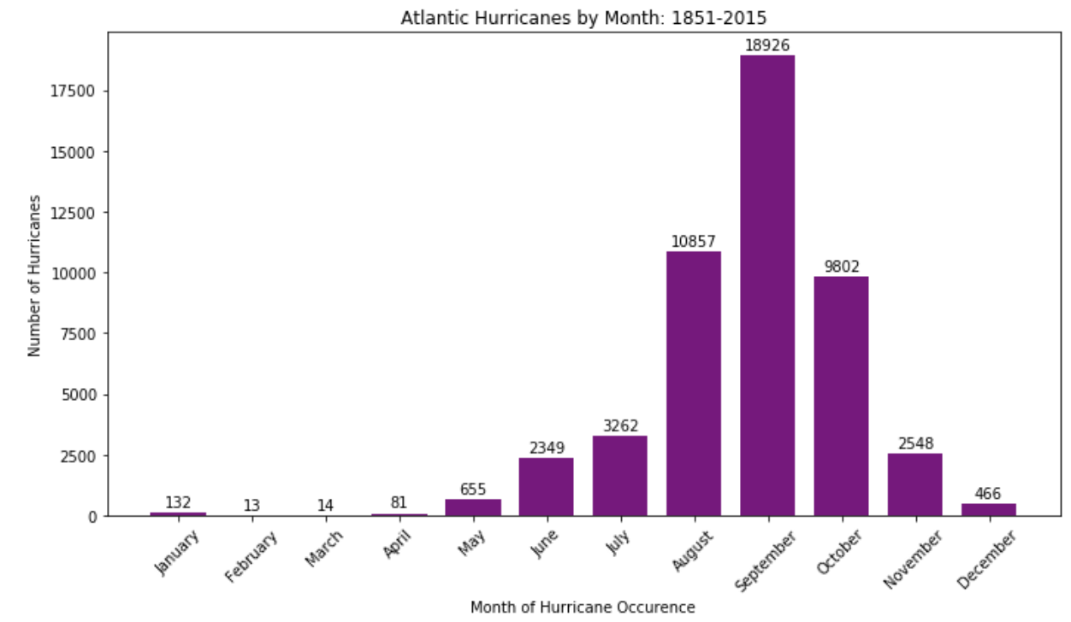
Team Member: Sarah
Describe
Why?
Analysis
Conclusion
Notes:
The question I asked was, “Are hurricanes occurring more or less than tropical storms and if so which category is it occurring in the most?” Firstly, to even become a category it has to be wind speeds greater than 73 miles per hour. Therefore, under TS which stands for tropical storms all the storms below 74 miles per hour were filtered into.
The reason I asked this question was to see if global warming was related directly to the number of tropical storms or hurricanes occurring and through this data I saw that it can possibly be because of the number of Tropical storms because there is a big gap between the number of times they occurred. In addition, it was interesting to see that each category occurring decreased as the category increased.
This visual brought me to my next visual’s question about if TS are filtered out then just looking at categories 1 to 5, in which month is it occurring the most from 1851 to 2015? The reason I wanted to investigate this question was to see if hurricanes have been affected equally throughout entering the months from May to October due to an increase of global warming or has it created a bell curve? Results showed that a bell curve occurred and that the hurricanes weren’t just equally distributed throughout May to October and that there was a gradual increase and decrease from 1851 to 2015 instead of a number gap with no pattern. For example, a difference of about 8,000 hurricanes on the right and left months of the peak month. If I saw a pattern which was not creating a bell curve then I would think that global warming is throwing the hurricanes off through out the months which would have gradually created an equality of hurricanes through the months by an increase number of hurricanes in May, June, July, October, and November by 2015 which it didn’t.
Why month was hurricanes occurring the most? September. Limitation: Although it was September what would be the pattern throughout the board throughout the specific years because then each year has to be plotted by category.

Slide 6
Team Member: OJ
Describe
Why?
Analysis
Conclusion

Slide 7
Team Member: Henry

Slide 8
Summary

Slide 9


