Slide 1
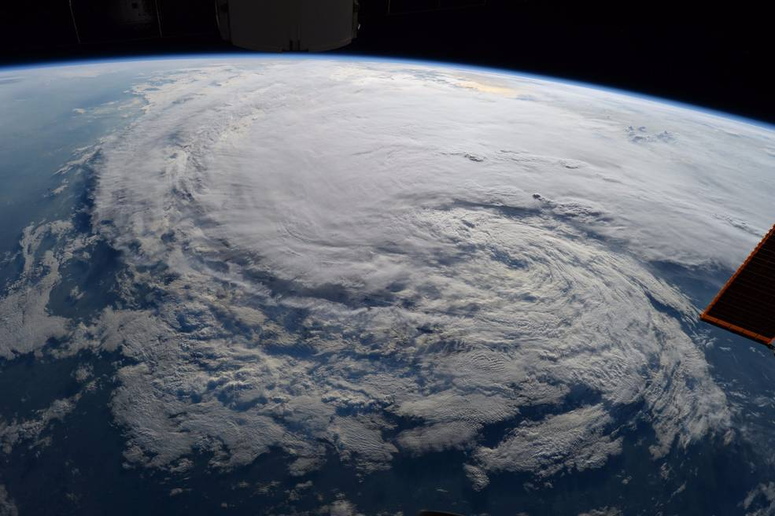
GLOBAL WARMING – ARE WE READY?
Courtesy of NASA; photo taken by Astronaut Randy Bresnik on ISS – Hurricane Harvey
Notes:
This beautiful picture is captured from ISS of Harvey which destroyed Houston not long ago. The topic we would like to talk about today is Global Warming which lots of people believe is the main cause of hurricanes.

Slide 2
Introduction
Team Member:
Sarah Sutar
O.J. Ndebbio
Henry Le
Agenda:
Intro & Topic Discover (# 1, 2, 3) 01 min H. Le / S. Sutar
Data Sourcing, Clean-Up and Exploration (#4) 01 min O.J. Ndebbio
200yrs/50yrs/Yearly Storms (#5,6) 02 min S. Sutar
Storm Frequency (#7) 02 min O.J. Ndebbio
Category 3, 4, 5 Hurricanes | Storm Trackers (#8, 9) 02 min H. Le
Challenges | Limitations (#10) 01 min H. Le
Summary (#11) 01 min H. Le
Q&A (#12) 05 min Team 4
Notes:
Include the name of the Project and Group Members

Slide 3
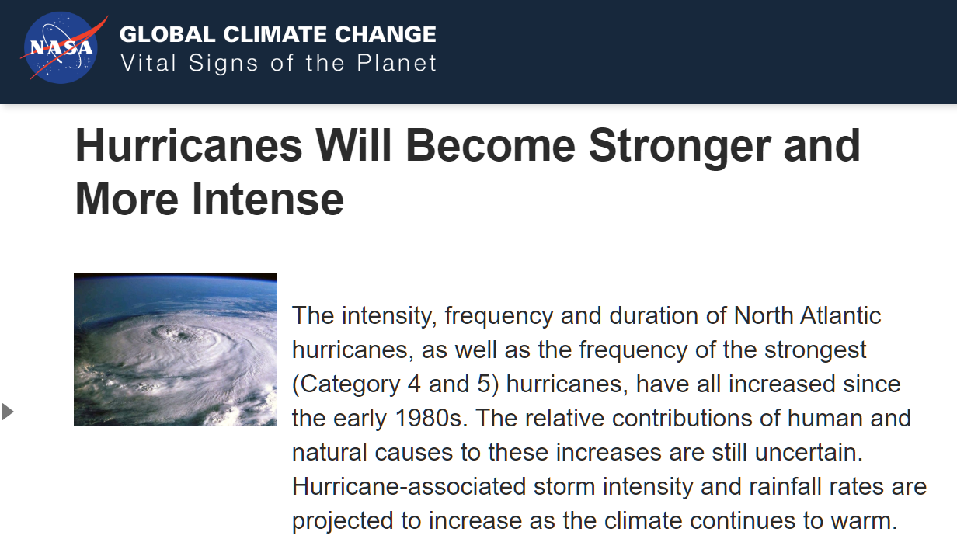
Topic Discover
<https://climate.nasa.gov/effects/>
???
Notes:
Hypothesis: Is it true that hurricane is stronger, more intense and increasing in frequency?
To validate by data and hard evidence the claim from NASA about hurricane

Slide 4
Data Sourcing, Clean-Up and Exploration
Data Type:
Historical data of hurricanes and tropical storms
Continuously updated for 50+ years
Data Sourcing & Exploration and Clean-up:
NOAA, EPA, Uni. of Colorado, NASA, Kaggle
Techniques: .groupby | .loc | del | matplotlib | gmaps | pandas | etc.
Drop null values, extract relevant column, covert date to year and month, separate hurricane and tropical storm data, convert coordinates, convert number format.
Split Dataset into Hurricanes and Tropical Storms
Final clean data is exported for team utilization
Notes:
For this project we know that we need historical data of all hurricanes and trop storms, and the database has to have to be at least > 50 years span to see any significant trend.
We have looked through multiple sources including NOAA, NASA, EPA and we finally found on Kaggle 2 csv files of hurricane dated from 1851 to 2015. After inspecting the files, we found both of the csv contains great data for analyzing and answers our questions. We glad that the data we found helps us gain understanding about the real truth behind the claim.

Slide 5
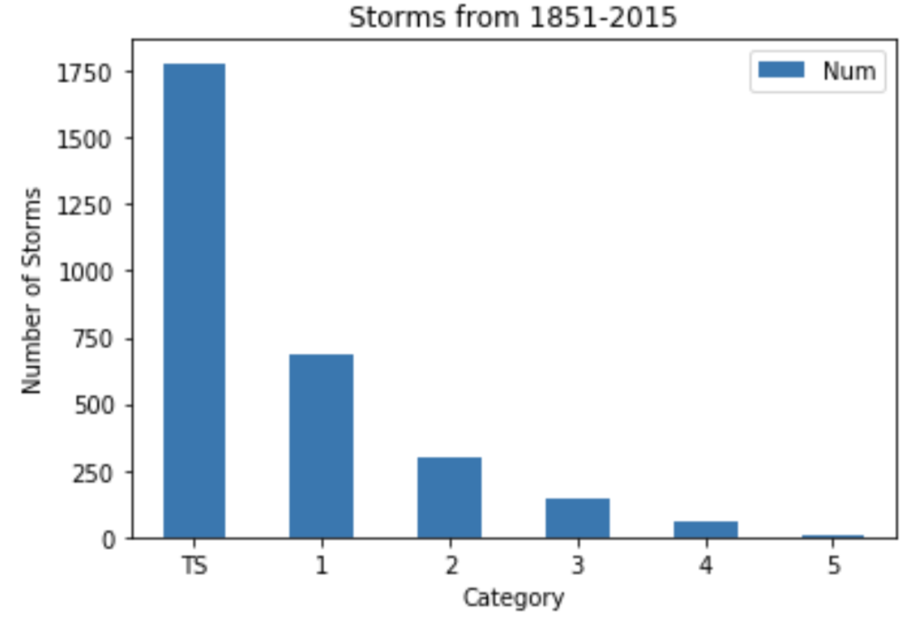
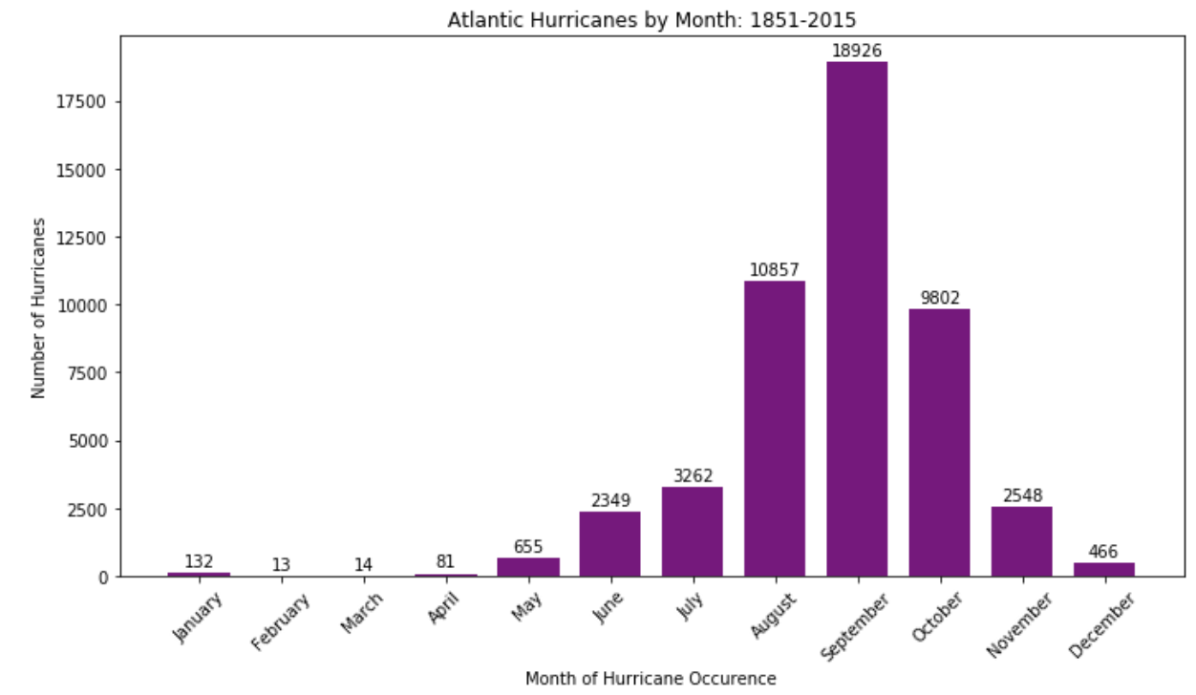
Team Member: Sarah
Questions to Answer
Why These Questions?
Data Analytics
Conclusion
Notes:
The question I asked was, “Are hurricanes occurring more or less than tropical storms and if so which category is it occurring in the most?” Firstly, to even become a category it has to be wind speeds greater than 73 miles per hour. Therefore, under TS which stands for tropical storms all the storms below 74 miles per hour were filtered into.
The reason I asked this question was to see if global warming was related directly to the number of tropical storms or hurricanes occurring and through this data I saw that it can possibly be because of the number of Tropical storms because there is a big gap between the number of times they occurred. In addition, it was interesting to see that each category occurring decreased as the category increased.
This visual brought me to my next visual’s question about if TS are filtered out then just looking at categories 1 to 5, in which month is it occurring the most from 1851 to 2015? The reason I wanted to investigate this question was to see if hurricanes have been affected equally throughout entering the months from May to October due to an increase of global warming or has it created a bell curve? Results showed that a bell curve occurred and that the hurricanes weren’t just equally distributed throughout May to October and that there was a gradual increase and decrease from 1851 to 2015 instead of a number gap with no pattern. For example, a difference of about 8,000 hurricanes on the right and left months of the peak month.
What month was hurricanes occurring the most? September. Limitation: Although it was September what would be the pattern throughout the board throughout the specific years because then each year has to be plotted by category.

Slide 6
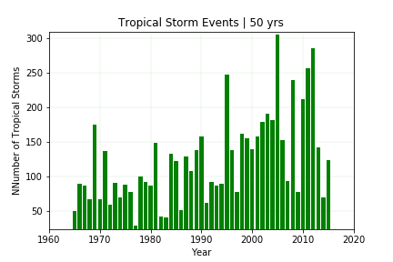
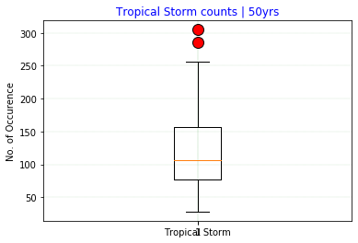
Team Member: Sarah / Henry
Notes:
The question I asked was, “Are hurricanes occurring more or less than tropical storms and if so which category is it occurring in the most?” Firstly, to even become a category it has to be wind speeds greater than 73 miles per hour. Therefore, under TS which stands for tropical storms all the storms below 74 miles per hour were filtered into.
The reason I asked this question was to see if global warming was related directly to the number of tropical storms or hurricanes occurring and through this data I saw that it can possibly be because of the number of Tropical storms because there is a big gap between the number of times they occurred. In addition, it was interesting to see that each category occurring decreased as the category increased.
This visual brought me to my next visual’s question about if TS are filtered out then just looking at categories 1 to 5, in which month is it occurring the most from 1851 to 2015? The reason I wanted to investigate this question was to see if hurricanes have been affected equally throughout entering the months from May to October due to an increase of global warming or has it created a bell curve? Results showed that a bell curve occurred and that the hurricanes weren’t just equally distributed throughout May to October and that there was a gradual increase and decrease from 1851 to 2015 instead of a number gap with no pattern. For example, a difference of about 8,000 hurricanes on the right and left months of the peak month. If I saw a pattern which was not creating a bell curve then I would think that global warming is throwing the hurricanes off through out the months which would have gradually created an equality of hurricanes through the months by an increase number of hurricanes in May, June, July, October, and November by 2015 which it didn’t.
What month was hurricanes occurring the most? September. Limitation: Although it was September what would be the pattern throughout the board throughout the specific years because then each year has to be plotted by category.

Slide 7
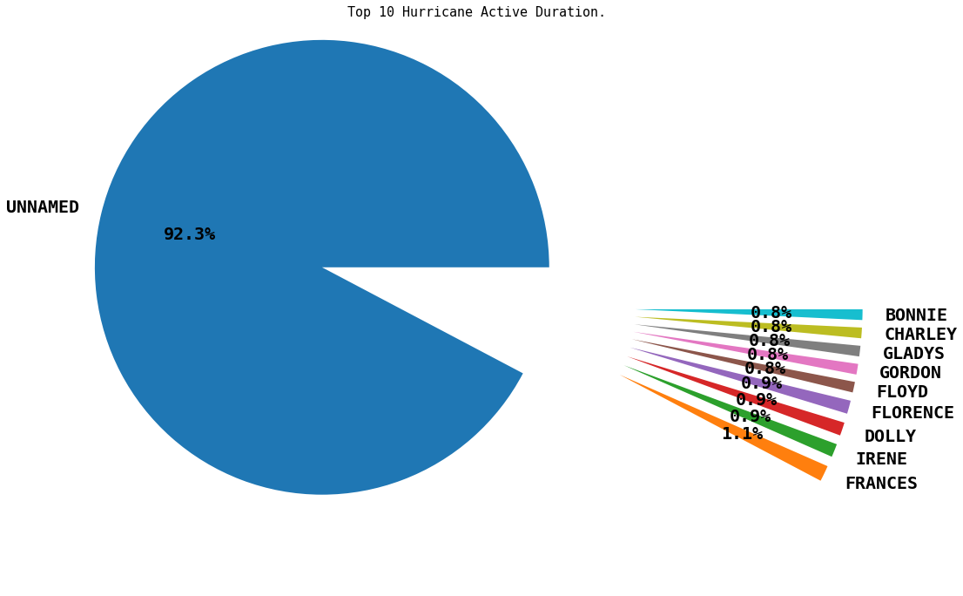
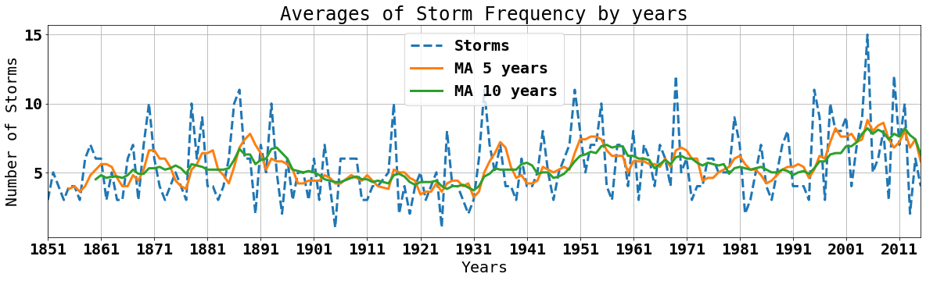
Team Member: O.J.
Questions to Answer
Why These Questions?
Data Analytics
Conclusion
MA : Moving Average
Notes:
PACMAN Pie Plot tries to eat pizzas
Analysis: Plot A
-After cleaning up the data and doing the necessary groupings for the analysis, a pie plot was created to show the 10 top hurricanes that occurred during the time interval. 92% of the storm was unnamed and 8% represented the 10 top hurricane hits.
-
Plot B (Periodic hurricane intervals)
-The second plot shows the average storm hits yearly. An average of 10 storms occurs during each hurricane season looking at the plot.
-The plot also shows a slight increase in the occurrence & severity of storms over the decades.
-It could also be said that with the slight spike in hurricane activities, this could be as a result of multi-decadal oscillation patterns in the north Atlantic ocean.
-Conclusion:
-From the analysis above, it's still uncertain to say if climate change is the cause for the increase in occurrence & severity of storms.
-A more comprehensive analysis taking all other causes and effects would validate the concept of global warming.

Slide 8
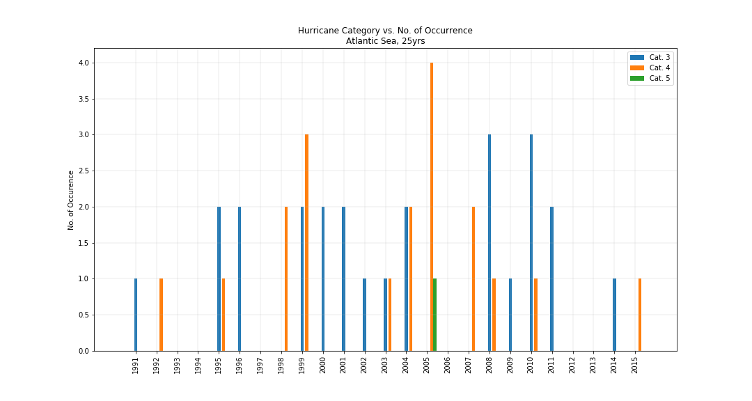
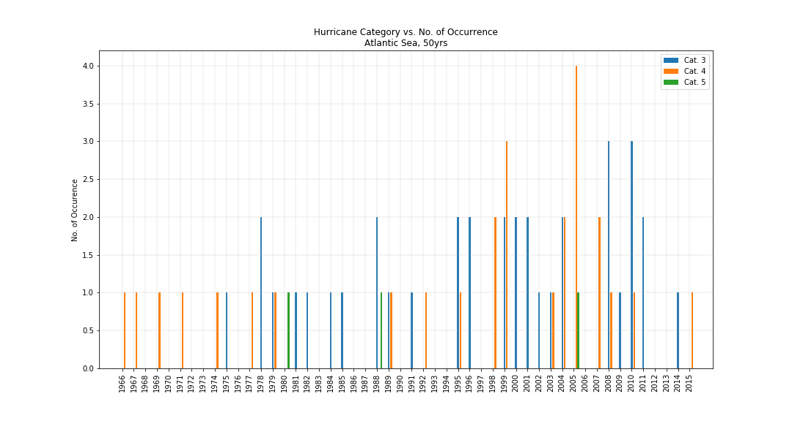
Team Member: Henry
Questions to Answer
Why These Questions?
Data Analytics
Conclusion
Notes:
What is the trend of number of hurricanes in the past 25-50 years, or may be more?
How often do we see catastrophic hurricane (Cat 3, 4, 5 )?
Where are all the hurricanes on the map? Any trend of a certain concentrated region?
Why: tendency of increasing as per claim

Slide 9
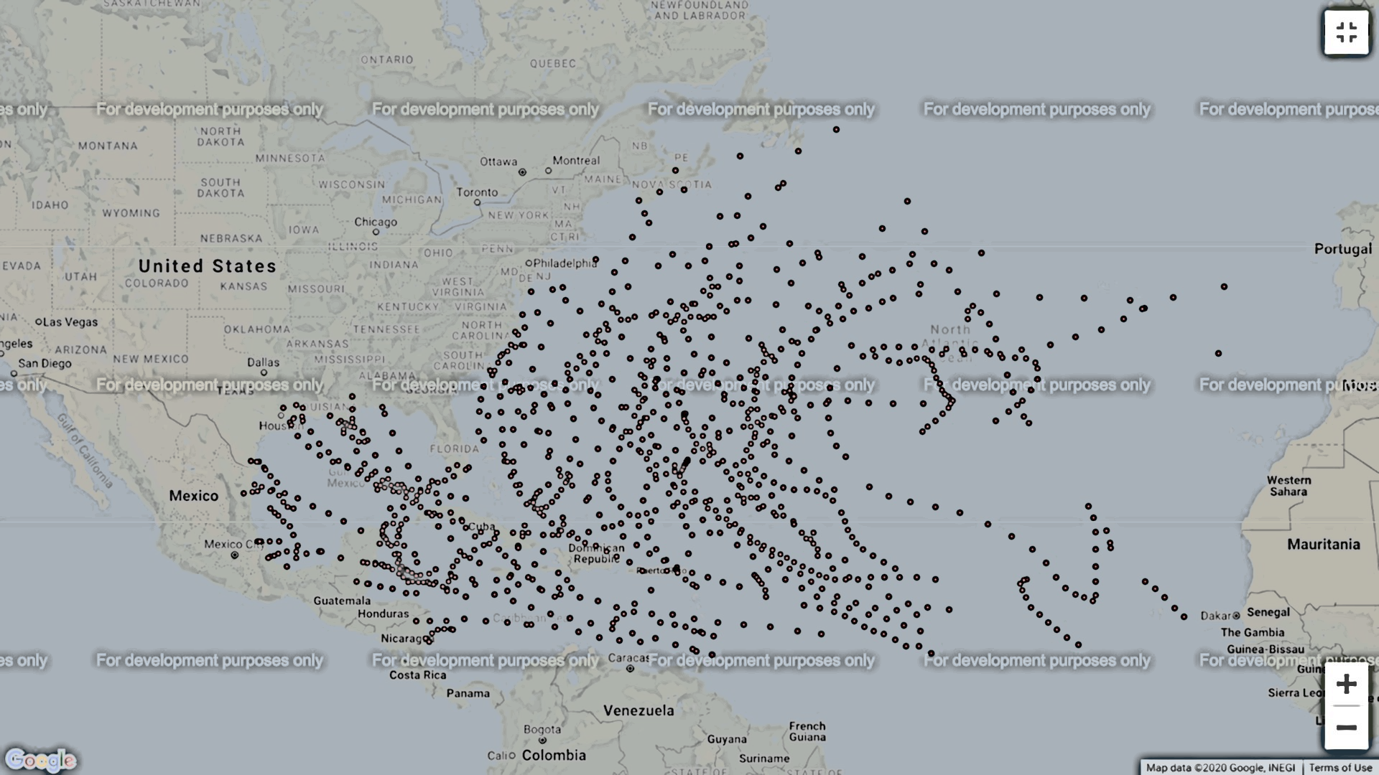
Team Member: Henry
Notes:
What is the trend of number of hurricanes in the past 25-50 years, or may be more?
How often do we see catastrophic hurricane (Cat 3, 4, 5 )?
Where are all the hurricanes on the map? Any trend of a certain concentrated region?

Slide 10
Challenges
Date format: year, month, date was combined into one string; no separator
Coordinates were in different format: **N, **W
Multiple indexes data frame encountered
Watermarks on Gmaps
Limitations
Does it include every storm/ hurricane that actually occurred?
200yrs dataset

Slide 11
Summary (Atlantic)
Increasing Trend of Tropical Storm Occurrence observed
No clear trend of Hurricane getting more stronger/ intense over time
~50% Hurricanes and ~50% Tropical Storms (200yrs period)
Average 105 Tropical Storms per years
2005 was a very active year of hurricanes including Katrina and Rita
What else:
Pacific Analysis
Factors affect Hurricane besides Global Warming
Expand Dataset into millennium: Has it been like this even before industrial revolution?
Analyze hurricane energy for better resolution of hurricane severity

Slide 12
THANK YOU! Q&A

Slide 13


