Slide 1
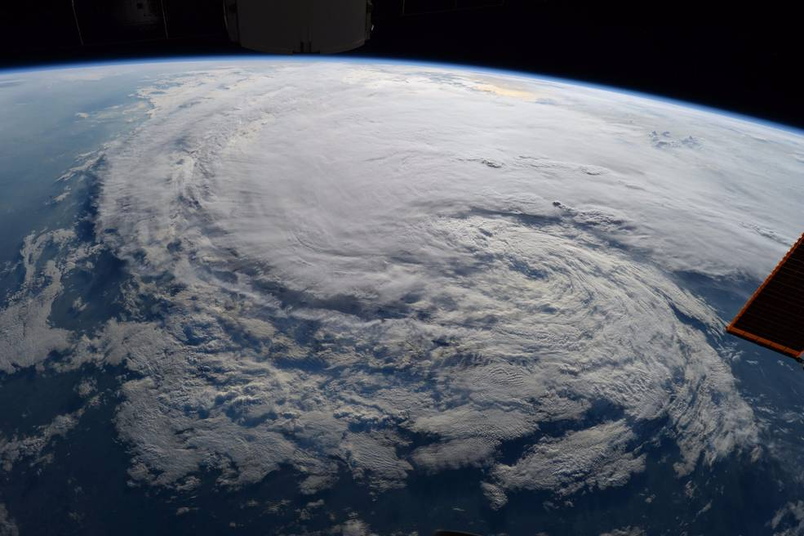
GLOBAL WARMING – ARE WE READY?
Courtesy of NASA; photo taken by Astronaut Randy Bresnik on ISS - Tropical Storm Harvey

Slide 2
Introduction
Team Member:
Sarah Sutar
O.J. Ndebbio
Henry Le
Agenda:
Intro & Topic Discover 01 min H. Le
50-yrs Hurricane Review 02 min H. Le
50-yrs Tropical Storm 02 min H. Le
Notes:
Include the name of the Project and Group Members

Slide 3
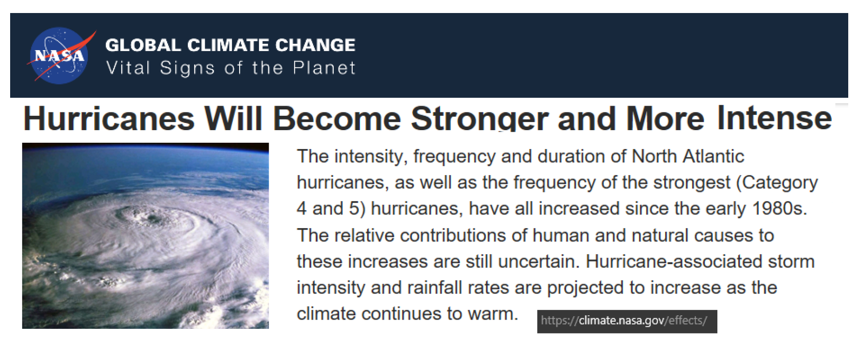
Topic Discover
???
Notes:
Hypothesis: Is it true that hurricane is stronger and more intense and increasing in frequency?
What is the trend of number of hurricanes in the past 25-50 years, or may be more?
How often do we see catastrophic hurricane (Cat 3, 4, 5 )?
Are all tropical storms become hurricanes?
Where are all the hurricanes on the map? Any trend of a certain concentrated region?
To validate by data and hard evidence the claim from NASA about hurricane

Slide 4
Data Sourcing, Clean-Up and Exploration
Data Type:
Historical data of hurricanes and tropical storms
Continuously updated for 50+ years
Data Sourcing & Exploration and Clean-up:
NOAA, EPA, Uni. of Colorado, NASA, Kaggle
Drop null values, extract relevant column, covert date to year and month, separate hurricane and tropical storm data, convert coordinates, convert number format.
Techniques: .groupby | .loc | del | matplotlib | gmaps |pandas
Final clean data is exported for team ultilization
Notes:
We know for sure, to answer this question, we need to look for historical data of global hurricanes and tropical storms. We have looked through multiple sources including NOAA, NASA, EPA and we finally found on Kaggle 2 csv files of hurricane dated from 1851 to 2015. After inspecting the files, we found both of the csv contains great data for analyzing and answers our questions. We glad that the data we found helps us gain understanding about the real truth behind the claim.

Slide 5
