Slide 1
News Alerts Tool Weekly Touchpoint 1
Henry Quillin

Slide 2



Develop a prototype for a news alerting tool that notifies users of recent significant events related to their portfolio companies
Objective

Slide 3

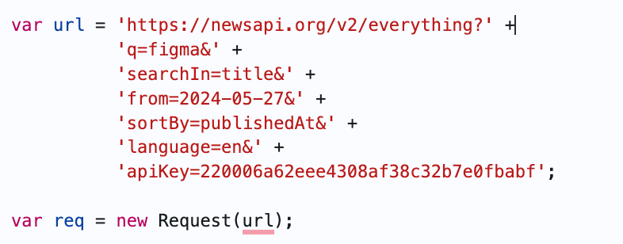
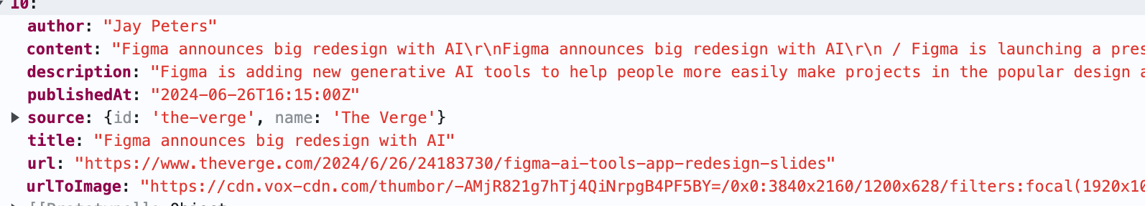
Data Source:

Slide 4
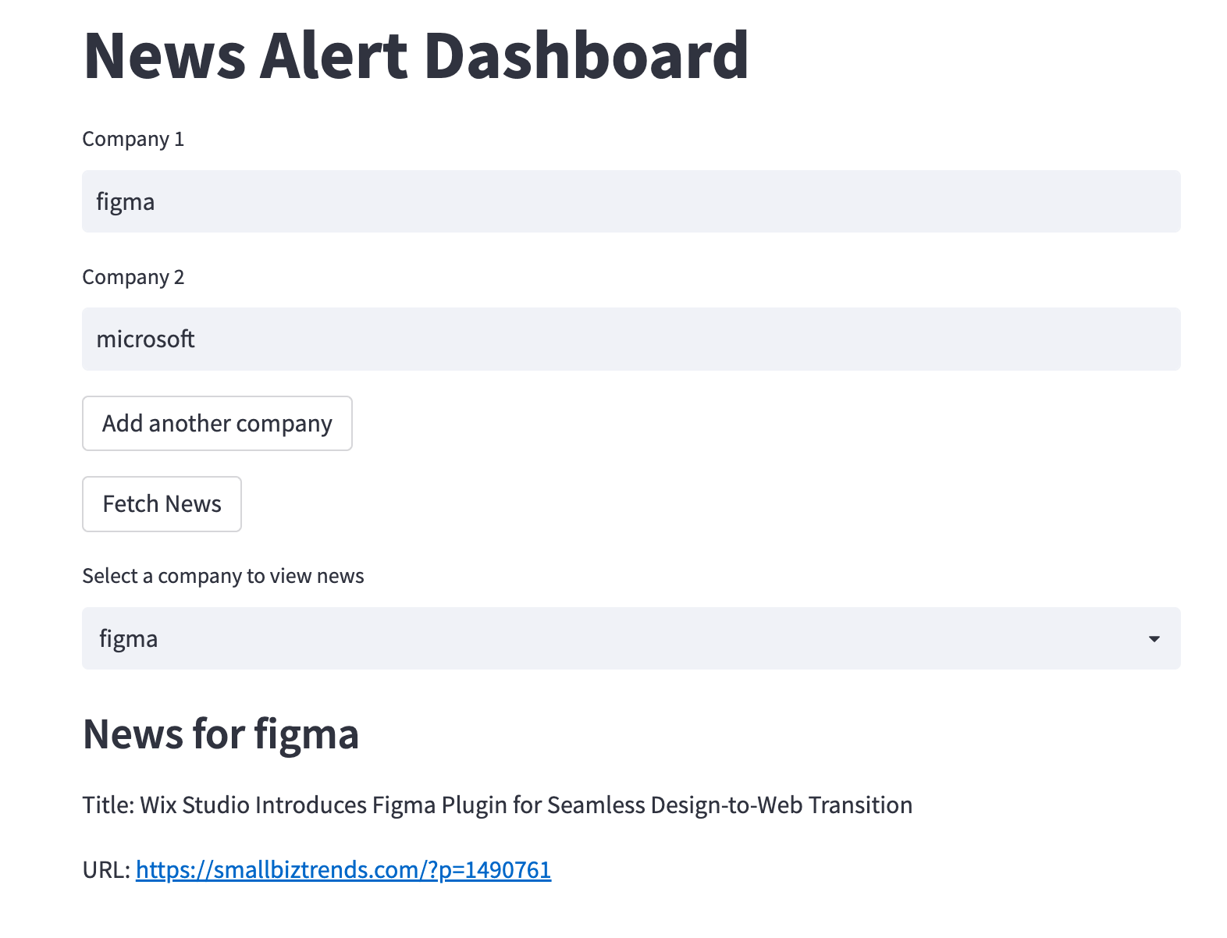
Progress
Input fields for company names
"Add another company" button for expanding the watchlist
"Fetch News" button to retrieve and display news
Dropdown menu for selecting a company to view its news
Session state: maintains user input and state across refreshes and reruns

Slide 5
Next Steps

