Slide 1
NewsNudge
Henry Quillin

Slide 2



About Me
The University of Texas at Austin (May 2026)
Computer Science and Business Honors
Software Engineer Intern
GCB Tech — Data Science
Manager — Deanna Tufano

Slide 3
Overview
Project Motivation
Solution
Data
Architecture
Duplicate detection
Demo
Next Steps
Key Takeaways
Q & A

Slide 4
Project Motivation
Current challenges with news tracking:
Our bankers must seek out news themselves
Information overload
Time sensitivity: Delayed reaction to important news can be costly
Inefficient use of time in manual news monitoring
Expected Outcomes:
Increased efficiency in monitoring portfolio companies
Improved decision making through timely access to important news
Improved advisory for clients
Target Users: GCB and BB Bankers
Notes:
Let's dive into the motivation behind this project. Our primary users are Bank of America GCB and BB Bankers - professionals who rely heavily on recent news to make critical decisions.
They typically have a set of covered companies, which are usually current or prospective clients, that they need to track and stay on top of.
The main issue is that our bankers must seek out news themselves. They’re not being notified when important news comes out, and there’s nothing that’s providing them content. They need to search for it on their own.
Even if they are diligent with their news consumption, there’s just so much news out there. Tracking it all is like drinking from a firehose.
We’re also dealing with extreme time sensitivity. In the financial world, a delayed reaction to important news can be incredibly costly.
Lastly, we're seeing an inefficient use of our bankers' time. We don’t want them to be spending hours each day manually monitoring news, especially if this is something that can be automated.
Now, let's talk about what the expected outcome of this project is:
We expect to see a significant increase in efficiency when it comes to monitoring portfolio companies. This shouldn’t just make it easier for bankers to monitor their covered companies, it should make them better.
We're aiming for improved decision-making. By ensuring timely access to important news, we're empowering our professionals to make well-informed choices quickly.
By automating much of the news monitoring process, we're freeing up valuable time that can be redirected to more complex, high-value tasks
In essence, this project is about empowering our bankers with the right information at the right time, which will no doubt make them better advisors for their clients.

Slide 5
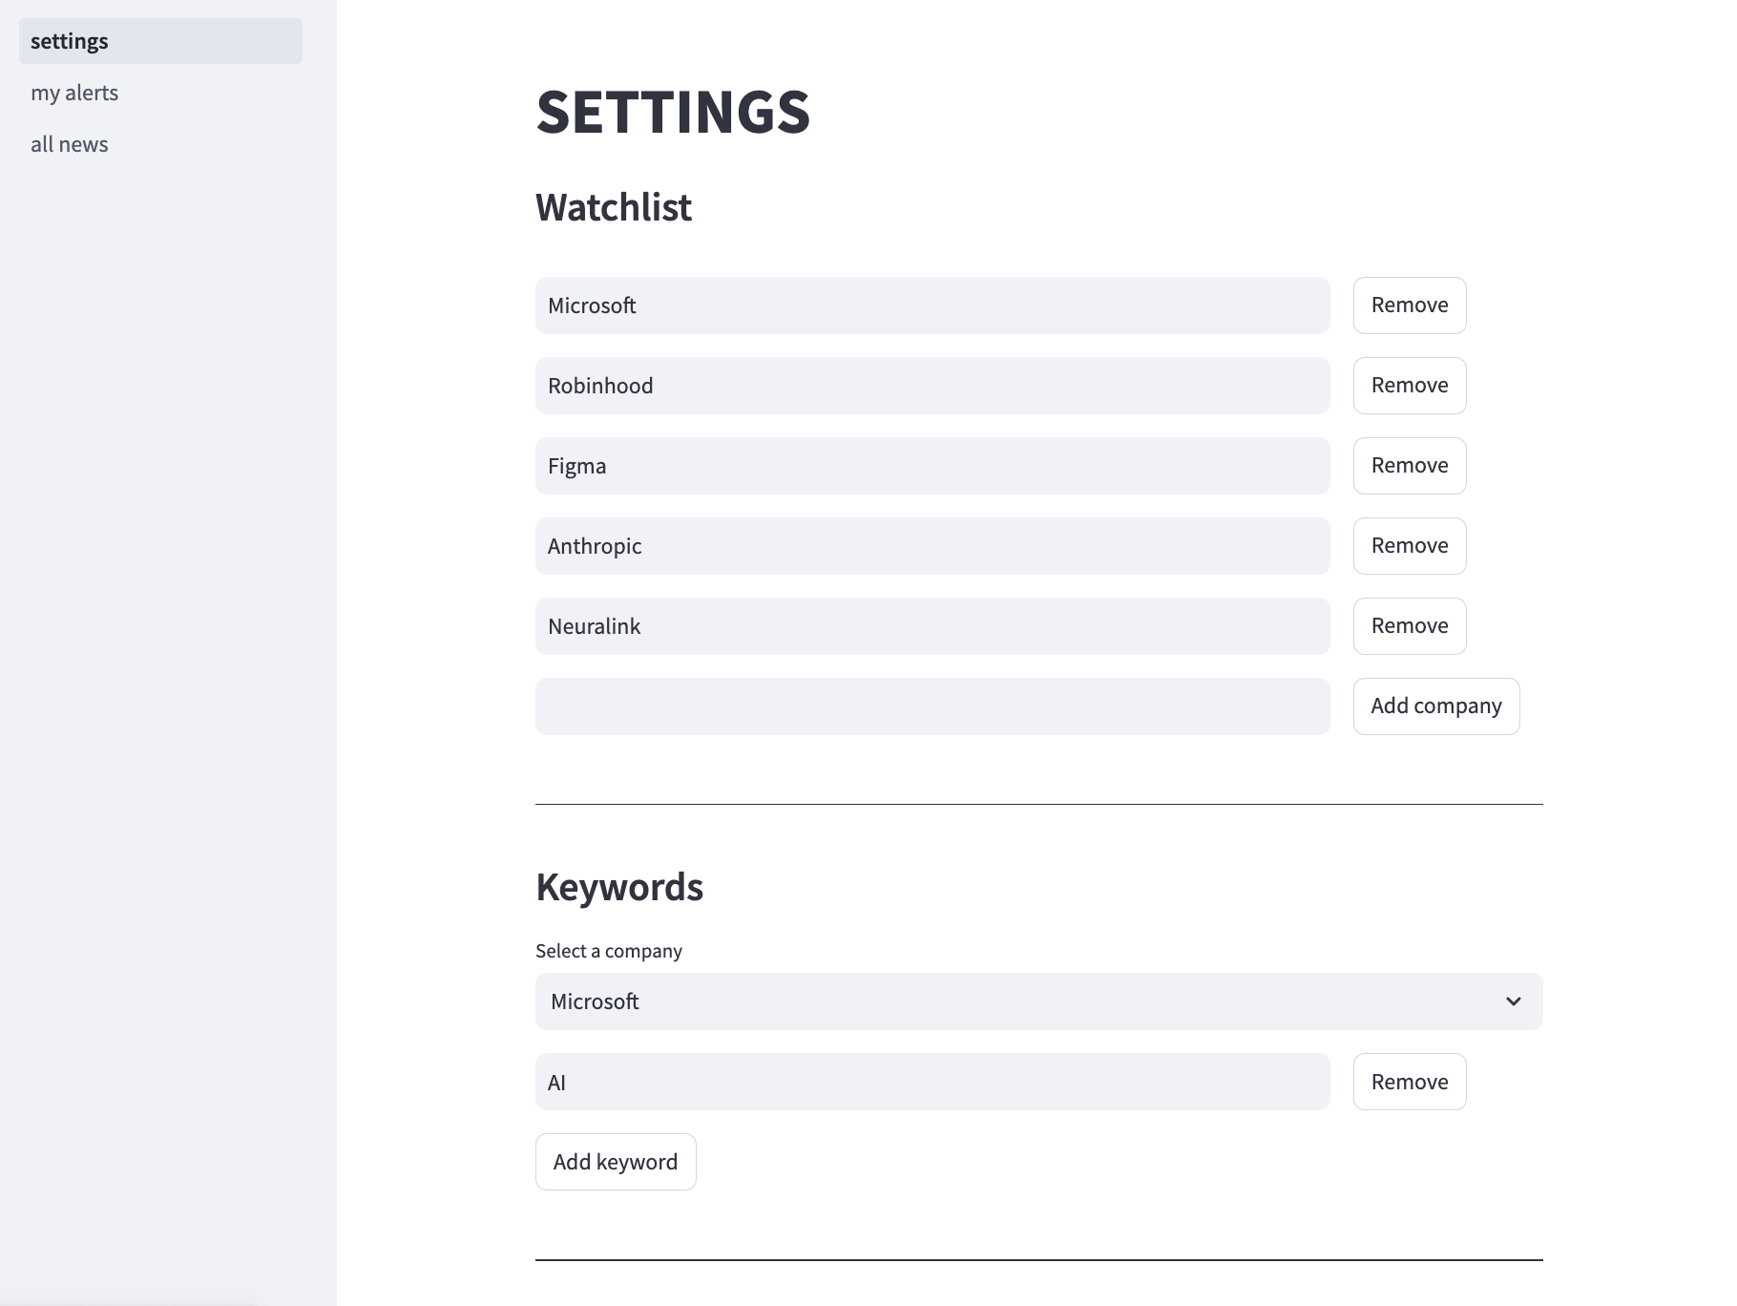
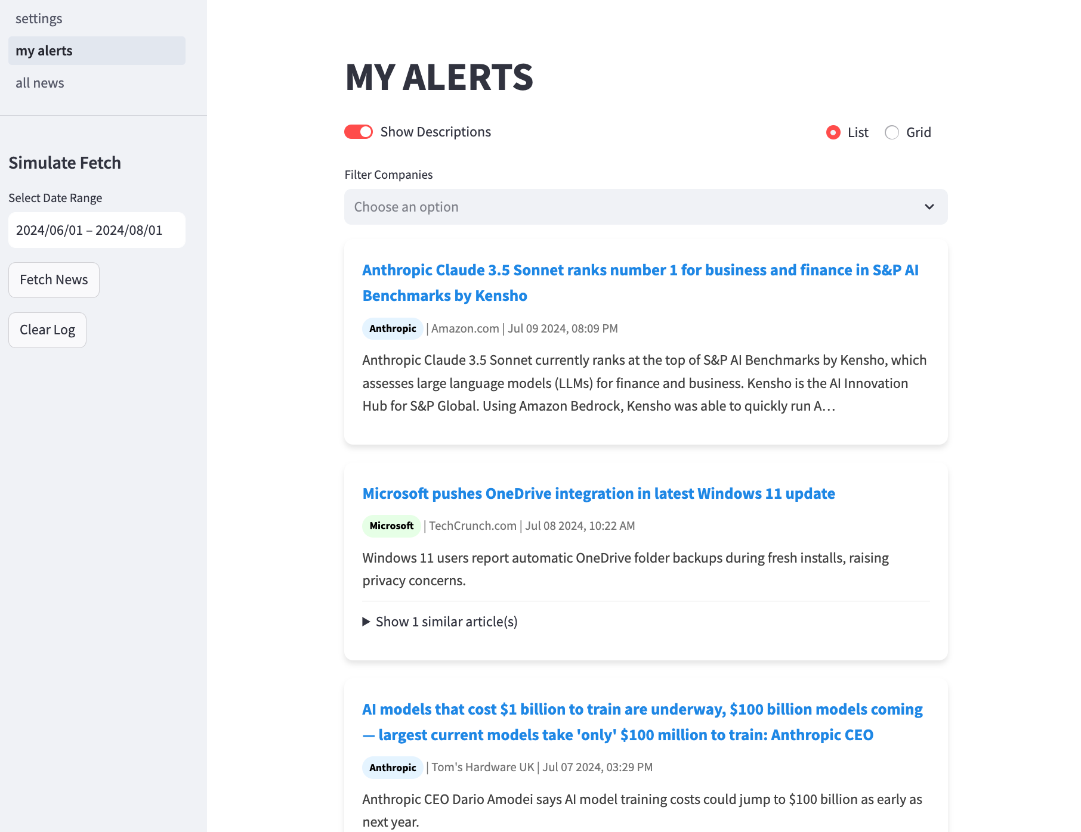
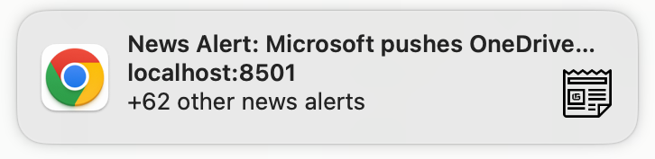
Solution: NewsNudge
Notes:
The solution is NewsNudge, a news alerting tool that notifies users of important news relating to their portfolio companies via popup notifications.
We allow users to create a list of companies they want to track, further refine what news they want to receive via a list of keywords, and see a log of all their past notifications in case they missed anything.
There is also an all news page, for more exploratory – in depth research.
On the left is the settings page. ON this page, users can enter a list of companies they want to track.
They can also add a list of keywords for each company.
So lets say I want to track Microsoft but only get notified about events relating to AI. I can set the keyword AI for Microsoft, and I will only get alerted about news that involves AI.
On the right is my alerts page, which is essentially a log of all the alerts that you have received.
The idea is that the tool will run in the background and look for new news on a recurring basis, like once an hour for example.
However, for demo purposes, I have added a fetch news button that will search for new articles within a certain date range.
The tool also consolidates duplicate articles, since one story is often published by multiple news outlets. I’ll go more into depth on the similar article detection and how it works in a later slide.

Slide 6
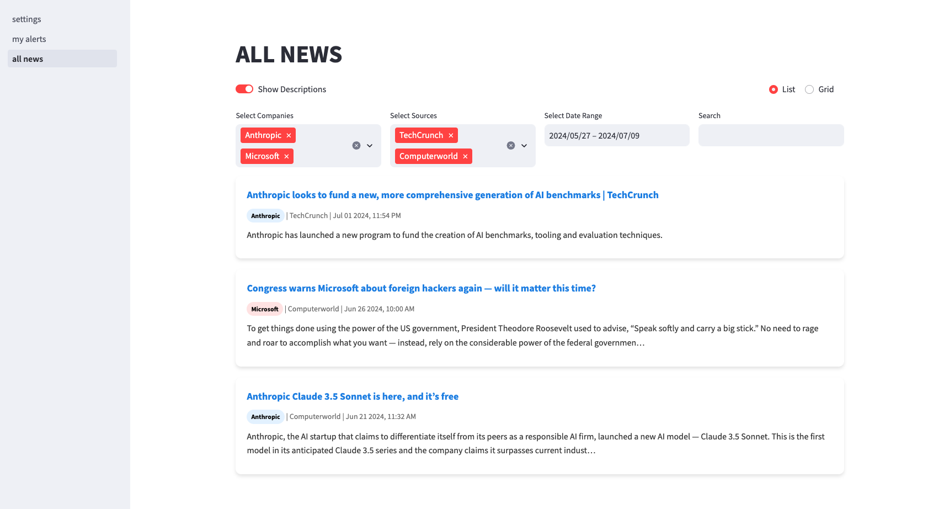
Solution: NewsNudge
Notes:
This is the all news page
It is not affected by what on your watchlist or keyword list.
While the alerts focus on immediate, high-priority news, the All News page allows for more exploratory, in-depth research
An example of where this could be useful is imagine you have tracking a company and you’ve set some very specific keywords for it, but every now and then you want to see the general unfiltered news for that company.
Or imagine you're tracking Apple closely, but want to stay informed about its main competitors.
Or A major event affects multiple companies in your portfolio. You can use the All News page to quickly assess how different companies are responding to the crisis and how it's impacting them.

Slide 7
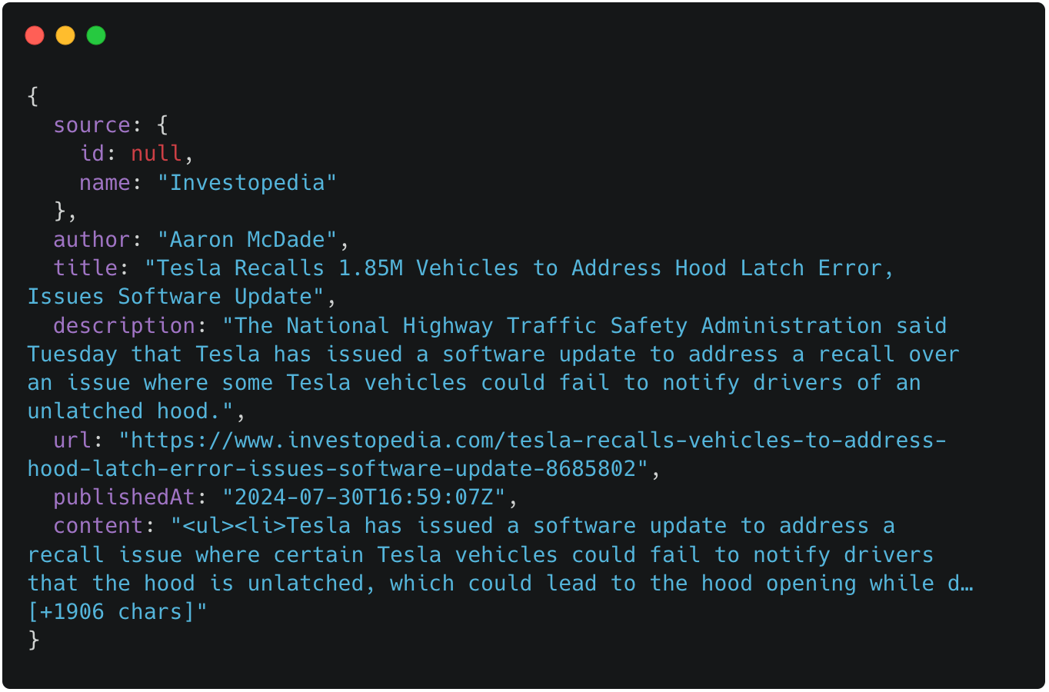
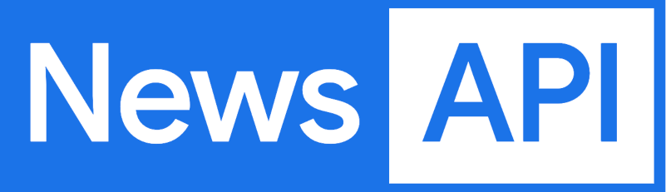
Data
Notes:
I’m using a free public API called News API as my data source
News API provides real-time access to news articles from various sources worldwide
Due to bank restrictions, I’m unable to make direct API calls in my Python code
Solution: Used JavaScript to make API requests in the browsed, and copied the response data directly into my Python code as mock data
The line of business is currently in conversation with Moody’s to sign a contract for their news feed API.
I wanted to use data from a similar API instead of a static data set so we can easily transition to direct API usage in the future.

Slide 8
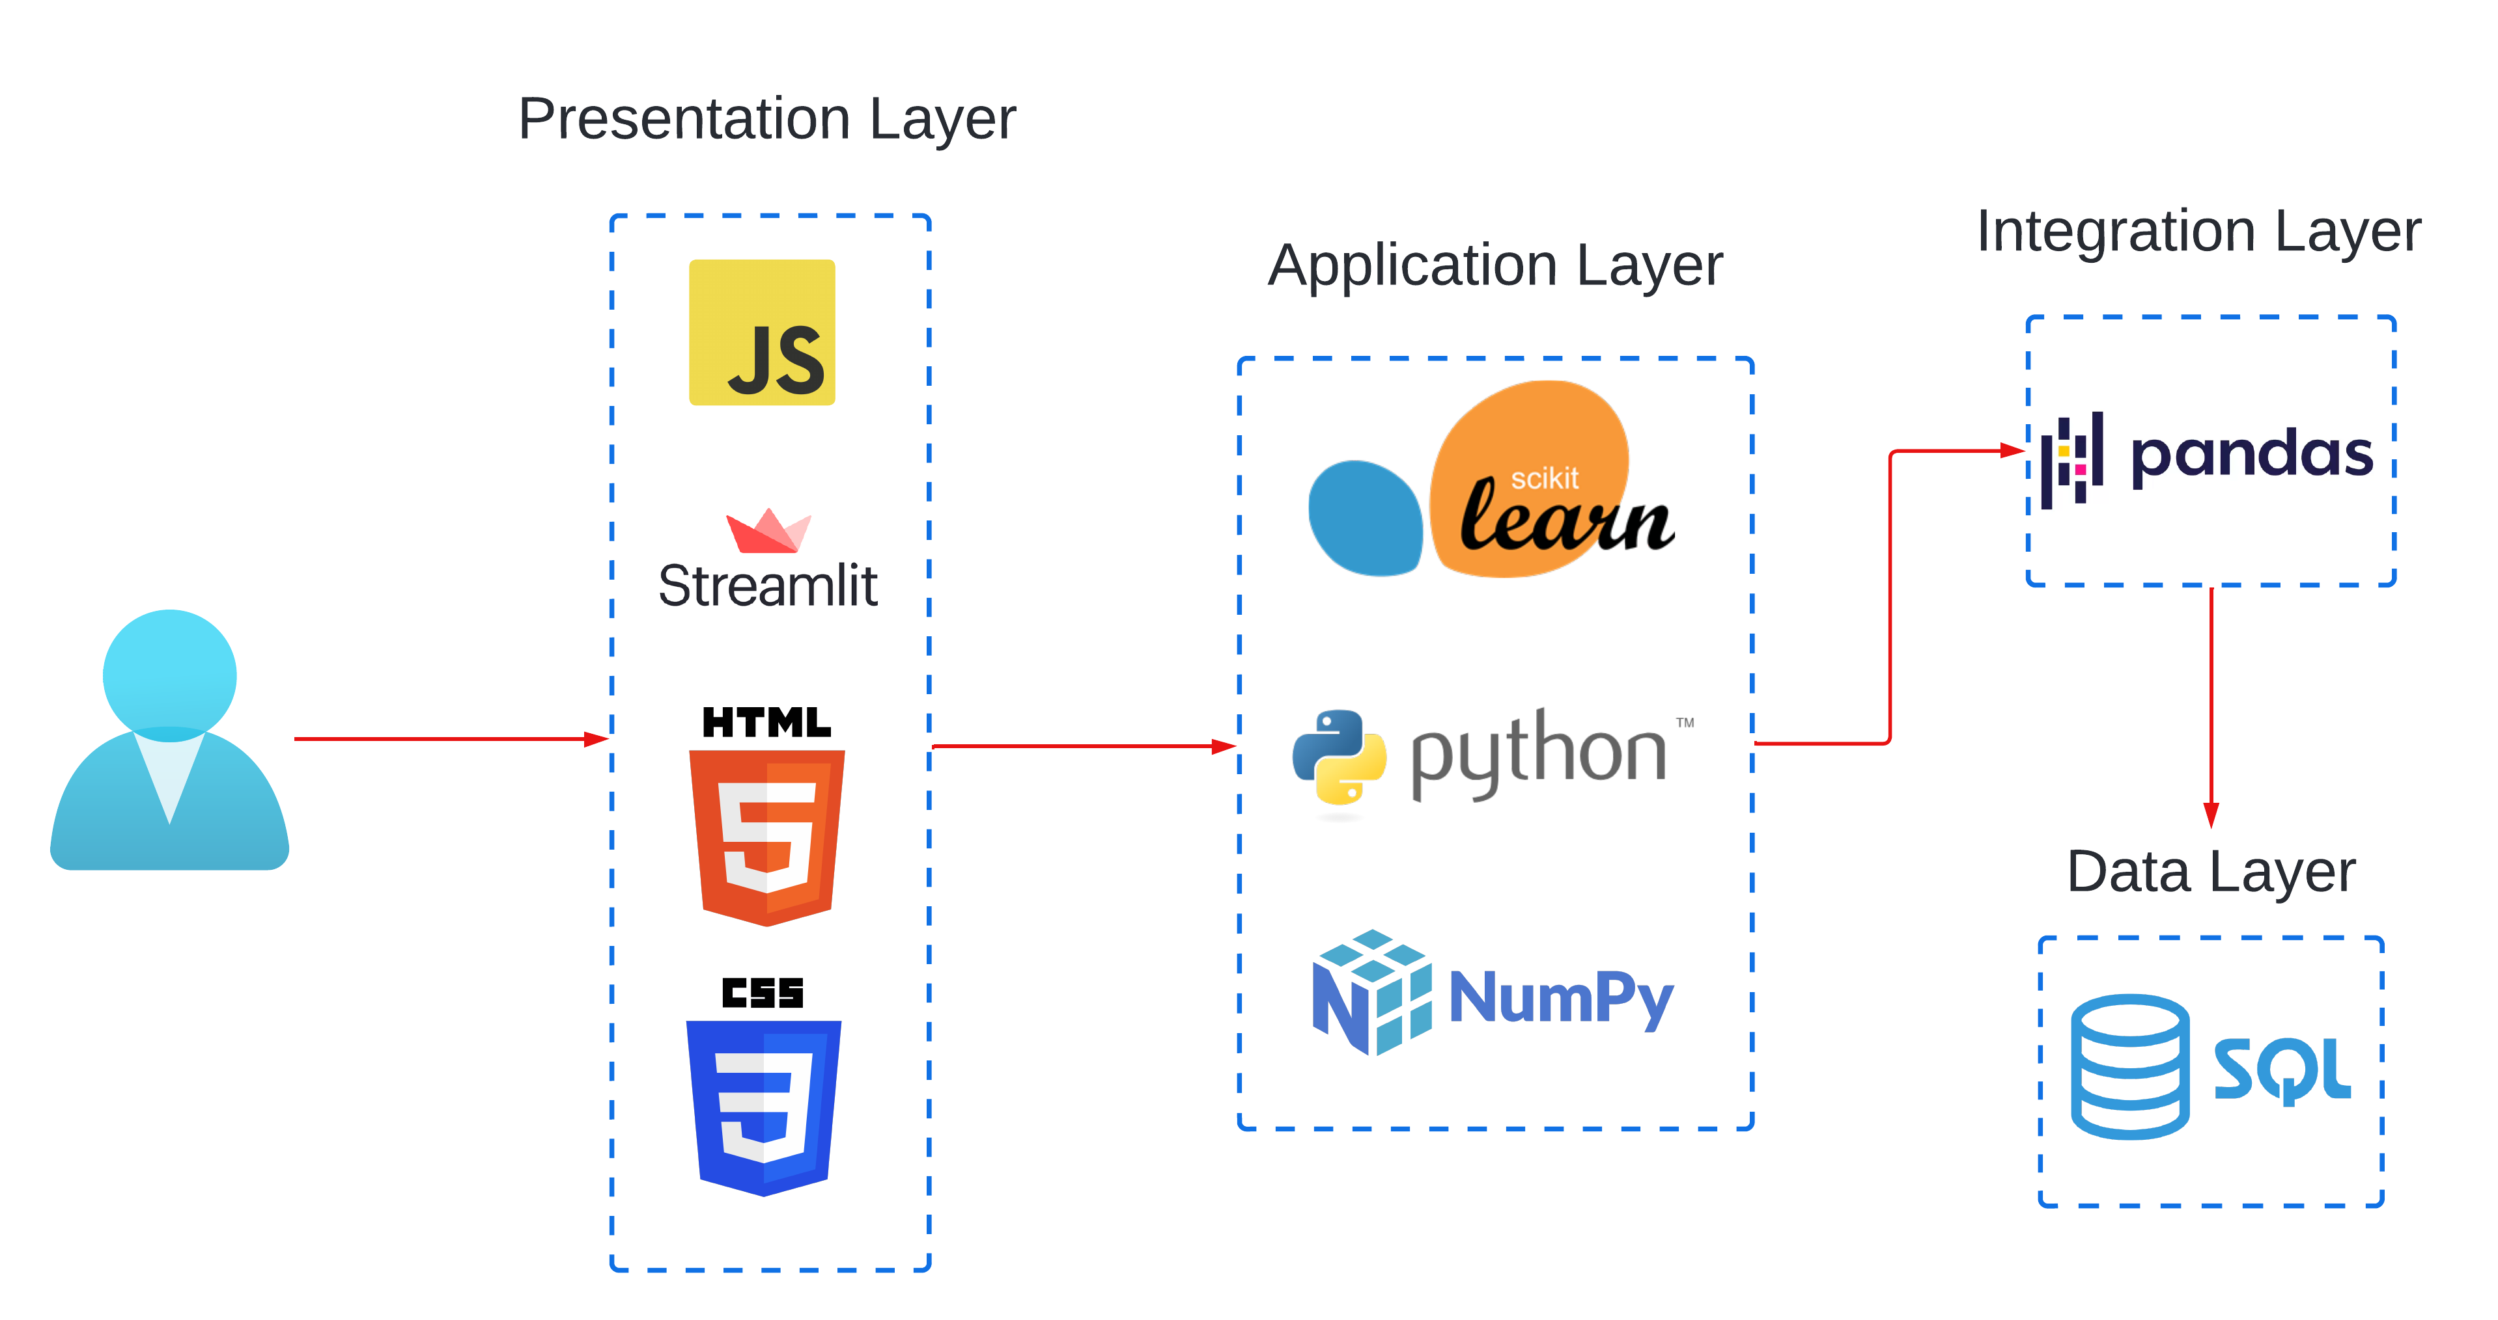
Architecture / Tech Stack
Notes:
Now im going to talk

Slide 9
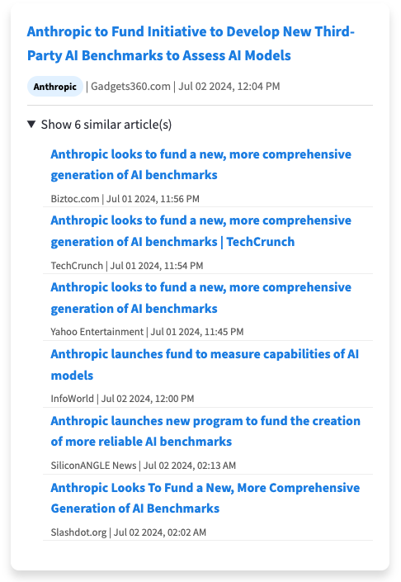
Duplicate Consolidation
TF-IDF
Vectorization
Cosine similarity
Duplicate selection
Grouping
Term Frequency-Inverse Document Frequency
Frequent in one article but rare in others -> higher score
TF-IDF scores of all words in one article are used to create a vector
Cosine of two TF-IDF vectors
Compare similarity score to threshold
Attach duplicates to one primary article
Stored in a 2d matrix
Notes:
One issue I ran into early on was that I noticed there were a lot of the same stories, in some cases with exactly the same titles, appearing in the news data. Obvously, you wouldn’t want to get five different push notifications for the same piece of news, so I needed to find some way to consolidate similar stories into one alert.
So this process involves three main steps: computing similarity between articles, detecting duplicates, and grouping similar articles together.
First, let's talk about how I compute similarity. I use a technique called TF-IDF, which stands for Term Frequency-Inverse Document Frequency.
TF-IDF helps convert text into numbers that a computer can understand and compare. It does this by measuring how important each word is, both within a single article and across all the articles I'm looking at. Words that appear frequently in one article but rarely in others are considered more important and get a higher score.
Then the scores of all the words in the article are used to convert the article text into a vector.
Once I have these vector representations of the articles, I use something called cosine similarity to compare them. This is literally just taking the cosine of two vectors.
This gives me a similarity score for each pair of articles, which I store in a 2d matrix.
So then I just loop through the matrix, and compare the similarity score to a threashold value, if its over the threashold its marked as a duplicate.
The final step is grouping these articles. I choose one article as the "primary" article for each group. All the information about its duplicates is stored within this primary article.
TF-IDF
Vectorization
Cosine similarity
Duplicate selection
Grouping

Slide 10
DEMO
Notes:
All News Page
This is the all news page. The idea here is that you search and filter news that is not affected by your watchlist or keyword list.
You can filter by company, source, date range, and you can search by keyword or phrase
There’s also an option to hide the descriptions and you can toggle between a list and grid view.
Settings/my alerts page
The settings page is where you can you set the company watchlist and keyword list.
Add Neuralink, no keywords. Demonstrate when there are multiple articles.
Click one of the links ‘China plans standardized brain-computer tech similar to Elon Musk’s Neuralink’
Demonstrate the alerts when there are multiple articles vs one (use July 4th for one)
Demonstrate with keywords. Use ‘China’. Date range 6/14 – 7/05
Demonstrate with multiple keywords. Use ‘Gaming’ and ‘Gamer’
Add Microsoft, Figma, Robhinhood, and Anthropic
Show filter: filter only Microsoft
Show duplicates (Microsoft pushes OneDrive, Microsoft Surface Pro, Bundling teams and office, Skeleton Key)
List and Grid view, show/hide descriptions
Edge cases
Show trying same fetch twice.
Show if you fetch dates in a previously fetched date
Show fetching from a date where there’s no news
Show trying to add a company that’s already on the watchlist

Slide 11
Next Steps
News API integration
Interval fetching & custom notification schedules
Improve similar article detection
Email notifications
Mobile push notifications
Sentiment analysis

Slide 12
Professional and personal takeaways
Gained experience with new technologies
Improved my skill level in technologies I was familiar with
Practiced SCRUM / Agile methodologies
Learned to work within the constraints of a large financial institution
Networked and built professional relationships
Navigated a new city on the other side of the country

Slide 13
QUESTIONS
Notes:
Feedback:
Refer to our team as GCB Tech - Data Science
Main users
GCB and BB Bankers.
Global commercial banking
Business banking
This took is for bankers
Our bankers need to sta
The biggest challenge is that bankers need to be proactive on their own to search for news. Theres nothing that’s giving them content. They have to gout and seek that news for themselves
Try to word in there the fact that information needs to be looked for instead of automatically received.
Outcomes
Increased efficiency in monitoring covered ccompaneis
Replace last bullet with Improved advisory for clients
Solution
Don’t spend so much time talking through the specific features.
Have a one pager on what the solution is
Give a one liner.
A settings for preferences
Easy access to a alerts via a UI and from push notification
Talk about the all news page in the demo
Keep everything high level in the deck
Implementation
Data should come first
The line of business is currently in conversation with Moody’s to sign a contract for their real time news feed API
Tech stack
Make an architecture diagram
Have a user & computer that points to the business logic that points to the database schema
Database schema
Move to the appendix
Duplication
Don’t spend too much time on this
Remove the three examples on the left
Demo
Showcase the proactive alerts before showing the all news page
Go right into the settings first.
Do the first alert for just one article. Then show multiple alerts
Takeaways and next steps
Do top three next steps and top three takeaways
There’s keyword shortcut for switching between shared screens on Webex

Slide 14
APPENDIX

Slide 15




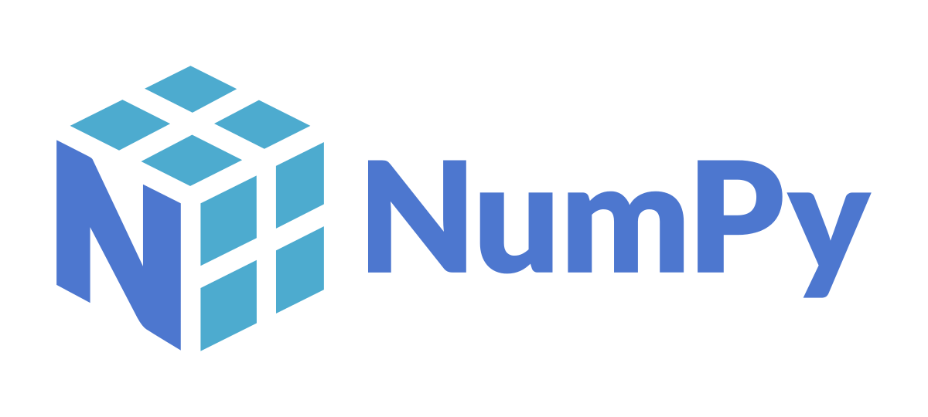


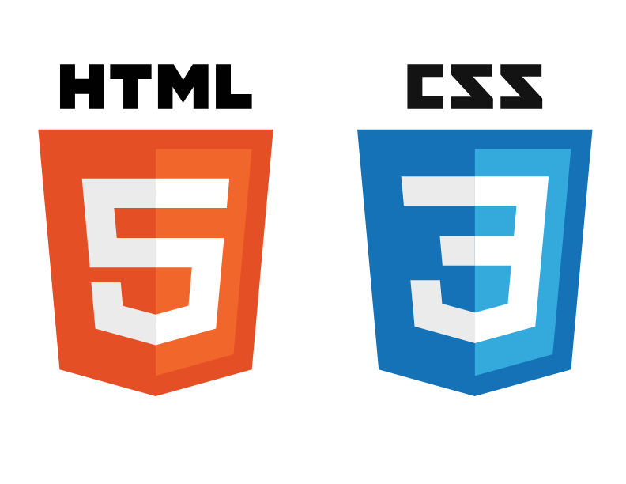
Tech Stack
Data Layer
Application Layer
Presentation Layer

Slide 16
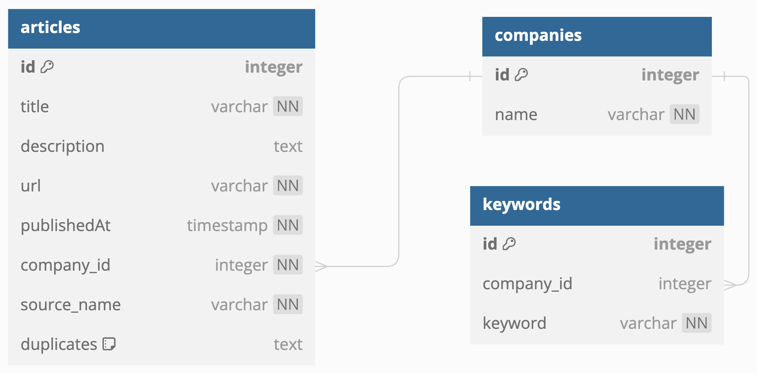
Database Schema
Notes:
Now, let's examine the database schema I've designed for this news alert application.
As you can see, we have three main tables: articles, companies, and keywords.
Go through the properties
In terms of relationships you can see there is a many to one relationship between articles and companies, and a one to many relationship between company and keywords

