Slide 1
NewsNudge
Henry Quillin

Slide 2



About me
The University of Texas at Austin (May 2026)
Computer Science and Business Honors
Software Engineer Intern
GCB/BB & Enterprise CRM Technology
Manager – Deanna Tuffano

Slide 3
News360 – Overview
Project Motivation
Solution
Data
Architecture
Duplicate detection
Demo
Next Steps
Key Takeaways
Q & A

Slide 4

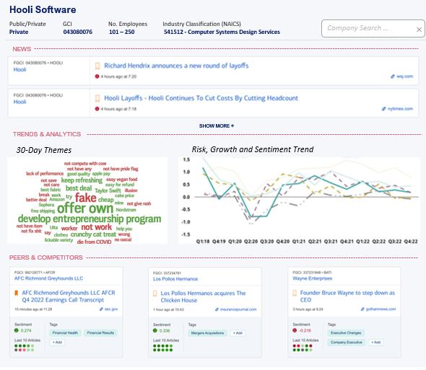
News360 – Project Motivation
Problem Statement (Analyst/RM Challenges):
Countless hours spent manually researching news articles
Information overload and data fragmentation
RM’s and Bankers sifting though multiple news sources/platforms
Proposed Solution:
News 360 – Consolidated view of Latest, Breaking News
Interactive view of trends, sentiments, analytics and peer comparison
Enhanced decision-making through a data-driven solution
Intuitive search functionality for quick access

Slide 5
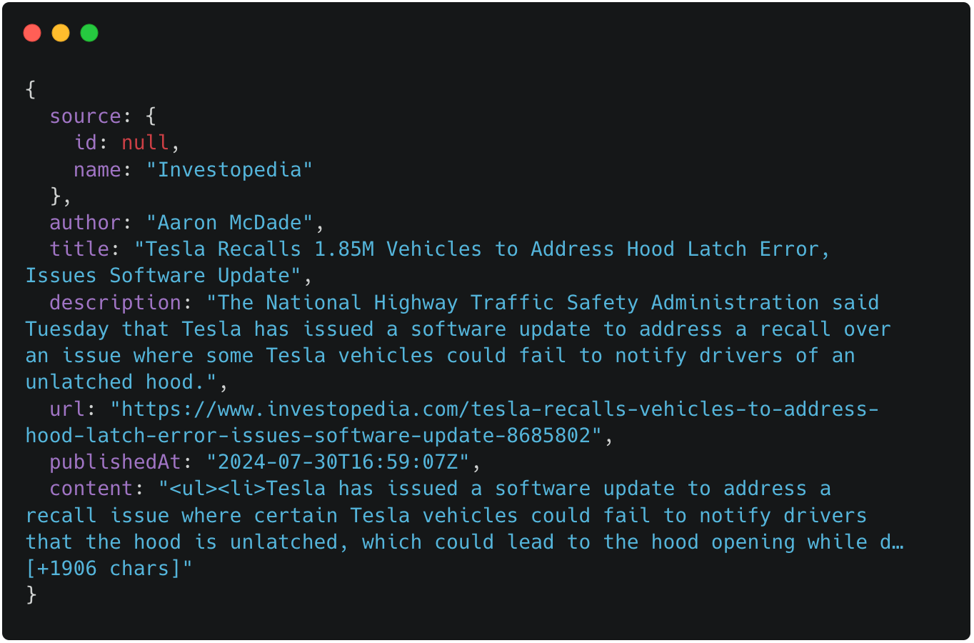

NewsNudge – Data
Notes:
I’m using a free public API called News API as my data source
News API provides real-time access to news articles from various sources worldwide
Due to bank restrictions, I’m unable to make direct API calls in my Python code
Solution: Used JavaScript to make API requests in the browsed, and copied the response data directly into my Python code as mock data
I wanted to use data from this API instead of a static data set so we can easily transition to direct API usage in the future, if permitted

Slide 6
News360 – Datasets
Real Time Data
News API → Curated news content accompanied by relevant metadata tags
Sentiment Scores API → Bitvore-generated sentiment, risk, and growth scores
Retrived Data
Datasets API → Provides different types of data sets that can be exported and downloaded in CSV
Leveraged Elastic for querying company info (NAICS, Ticker, #Employees, Headquarters)
Accelerated data accessibility
Targeting seamless shift towards mapping Global Company Identifier (GCI)

Slide 7




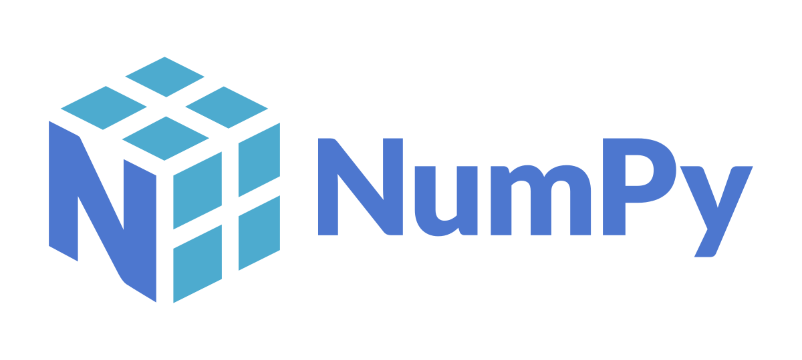
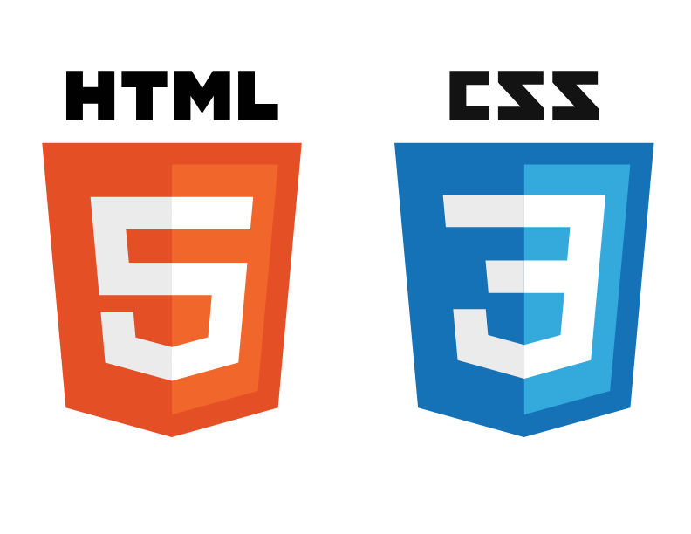


News360 – Tech Stack
Data Layer
Application Layer
Presentation Layer

Slide 8
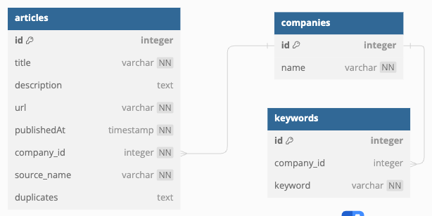
News360 – Database Schema

Slide 9
DEMO

Slide 10
News360 – Next Steps
Tailor landing page for RM-specific portfolio
Seamless Integration with Client 360 (Salesforce)
Enhanced search capability leveraging GCI
Enhance Wordcloud Interactivity
Integrate Financial filings section
Incorporate Industry view for broader insights

Slide 11
News360 – Key Takeaways
Effectively utilized resources – Collaboration across Data Science team
Resolved data gaps for a seamless user experience
Created a thorough code plan to prevent having to rewrite/restructure code later on
Effective communication within a team environment

Slide 12
QUESTIONS

Slide 13
APPENDIX

Slide 14
News360 – Company Summary

Slide 15
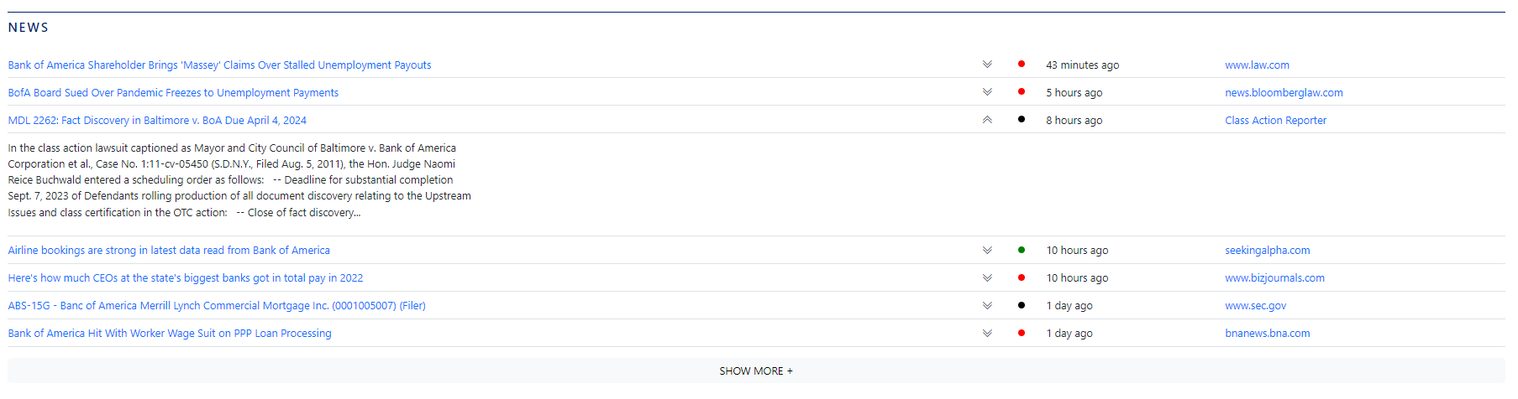
News360 – Latest News Section

Slide 16
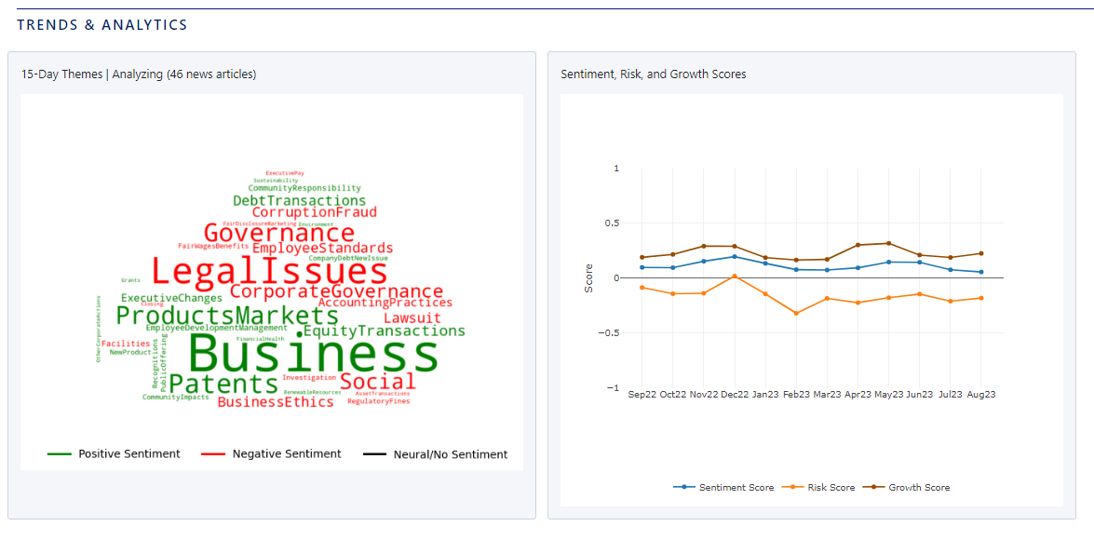
News360 – Trends & Analytics Section

Slide 17
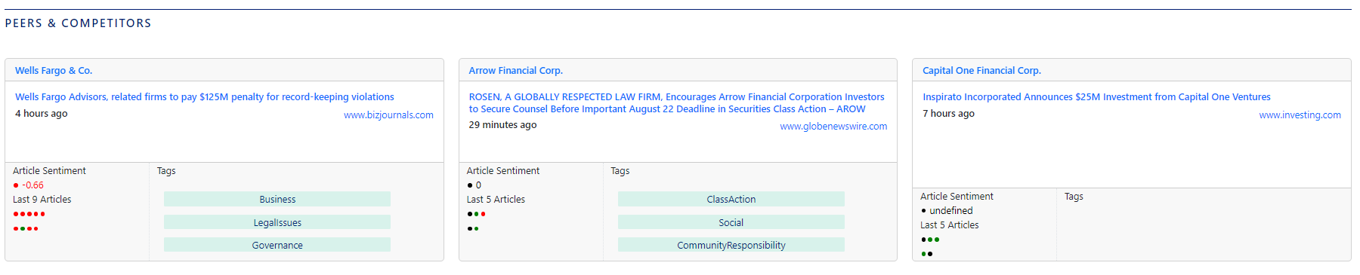
News360 – Peers & Competitors Section

