Slide 1
Henry Siukola COMP.CS.300
Insecure Login Lab
Educational Flask Security Project

Slide 2
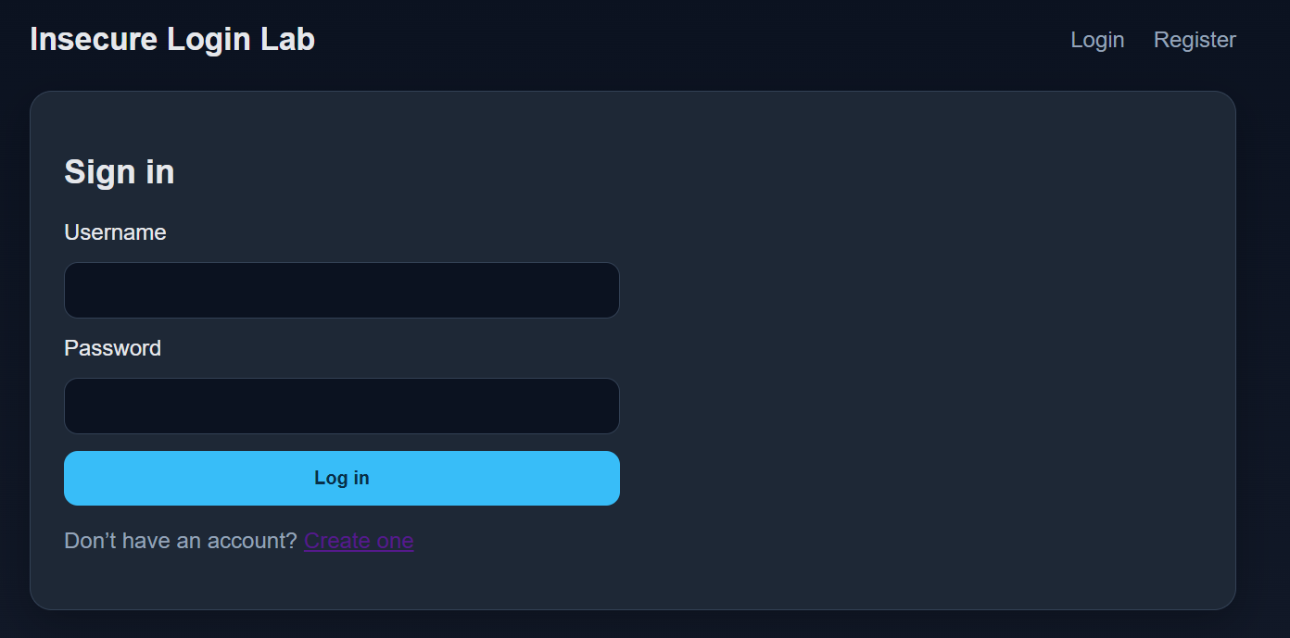
Overview
- A deliberately vulnerable web application used to practice security testing, exploitation, and secure remediation techniques.
- Inspired by Google Gruyere
• Flask + SQLite
• Vulnerable and secure branches
• OWASP ZAP testing
• Manual verification
Insecure Login Lab

Slide 3
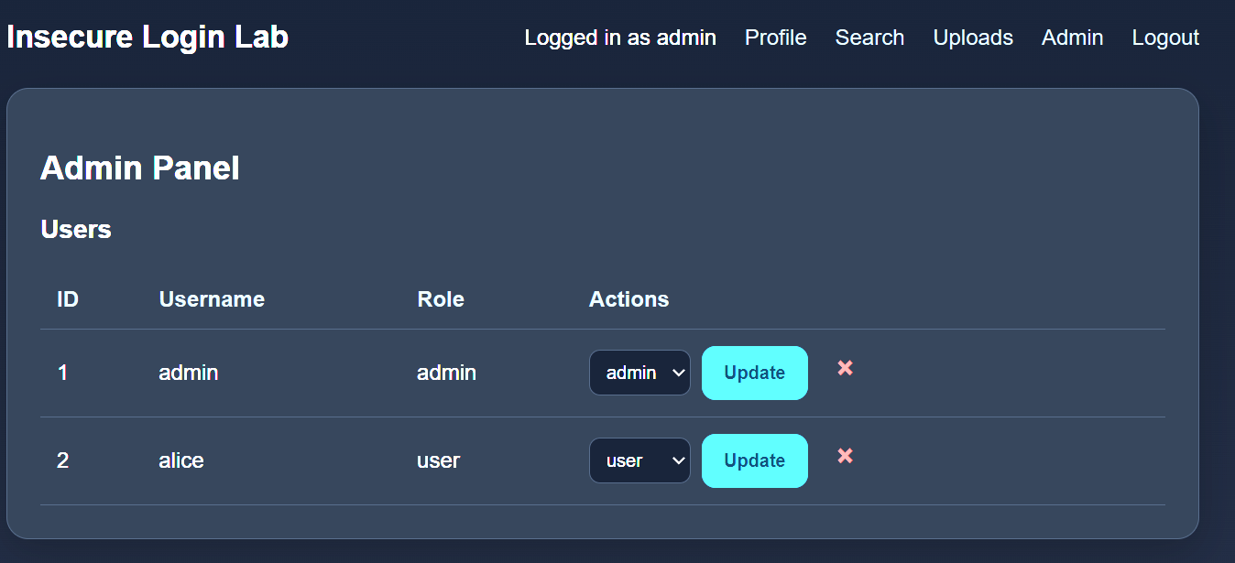
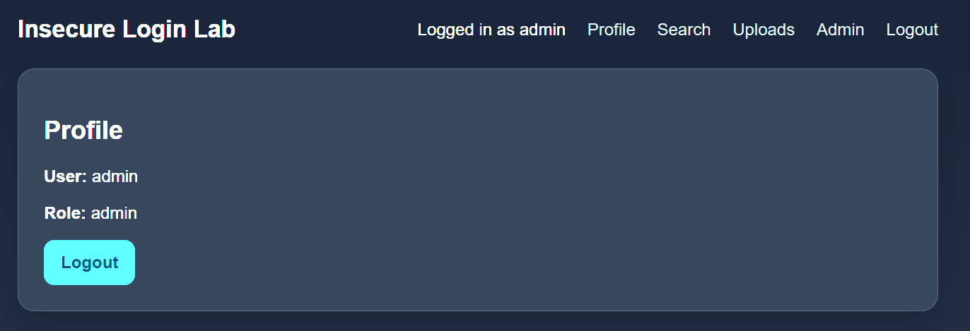
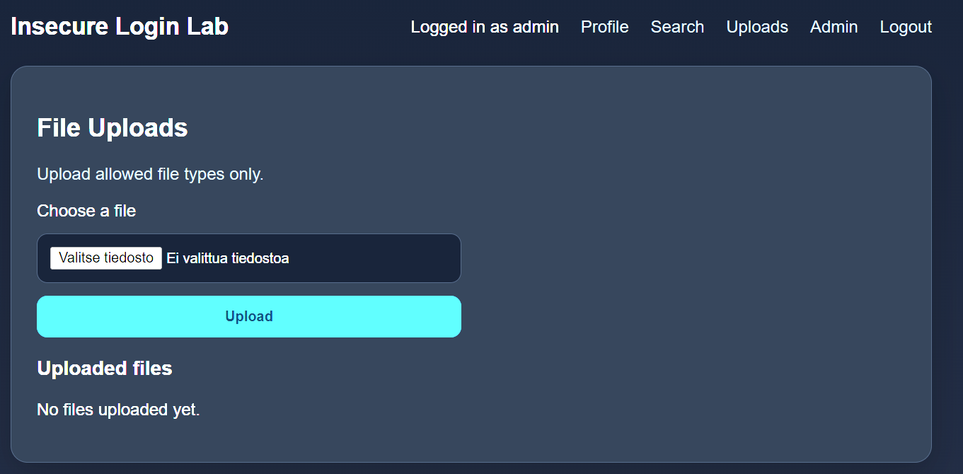
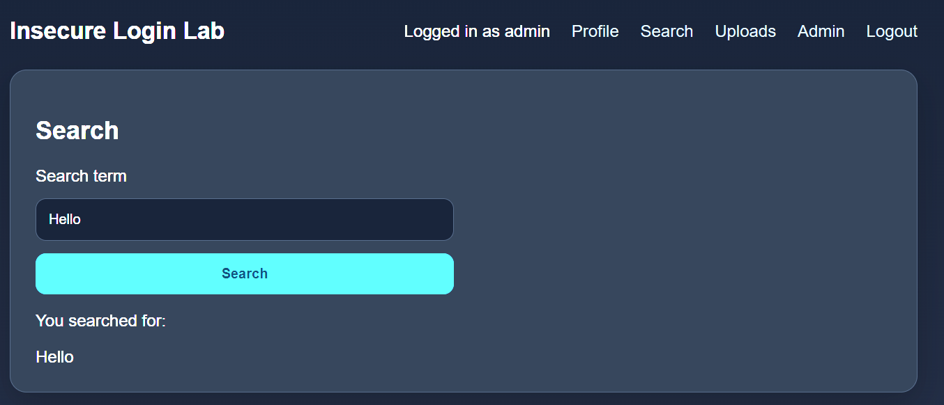


Slide 4
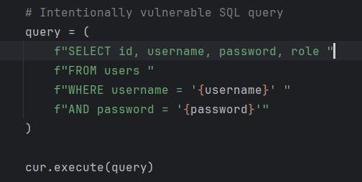
Implemented Vulnerabilities
The vulnerable branch intentionally contains realistic security flaws for educational purposes.
• SQL Injection
• Reflected and Stored XSS
• CSRF
• Cookie poisoning
• Privilege escalation
• Unsafe uploads
Insecure Login Lab

Slide 5
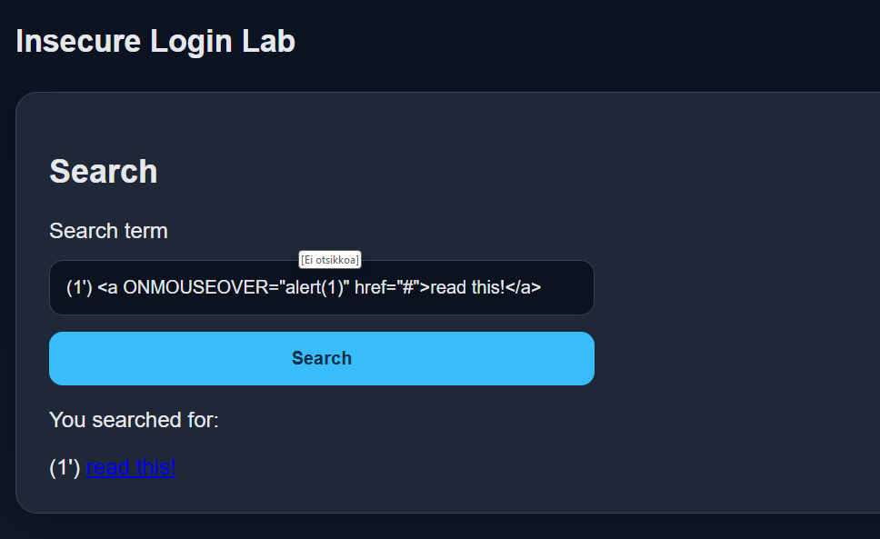

Slide 6
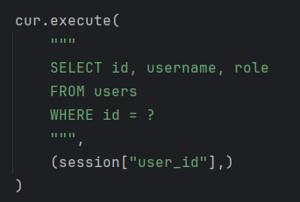
Secure Branch Improvements
The secure branch demonstrates practical Flask hardening techniques.
• Parameterized SQL queries
• Password hashing (Werkzeug)
• Flask sessions
• CSRF protection
• Security headers
• Upload restrictions
Insecure Login Lab

Slide 7
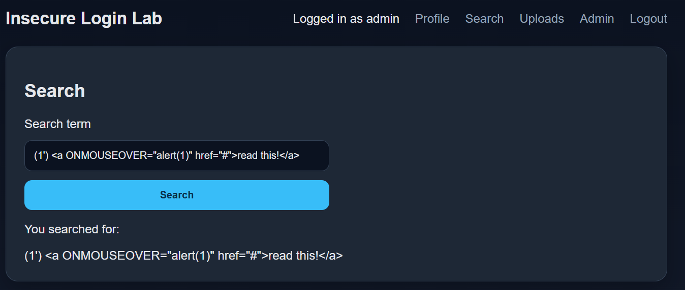

Slide 8
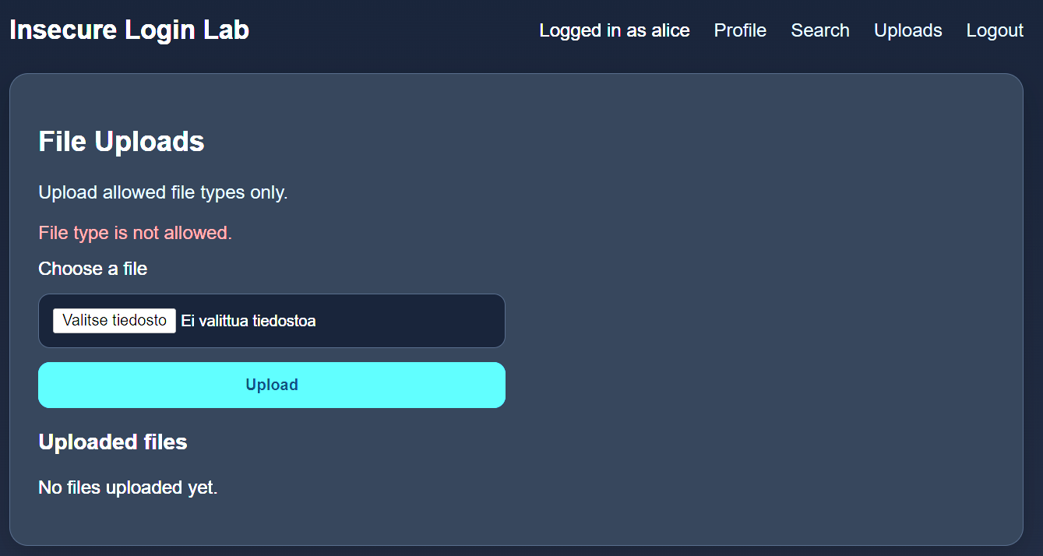

Slide 9
OWASP ZAP Results
Automated scanning was used to compare the vulnerable and secure implementations.
• High severity findings mitigated
• XSS removed
• SQL injection mitigated
• Remaining findings mostly informational
Insecure Login Lab

Slide 10
Documentation
The documentation for the project includes:
• README.md
• documentation.md
• exercises.md
• security_fixes.md
Insecure Login Lab

Slide 11
Key Lessons
The project demonstrates both offensive and defensive security concepts.
• Automated scanners have limitations
• Manual validation is essential
• Small flaws create major risk
• Defense-in-depth matters
Insecure Login Lab

Slide 12
AI Usage
Artificial Intelligence was used to:
• Most of the CSS
• Help with commenting code
• Initial documentation drafting
Insecure Login Lab

Slide 13
Thank You! Questions?

