Slide 1

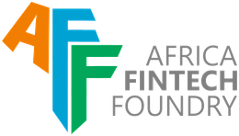

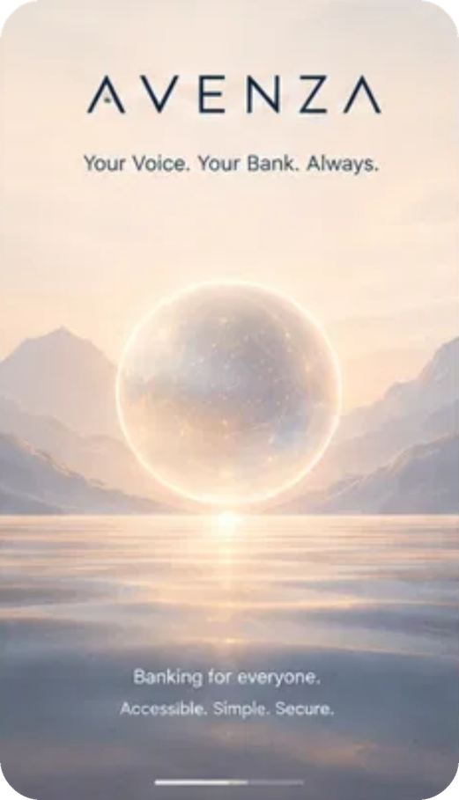
Avenza
Payments and Financial Infrastructure
Voice banking any bank plugs into its app: speak, hear the bank-verified name, approve with your fingerprint.
Avenza | team18
Henry Fakorode
Backend, AI and bank integration
Abdulwahab Yusuf
App, accessibility and fingerprint
Muiz Adeyemi
Product, user research and pilots
AVENZA · ACCESS YOUTH TECH FORGE 2026 | TEAM18
01
Notes:
Good morning. We are Avenza, team 18, on the Payments and Financial Infrastructure track. I'm Abdulwahab, with Henry and Muiz. We built voice banking that any bank can plug into its app: you speak, you hear the bank-verified name, and only your fingerprint approves.
1

Slide 2
THE PROBLEM
Help shouldn't cost your savings.
WHO HAS THE PROBLEM
NNEWI · DECEMBER 2024
~40M
14.8M
3 in 10
A visually impaired widow asked a stranger for help at an ATM. The stranger watched her PIN and swapped her card.
Nigerians living with a disability
Nigerians aged 60 and above
adults can't read and write
₦2M+
CBN, 2026
NBS
World Bank, 2024
WHY IT MATTERS
gone within minutes
47%
of 2025 fraud cases were social engineering: people tricked into handing over access.
₦17.84bn lost · NIBSS, Jan 2026
Today, apps need sight, reading and menus. So millions bank through a helper, and share their PIN.
AVENZA · ACCESS YOUTH TECH FORGE 2026 | TEAM18
02
Notes:
December 2024, Nnewi. A visually impaired widow couldn't use the ATM alone. A stranger offered to help, watched her PIN and swapped her card. Over two million naira was gone within minutes. Her only mistake was needing help. She is not alone: the CBN says about forty million Nigerians live with a disability, 14.8 million are over sixty, and three in ten adults can't read and write. Today, apps need sight, reading and menus, so millions bank through a helper and share their PIN. And social engineering, tricking people into handing over access, was 47% of fraud cases last year.
2

Slide 3
OUR SOLUTION
One sentence. One fingerprint.
A voice layer inside the bank's app: speak a transfer, hear the bank-verified name, approve with your own fingerprint.
01
02
03
04
05
Speak
Bank checks
Hear it back
Approve
Hear it settled
“Send ₦5,000 to GTBank 0123987001”
Live name check. Nothing moves yet
The bank's verified name and amount
Your fingerprint, for this one payment
Status, reference and bank charge
IN YOUR LANGUAGE
English live
Yorùbá demoed
Igbo in testing
Hausa in testing
Nigerian voices by YarnGPT
AVENZA · ACCESS YOUTH TECH FORGE 2026 | TEAM18
03
Notes:
Avenza is a voice layer that lives inside the bank's own app. One sentence starts a transfer. The bank checks the account first, and Avenza reads back the real, bank-verified name, so a blind customer knows who they're paying before any money moves. Only the fingerprint approves, and the result is spoken back. English is live, Yoruba is demoed, and Igbo and Hausa are in testing.
3

Slide 4

OUR SOLUTION · IN THE APP
What the customer hears.
Send ₦5,000 to GTBank 0123987001
<40 ms
600+
2
Chukwuemeka Ifeanyi Nwosu
GTBank · ₦5,000. Say yes to continue.
bank name check, live sandbox
automated tests passing
languages demoed end to end
Yes
ALSO WORKING TODAY
Voice set-up with spoken consent
Saying “yes” never pays
Sent. Ref AVZ-… Charge ₦10.75
Balance and last five transactions
“Emergency lock” by voice
AVENZA · ACCESS YOUTH TECH FORGE 2026 | TEAM18
04
Notes:
This is what the customer hears. They say, 'Send five thousand naira to GTBank, zero one two three nine eight seven zero zero one.' Avenza reads back Chukwuemeka Ifeanyi Nwosu, the name the bank verified. They say yes, place their finger on the sensor, and hear 'Sent' with the reference and the bank's charge. We built and demoed all of this in 72 hours: a bank name check under 40 milliseconds, 547 automated tests, and the full flow in English and Yoruba, plus voice set-up with spoken consent, balance and history by voice, and the emergency lock.
4

Slide 5



UNIQUE VALUE PROPOSITION AND COMPETITIVE ADVANTAGE
No PIN shared. Every payee verified.
No PIN shared
Bank-verified name read aloud
Works without reading
Plugs into any bank's app
WHY WE KEEP THE LEAD
Distribution
Screen reader + bank app
Ships inside the bank's own app: no customer acquisition cost
USSD codes
Technology
Voice / braille ATMs
Speech tuned for Nigerian accents and languages
Siri / Google Assistant
Engine
Avenza
Bank-grade transfers that can never pay twice
Others fall short: each solves one piece, none removes the PIN and verifies the payee.
AVENZA · ACCESS YOUTH TECH FORGE 2026 | TEAM18
05
Notes:
What makes Avenza different? Every alternative solves one piece. Screen readers read menus but you still type a PIN. USSD needs reading. Voice ATMs help at the machine, not at home. Siri and Google can't verify a payee with your bank. Avenza is the only one that removes the PIN, reads back the bank-verified name, works without reading, and plugs into any bank's app. We keep the lead through distribution inside the bank's own app, speech tuned for Nigerian accents, and a bank-grade engine that can never pay twice.
5

Slide 6
TECHNOLOGY AND SECURITY
How it works.
AI only understands and speaks
Only the bank moves money, after the fingerprint
Customer's phone
Bank app or PWA + Avenza SDK
Avenza backend FastAPI · SQLite, Postgres-ready
Bank APIs
Forge Xtradot sandbox
NIBSS NIP
Instant transfer to the payee's bank, unchanged
Speech to text
Sahara · YarnGPT
Understanding
Rules + Huawei MaaS
Voice replies
YarnGPT, cached
Name check
Transfer
Status
Balance and history
Signed webhooks
Microphone
Speaker
Transfer engine
Idempotent, never repeats
Approval check
Passkey for this payment
Audit log
Every step, with consent
Passkey
TOOLS AND APIS
Forge Xtradot bank sandbox
Huawei MaaS (GLM)
Sahara speech
YarnGPT speech and voices
WebAuthn passkeys
Forge Kubernetes
AVENZA · ACCESS YOUTH TECH FORGE 2026 | TEAM18
06
Notes:
Here is how it works. The customer's phone runs the bank's app, or our installable web app, with the Avenza SDK: microphone, speaker and a passkey in the phone's secure chip. Voice goes to the Avenza backend: speech to text with Sahara and YarnGPT, understanding with rules first and Huawei MaaS only when unclear, Nigerian voice replies, a transfer engine that never repeats a payment, an approval check, and an audit log. The backend calls the bank's own APIs, here the Forge Xtradot sandbox, and money moves over NIBSS exactly as it does today. AI only understands and speaks. Only the bank moves money, after the fingerprint.
6

Slide 7




TECHNOLOGY AND SECURITY
Your voice asks. Your fingerprint pays.
YOUR VOICE CAN
ONLY YOUR FINGERPRINT CAN
Ask · Hear · Lock
Move money
“Emergency lock” freezes every transfer
A passkey in the phone's secure chip
Signed for one payment
“Yes” never pays
Never pays twice
Private by design
Exact amount and payee
A voice can be copied; a fingerprint can't
Asks the bank before any retry
No money or PINs held; NDPA 2023 consent; audit log
AVENZA · ACCESS YOUTH TECH FORGE 2026 | TEAM18
07
Notes:
Security follows one rule: your voice asks, your fingerprint pays. Your voice can ask, hear and lock; saying 'emergency lock' freezes every transfer. Only your fingerprint can move money, through a passkey in the phone's secure chip. Each approval is signed for one exact amount and payee. A double yes is refused, because a voice can be copied. The engine asks the bank before any retry, so it never pays twice. And Avenza holds no money and no PINs, processes voice only with consent under the NDPA 2023, and logs every step.
7

Slide 8
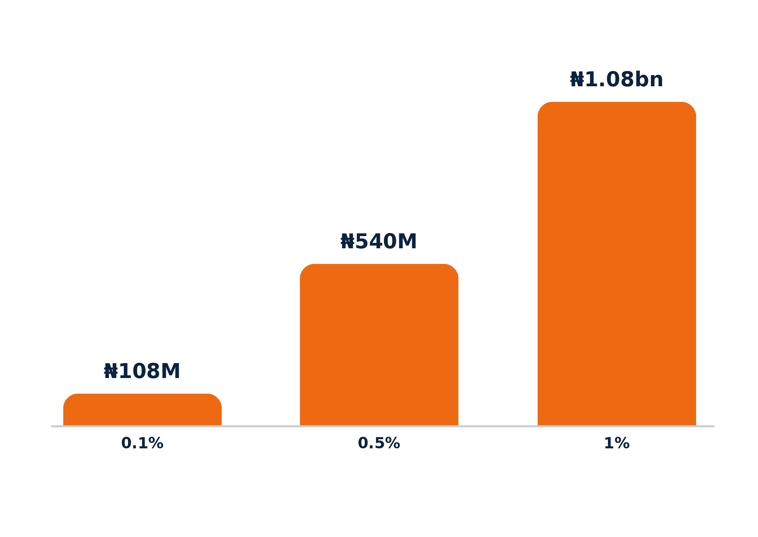
BUSINESS MODEL AND IMPACT
Banks pay. Customers never do.
Customer
banks alone, free
Avenza
inside the bank's app
Bank pays
for new users and volume
YEARLY FEES · ACCESS BANK ALONE
₦150
₦5M
per active user, per month
one-time integration per bank
₦0
3 months
of Access Bank's 60M+ customers using Avenza
for customers, always
free pilot
Impact at 1%: 600,000 people banking without sharing a PIN
Illustration: users × ₦150 × 12. Customers: ThisDay, Sept 2026. Pricing validated in the pilot.
AVENZA · ACCESS YOUTH TECH FORGE 2026 | TEAM18
08
Notes:
Customers use Avenza free; accessibility is never a surcharge. Banks pay, because Avenza brings them users and transfer volume they can't reach today: 150 naira per active user per month and five million naira once to integrate, after a free three-month pilot. There's no customer acquisition cost because Avenza ships inside the bank's app. If just one percent of Access Bank's sixty million customers use it, that's 600,000 people banking without sharing a PIN, and about 1.08 billion naira a year.
8

Slide 9
BANK FIT AND SCALE
Built to plug into Access Bank.
HOW ACCESS BANK DEPLOYS IT
HOW IT GROWS
NEXT STEPS
1
SDK in the Access app
West Africa
Yorùbá, Igbo, Hausa and beyond
1
More banks
Same SDK for banks and fintechs
3-month Access Bank pilot, free
5
API calls on existing rails
Same bank
Elderly, low-literacy, POS agents
2
Intros to blind and low-vision user groups
1
signed webhook
Pilot
Blind and low-vision customers
3
Testing, language checks, security review
Ghana requires accessible banking by 31 Dec 2026
AVENZA · ACCESS YOUTH TECH FORGE 2026 | TEAM18
09
Notes:
Access Bank can deploy Avenza with one SDK in the Access app, five API calls on its existing rails, and one signed webhook. We grow in steps: a pilot with blind and low-vision customers, then the same bank's elderly and low-literacy customers and POS agents, then more banks and fintechs on the same SDK, then West Africa and more languages. Our next step is a three-month pilot with Access Bank.
9

Slide 10
Access Youth Tech Forge 2026
Avenza · Your voice asks. Your fingerprint pays.
team18 · Henry Fakorode · Abdulwahab Yusuf · Muiz Adeyemi
Live: team18.xtradot.co
Notes:
One of our own family members lost 250,000 naira to a helper who knew her PIN. We built Avenza so nobody has to hand theirs over again. Our ask: a three-month pilot with Access Bank, blind and low-vision customers first. Your voice asks. Your fingerprint pays. Thank you.
10

