Slide 1
Predict Policy Changes
based on Case Data
Chao Cao(UTA)
( *: Project is finished at UMD)

Slide 2
Outline
Introduction
Data
Raw Data
Data Processing
Visualization
Conclusion
Future
Challenges
Future

Slide 3
Introduction

Slide 4
Introduction
COVID-19 is an ongoing, multi-year event. Public health policies change over time, as do infection rates.
This leads to the questions:
Is there any way we can visualize the case data and policy data at the same time?
Can we predict policy changes based on the case data?

Slide 5
Data
Raw Data
Data Processing
Visualization

Slide 6
Raw Data

Slide 7
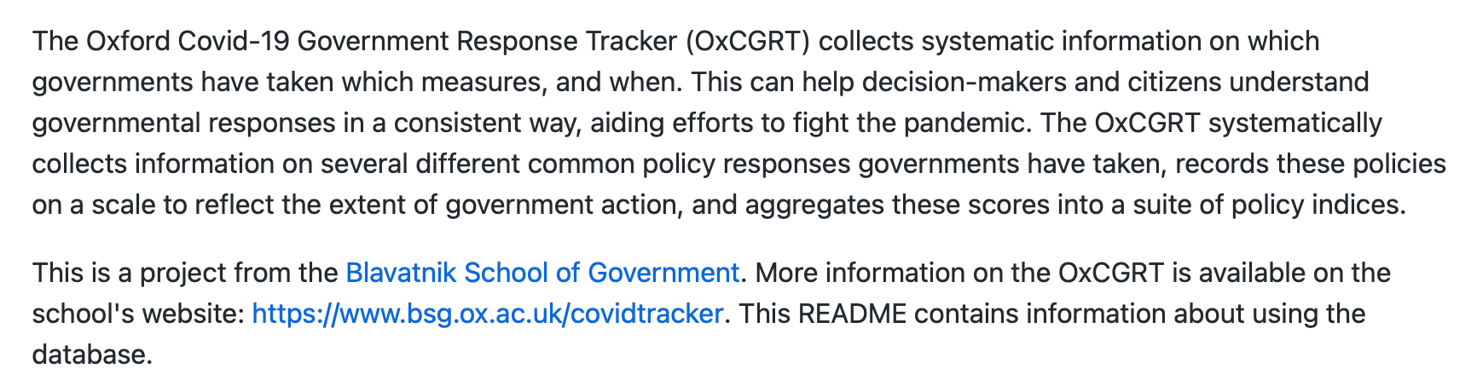
Data Source (1)
Policy data
Oxford Covid-19 Government Response Tracker (OxCGRT)
https://github.com/OxCGRT/covid-policy-tracker

Slide 8
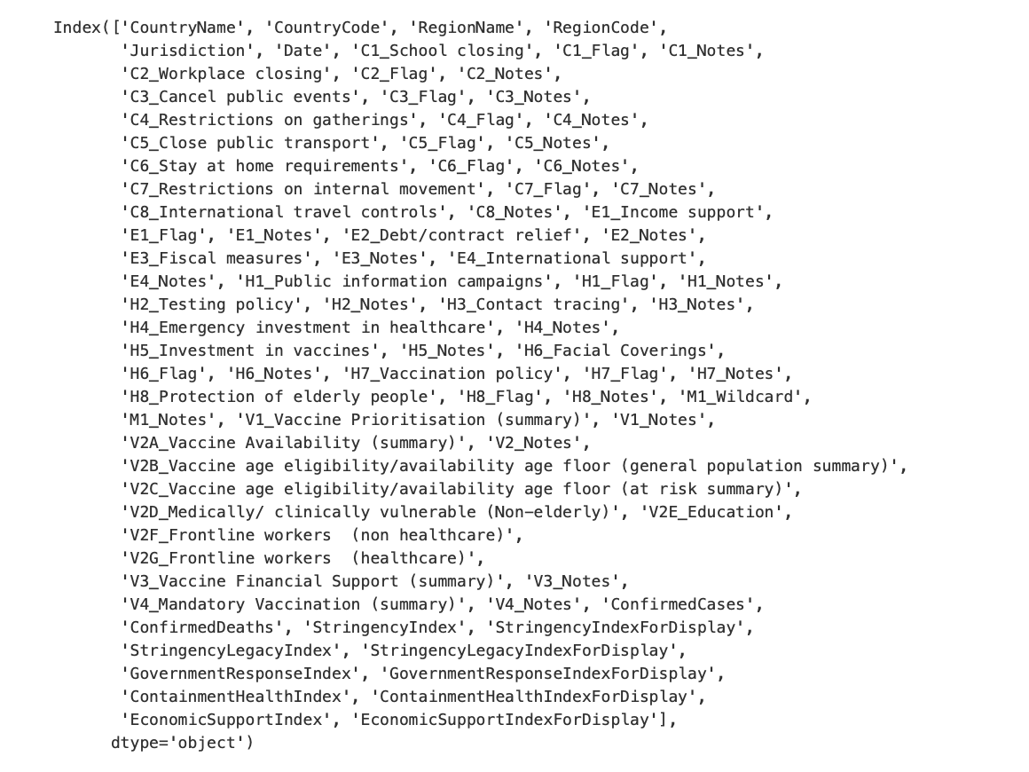
Policy data

Slide 9
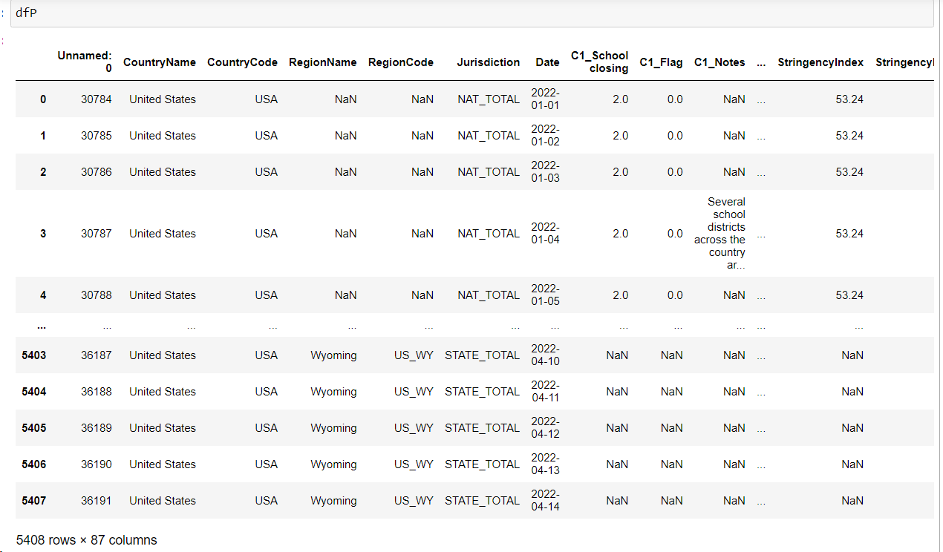
Policy data

Slide 10
Data Source (2)
Case data
United States COVID-19 Cases and Deaths by State
CDC reports aggregate counts of COVID-19 cases and death numbers daily online.
Due to many municipalities do batch-reporting, use a 20-day window to keep the data smooth, rather than the daily numbers
https://data.cdc.gov/Case-Surveillance/United-States-COVID-19-Cases-and-Deaths-by-State-o/9mfq-cb36/data

Slide 11
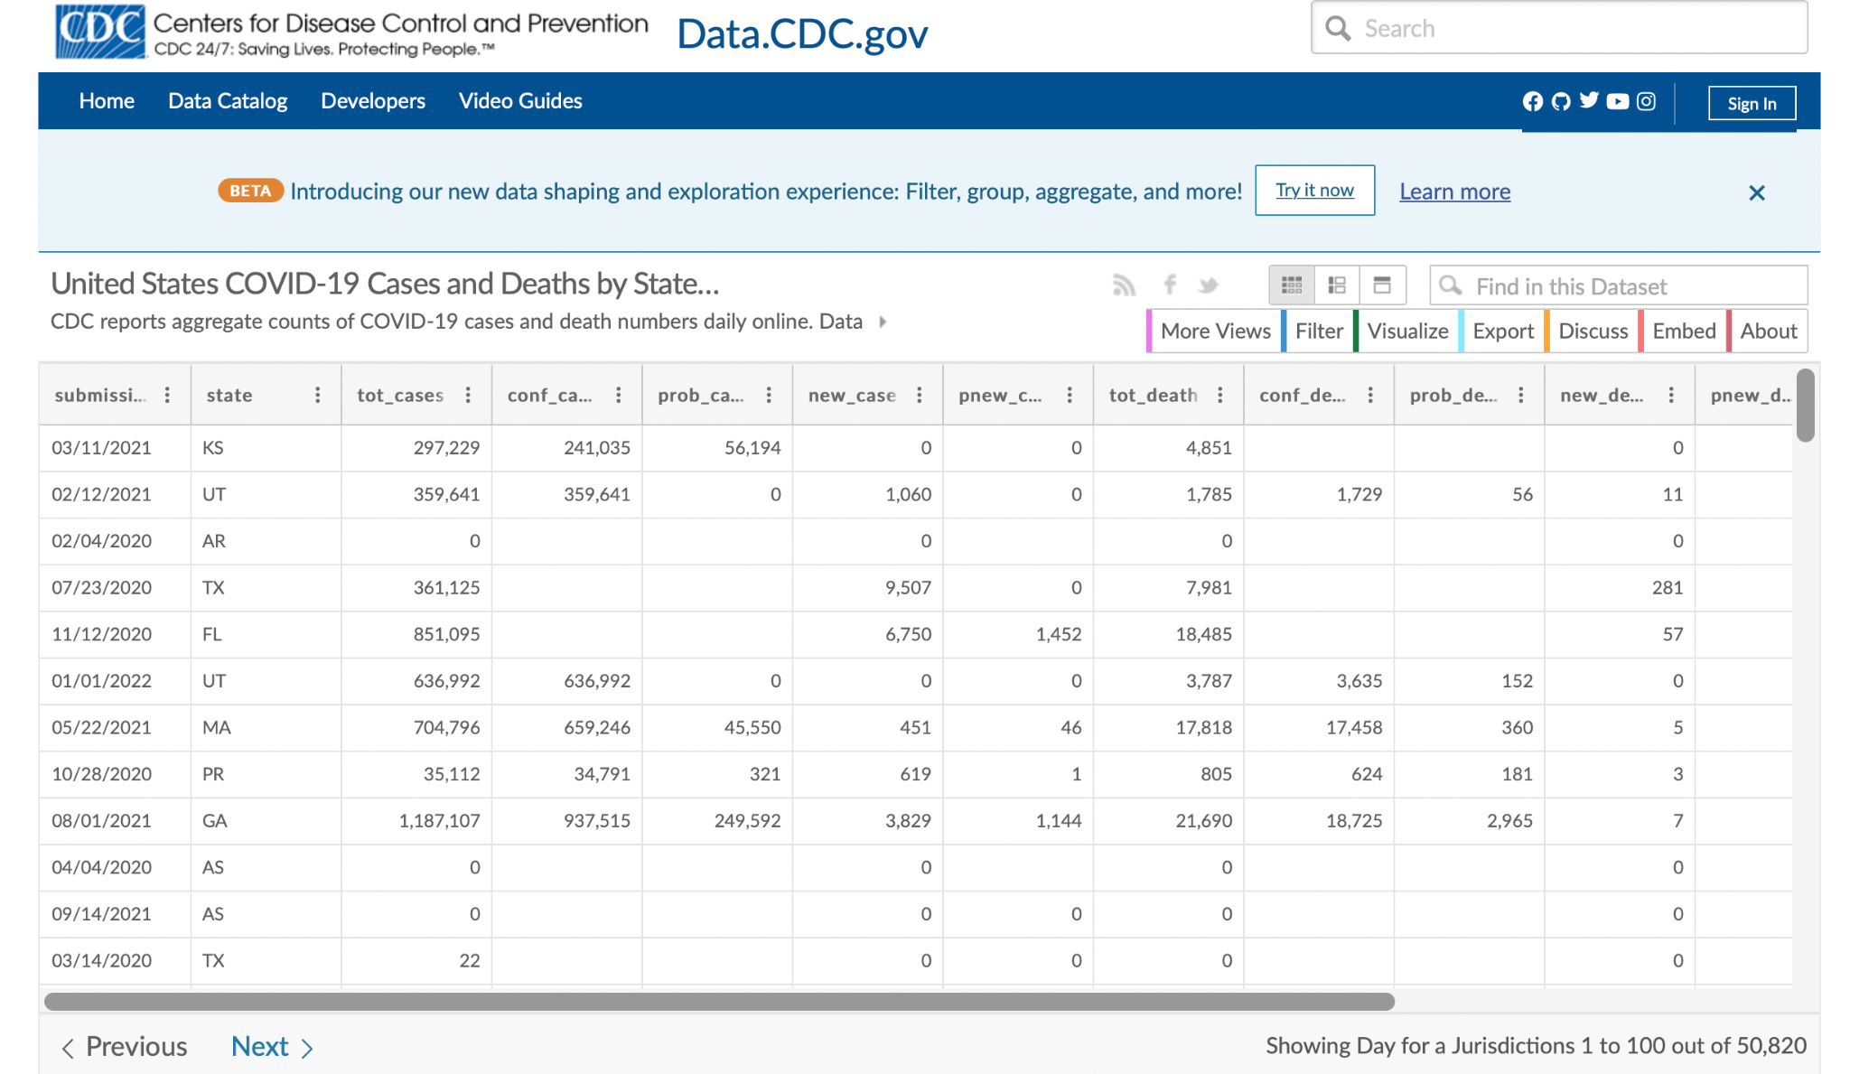

Slide 12
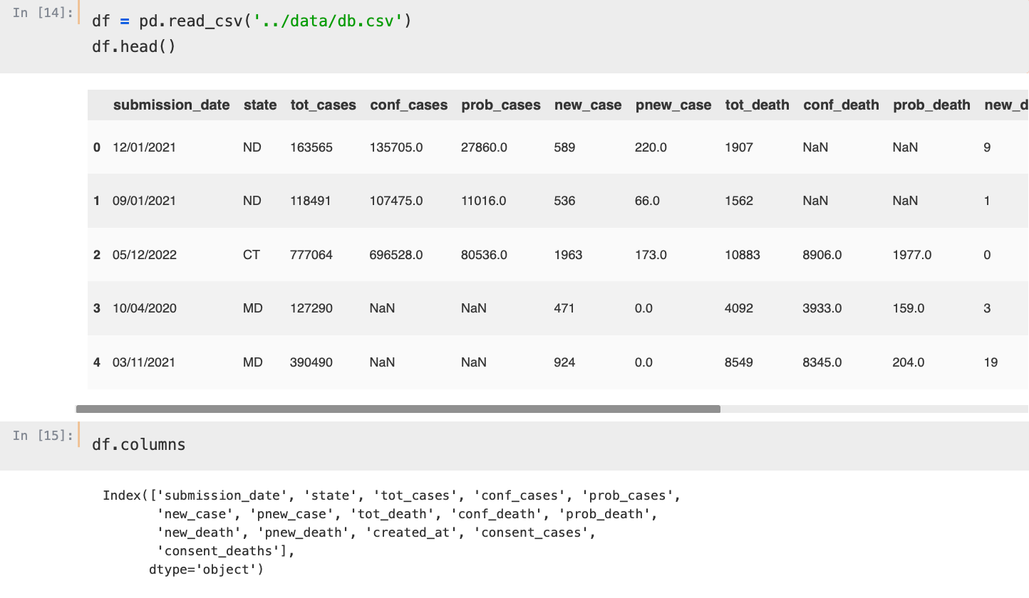

Slide 13
Data Processing & Visualization

Slide 14
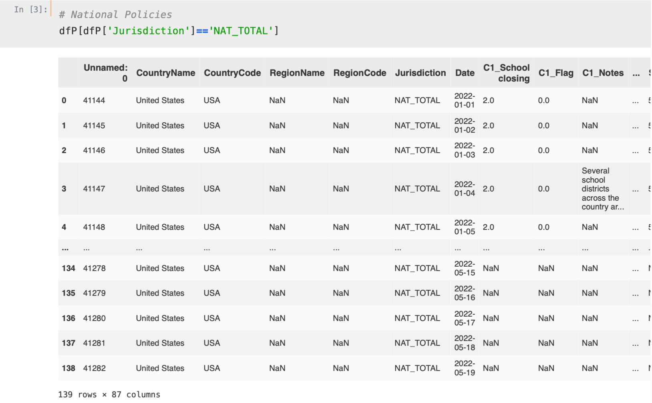
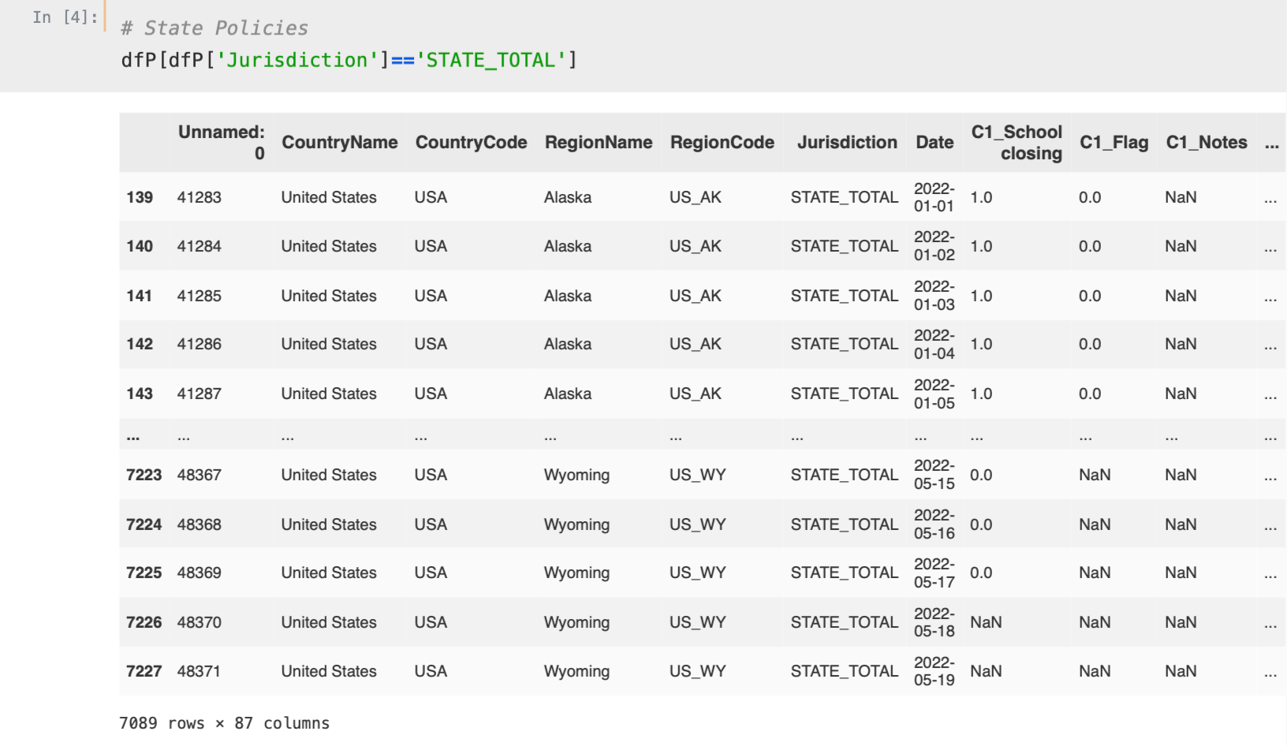
Part 1: Exploring Policy Data
Separate national policy and state policy

Slide 15
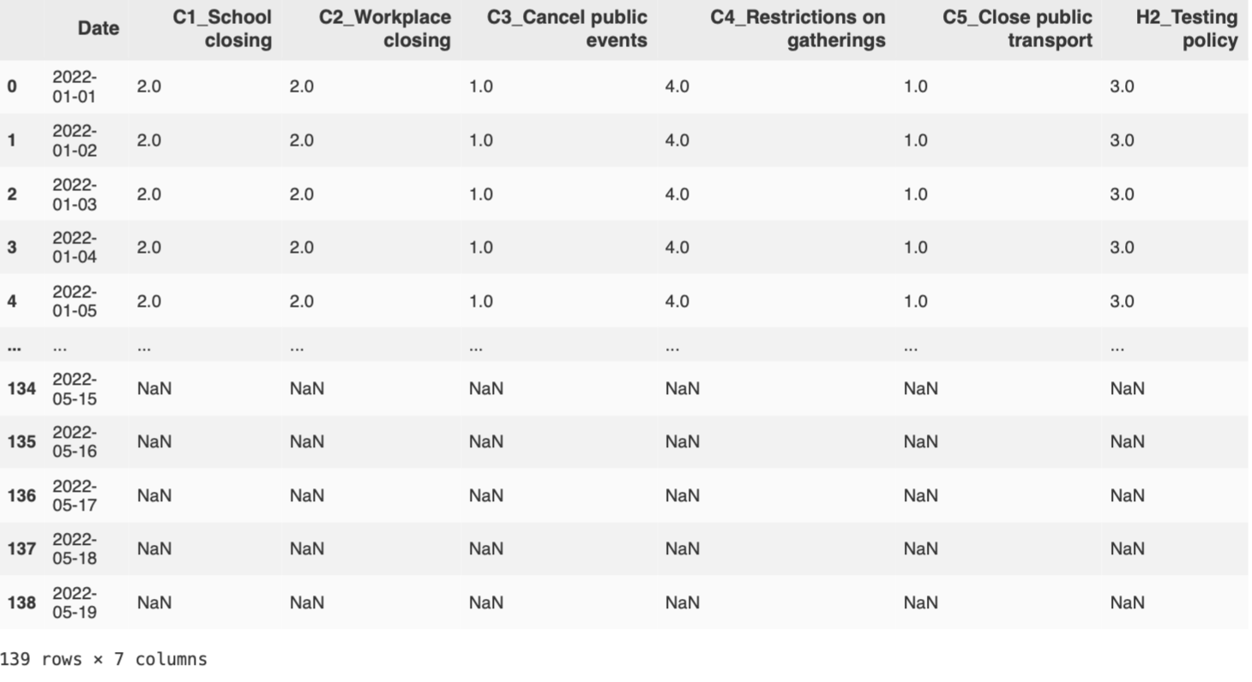
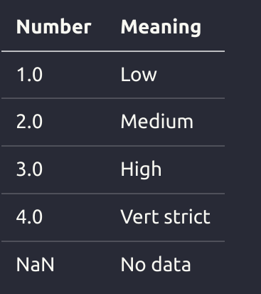
Part 1: Exploring Policy Data
2. Focus on instereted policy (Sort by date)

Slide 16
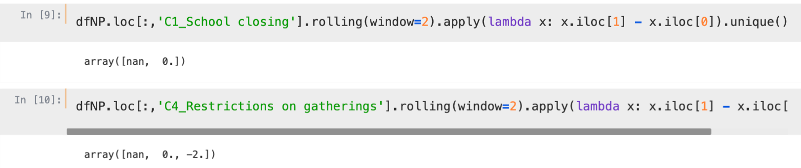
Part 1: Exploring Policy Data
3. Calculate the difference to know when the policies change

Slide 17
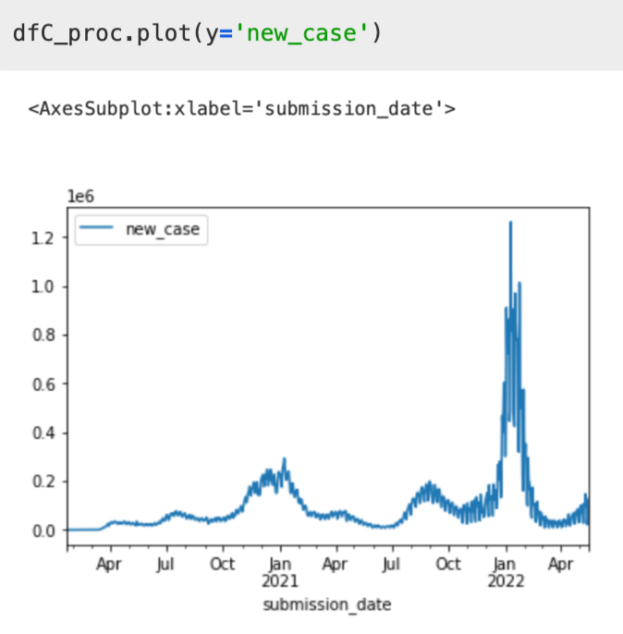
Part 2: Exploring Case Data
1. Visualization of cases

Slide 18
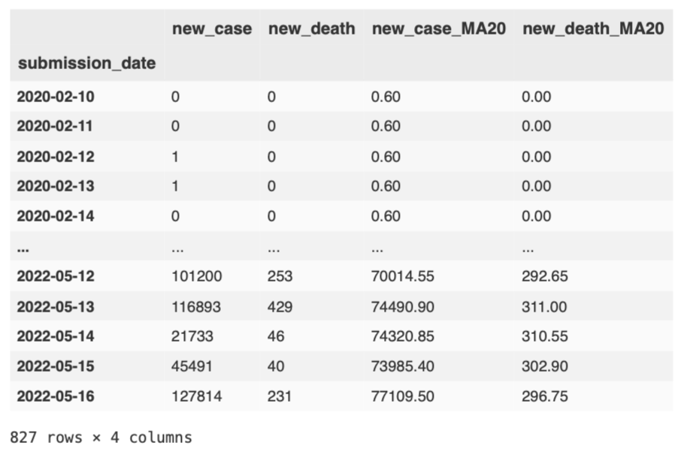
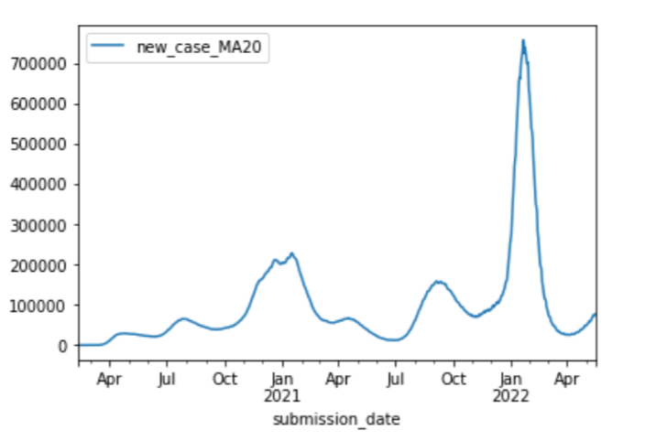
Part 2: Exploring Case Data
2. Make it flatter and smoother by calculating the average number of each 20 days

Slide 19
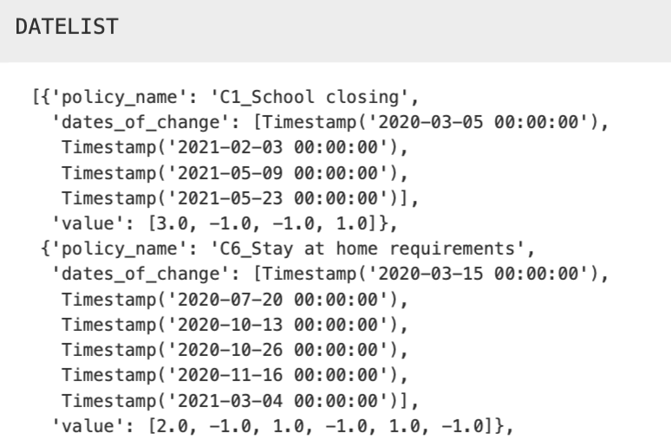
Part 3: Fusion
1. reset 0 in specfic columns
2. get the value and datelist
3. Plot

Slide 20
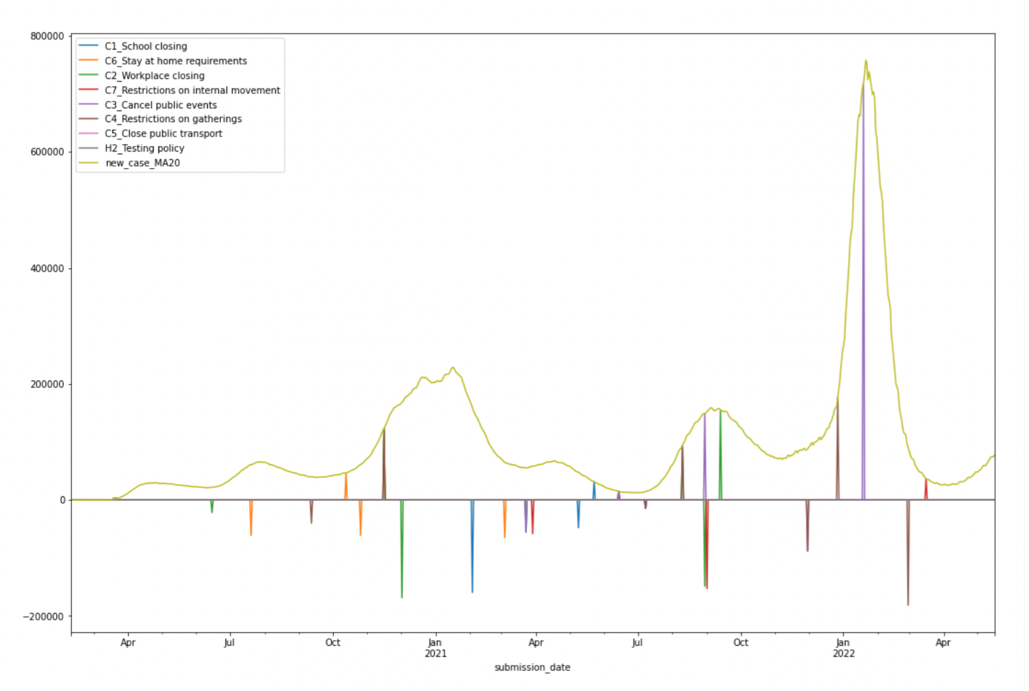
Results (nation)
COVID-19 Cases and Public Policy, United States

Slide 21
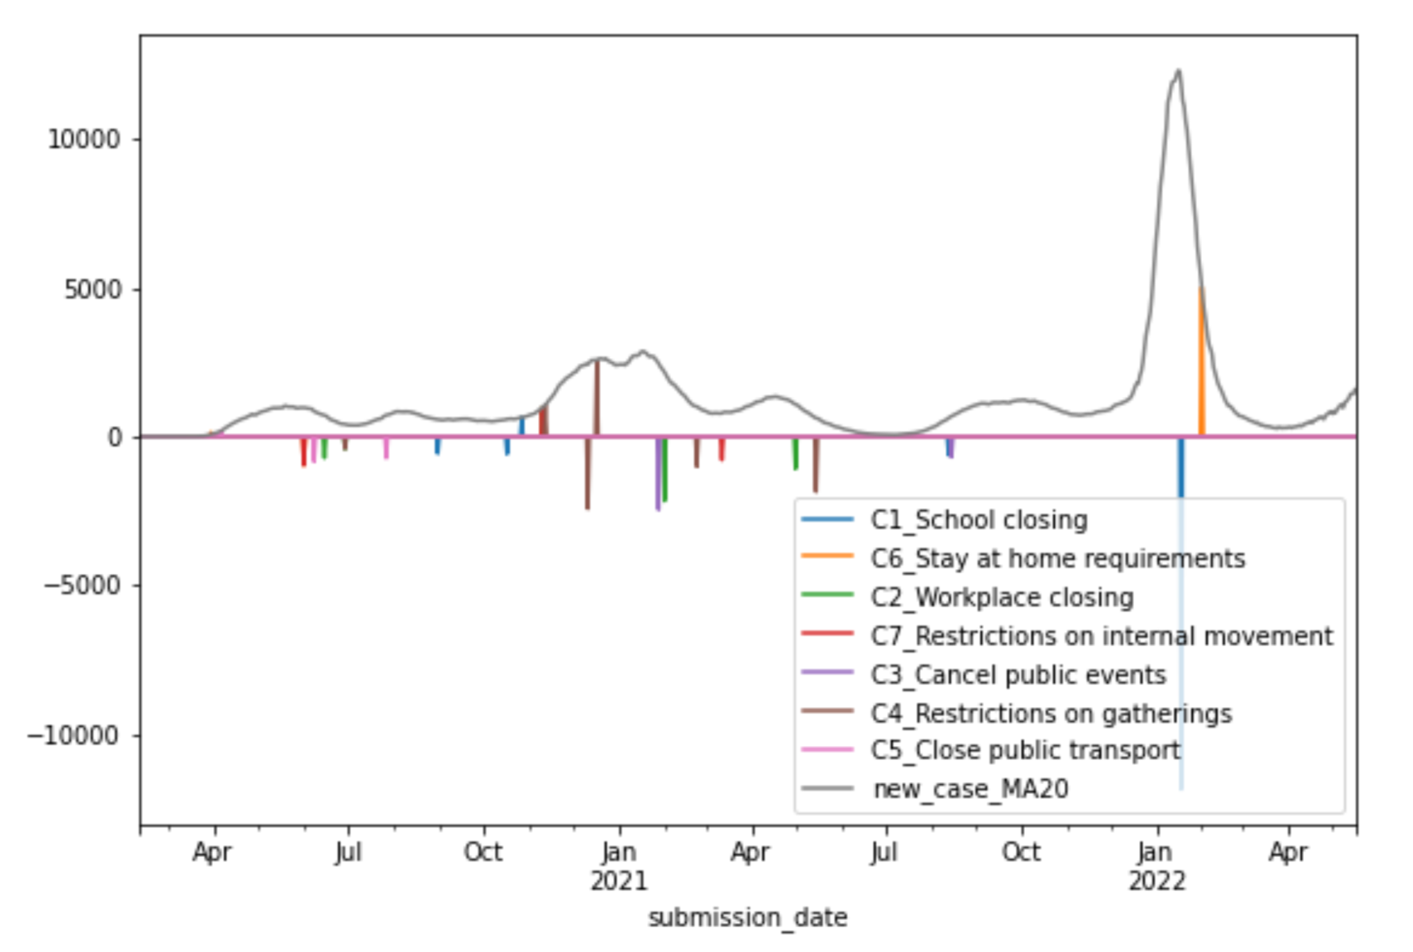
Results (state)
COVID-19 Cases and Public Policy, Maryland

Slide 22
Conclusions

Slide 23
Conclusion
Responses tend to have a one-month lag time
Last peak was caused by the Omicron variant.
No policy changes made this year with regard to school closure.

Slide 24
Challenges
Data
Evaluation
Cleaning
Visualization
Missing data / facts?

Slide 25
Future work
Docker or other deployment technologies to make it real-time
Study relationships between differerent policies
Study specfic states (Using current cases)
Apply recommendation system algorithms to apply to similar situations

Slide 26
Thank you!

Slide 27
Thank you!

Slide 28
Github Repository
https://github.com/HenryVarro666/policy-changes-prediction

