Slide 1
Henry Crofts
Using A Behaviour Tree to Control the Behaviours of Artificial Intelligence in a Stealth Environment

Slide 2
Completed Milestones
Research into AI techniques
Research AI in various games
Built Behaviour Tree
Implemented Blackboard
Implemented Line of Sight (LoS)
Implemented some behaviours

Slide 3
Researching AI Techniques
Champandard, A. J (2007, September, b). On Finite-State Machines and Reusability. AiGameDev. [online] Available at http://aigamedev.com/open/article/fsm-reusable/
Buckland, M. (2005). Programming Game AI by Example. Wordware Pub.
A. J Champandard and P. Dunstan. (2014) “Getting Started with Decision Making and Control Systems” in Programming Game AI Wisdom 4, edited by Steve Rabin. pp. 257-264
Champandard, A. (2007). The Gist of Hierarchical FSM | AiGameDev.com. [online] Aigamedev.com. Available at: http://aigamedev.com/open/article/hfsm-gist/
Rabin, S. 2013, Game AI Pro, CRC Press, Boca Raton, Florida.
Rabin, S. 2015, Game AI Pro 2, CRC Press, Boca Raton, Florida.
Rabin, S. 2017, Game AI Pro 3, CRC Press, Boca Raton, Florida.

Slide 4
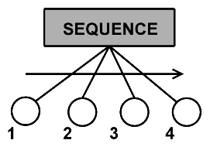
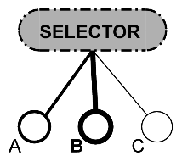
Behaviour Tree
Sequence Nodes
Selector Nodes
Leaf Nodes
Champandard, A. (2007) a. The Power of Sequences for Hierarchical Behaviors | AiGameDev.com. [online] Aigamedev.com. Available at: http://aigamedev.com/open/article/sequence/
Champandard, A. (2007) b. The Flexibility of Selectors for Hierarchical Logic | AiGameDev.com. [online] Aigamedev.com. Available at: http://aigamedev.com/open/article/selector/
Champandard, A (2007) a.
Champandard, A (2007) b.

Slide 5
Where the Project is at
Agents patrol around predefined areas
Agents can seek the player if seen
Behaviour Tree functioning as intended

Slide 6
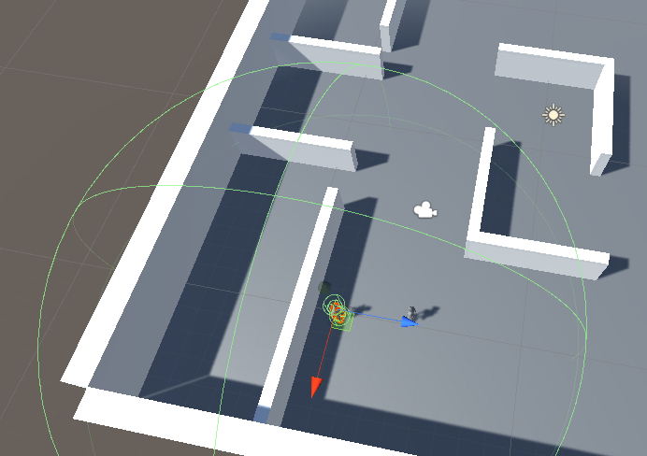
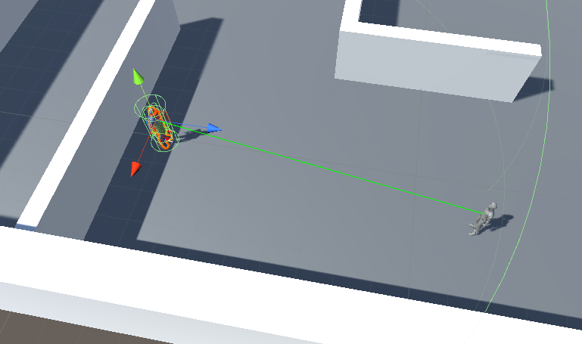
Issues and Setbacks
Line of Sight Raycast
Behaviour Tree not resetting children
Personal Issues
Design Masterclass
Some research made redundant
Two weeks behind milestones

Slide 7
Remaining Milestones
Breakdown behaviours further
Update agent & global blackboards
Agent interactions
Security Cameras

Slide 8
Breaking Down Behaviours
Patrol
Normal patrol
Alerted patrol
Seek
Hunt player
Investigate area

Slide 9
Blackboards
Update to hold more information
Getter and Setter
Debug functions
Champandard, A. (2007). Using a Static Blackboard to Store World Knowledge | AiGameDev.com. [online] Aigamedev.com. Available at: http://aigamedev.com/open/article/static-blackboard/

Slide 10
Agent Interaction
“Implied” conversations
Needs

Slide 11
Security Cameras
Placed around the scene
Update player position for all agents

Slide 12
Next Steps
Increase hours
Contingency weeks
Milestones back on track

Slide 13
What am I handing in?
A 3D Stealth Test Environment
Agents controlled by a behaviour tree
Agents acting in a believable way (Excluding models and animations)

Slide 14
Questions?

