Slide 1
Socket Programming
Outline
Client-Server Model
What is a socket?
TCP Socket in Java
UDP Socket in Java*
Assignment 1*
* Not covered in this lecture

Slide 2
Client-Server Model
Client
Network
Client
Network
Server
Client
Network
Servers passively accept connection requests from clients. One server can communicate with multiple clients at the same time.
Clients actively request connection to servers. Normally, a client communicates with one server at a time.

Slide 3
A (n Overly) Simplistic Model
Client 0
OS
Application
Socket
Server
Socket
Service 0
OS
Client 1
OS
Socket
Service 1
Application
Socket

Slide 4
What is socket?
API between application and transport layers
Berkeley sockets interface -­­ originally provided by BSD 4.1 in about 1982
Java interface is slightly different from the C interface
Operations defined by the interface
Creating a socket
Attaching the socket to the network
Sending/receiving data through the socket
Closing the socket
CS 640
‹#›

Slide 5
Flow Chart (TCP)
Server
s=new ServerSocket()
s.bind(endpoint)
Client
c=new Socket()
c=s.accept()
Connection Established
c.connect(endpoint)
Data Transmission
Data Transmission
c.close()
c.close()
CS 640
‹#›

Slide 6
Data Transmission
Receive
in = Socket.getIntputStream();
// 1. Read raw bytes
in.read();
// 2. Read primitive types
DataInputStream(in).readType();
e.g.: readInt(); readDouble();
// 3. Recommended
// Read characters or a line
BufferedReader(in).read();
BufferedReader(in).readLine();
Send
out = Socket.getOutputStream();
// 1. Write raw bytes
out.write();
// 2. Read primitive types
DataOutputStream(out).writeType();
e.g.: writeInt(); writeDouble();
// 3. Recommended
// Print as write
PrintWriter(out, True).print();
PrintWriter(out, True).println();

Slide 7
TCP Socket API (Server Side)
Java methods in ServerSocket class
ServerSocket()
Creates a new unbounded server socket.
bind(SocketAddress endpoint)
Assigns an IP address and port number to the socket.
accept()
Waits for an incoming connection request.
When a connection is accepted, a Socket object for that specific connection is returned, and the server socket is free to accept another connection request.
CS 640
‹#›

Slide 8
TCP Socket API (Server Side)
Java methods in ServerSocket class
ServerSocket()
Creates a new unbounded server socket.
bind(SocketAddress endpoint)
Assigns an IP address and port number to the socket.
accept()
Waits for an incoming connection request.
When a connection is accepted, a Socket object for that specific connection is returned, and the server socket is free to accept another connection request.
ServerSocket(int port)
Creates a server socket, bound to the specified port.
CS 640
‹#›

Slide 9
TCP Socket API (Server Side)
Java methods in Socket class
getInputStream()
Returns an input stream for this socket.
The application reads from the input stream to receive data.
getOutputStream()
Returns an output stream for this socket.
The application writes to the output stream to send data
CS 640
‹#›

Slide 10
TCP Socket API (Client Side)
Java methods in Socket class
Socket()
Creates a new socket.
connect(SocketAddress endpoint)
Specifies the address and port used on the remote host (the server).
Does not return until TCP has successfully established a connection.
getInputStream()
getOutputStream()
CS 640
‹#›

Slide 11
TCP Socket API (Client Side)
Java methods in Socket class
Socket()
Creates a new socket.
connect(SocketAddress endpoint)
Specifies the address and port used on the remote host (the server).
Does not return until TCP has successfully established a connection.
getInputStream()
getOutputStream()
Socket(InetAddress address, int port)
Creates a stream socket and connects it to the specified port number at the specified IP address.
CS 640
‹#›

Slide 12
Demo

Slide 13
Flow Chart (UDP)
Server
s=new DatagramSocket()
Client
c=new DatagramSocket()
s.bind()
c.send()
c.receive()
s.send()
s.receive()
c.close()
s.close()
CS 640
‹#›

Slide 14
UDP Socket API
Java methods in DatagramSocket class
DatagramSocket()
Constructs a datagram socket and binds it to any available port on the local host machine.
send(DatagramPacket p)
Sends a datagram packet from this socket.
Since UDP is connectionless, the application needs to provide the address and port for the remote host when constructing the packet
receive(DatagramPacket p)
Receives a datagram packet from this socket.
Packet could have come from anyone -­­ call getAddress() and getPort()
CS 640
‹#›

Slide 15
Assignment 1
Outline
Part 1: Write Iperfer
Part 2: Mininet Tutorial
Part 3: Measurements in Mininet

Slide 16
Part 1: Write Iperfer
Write a tool called Iperfer to measure network bandwidth.
Client mode
Send TCP packets to a specific host for a specified time window and track how much data was sent during that time frame
Calculate and display the bandwidth based on how much data was sent in the elapsed time
Should be invoked as follows:
java Iperfer -c -h <server hostname> -p <server port> -t <time>
CS 640
‹#›

Slide 17
Part 1: Write Iperfer
Write a tool called Iperfer to measure network bandwidth.
Server mode
Receive TCP packets and track how much data was received during the lifetime of a connection
Calculate and display the bandwidth based on how much data was received and how much time elapsed between received the first and last byte of data
Should be invoked as follows:
java Iperfer -s -p <listen port>
CS 640
‹#›

Slide 18
Part 2: Mininet Tutorial
Mininet is a software emulator for prototyping a large network on a single machine.
To run Mininet, you will need a virtual machine (VM) in the Instructional Virtual Lab.
You should use SSH, not the VMware remote console, to access your VM. For example:
ssh -X mininet@mininet-02.cs.wisc.edu
Use the scp (secure copy) command to transfer files to/from your VM, for example:
scp Desktop/sockets-demo/Server.java mininet@mininet-02.cs.wisc.edu:Server.java
CS 640
‹#›

Slide 19
Part 2: Mininet Tutorial
Run Mininet:
sudo python assign1/assign1_test.py
Some useful commands in Mininet:
help
nodes
net
dump
h1 ifconfig –a
h1 ping -c 1 h2
xterm h1
CS 640
‹#›

Slide 20
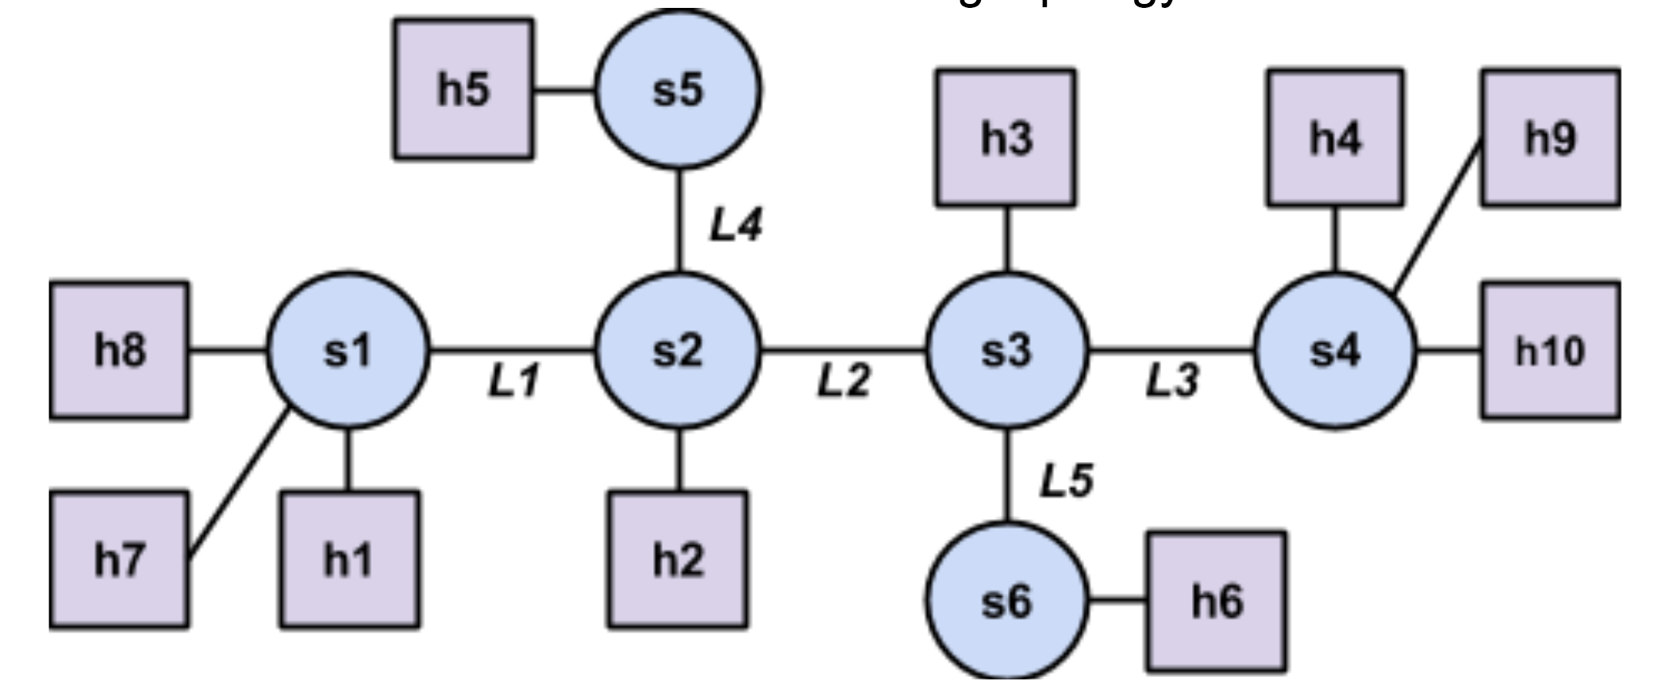
Part 3: Measurements in Mininet
Link Latency and Throughput
Path Latency and Throughput
Effects of Multiplexing
Effects of Latency
CS 640
‹#›

