Slide 1
Project 3
Shuoheng Zhang

Slide 2
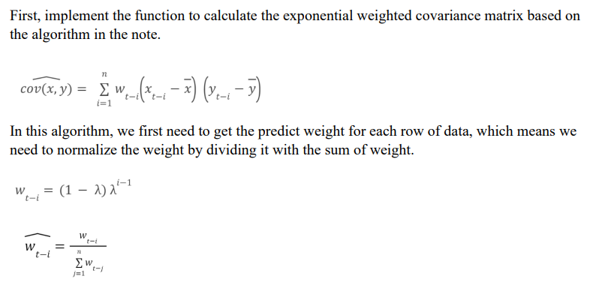
Problem 1

Slide 3
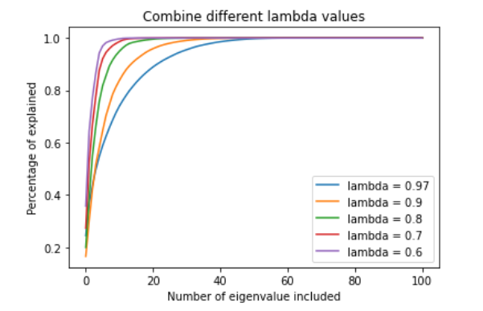
Problem 1
We can see that the higher λ is, the more weight we put on the most recent data, the smaller number of eigenvalues we need to explain the whole data.

Slide 4
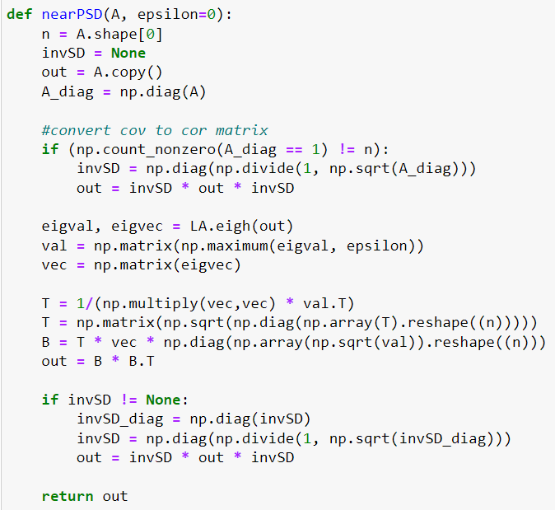
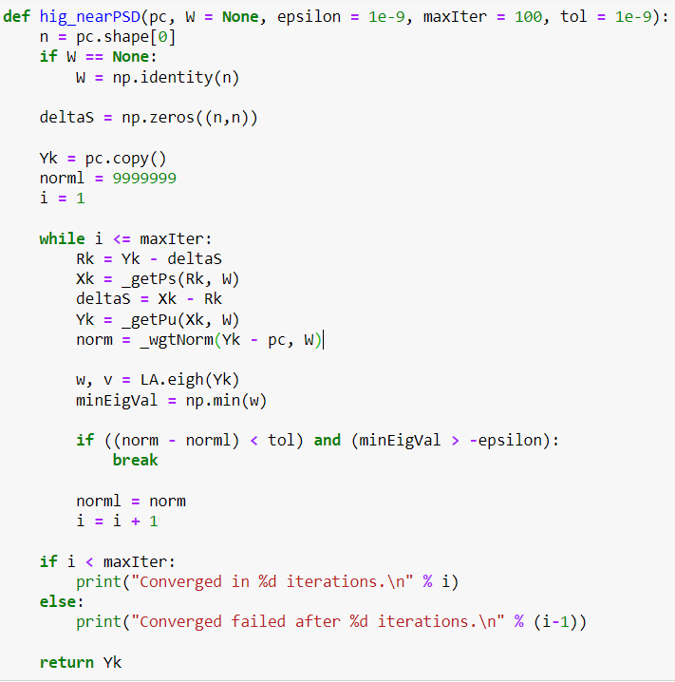
Problem 2
Rebonato and Jackel (1999)
Higham (2002)

Slide 5
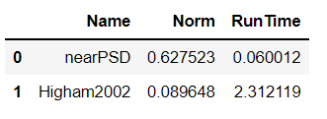
Problem 2
Higham’s method is more precise, but it also takes significantly more time to run

Slide 6
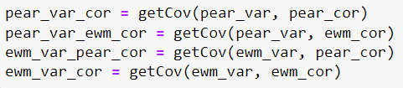
Problem 3
We first need to get the variance and correlation matrix of the data using standard Pearson and exponentially weighted method, then combine them to get 4 different types of the covariance matrix.

Slide 7
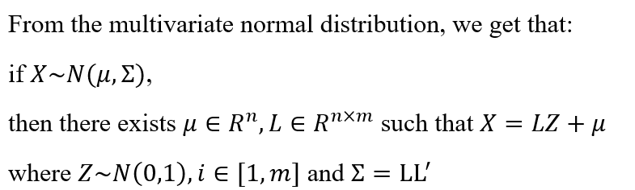
Problem 3

Slide 8
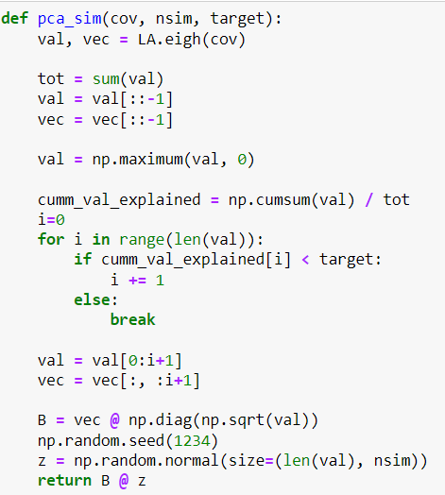
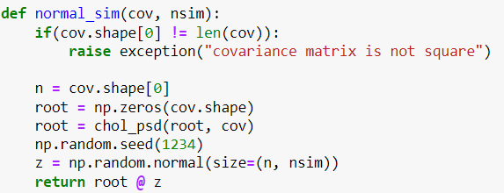
Problem 3

Slide 9
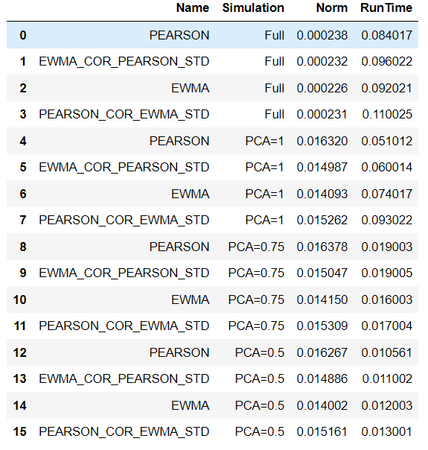
Problem 3
From the result, we can see that the precision is negatively related to the runtime. The full rank simulation has the best precision, while the precision of PCA decreases as the required amount of explanation decreases.

