Slide 1
Project 4
Shuoheng Zhang

Slide 2
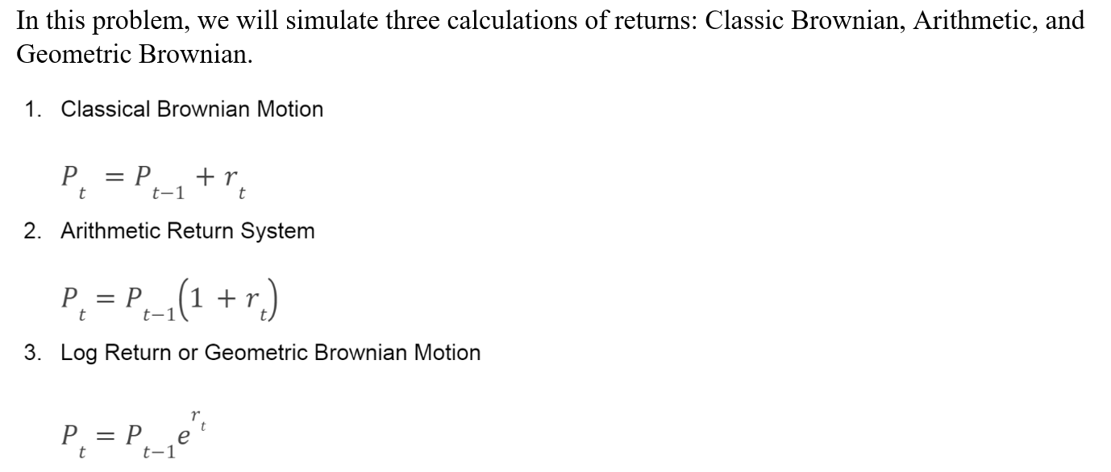
Problem 1

Slide 3
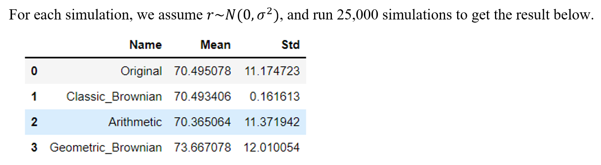
Problem 1
We can see that the Classic Brownian has the most biased standard deviation because the standard deviation of the rate of return is low, and it will remain low since it uses addition.
We can also see that the Geometric Brownian has the most biased mean because the logarithm will change the curve of the distribution.
Therefore, since the Arithmetic method has the most accurate mean and std, it is the most widely used method.

Slide 4
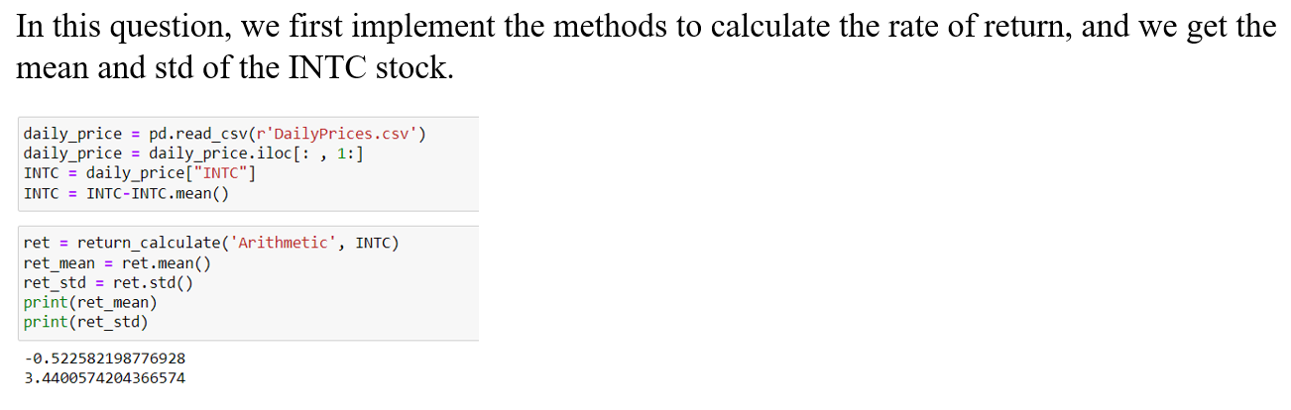
Problem 2

Slide 5
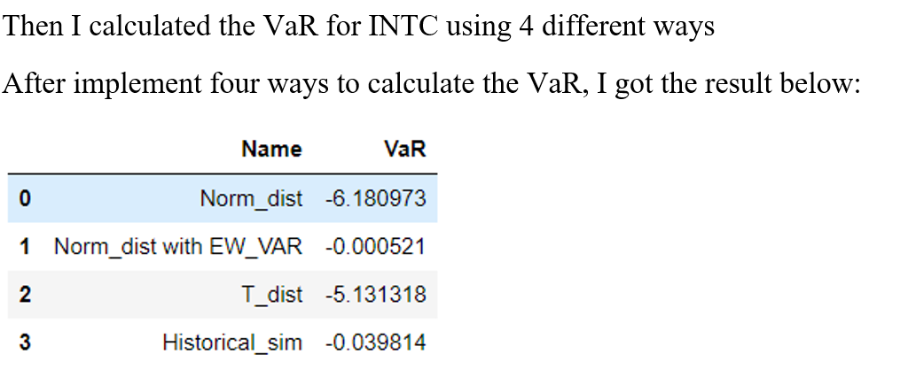
Problem 2

Slide 6
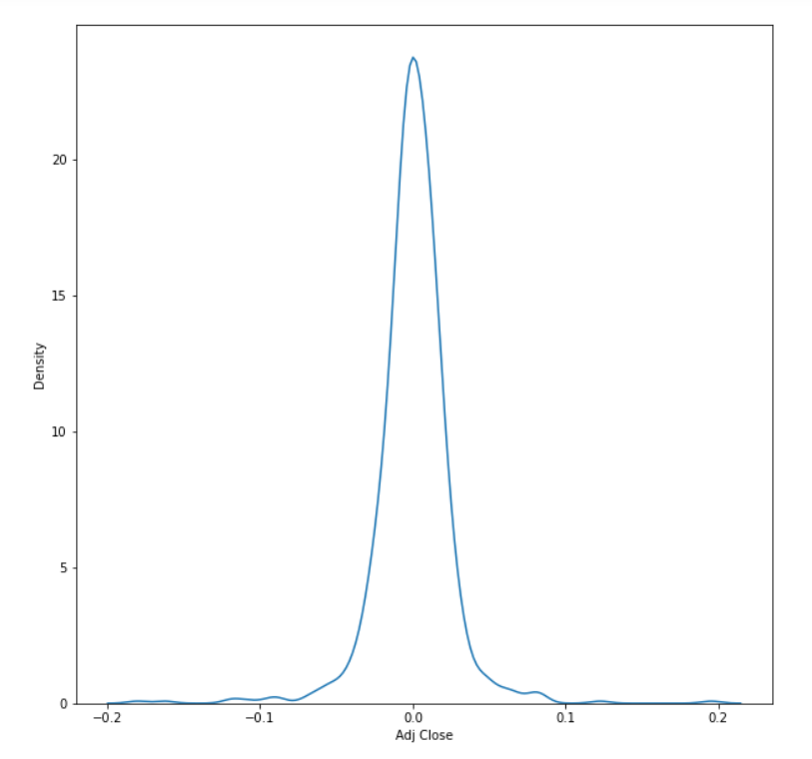
Problem 2

Slide 7
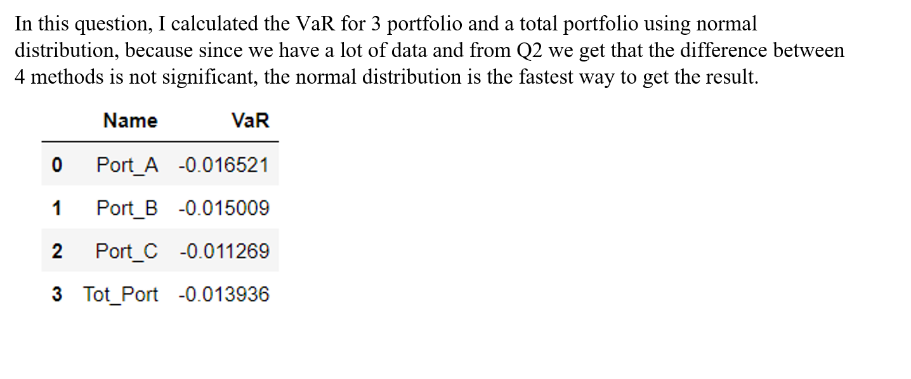
Problem 3

