Slide 1
Project 5
Shuoheng Zhang

Slide 2
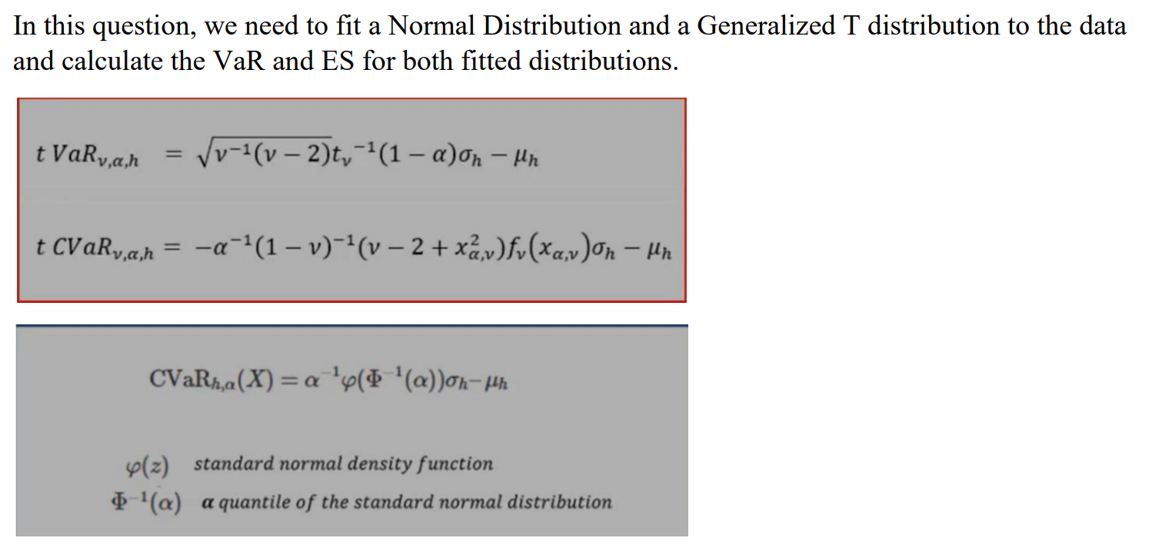
Problem 1

Slide 3
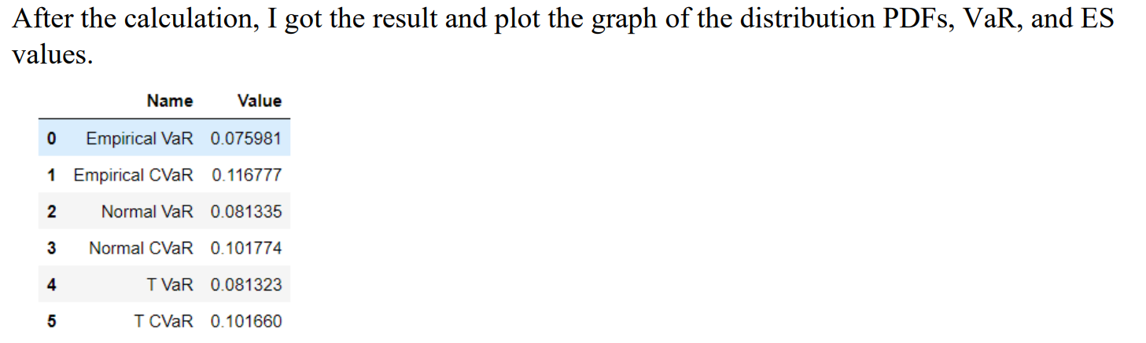
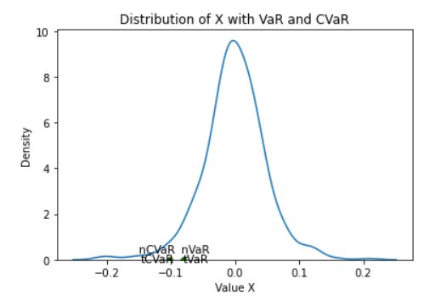
Problem 1

Slide 4
Problem 3

