Slide 1
Project 6
Shuoheng Zhang

Slide 2
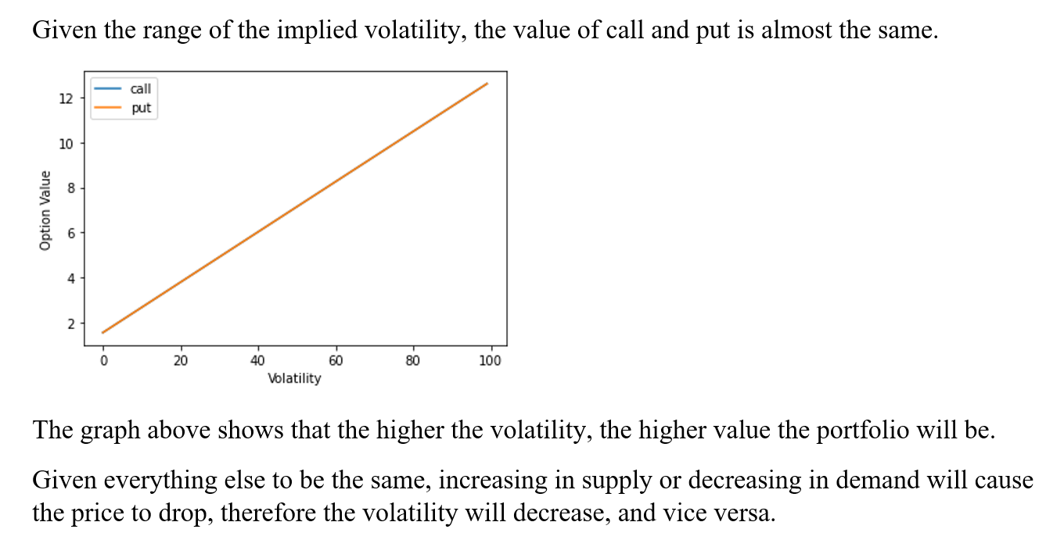
Problem 1

Slide 3
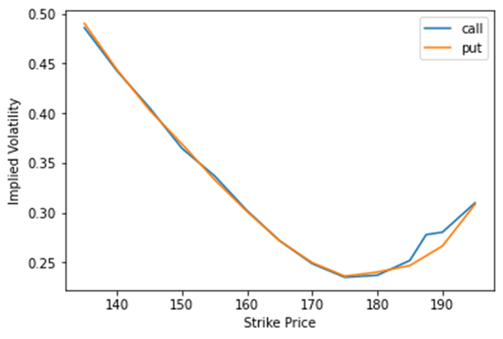
Problem 2
This is the typical graph between strike price and implied volatility, Implied volatility rises when the underlying asset of an option is further out of the money (OTM), or in the money (ITM), compared to at the money (ATM). However, not all options will have this kind of graph, near-term equity options and currency-related options are more likely to have a volatility smile.

Slide 4
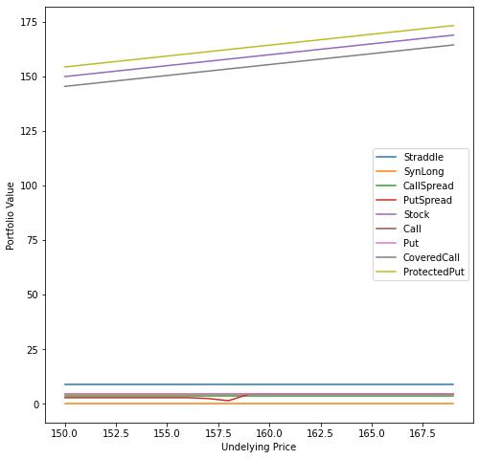
Problem 3
This first part of the problem is to divide the csv file and calculate the value and P&L for each portfolio.

Slide 5
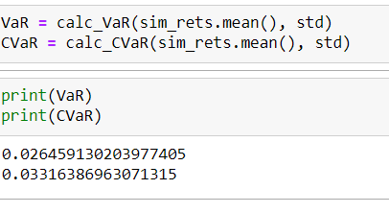
Problem 3
The second part is to simulate AAPL’s return in ten days and calculate the VaR and ES.

