Slide 1
Project 7
Shuoheng Zhang

Slide 2
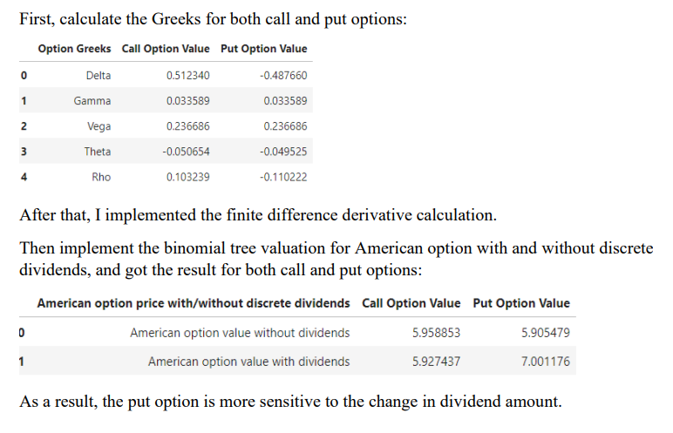
Problem 1

Slide 3
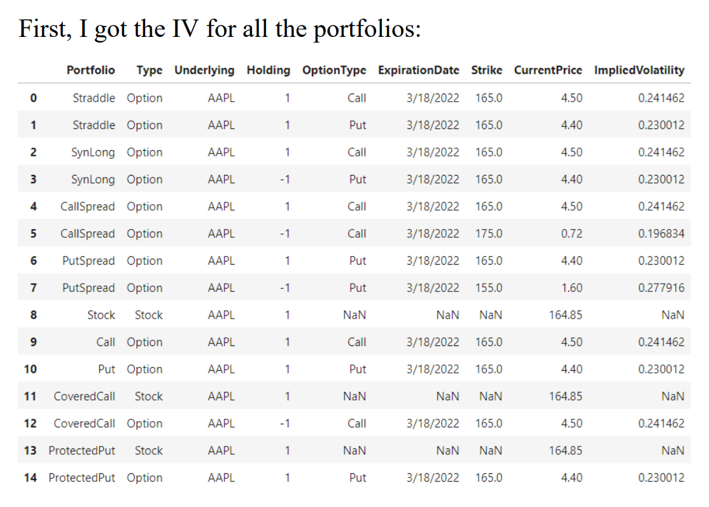
Problem 2

Slide 4
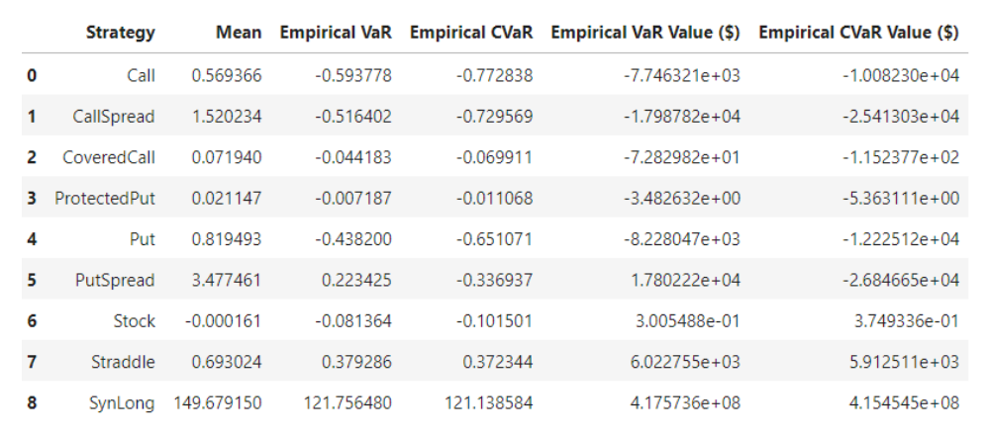
Problem 2

Slide 5
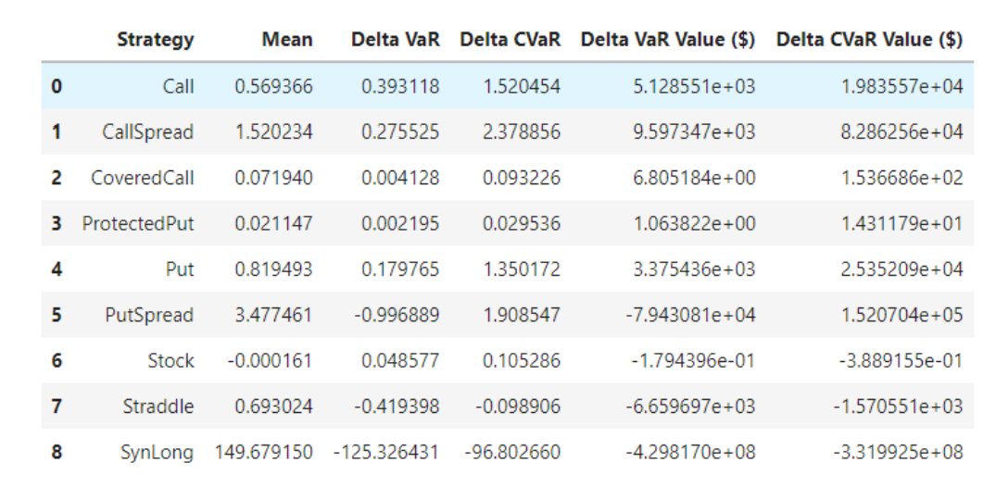

Problem 2

Slide 6
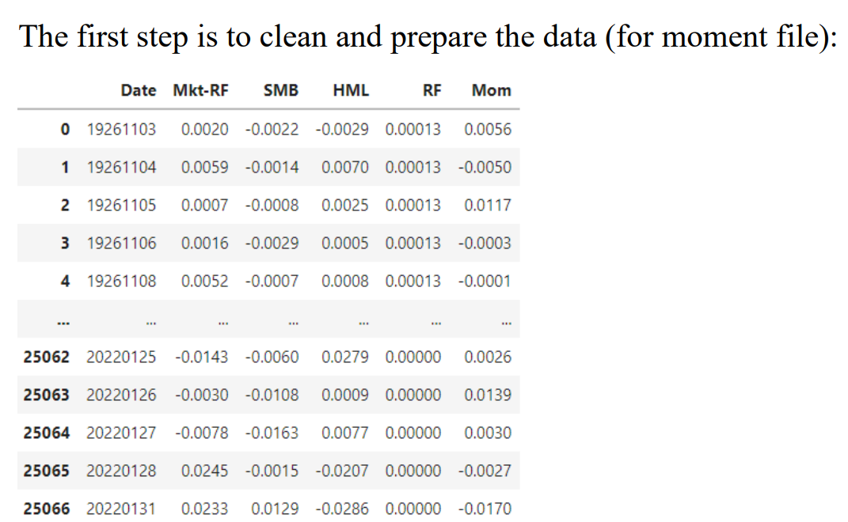
Problem 3

Slide 7
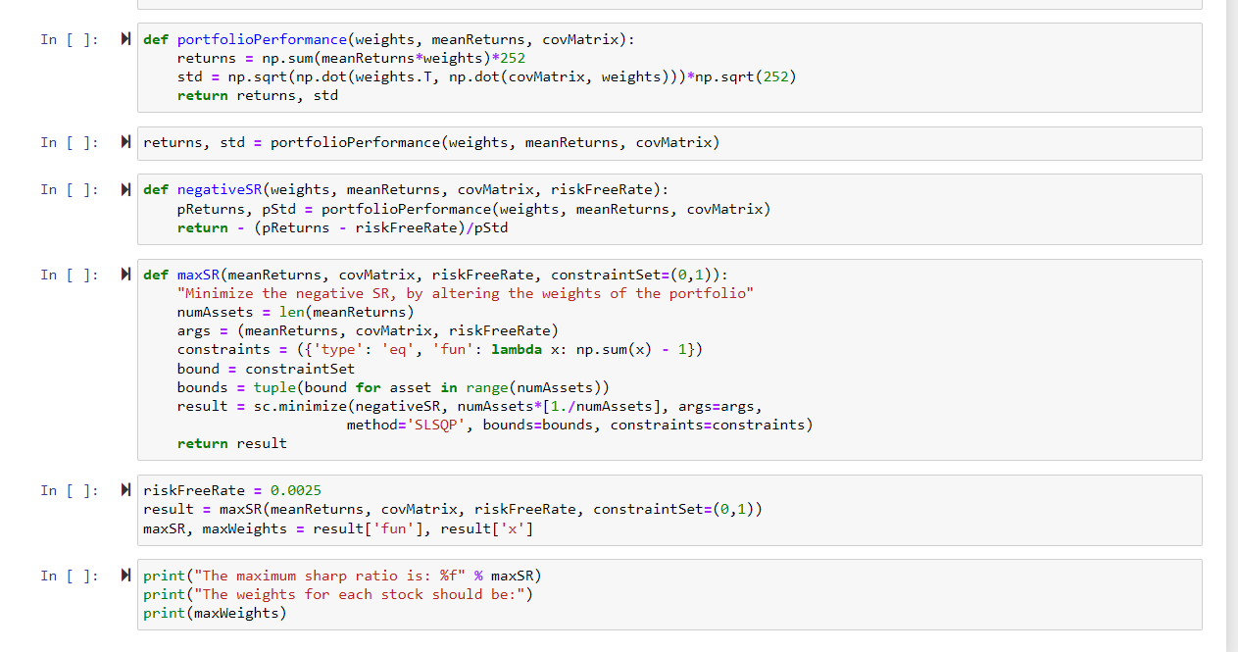
Problem 3

Slide 8
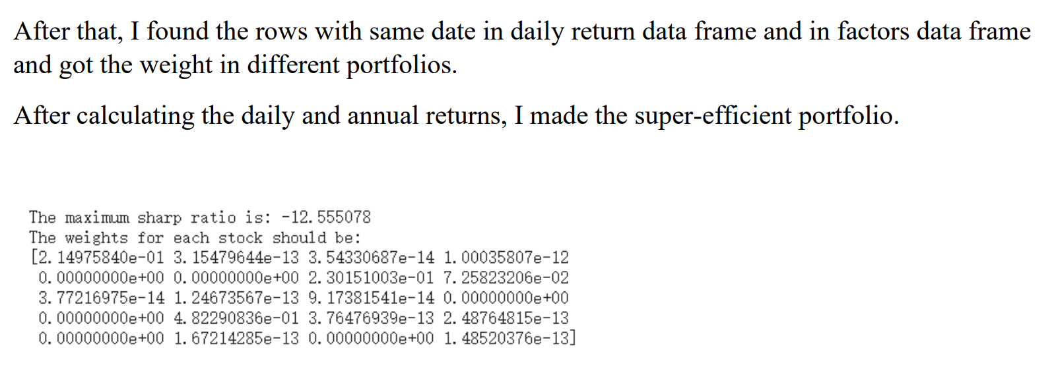
Problem 3

