Slide 1
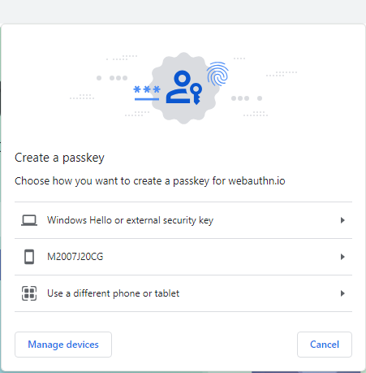
atradius.com

Slide 2
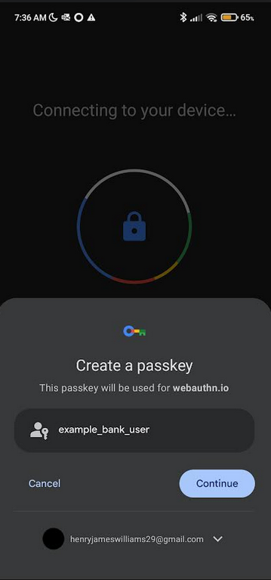
atradius.com
example_user@gmail.com

Slide 3
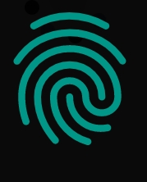
Use your screen lock
Create passkey for atradius.com
atradius.com
example_user@gmail.com
Use password

Slide 4

Use your screen lock
Use passkey for atradius.com
atradius.com
example_user@gmail.com
Use password

